Slide 1
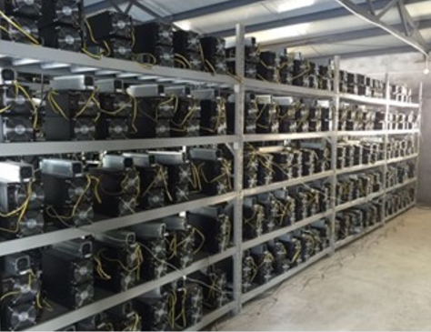
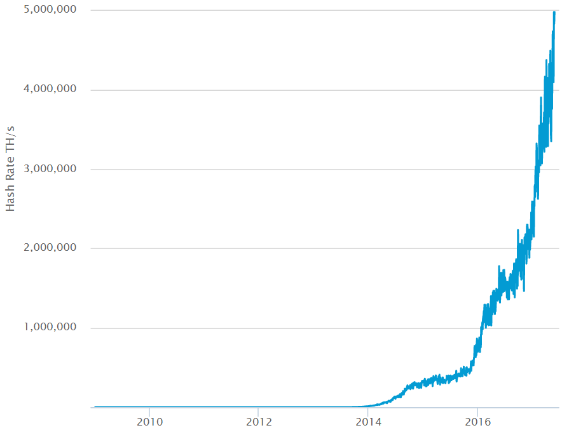
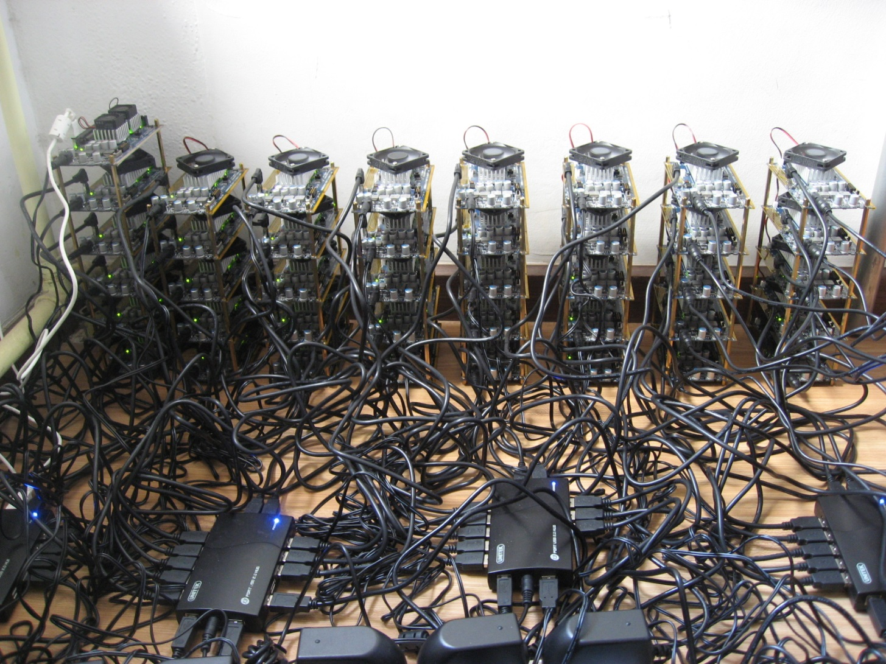
Mining
CPU
GPU
ASIC
Links

Slide 2

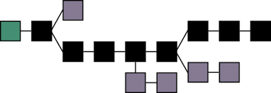
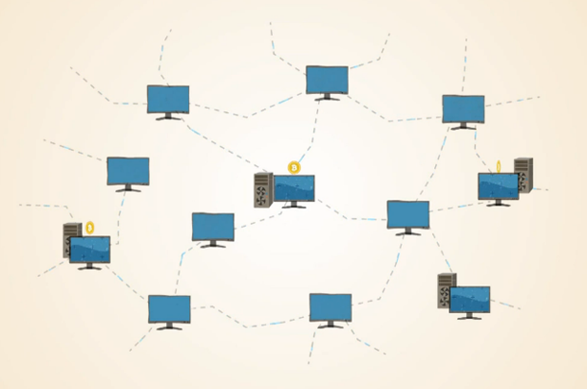



Mining
#0
#1
#2
#3
#4
#5
#38976
#38977
#38978
挖矿是一场竞赛，通常全网只有一个胜出者！
新挖出来的区块向全网广播

Slide 3
Blockchain
Miner machine keeps unconfirmed transactions
Mining process
Construct block, fill in unconfirmed transactions
txnHash = SHA256(transactions) :
0x 155c4f360……d2155c038264470eb71cdab81
blockID = SHA256(prev ID, txnHash, random number) : 0x 4470eb71……cdabc3d2155cb81f360385ac26
blockID < target difficulty → Target: 0x 00000000……0000a1b7e0eb71cda55c4f70eb7
Award & Fees
Every 4 years, award cut in half,
Start from 50 BTC / block
Current: 12.5 coins, + transaction fees
Future: no award, depend on transactions
all 21 million in 2140, Current 16.3 million
System control one block every 10 minutes
Adjust difficulty every 2016 blocks
To calculate
const
const
variable

Slide 4
Blockchain – Longest Chain Competition
Longest Chain Competition

Slide 5
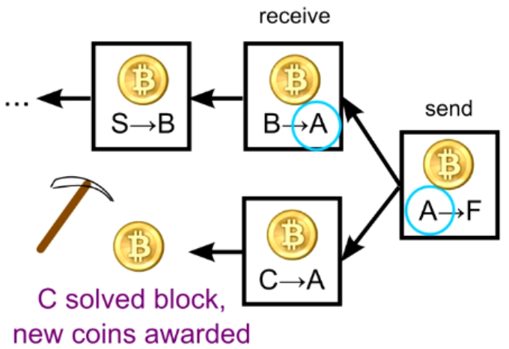
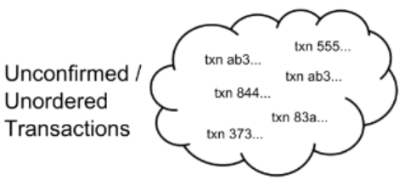
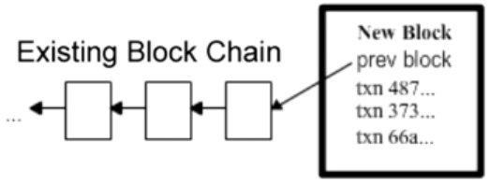
Blockchain with transaction
The Block Chain: Ordering Solution
Transactions: History of Ownership
Confirmed Transactions → added to blockchain
Unconfirmed Transactions → to add to blockchain

Slide 6
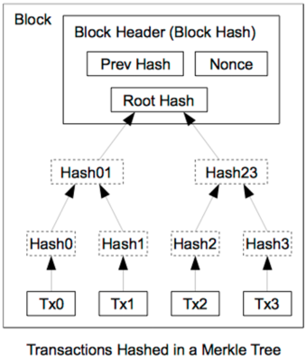
Block Header Hash
Name | Byte Size | Description
Version (V) | 4 | Block Version Number.
Pre Hash (P_{h}) | 32 | This is the hash of the previous block header.
Merkle Root (H_{t}) | 32 | The hash based on all the transactions
Time (T) | 4 | Current Timestamp in seconds. unix fmt.
Target | 4 | Target value in compact form.
Nonce (R) | 4 | User adjusted value starting from 0

