Slide 1
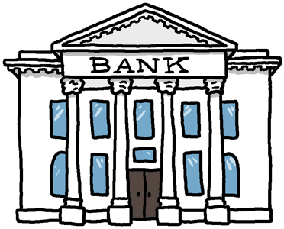
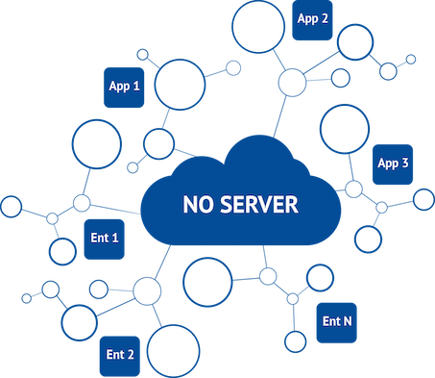
Transactions
Ledger
____ ____
____ ____
____
Ledger
____ ____
____ ____
____
Ledger
____ ____
____ ____
____
Ledger
____ ____
____ ____
____
Ledger
____ ____
____ ____
____
Ledger
____ ____
____ ____
____

Slide 2
Transactions
Ledger
____ ____
____ ____
____
Ledger
____ ____
____ ____
____
Ledger
____ ____
____ ____
____
Alice → Bob 5 BTC
Ledger
Alice 25
Bob 10
____ ____
20
15
Ledger
____ ____
____ ____
____
Ledger
Alice 25
Bob 10
____ ____
20
15
Ledger
____ ____
____ ____
____
Ledger
____ ____
____ ____
____
Ledger
Alice 25
Bob 10
____ ____
20
15
A→B
5 BTC
A→B
5 BTC
A→B
5 BTC
Passing other’s transactions along
A→B
5 BTC
Alice → Bob 5 BTC
June → Kaven 8 BTC
Sam → Tayler 8 BTC
… …

Slide 3
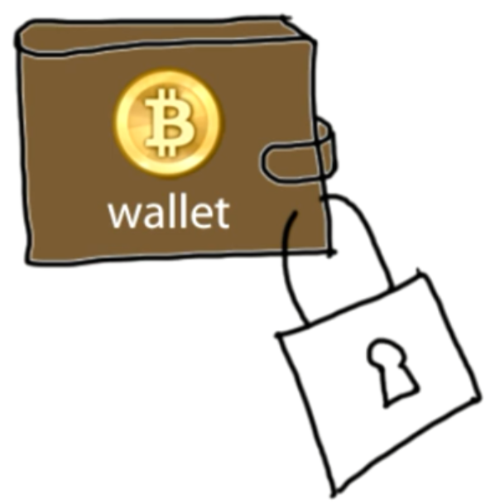
Authentication
Cryptographic Basics
Transaction Messages
Digital Signature
Alice → Bob 5 BTC d302721…
June → Dave 8 BTC 81758de…
Andy → Juan 6 BTC 17512c8…
Sam → John 4 BTC 9eac123…
? Alice ?
Digital Signature
Bf853d30272138df448817512c8de9cc3f75849eac1234cc …
different every time
How Can We know how much alice have ?

Slide 4
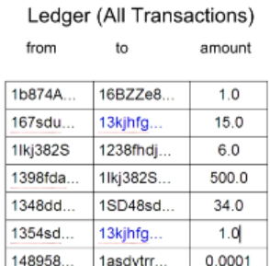
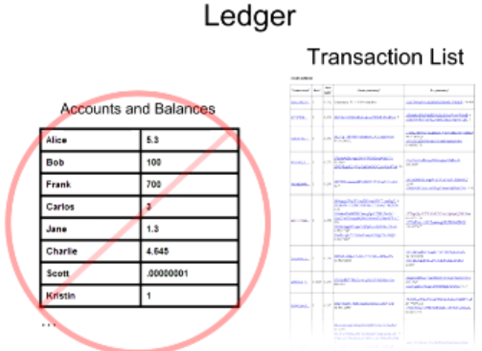
Balance Calculation
Balance: 16
4

Slide 5
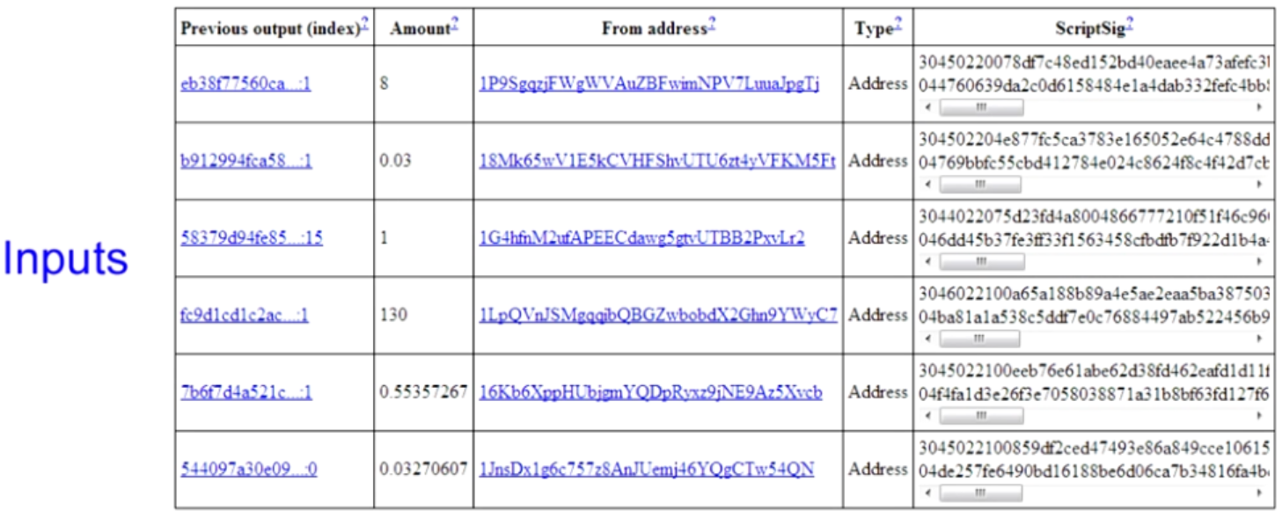
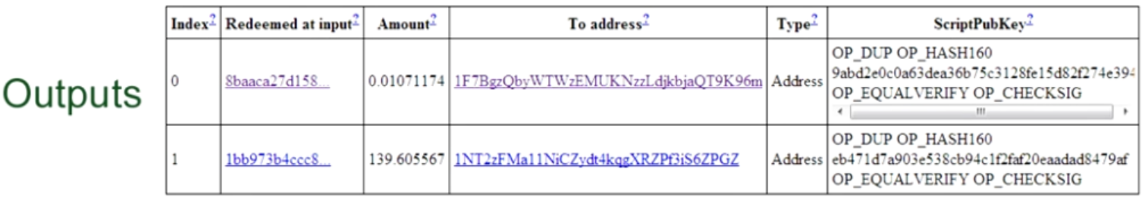
Real Transactions
Alice → Bob: 139.606 BTC
Ledger
______ ______
______ ______
Ledger
______ ______
______ ______
A→B
139 BTC
A→B
139 BTC
Ledger
______ ______
______ ______
= 139.616
A→B
139 BTC
back to sender
0.011
139.606
Added One more txn record in the next Block
But How?
5

Slide 6
Transaction Types
一对一（无找零）
一对一（有找零）
Output 0
“To 小红”
Input 0
“来自于小明，
被小明签名“
Input 0
“来自于小明，
被小明签名“
Output 0
“To 小红”
Output 1
“To 小明”
（找零）
组合交易（多对一）
分配交易（一对多）
Input 0
Output 0
Input 1
Output 1
Output 0
Input 0
Input 2
Output 2
Input n
Output n
6
6

Slide 7
Transactions in more detail
Input
Original Message
An ECDSA hash (Signature)
A public key
Output contains
Amount: being sent to the recipient.
Voluntary transaction fee
Change: being sent back to the original sender
blockchain.info
Create
Verify
Notes:
Block chain
prevents the double spend attack
by giving other nodes the power to verify that transaction inputs were not already spent somewhere else.

Slide 8
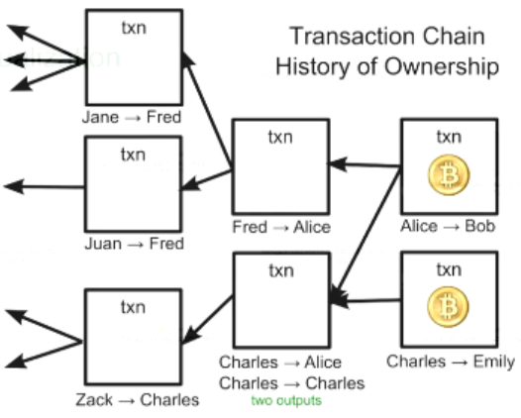
Transaction and Ledger
Bitcoins comes from chains of transactions
Check & index all transactions first time run mining
1 week download
~24 hours index
Why check & index all transactions in blockchain ?
8
8
Notes:
?? How the process pay 1.2, 2.5, 3.4

Slide 9
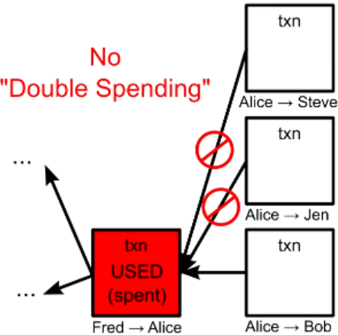
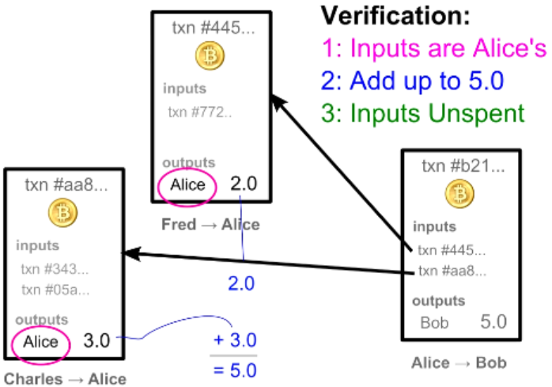
Transaction Verification
Each node verify block & txn before broadcast
Each txn Can Only be Used Once as an input
Recap: Blockchain & transaction
Blockchain.info
How the User info is kept in blockchain?
9
9

Slide 10
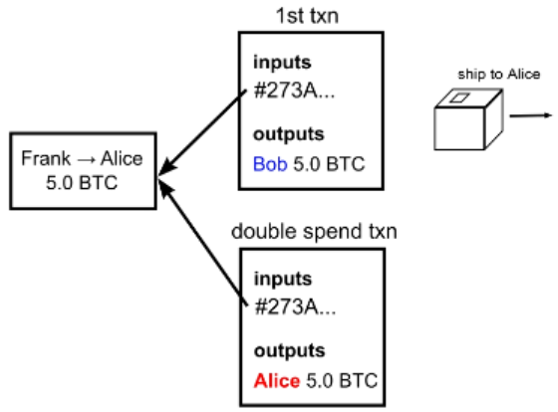
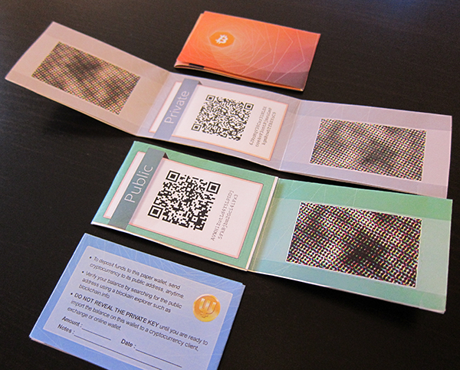
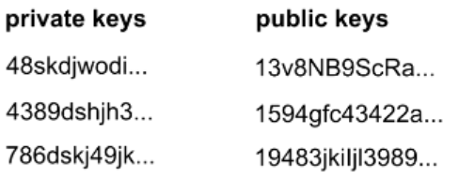
User info & Security
Anonymity: bitcoin address: 2^160
Wallet Generator
Security Hole: Transaction Order
Double Spending Fraud
Wallet

Slide 11
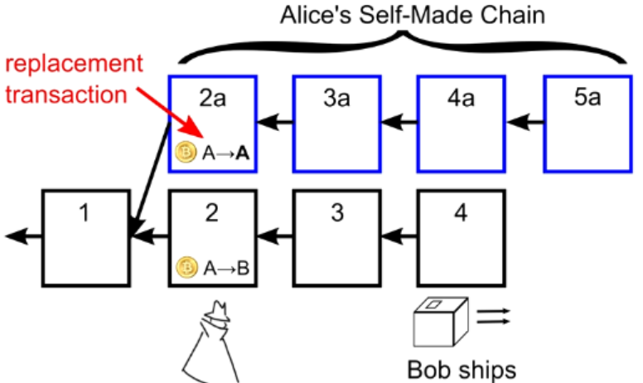
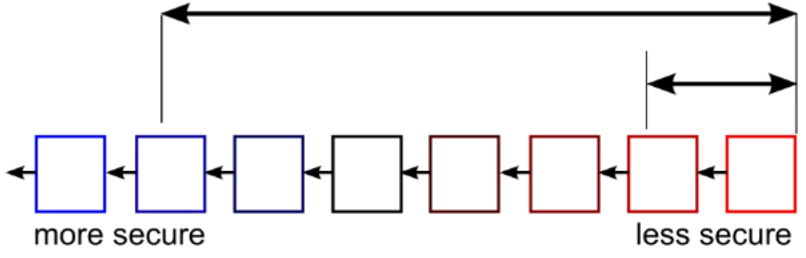
Double Spending Prevention
Wait for several block for safety

Slide 12
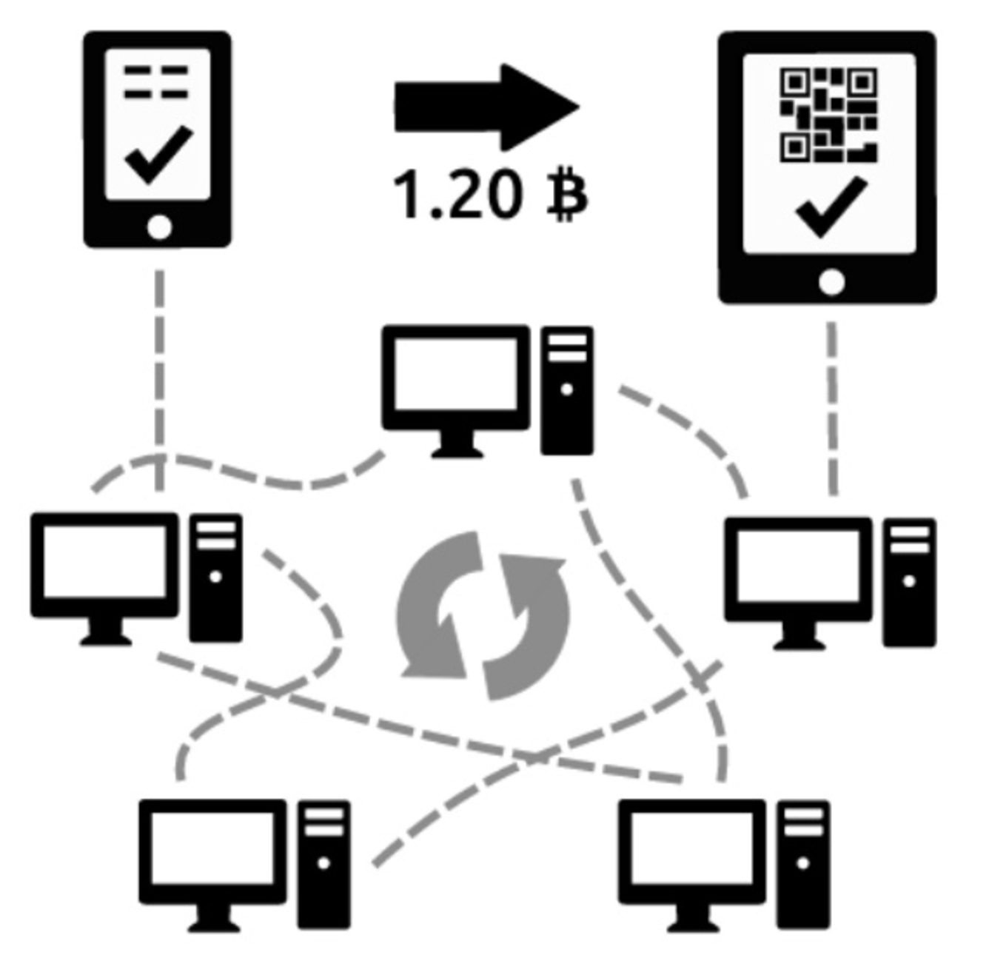
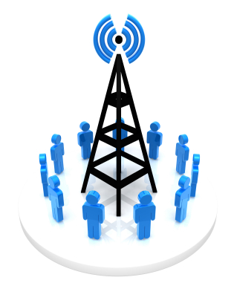
Recap
Blockchain:
block linked to a pre block → blockchain formed
Block Chain Orders Transactions
Transactions Chain transfers Ownership
How the Bitcoin network runs
New transactions are broadcasted to all users
Minters find the solution to the proof of work of the block
creates new block with Txn & broadcasted to all users
Each user accepts the received block if valid
existing blocks
new block
Time

