Slide 1
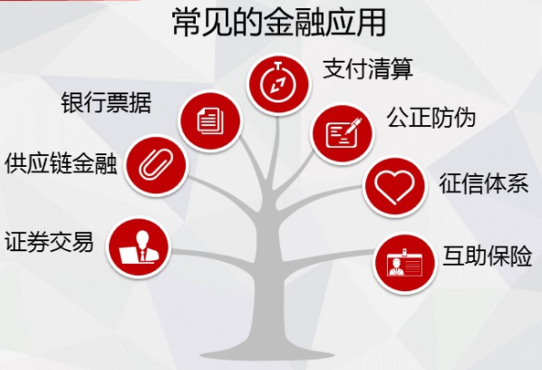
区块链应用
物联网应用
食品安全: 沃尔玛猪肉安全
基于区块链的智慧消防
消防设备出厂
上报消防数据
火警设备数据
出警设备数据
去中心化租房
…
Notes:
猪肉也用区块链技术： http://www.sohu.com/a/121532565_236263

Slide 2
食品安全：农产品出厂全过程

Slide 3
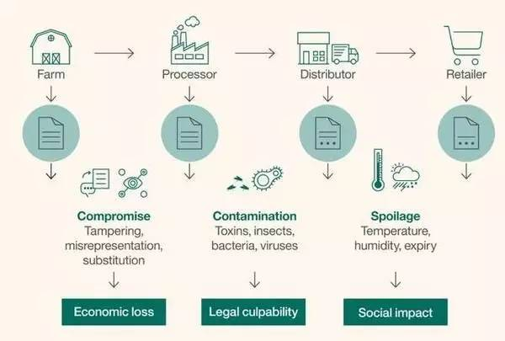
食品安全：农产品出厂全过程

Slide 5
Specific Applications
Smart Renting: air Bnb
Food safety: pork traceability
IBM Walmart, Tsinghua Univ.
Certification Transparent
Notarization: public trust
Uber-less transportation
验证学位信息
百度金融也发行了基于区块链技术支持的ABS（资产证券化）项目
在微信黄金红包中已开始应用区块链技术进行数字资产的并行记账
Public blockchain
Private Blockchain
42 Banks alliance: R3CEV
Alliance blockchain
Notes:
Blockchain can transparently track the provenance of goods as they are passed from one organization to the next, building awareness and trust.
it supports an open source project called Hyperledger
One of the biggest philosophical o
obstacles is trust: Companies must get comfortable with the idea that their supply chain data won’t "live" in a central location.
终于把区块链的技术与应用讲清楚了: http://www.sohu.com/a/115881554_481636

