Slide 1
区块链应用及 物联网
区块链系列之一 比特币
持有、支付、挖掘比特币原理及协议
Andy Wu (吴增德）
Index
Notes:
Own, Send, Mine bitcoins
Public –Private Key Encryption
Question:
How the bitcoin is transferred, How the bitcoin is flowed
Bitcoin core code analysis
BitCoin Addresses:
Generate public / private key pair
Hash the public key → Bitcoin address
Guard the private key with your life
build an entire core banking platform on some form of distributed ledger technology.
One thing EWF potentially will work on, for example, is a unified blockchain platform
blockchain represents a real breakthrough when it comes to verifying "tiny little contracts in a point-to-point realm.“
sees blockchain as a breakthrough for traceability

Slide 2
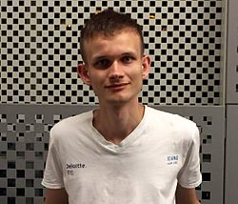




区块链演化史
1.0
3.0
电子现金
去中心化交易
去中心化互联网、 去中心化社会治理
2.0
智能合约、数字资产、
物联网、各行业应用

Slide 3
国内外比特币新闻
全球多数据国家用比特币交易合法
迪拜计划成为世界首个区块链国家
日本 - 比特币正式成为一种合法的支付方式（2017.4）
菲律宾 - 承认比特币为一种支付系统， 给予正式“金融地位”
阿联酋 – 年初下禁令，一月后变更
俄罗斯 - 比特币没有威胁，比特币禁令无限期搁置
俄罗斯央行拟打造国家虚拟货币
全球最大比特币交易所正进行融资 估值达10亿美元
央行区块链的数字票据交易平台测试成功
中国央行数字货币研究所即将挂牌
世界七成比特币产自中国 每枚电费成本达上万元
8年暴涨300万倍 风口上的比特币价值几何
比特币的红与黑：技术理念先进 价格暴涨暴跌引发担忧
比特币在国内三大交易平台成交超过80%
2017年5月份国内比特币交易成交额217.08亿元
Index

Slide 4
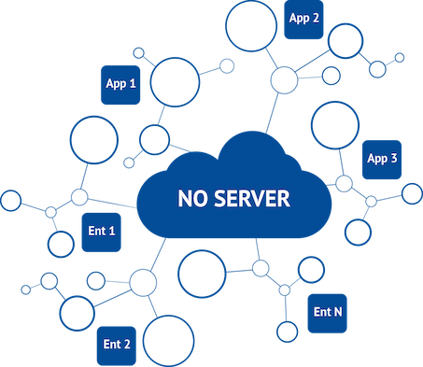
Introduction
Ledger
Alice → Bob | 5.4
Bob → Cindy | 100
Frank → Gary | 700
Carl → Dave | 0.001
… | …
What is blockchain?
What are transactions?
transfer of money! Alice → Bob 5 BTC
Where are they keeps?
In the ledger!
Where are user’s bitcoins come from?
From transactions!
Where is the ledger stored?
In the blockchain that every node maintains!
Index
Notes:
World's first decentralized Cryptocurrency
Invented in 2009 by Satoshi Nakamoto (中本聪)
No bank or central authority
Distributed consensus system
How transaction is done
How to transfer
RSA
Bitcoin cryptography
HASH 256
To understand: blockchain.info
Youtube: blockchain.info

Slide 5
Introduction
Ledger
Alice → Bob | 5.4
Bob → Cindy | 100
Frank → Gary | 700
Carl → Dave | 0.001
… | …
What is blockchain?
How is Block created?
Index
Notes:
World's first decentralized Cryptocurrency
Invented in 2009 by Satoshi Nakamoto (中本聪)
No bank or central authority
Distributed consensus system
How transaction is done
How to transfer
RSA
Bitcoin cryptography
HASH 256
To understand: blockchain.info
Youtube: blockchain.info

Slide 6
Outline
Cryptography Basics >>
Mining Blocks & Blockchain >>
Transactions >>
Blockchain application
Summary
Abbr. （简称）
BTC = bitcoin (比特币)
txn = transaction (交易)
sig = signature (数字签名)
blockchain (区块链)
ledger (账本)
Related Site
huobi.com
blockchain.info
Index

Slide 7
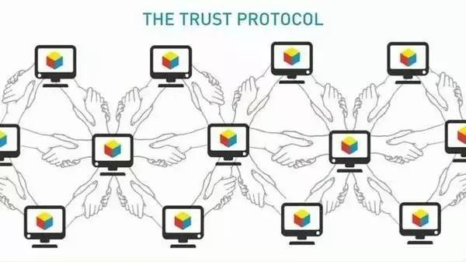
比特币（区块键1.0）小结
特点
独立性
不可重复支付
匿名
不可伪造性
去中心化
可传递性
可分性
公开透明
交易可追溯
局限性
交易确认时间长（平均10分钟）
交易吞吐量低
挖矿耗费大量机时和电力
分布式账本占用大量存储空间（~60GB）
经常性非法应用
任何政府和组织难以控制
安全、高效

Slide 8
区块链系列之二: 以太坊
1.0
3.0
Vitalik Buterin
电子现金
去中心化交易
去中心化互联网、 去中心化社会治理
2.0
智能合约、数字资产、
物联网、各行业应用

Slide 9
Q & A
Index

Slide 10
Summery
Benefits
Government can’t print money or manipulate currency
Anonymity
Lower global transaction costs
Challenges
Difficult to exchange
Used for illegal activity (Government can’t track
Mining, or solving blocks use large amount of energy
Mathematically protected digital currency
Maintained by a network of peers
Digital Signature:
Safeguard money
Transaction chains
Store history of ownership
Block Chain
Hold transaction order

Slide 11
References
How do bitcoin transactions work
The Challenges of Block Chain Indexing
Blockchain platform evolution
IOTA: A Cryptoplatform for Securing Transactions on the IoT
Why IBM sees blockchain as a breakthrough for traceability
Index

