Slide 1
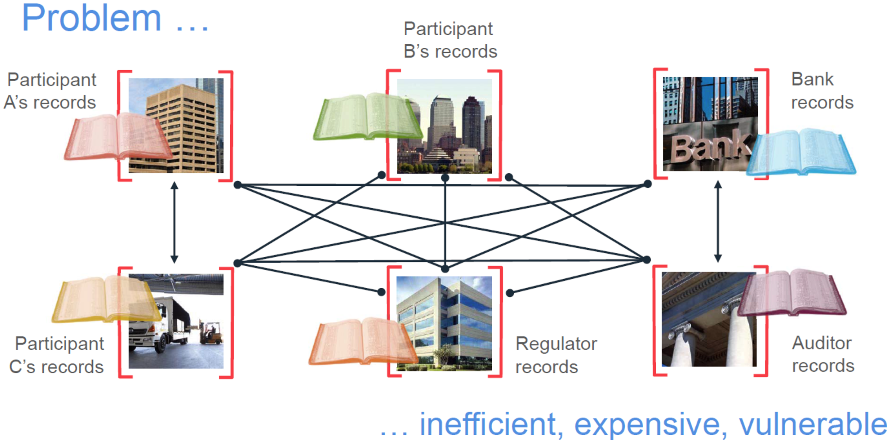
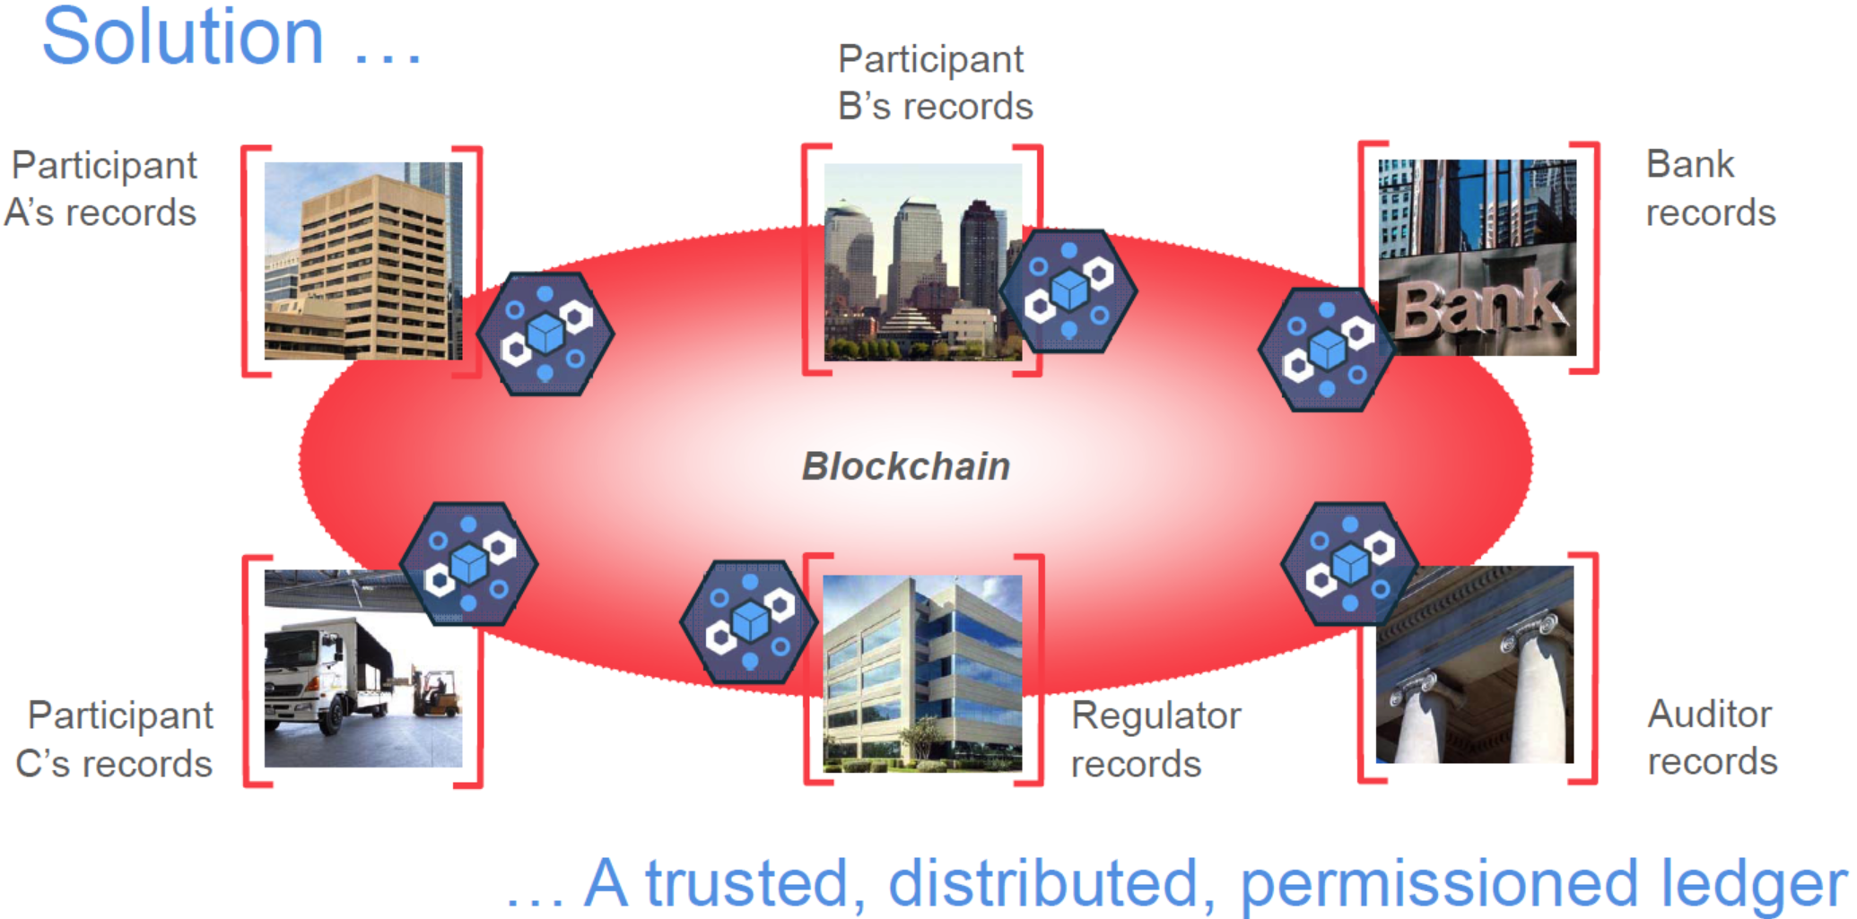
Chain Applications
Permanent and transparent records of transactions
Distributed, encrypted, trusted ledgers
Secure, indelible, consensus based, auditable
Permissioned or permissionless, replicated
Potential of eliminating intermediaries

Slide 2
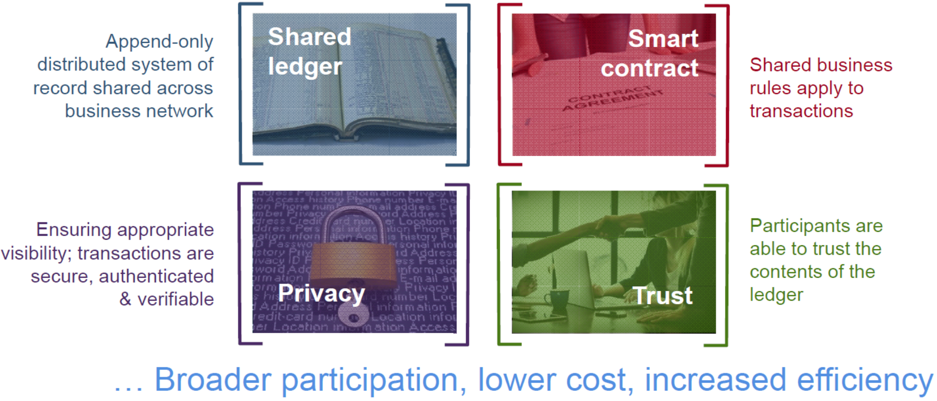
Blockchain for business

Slide 3
Shared ledger & Smart Contract
Shared ledger
Shared between participants
Participants have own copy through replication
Permissioned, so participants see only appropriate transactions
THE shared system of record
Records all transactions across business network
Smart Contract
Verifiable, signed
Encoded in programming language
Example:
Defines contractual conditions under which corporate Bond transfer occurs
Business rules implied by the contract … embedded in the Blockchain and executed with the transaction

Slide 4
Privacy & Trust
Privacy
Participants need:
Appropriate confidentiality between subsets of participants
Identity not linked to a transaction
Transactions need to be authenticated
Cryptography central to these processes
The ledger is shared, but participants require privacy
Trust
Participants endorse transactions
Business network decides who will endorse transactions
Endorsed transactions are added to the ledger with appropriate confidentiality
Assets have a verifiable audit trail
Transactions cannot be modified, inserted or deleted
The ledger is a trusted source of information

Slide 5
Specific Applications
Smart Renting: air Bnb
Food safety: pork traceability
IBM Walmart, Tsinghua Univ.
Certification Transparent
Notarization: public trust
Uber-less transportation
验证学位信息
百度金融也发行了基于区块链技术支持的ABS（资产证券化）项目
在微信黄金红包中已开始应用区块链技术进行数字资产的并行记账
Public blockchain
Private Blockchain
42 Banks alliance: R3CEV
Alliance blockchain
Notes:
Blockchain can transparently track the provenance of goods as they are passed from one organization to the next, building awareness and trust.
it supports an open source project called Hyperledger
One of the biggest philosophical o
obstacles is trust: Companies must get comfortable with the idea that their supply chain data won’t "live" in a central location.
终于把区块链的技术与应用讲清楚了: http://www.sohu.com/a/115881554_481636

