Slide 1

比特币 实现技术解析
持有、支付、挖掘比特币原理及协议
Andy Wu (吴增德）
2017－05－29
Index
Notes:
Own, Send, Mine bitcoins
Public –Private Key Encryption
Question:
How the bitcoin is transferred, How the bitcoin is flowed
Bitcoin core code analysis
BitCoin Addresses:
Generate public / private key pair
Hash the public key → Bitcoin address
Guard the private key with your life
build an entire core banking platform on some form of distributed ledger technology.
One thing EWF potentially will work on, for example, is a unified blockchain platform
blockchain represents a real breakthrough when it comes to verifying "tiny little contracts in a point-to-point realm.“
sees blockchain as a breakthrough for traceability

Slide 2
How Bitcoin Works
Andy Wu (吴增德）
2017－05－29
Index
Notes:
Own, Send, Mine bitcoins
Satoshi Nakamoto

Slide 3
Introduction
Blockchain Viewer: Block, txn, Address, tree
Ledger
____ ____
____ ____
____
Ledger
Ledger
____ ____
____ ____
____
Alice | 5.4
Bob | 100
Frank | 700
Carlos | 0.0000001
… | 1
Ledger
____ ____
____ ____
____
Ledger
____ ____
____ ____
____
Ledger
____ ____
____ ____
____
Ledger
____ ____
____ ____
____
.32,A->B
1.0,J->Z
1.45,C->S
1.0,H->J
1.03,S->J
.23,B->C
1.2,E->J
.9,M->B
2.5,M->S
.1,S->F
.2,M->J
1.3,S->S
...
...
...
...
HASH
HASH
HASH
Index
Block 1
Block 2
Block 3
Block 4
Notes:
World's first decentralized Cryptocurrency
Invented in 2009 by Satoshi Nakamoto (中本聪)
No bank or central authority
Distributed consensus system
How transaction is done
How to transfer
RSA
Bitcoin cryptography
HASH 256
To understand: blockchain.info
Youtube: blockchain.info

Slide 4
Outline
Reference
Blockchain Viewer:
Block,
txn,
Address,
tree
Cryptography Basics >>
Mining Blocks & Blockchain >>
Transactions >>
Blockchain application
Summary
Index

Slide 5
Transactions: Sending Money
Alice → Bob 5 BTC
June → Dave 8 BTC
Andy → Juan 6 BTC
Sam → John 4 BTC
Alice → Bob 5.0 BTC
Ledger
Alice 25
Bob 10
____ ____
20
15
Passing other’s transactions along
Ledger
Alice 25
Bob 10
____ ____
20
15
Ledger
Alice 25
Bob 10
____ ____
20
15
A→B
50 BTC
A→B
50 BTC
A→B
50 BTC
Index

Slide 6
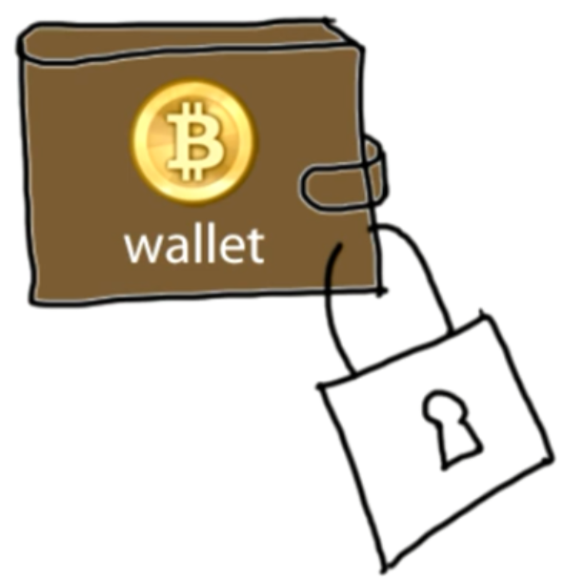
Authentication
Transaction Messages
Digital Signature
Alice → Bob 5 BTC d302721…
June → Dave 8 BTC 81758de…
Andy → Juan 6 BTC 17512c8…
Sam → John 4 BTC 9eac123…
? Alice ?
Digital Signature
Bf853d30272138df448817512c8de9cc3f75849eac1234cc …
different every time
Create
Verify
Signature = f(message, private key)
1=? V(message, public key, signature)
Index

Slide 7
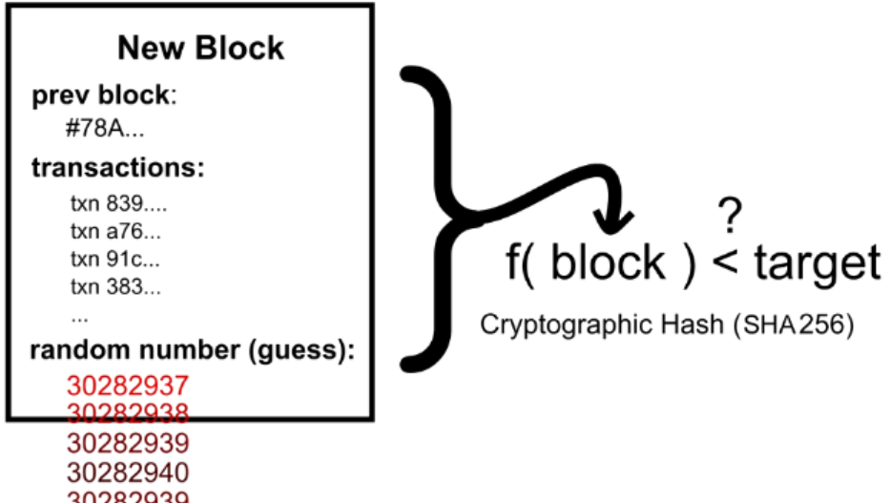
Transactions in more detail
Create
Verify
Signature = f(message, private key)
1=? V(message, public key, signature)
Input
Original Message
An ECDSA hash (Signature)
A public key
that belongs to the redeemer of the output transaction.
Output contains
Amount: being sent to the recipient.
Voluntary transaction fee
Change
being sent back to the original sender
Block chain
prevents the double spend attack
by giving other nodes the power to verify that transaction inputs were not already spent somewhere else.
Index

Slide 8
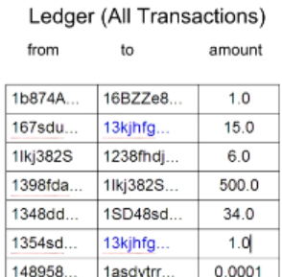
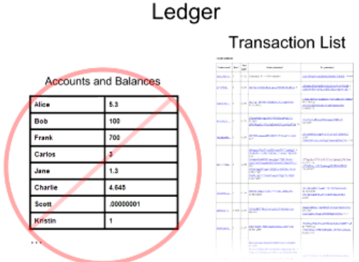

Balance Calculation
16
Index

Slide 9
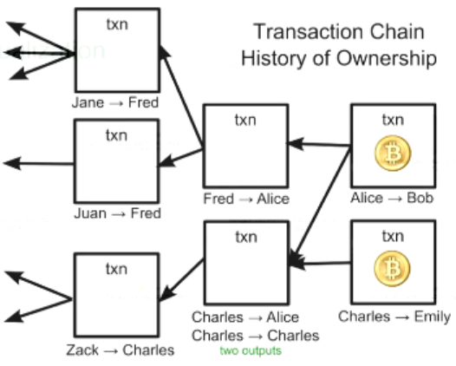
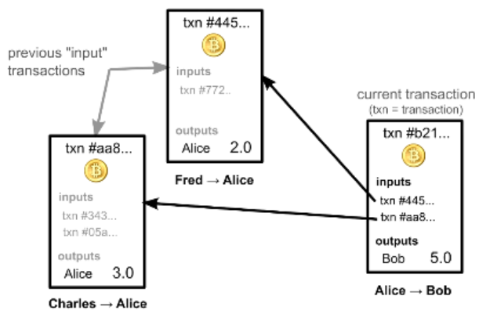
Transaction and Ledger
Bitcoins comes from chains of transactions
Ownership via previous transactions
Check previous transactions ~ 24h
Blockchain.info
Index
Notes:
?? How the process pay 1.2, 2.5, 3.4

Slide 10
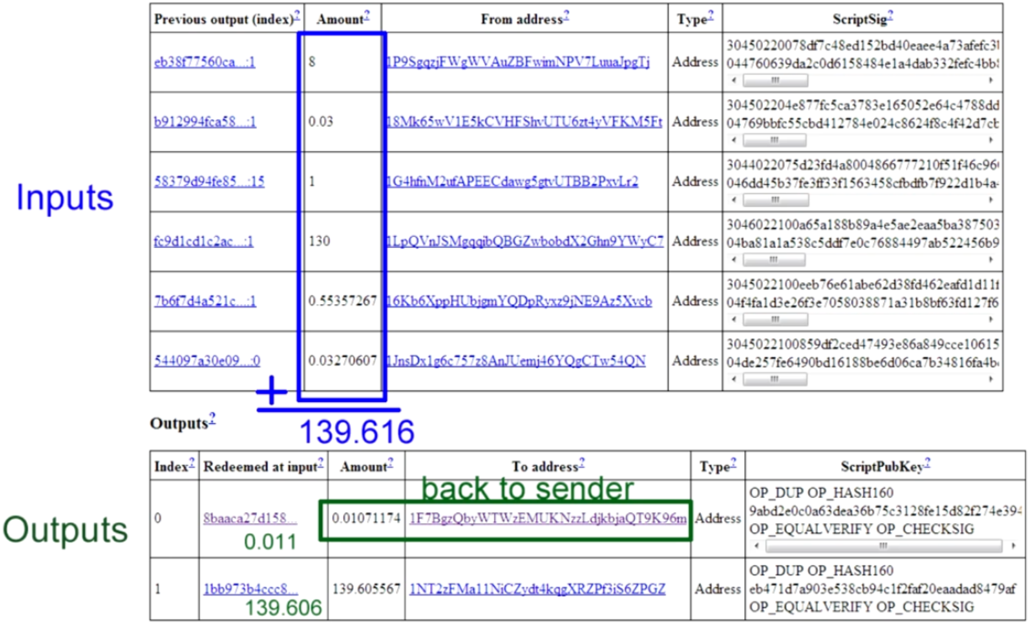
Real Transactions
Index

Slide 11
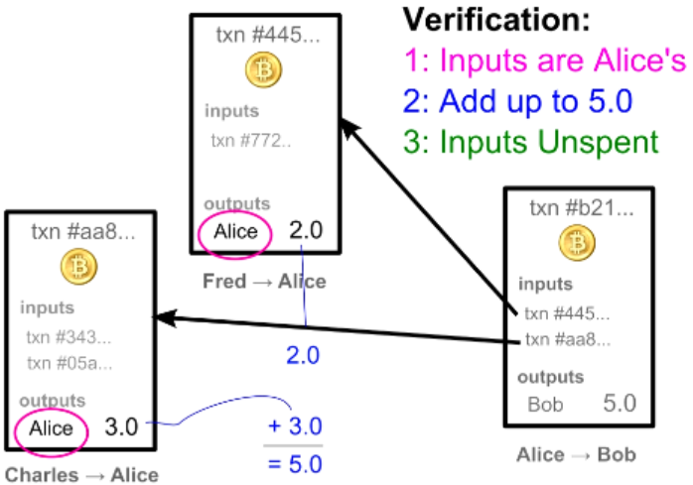
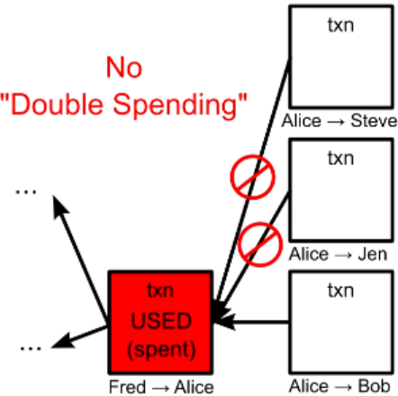
Transaction Verification
Each node verify block & txn before broadcast
Each txn Can Only be Used Once as an input
Index

Slide 12
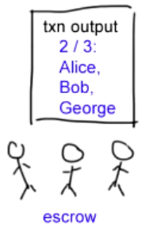
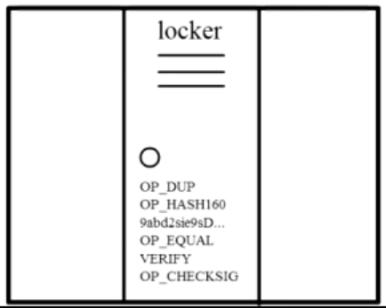
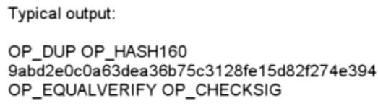
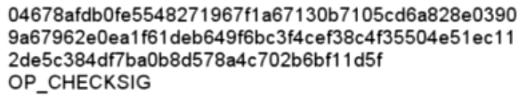
Complex Transactions: Mathematical Puzzles
Transactions: Mathematical Puzzles with locker
Defined with special Scripting language
Only owner can solve it
Support more complex conditions
First Transaction: 2009, Jan 3, 50BTC
Index

Slide 13
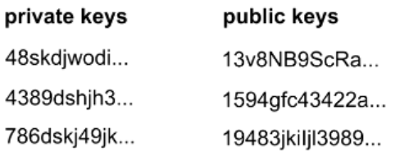
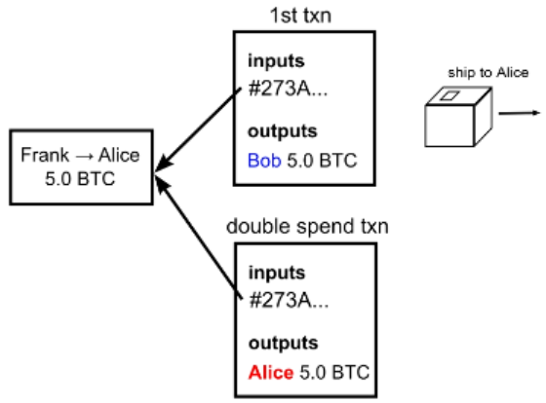
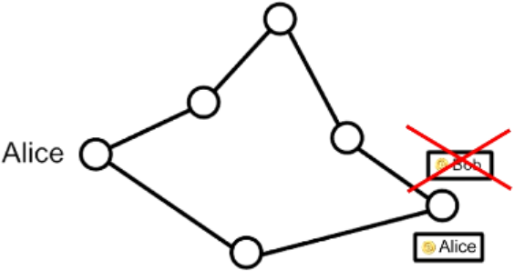
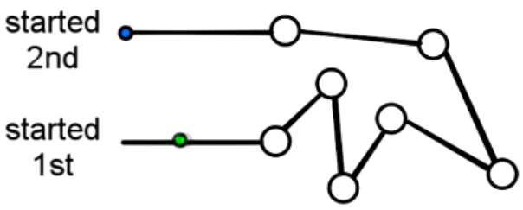
Transaction Security
Wallet
Anonymity
Possible bitcoin address: 2^160
Bitcoin transaction Security:
Digital Signatures
Referenced Transactions
Security Hole: Transaction Order
Double Spending Fraud
Nodes need to agree on transaction order
Index

Slide 14
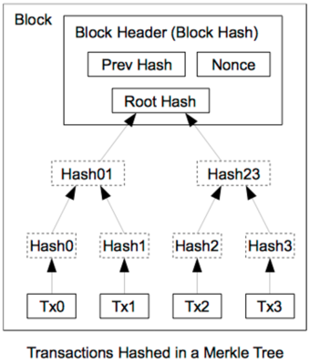
Block Header Hash Relations
Name | Byte Size | Description
Version (V) | 4 | Block Version Number.
Pre Hash (P_{h}) | 32 | This is the hash of the previous block header.
Merkle Root (H_{t}) | 32 | The hash based on all the transactions
Time (T) | 4 | Current Timestamp in seconds. unix fmt.
Target | 4 | Target value in compact form.
Nonce (R) | 4 | User adjusted value starting from 0
Index
3028237 ...

Slide 15
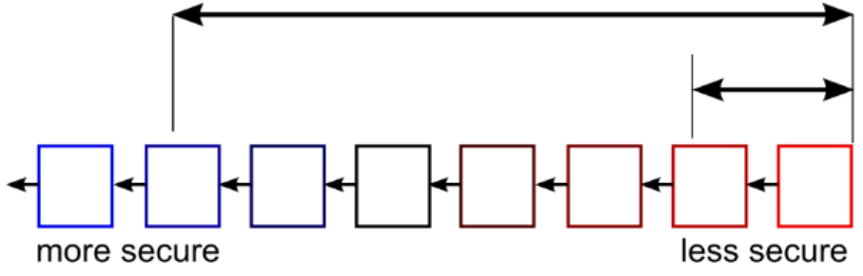
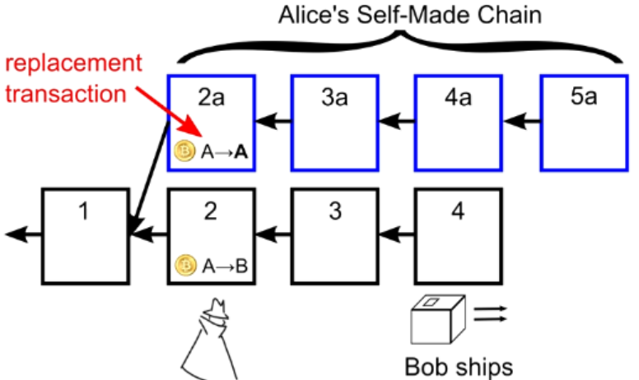
Double Spending Prevention
.32,A->B
1.0,J->Z
1.45,C->S
1.0,H->J
1.03,S->J
.23,B->C
1.2,E->J
.9,M->B
2.5,M->S
.1,S->F
.2,M->J
1.3,S->S
...
...
...
...
HASH
HASH
HASH
Block 1
Block 2
Block 3
Block 4
Wait for several block for safety
Index

Slide 16
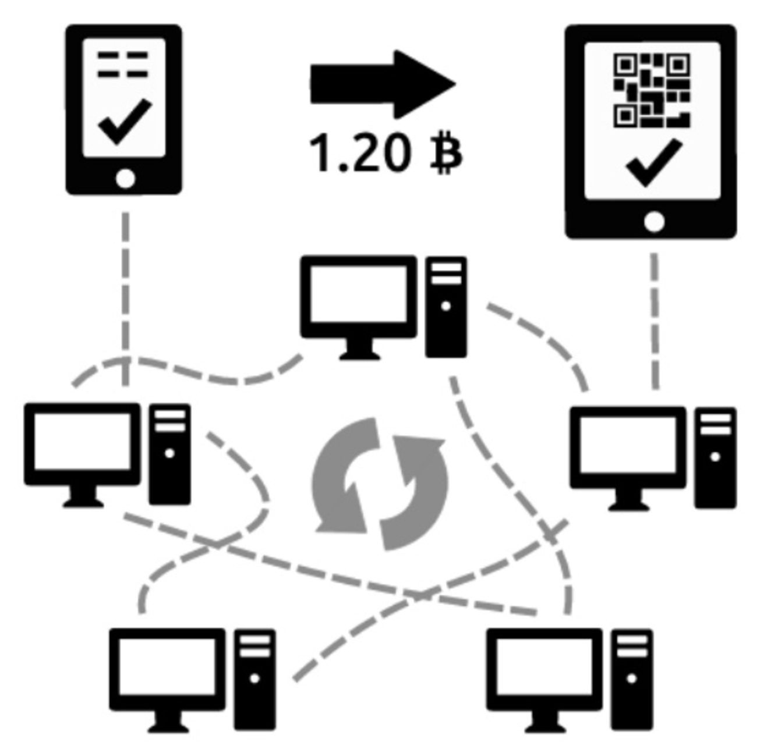


Recap
Blockchain:
block linked to a pre block → blockchain formed
Block Chain Orders Transactions
Transactions Chain transfers Ownership
How the Bitcoin network runs
New transactions are broadcasted to all users
Minters find the solution to the proof of work of the block
creates new block with Txn & broadcasted to all users
Each user accepts the received block if valid
existing blocks
new block
existing blocks
Index
Time
Time
branches

Slide 17
Summery
Benefits
Government can’t print money or manipulate currency
Anonymity
Lower global transaction costs
Challenges
Difficult to exchange
Used for illegal activity (Government can’t track
Mining, or solving blocks use large amount of energy
Mathematically protected digital currency
Maintained by a network of peers
Digital Signature:
Safeguard money
Transaction chains
Store history of ownership
Block Chain
Hold transaction order
Index

Slide 18
Q & A
Index

Slide 19
Reference documents
How do bitcoin transactions work
The Challenges of Block Chain Indexing
Blockchain platform evolution
IOTA: A Cryptoplatform for Securing Transactions on the IoT
Why IBM sees blockchain as a breakthrough for traceability
Index

Slide 20
Coins flow from Inputs to Outputs_TODO
Each bitcoin defined as a chain of digital signature
When A wants to transfer a bitcoin to B, A creates a digital signature with A’s private key, based on
The hash of The previous transaction of this coin
The public key of B
Everyone can verify the transaction by verifying the digital signature with public key of A
Create
Verify
Index

