Slide 1
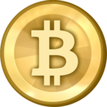
Bitcoins!

Slide 2
Jim Coman
james@coman.com
www.coman.com/bitcoin
Not licensed to give financial advice; There is no financial advice contained herein
Not a lawyer; There is no legal or tax advice herein
Nothing here is designed to help you avoid paying taxes
I do not represent my company; these opinions are my own
I own some Bitcoin so I have a vested interested in Bitcoin
Undergrad: Purdue Computer Science
Graduate: Northwestern Kellogg MBA: Finance
Programming professionally since 1989: Unix and Windows
Banking experience
Hedge fund experience
Derivatives (equities) trading experience
Bond trading experience
Asset backed and structured securities experience
Start-up experience
Currently managing software developers making banking software (11 products)
Advisory board member New Money Systems Board of the Lifeboat Foundation

Slide 3
Bitcoin
Is a global currency (symbol BTC)
Very different from fiat currencies
Around since January of 2009
Not issued by any entity
Peer-to-peer / decentralized
Trading over the internet
Protocol is open source
Somewhat anonymous
Protected by strong encryption (cryptoCurrency)
If you know the secret “account number” the coins are yours
People who transmit transactions are called miners
The maximum number of Bitcoins will be about 21 million
A bitcoin is a unit of measurement
Not completely illegal yet
Not a scam or get-rich-quick scheme
May change money forever

Slide 4
The Basic Mechanism
Transactions are published to the Bitcoin P2P network
Miners (computers) compete to solve a proof-of-work problem on average every 10 minutes
The winning miner publishes a summary of recent transactions in a block
Miners are rewarded with new coins for having published a valid block
Blocks are linked to previous blocks, creating a block chain
The value of every account is evident on the blockchain
Everyone is expected to know the whole blockchain

Slide 5
Genesis Story
The original version of the Bitcoin-QT program was apparently written and published by a person going by the name Satoshi Nakamoto.
Some time after starting up the software, Mr. Nakamoto stopped communicating with the developers who took over the project.
Nobody knows who Satoshi really is, but his English is really good as well as his programming
Satoshi owns nearly 1M bitcoins
He/she delivered the Bitcoin software with some incredibly insightful design decisions, but has so far declined to take credit.
The software is open source and royalty free

Slide 6
There are Core Developers
The developers who wrote the core Bitcoin-QT program are still mostly working on the software
They are passionate about Bitcoin
There are many other developers and tools that emulate protocol
Higher-security wallets
Miners
Exchanges
Currency exchangers/transmitters
Nobody is really “in control” but some people have a lot more influence than others
It is possible for developers to alienate themselves and become irrelevant

Slide 7
There is a Bitcoin Foundation
Tries to represent Bitcoin
Non-profit
Modeled after Linux Foundation
Fragile coalition of interested parties
Pays the developers
Small disagreements have led to calls for a new organization
Way too cozy with the US government
One member has been arrested so far (Silk Road)

Slide 8
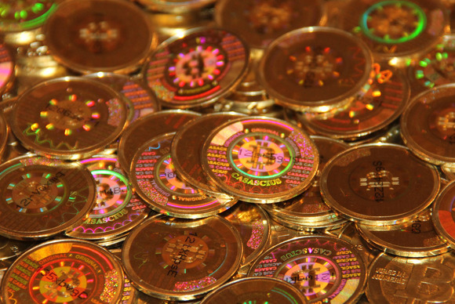
Physical Coins
You may have seen pictures
Some of the pictures are of just play money
They are not “real Bitcoins” but Casascius coins are supposed to be tradable for Bitcoins
They are not a good way to hold Bitcoins
Some guy in Utah makes them (Casascius)
They have a number inside!
The US Government (FinCEN) shut Casascius down

Slide 9
Bitcoin Wallets
The term Bitcoin wallet refers to a file that contains the number or numbers of accounts that hold money
There is also wallet software for managing accounts and transactions
Since Bitcoins are valuable, wallets should be encrypted
The secret numbers can be printed, generally as a barcode
Printed Bitcoin values may be
Locked up for security’s sake
Held as a backup to an electronic wallet
Used as paper money

Slide 10
Features of Bitcoin
All-electronic
Provable value
Fast transactions
Low-cost transactions
Divisible down to 0.00000001 BTC
No third-party trust required
Uncontrollable (Decentralized)
Irreversible trades
No double-spending
Some anonymity (pseudonymity)
Inflation resistant
Deflationary (Maximum of 21M issued)
International
Widely accepted as a currency

Slide 11
Uses For Bitcoin
Convenient online purchases
Tips and donations
Micro-payments
Transactions that must be irreversible
When information is transferred
When an irreversible action is performed
Embarrassing transactions
Black-market transactions
A store of value
Investment
A place to hide money
Gambling
Ransom
Escape currencies that are in trouble
International transactions and financing
Buying foreign goods (currency lingua franca)
Paying foreign employees

Slide 12
Comparison to US Dollar
US Dollar (Cash)
Bitcoin
Backed by United States?
Controlled by US
Primarily US-only
Created by government
Supply controlled by politics
Easy to steal by muggers
Hard to steal by hackers
Hard to transmit
Hard to trace
Non-refundable
Used for crime
Backed only by other users
Controlled by users
International
Created based on work done
Fixed number issued
Hard to steal by muggers
Easier to steal by hackers
Easy to transmit
Hard to trace
Non-refundable
Used for crime

Slide 13
Comparison to Gold
Gold
Bitcoin
Backed by itself?
Internationally accepted
Supply controlled by miners
Difficult/expensive to store
Not easy to divide
Difficult to use for transactions
Can make jewelry out of it
Easy to steal by muggers/invaders
Hard to steal by hackers
Hard to trace
Non-refundable
Backed only by other users
Internationally accepted
Supply is fixed
Easy to store
Easy to divide
Easy to use for transactions
Easy to make backups
Hard to steal by muggers/invaders
Easy to steal by hackers
Hard to trace
Non-refundable

Slide 14
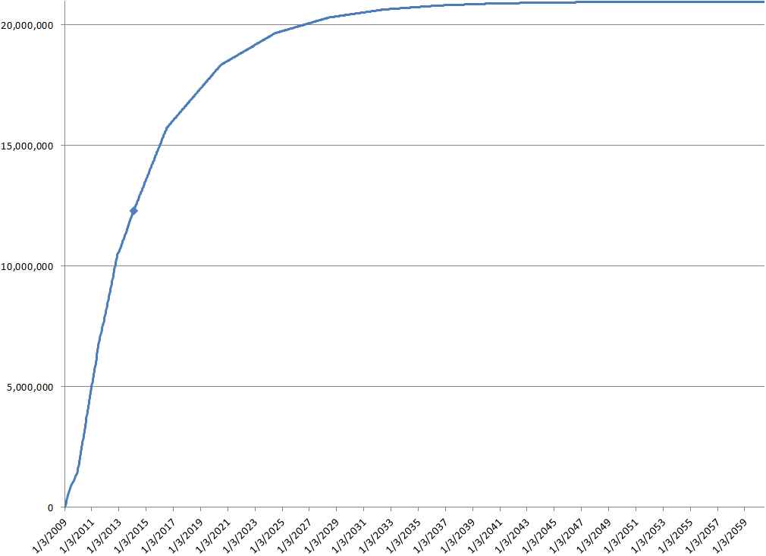
Money Supply

Slide 15
Divisibility
1000 MilliBits = 1 BTC
MilliBits is abbreviated mBTC
For the time being, sandwiches are likely to be priced in millibit
If Bitcoin are eventually worth $1,000,000, the lowest amount of money you will be able to transact is $0.01 worth

Slide 16

Reversible Transactions are Good
Take the form of chargebacks
Reversibility “protects consumers” by allowing for an authority (ultimately the government) to mediate transactions
Protection from unscrupulous vendors
Recovery from identity theft
Accidental transfers can be fixed
Although they are expensive, most people demand reversible transactions from their governments
The US government thinks chargebacks are important
In the US, nearly all non-cash transactions are reversible

Slide 17

Reversible Transactions are Bad
They allow vendors to get scammed, increasing costs for everyone
Require extensive work by vendors to coordinate
Require extensive government oversight
Obviates the need for extensive consumer data collection for credit checking
Expensive and slow
Prevents micro-payments
Locks the poor out of many credit transactions

Slide 18
Irreversible Transactions
Bitcoin transactions are all irreversible
But, for some transactions, people don’t want the baggage of the government oversight
If you use banknotes or coins, you are familiar with irreversibility

Slide 19
Anonymity
Bitcoin provides some anonymity (pseudonymity)
Bitcoin addresses are like numbered bank accounts with a password
The flow of money from address to address is completely public
You can try to deny that you “have” BTC
You can try to deny knowing where BTC went
There are ways to increase anonymity

Slide 20
Silk Road Website
A black market website that began on the TOR network starting in February of 2011
Bitcoin predates Silk Road
Transactions are paid for with Bitcoin
Uses an escrow system to reduce abuse
Looks like eBay, but most things are illegal—most notably, drugs
Shut down by the FBI on 10/2/2013 and a suspected leader (Dread Pirate Roberts) was arrested
Many millions of dollars worth of BTC were confiscated from people all over the world, even if they broke no laws
On 11/6/2013 the website re-opened as 2.0, apparently with new management, but he calls himself DPR
Silk Road is only the most successful marketplace for black market goods. There are others

Slide 21
The Technology Behind BTC
Hashing (double-SHA256, RIPEMD-160)
Proof-of-work (hashcash proof)
Dual key encryption (Elliptical Curve Digital Signature Algorithm, Merkle Trees )
Peer-To-Peer Networking (similar to IRC Internet Relay Chat)

Slide 22
Hashing
Hashing is applying an algorithm to find a short number (digest) of a block of data
A checksum is an example hashing algorithm
Every time you apply a hash to some data, you get the same hash number
Hashes are one-way. If you have the data, you can find the hash. But, if you have the hash, you can’t figure out the data.
Hashes are useful for verifying data

Slide 23
Checksum (type of hash)
Add up numbers
Take the least significant digits
Example:
7
7
3
4
2
5
9
0
0
6
43

Slide 24
Checksum as Hash
Checksums are a bad (but easy to do) hash
SHA256 is a “secure hashing algorithm” that produces 256 bits of output (equivalent to a 78-digit number)
A checksum doesn’t care about the order of the numbers
With SHA256, any tiny change to the data being hashed will completely change the output hash value

Slide 25
Proof-of-Work
Hashcash algorithm designed to prevent spam
A hash is an apparently random set of 256 bits
Every time you change something being hashed (for example, with a nonce) the hash completely changes
There is a 50% chance the first bit might be 0
If you change the thing-to-be-hashed a little bit, you could try a few times and get one with the first bit of 0
First 2 bits: 25%
First 10 bits: 0.0977%
Find a hash with the first 63 bits as 0 (0.00000000000000001%), and you can publish a block and win 25 Bitcoins

Slide 26
Dual-key Encryption
Fundamental to understanding virtual currencies
Encrypting with a password is single-key
Dual-key encryption uses two keys
If one key is used to encrypt, the other key can be used to decrypt
And vice-versa
The key that encrypted CANNOT decrypt

Slide 27
Single Key Encryption
A key (like a password) can encrypt data
Key
Unencrypted data

Slide 28
Single Key Encryption
Use the key to encrypt some data
Key
Unencrypted data
Encrypted data

Slide 29
Single Key Encryption
Use the same key to unencrypt
But, I have to give away the key
And, I have to transmit that key
Key
Unencrypted data
Encrypted data

Slide 30
Dual-key Encryption
There are two keys (like special passwords)
Key 1
Key 2
These keys are big numbers
Unencrypted data

Slide 31
Dual-key Encryption
Keys are generated in pairs. They go together
One key can’t be used to find the other
Key 1
Key 2
Unencrypted data

Slide 32
Dual-key Encryption
Encrypt with Key 1
Key 1
Key 2
Unencrypted data
Encrypted data

Slide 33
Dual-key Encryption
Decrypt with Key 2
Key 1
Key 2
Unencrypted data
Encrypted data

Slide 34
Dual-key Encryption
Encrypt with Key 2
Key 1
Key 2
Encrypted data
Unencrypted data

Slide 35
Dual-key Encryption
Decrypt with Key 1
Key 1
Key 2
Encrypted
Unencrypted

Slide 36
Dual-key Encryption
If you only have one key, you can’t unencrypt your own data.
Key 1
Encrypted
Unencrypted

Slide 37
Private and Public Keys
Although keys are symmetrical, usually one key is kept private, while the other one is considered public.
Private
Key 1
Key 2

Slide 38
Private and Public Keys
If you want someone to sent you an encrypted file, tell them to use your public key to encrypt it.
That way, nobody (not even the person who encrypted it) can read the encrypted data, except you.
Private
Key 1
Key 2

Slide 39
Private and Public Keys
And, if you want to send someone a file so only they can read it, you can just use their public key. It’s probably on their website even.
Private
Key 1
Key 2

Slide 40
Digital Signing
Digital signatures prove that data came from the person with the private key
For me to sign some text
Do a hash of the text
Encrypt the hash with my private key
Send the encrypted hash with the text
To prove that I signed it
Do a hash of the text (same as I did)
Unencrypt the encrypted hash with my public key
Check that it matches the calculated value

Slide 41
What If I Lose My Key?
The blockchain will store your address forever in case you later find it
Ask Buddha for help
The real number of Bitcoins will be less than 21 million because some of them are already lost

Slide 42
Peer-to-Peer
Bitcoin originally used Internet Relay Chat
When a peer starts up, they get a list of other peers and go looking for a few peers who aren’t so busy
Peers share information about recent transactions and historical blocks
Blocks are verified with Merkle tree signature

Slide 43
Threats to Bitcoin
Competing currencies (Network effects)
Blockchain forking due to philosophical conflicts
Government attacks
Denial of service attacks (Probably temporary)
Hackers stealing currency
Unrecoverable bug in the protocol
Cryptography breakthrough (quantum computers?)
Loss of confidence due to volatility
Early adopters dumping
Redlisting
Processing power takeover
Pressure from Visa/MasterCard
Pressure from Internet providers
Crushing increase in volume
Selfish Miners problem
Mutable transactions
Byzantine Generals Problem
Maybe lack of regulation really is bad
Maybe free markets/capitalism just don’t work

Slide 44
Regulation of Bitcoin
A lack of regulation is preventing big institutions from entering the market
Bitcoin is a distributed peer-to-peer system (hard to seize)
Bitcoins aren’t even tied to it’s current network protocol
Bitcoin is mostly not in the US – there are no major exchanges in the US
To stop bitcoin trading, the US will have to be ON your computer
Blocking the US from Bitcoins will hinder our participation in a possible technology revolution; American companies will lose contracts
America has an established network of drug dealers
Paying for drugs with bitcoin makes a lot of sense
Accepting bitcoins for drugs makes a lot of sense
Drug dealers are probably going to have Bitcoin for sale
Organized crime wouldn’t turn down a new way to make money (Bitcoin trade)
It is possible to curtail legal usage of Bitcoin within dedicated countries, but very difficult to catch bitcoin criminals
Bitcoin can adapt around regulation
America already has $1.5 Trillion cash overseas. How did it get there?
Pandora’s box is already open
Virtual currencies pose a credible threat to the ability of sovereign nations to govern

Slide 45
Bitcoin is hard to regulate because it is:
Decentralized
Global
Flexible
Popular

Slide 46

The People’s Republic of China
Like some Americans, some Chinese have a desire to hide some of their wealth
The Chinese government probably won’t ban Bitcoins—Are Bitcoins worse than USD to them?
Like the US, the regulatory environment in China is ambiguous
Chinese people (possibly moreso than Americans) like to gamble
Chinese citizens are already moving into Bitcoins in a big way
Some of the biggest exchanges are in China
Chinese exchanges publish fake trading information
More full nodes are running in China than any other country
Chinese people can buy Bitcoins with Renminbi or USD
Chinese people hold a LOT of USD
China won’t have much sympathy if the US bans bitcoins

Slide 47
Mining
Byproduct of publishing the blockchain
This is the way new Bitcoins are created
Miners publish blocks on the blockchain
As a reward for publishing blocks, they get to keep Bitcoins. (50 for the first 4 years, 25 now, halving every four years)
Miners also get transaction fees
Race to find a conforming hash every 10 minutes
Don’t do it (unless you have cash, time, and an underutilized electrical engineering skill)
Incredibly competitive
Risky
High upfront investment
Technology is changing rapidly
Now requires specialized hardware (ASIC chip)
Miners reasonably must join a guild
The combined computing power of the miners is thousands of times more powerful than the most powerful super computers in the world

Slide 48
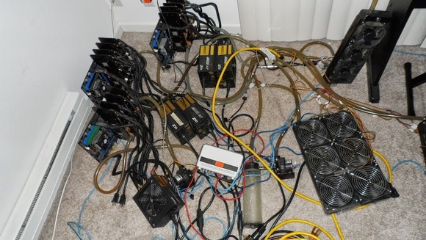
Mining

Slide 49
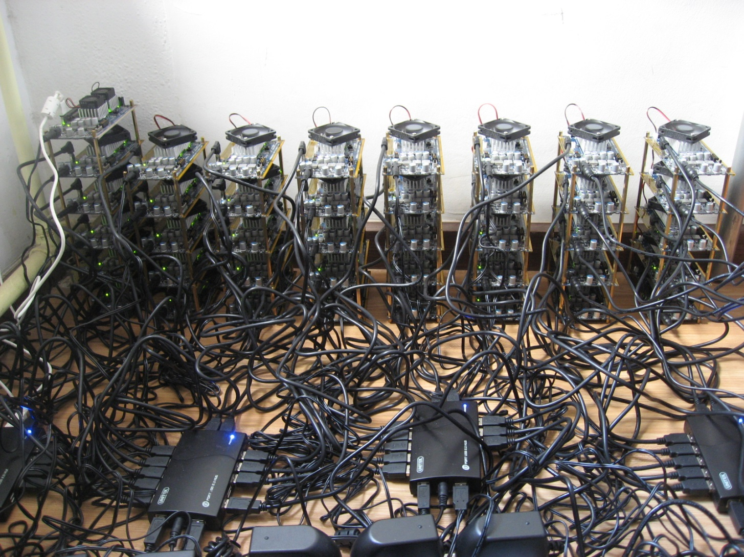
Mining

Slide 50
How Bitcoins are Created
Every 10 minutes (average), miners try to solve a proof-of-work problem
The first one to solve the problem publishes a “block” on the “blockchain” that includes all transactions from the last 10 minutes
In 2009, the reward for publishing a block was 50 Bitcoins. Now it is 25. In 2016 it will be 12.5 Bitcoins
With the constant halving, eventually there will only be about 21 million Bitcoins

Slide 51
How Bitcoins are NOT Created
You can’t pay to create extra coins. They can only be mined
There is no central bank to make them
The developers can’t add extra Bitcoins. Other users would rebel and not take the new version of the software (Litecoin)
Miners can’t mine extra or faster in response to market forces

Slide 52
Blockchain
Miners publish a block of recent transactions every 10 minutes on average
Each block is provably related to the previous
Every transaction ever is stored in the blockchain
If there are disagreements about valid blocks, the blockchain can fork
Miners add to the longest good chain
Searching the blockchain can reveal interesting things

Slide 53
EXTRA! EXTRA!
Bitcoins Hacked!
Real Bigfood Found!
Vaccines Really do Cause Autism!
Scientists Discover Proof of God!
Psychic Solves Crime!
Life On Mars!
Alcohol Makes People Live Longer!
Vitamins Cure Cancer!

Slide 54
Bitcoins Have Been Stolen
Some big heists have been pulled of with very large numbers of Bitcoins stolen
The thieves are usually hackers, not burglars
Generally, the stolen Bitcoins are never seen again on the blockchain
It is very important to protect your private key
Viruses can steal your Bitcoins
Other viruses can encrypt your hard drive and only decrypt if you provide Bitcoins
Botnets have mined Bitcoins

Slide 55
Bitcoin Wallet Security
Keep keys offline if you can
Encrypt your wallet
Make backup copies of your wallet
If you are going to keep your savings at home, put them on a computer you ONLY use for bitcoins
Keep multiple wallets
Always receive money to a new address
Online wallets: use 2-factor authentication
Don’t spend from your “savings” address(es)
Don’t brag about how many coins you have or where you stash them

Slide 56
Doom and Gloom
Some people say Bitcoin is not a currency and is doomed to fail
Almost everyone predicting the downfall of Bitcoin doesn’t really understand bitcoin
The arguments generally fall into the following categories

Slide 57
Bitcoins have No Intrinsic Value?
What is the intrinsic value of a US Dollar?
What is the intrinsic value of gold? Does jewelry and electrical contacts give it its value?
Classic chicken/egg problem
Most currency has value because people value it
What is the intrinsic value of eBay? None because they don’t sell anything themselves?
Doesn’t the merits of the protocol have intrinsic value?

Slide 58
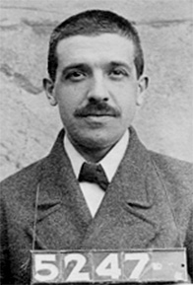
Are Bitcoins a Ponzi Scheme?
Charles Ponzi in 1920s defrauded investors
Bernie Madoff did the same thing in 2008
Very common
Ponzi Scheme:
Unreasonable returns are promised in a “confidence trick”
Early withdrawals are paid with other investor’s money
Depends on opaqueness of finances
Everyone can see your Bitcoins
There have been Bitcoin-denominated Ponzi-schemes

Slide 59
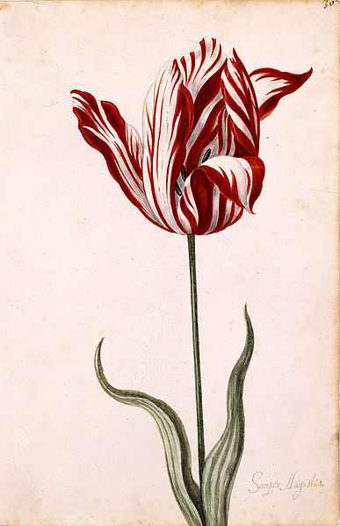
Are Bitcoins a Tulip Mania?
Tulip Mania happened in Netherlands in the 1630s and is a classic asset price bubble story
If the definition of tulip mania is rapidly increasing prices, then maybe Bitcoins are a tulip mania, because the price is going up
There is no control on the supply of tulips
Tulips aren’t great as a medium of exchange.
They die
They are not easily divisible
They are not easy to value
They are not uniform
You can’t prove the value of any particular bulb
They do have intrinsic value
So do Beanie Babies

Slide 60
Bitcoin Asset Bubble?
Maybe
Will the price shoot up and then fall back down rapidly?
Offshore US Dollars
Americans keep $1.5 Trillion outside the US
If they stored 5% of that in Bitcoin, BTC=$3,740
Foreigners with US Dollars
Foreigners hold $3.4 trillion
5% would be BTC=$8,095
US-based prepaid debit cards $77 billion/year
Western Union makes $5B/year on money transfers
Currently, millions of dollars worth of Bitcoin are being created each day

Slide 61
Bitcoins are Too Expensive
Yogi Berra: “Nobody goes to that restaurant anymore. It’s too crowded.”
Bitcoins are divisible down to 0.000000001
Unlike physical coins, you can buy a fraction of a Bitcoin without a problem

Slide 62
There Aren’t Enough Bitcoins To Go Around
Yogi Berra:
Waitress: “Would you like your pizza in 4 or 6 slices?”
Berra: “Better make it 4. I don’t think I can eat 6.”
7,000 million people can’t each have one of 21 million Bitcoins
If/when they become common, few individuals will have a “full” bitcoin.

Slide 63
The Bitcoin Market is Illiquid
The Bitcoin market is currently about $7 billion
But, if someone wanted to buy all of it, they would find that the market got much bigger before they acquired a substantial proportion
Liquidity will increase as the market (and price) expands

Slide 64
Bitcoin is Too Complicated
The Credit Default Swap market was complicated: $62.2 Trillian at peak
The Eurodollar market is $20+Trillion
The Clearing House Interbank Payments System moves $1 Trillian/day
Gold is a very simple system, but you probably never buy anything in gold
Download the app

Slide 65
Bitcoin Prices are Too Volatile
Bitcoin is a very young technology and is very likely to stabilize
Gold prices are volatile
You don’t see it, but USD is pretty volatile compared with other currencies and commodities
The price is volatile because people are buying and selling it
Bitcoin is attractive to traders because it is volatile

Slide 66
Bitcoin Mining is Wasteful
The Hashcash algorithm is almost useless except for within Bitcoin
Must show that work was done
Must be based on the previous block
Must be easily checkable
If the algorithm is useful to someone, that someone probably has an advantage
Changing the algorithm would be very disruptive to Bitcoin
Some altcoins attempt to solve this problem, but open vulnerabilities to do so
Nobody has found an acceptable alternative

Slide 67
Bitcoin Won’t Work Because it is Deflationary
“Crack Cocaine won’t become popular because it is too addictive.”
Deflation is when prices for goods become less expensive over time.
Deflation is also when the value of money goes up over time.
If people don’t desire to have Bitcoins, it won’t be deflationary
People will likely be able to choose among currencies, and will likely set prices in the most stable currency
Tight money supply isn’t the only reason for deflation

Slide 68
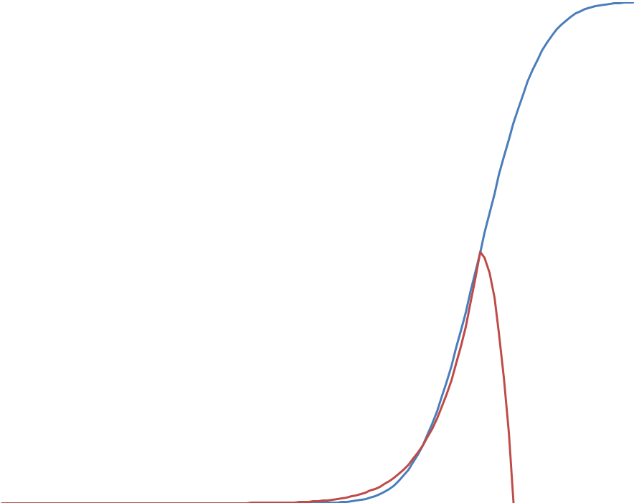
Sigmoid Adoption Pattern
When new things are adopted, the normal pattern is:
Slow initial growth
Rapid adoption period
Tapering off
S-curve’s happen with:
New technologies
Diseases
Gene propagation
Introduction of invasive species (rats on islands)
Etc.
The first part of the S-curve looks a lot like an asset bubble
The curves are never actually smooth

Slide 69
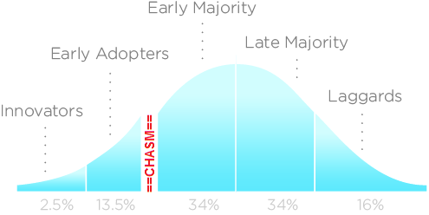
Technology Adoption Lifecycle
Visionaries
Innovators
Early Adopters
The Chasm
Pragmatists
Early Majority (are we here yet?)
Late Majority
Laggards

Slide 70
Network Effects
For many things, the more people in the network, the more valuable the network becomes
Not true of fashion and food where diversity is valued
The internet has no close competitors
Metcalfe’s Law (The value of a telecommunications network is proportional to the square of the number of connected users)
Why is there only one eBay?
eBay used to have many competitors
Where do you want to sell your goods? Where the buyers are!
Where do you want to shop for goods? Where the sellers are!
Sotheby’s is still around
How many virtual currencies does the world need?

Slide 71
Altcoins
Alternative digital currencies
There are many
Litecoin
Feathercoin
Namecoin
PPCoin/Peercoin
Zerocoins
Mastercoin
Quark
Devcoin
Dogecoin
Terracoin
Bytecoin
etc
All are based on versions of the Bitcoin source
Moribund

Slide 72
Chalkboard Coins 1.0
We need a money supply
The only thing we have in the room is a chalkboard
Jim writes up on the board what each person has, so everybody knows who has what
If there is a transaction, the old owner is crossed off and the new owner is written in
Coin Owner
1 Jim
2 Jim
3 Jim
4 Jim
5 Jim
6 Jim
Coin Owner
7 Jim
8 Jim
9 Jim
10 Jim
11 Jim
12 Jim

Slide 73
Chalkboard Coins 1.0
We need a money supply
The only thing we have in the room is a chalkboard
Jim writes up on the board what each person has, so everybody knows who has what
If there is a transaction, the old owner is crossed off and the new owner is written in
Coin Owner
1 Jim Alice
2 Jim
3 Jim
4 Jim
5 Jim
6 Jim
Coin Owner
7 Jim
8 Jim
9 Jim
10 Jim
11 Jim
12 Jim

Slide 74
Chalkboard Coins 2.0
Rather than writing things on the chalkboard right away, we just shout out the trade, and everyone remembers
At the end of the day, someone writes down the transactions for the day
As a reward for writing everything down, the scribe gets some Chalkboard Coins. This is the only way Chalkboard Coins can be created.

Slide 75
Chalkboard Coins 2.0
There is no reason for the scribe to re-write everything, so only changes are written down
If the scribe gets it wrong, someone ELSE writes it down correctly and gets the coins
Nobody pays attention to scribes who get it wrong. So it is important to be right
Coin Owner
1 Jim
-----Tuesday-----
Coin 1 Jim->Bob
New coin:
2 Scribe1

Slide 76
Chalkboard Coins 3.0
Nobody uses their real name. People only shout out a public key to own each chalkboard Coin
To ‘claim’ a Chalkboard Coin, you must sign the transaction with your private key
Coin Owner
1 1zKB543fJGRP075HGDm0Q
-----Tuesday-----
Coin 1 1zKB543fJGRP075HGDm0Q ->
1XPM77H5Z2vdD976BVISD
New coin:
2 1JC53YQ0L4LGMN3MN2IYV

Slide 77
Chalkboard Coins versus Bitcoins
Instead of shouting, people publish on a peer-to-peer network
There is no board at all. The transactions as well as the confirmations are published on the network and remembered
Confirmations are called blocks, and sent out every 10 minutes, not every night
If someone forgets (or is new), they ask their peers for old blocks
The scribes are actually miners

Slide 78
Will Bitcoins Last?
I don’t know.
Is there a demand for digital currency?
Prepaid credit cards ($77 billion/year)
Western Union ($5 billion/year revenue)
MoneyGram (in trouble with feds)
e-gold (grabbed by feds)
e-Bullion (grabbed by feds)
WebMoney (grabbed by Ukrainians)
DigiCash/eCash (bankrupt)
Tencent QQ Qcoins (in trouble with Chinese)
Liberty Reserve (grabbed by feds)
Paypal ($5.6 billion/year revenue)
High fees
Close government scrutiny
Many others from history
Is there room for many? Or, can there be only one?

Slide 79
Famous People and Bitcoins
Sir Richard Branson will sell you a ticket to space on (Virgin Galactic)
The Winklevoss Twins (Facebook fame) have 108,000 BTC and want to start a ETF
Many venture capitalists are backing startups
Ben Bernake “may hold long-term promise”
Marc Andreessen (Netscape founder) – “Bitcoin offers a sweeping vista of opportunity”
Jamie Dimon (CEO JPM) – “Bitcoin is a terrible store of value.”
David Woo (BofA/ML) “As a medium of exchange, Bitcoin has clear potential for growth, in our view.”
Goldman Sachs – “Bitcoin may emerge as the reigning standard [of natively digital transactions]”
Al Gore – “I’m a big fan of Bitcoin”
David Marcus (Pres of PayPal) “I really like Bitcoin. I own bitcoins.”
Jim Cramer (Mad Money) said that without a central bank Bitcoin is not a currency and “the Treasury should have shut down Bitcoin”
The Washington Post: “Bitcoin is ludicrous”
The New York Times: “How can bitcoin be anything but a passing fad?”
Paul Krugman (Nobel winning Keynsian Economist) – “Bitcoin is Evil”

Slide 80
Where to Find out More
www.coman.com/bitcoin
Bitcoin.org – The Bitcoin Foundation
Bitcoin Wiki
Bitcoin Forums
Reddit Bitcoin
Bitcoinity.org – Pretty real-time charts
blockchain.info

Slide 81
How to Get Bitcoins
Coinbase
Bitstamp
Localbitcoins
Proposed Chicago Bitcoin “ATM” coming in March

Slide 82
Current Events
Mt. Gox exchange is in trouble
First and formerly largest exchange
Got in trouble with Feds
Was having trouble with fiat withdrawals
Now also having trouble with Bitcoin withdrawals
Silk Road (or hackers) stole all bitcoin on site
ATMs are being set up in USA
Winklevoss twins filed for their ETF

Slide 83
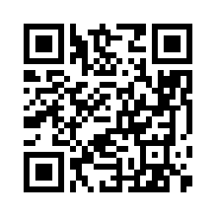
Donate to Me
My BTC Address:
1HLQ4vLRNnYE97SB6nRim9NL2aEBxPvXbk

Slide 84
Questions

Slide 85
Facts
Current Bitcoin price
Reward for finding block 25
Mining difficulty
Number of blocks so far 269,632
Dollars moving into Bitcoins per day
Price chart

Slide 86
Fungability
Mutual substitution (Exchangeability)
Critical to success of a currency
USD have serial numbers. Bitcoin has the blockchain
Coin Validation private company that plans to track bitcoins
Redlisting (blacklisting) of Bitcoin accounts may pose a risk to growth of currency

Slide 87
Arbitrage
Risk-free profitable transactions
Different exchanges consistently have different prices
Movement of fiat currencies is difficult

Slide 88
m of n Transactions
Transactions have an input and output address
Output addresses can be scripts
Scripts can have more than one address (n)
Sometimes only a certain number (m) of the addresses need to be signed
Can be used for escrow, estate planning, and many other uses

Slide 89
Incentives
Miners want to publish the blockchain, because they are paid to do it
Guilds want to please miners to attract them
Guilds and Miners want Bitcoin to thrive because the are heavily invested
Consumers want to hold Bitcoins because the value is expected to rise
Consumers want to spend Bitcoins because the transaction costs are low, immediate, and there is some anonymity
Merchants want to accept Bitcoin
Because there are no chargebacks
They get paid immediately
To accumulate Bitcoin
To be flexible for consumers
Advertising to the Bitcoin community

Slide 90
Peer-to-Peer Technologies
Language
Jokes
Rumors
Literary style
Fashion
The Internet
Recreational drugs

Slide 91
Bitcoin Transaction
Vendor creates brand new keypair
Vendor shows customer barcode asking for price to be send to the new address
Customer scans barcode with wallet software (on a smartphone)
Wallet software asks if it is okay to send the requested amount. Customer approves
Password is supplied to unlock private key
Transaction message is sent to bitcoin network
Vendor receives transaction notification on bitcoin network
Vendor optionally waits for block confirmation
Customer is informed that transaction is complete

Slide 92
Zero-knowledge Proofs
Could provide complete anonymity
Proposed to Bitcoin
Implemented in Zerocoin
Non-iterative zero-knowledge proof of knowledge proofs

Slide 93
Mt. Gox
The original Bitcoin exchange
M Magic
t The
G Gathering
o Online
x eXchange
Has had significant difficulty handling volume
Blaming mutable transactions

Slide 94
Bitcoin Exchanges
Mt. Gox – Tokyo, Japan
Bitstamp - Slovenia
BTC-e – Bulgaria?
Bitfinex – Hong Kong
CampBx – Atlanta, Georgia, USA
Kracken – San Francisco/Germany?
BTCChina – Shanghai, PRC
Huobi – Hong Kong?
Bitcoin.de - Germany

