Slide 1
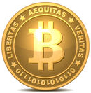
BitCoin – The New Currency
By SIR Phil Goff
Branch 116
March 20, 2014

Slide 2
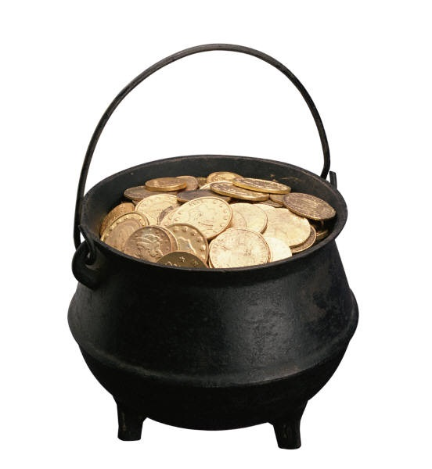
Bitcoin – The New CryptoCurrency
How did it get started?
How is the currency created?
Why does it have value?
Who controls the value?
Who Accepts Bitcoin?
How Would I buy some Bitcoins?
Why would I want some Bitcoins?
Problems with Bitcoin currency.

Slide 3
How Did It Start?
In 2009 A technical paper was posted on the internet by Satoshi Nakamoto titled Bitcoin: A Peer-to-Peer Electronic Cash System
It described a sytem of cryptocurrency that was not backed by any government or any form of existing currency.
Interestingly, there is no such person. It’s a pseudonymn.

Slide 4
Where Do Bitcoins Come From?
Bitcoin is based on solving an encryption formula which requires extreme amounts of computing power.
  Each time you solve a portion of the formula you earn a “BitCoin.”
  Websites like Deepbit.net help you set up the mining formula.
  Companies began to sell hardware called gate array miners to enhance the processing speed.
  Only 21 million BitCoins will ever exist
Nearly all Bitcoins have been mined and are now in circulation.
Great article on tomshardware.com titled “Confessions of an Accidental Bitcoin Miner.”

Slide 5
What is the Vision of Bitcoins?
Bitcoins are intended to be digital currency.
Buyers and sellers will use them and eliminate all the middlemen such as credit cards, ATM machines, etc.
Bitcoins will be safer than carrying a plastic card.
Bitcoins will be an international currency with no exchange transaction fees.

Slide 6
What is the Value of a Bitcoin?
Bitcoins are like diamonds or gold – no intrinsic value.
  As more people want to buy Bitcoins, sellers will charge more.
  It’s a free market and as wild as you can imagine.
  No rules, regulations or oversight.
Speculators who think Bitcoins will be successful, buy as many as they can and hold them price appreciation.
If 21 million Bitcoins are in circulation and current price is $500, then total market value is ~$10 Billion.

Slide 7
Who Sells Bitcoins?
Larger Buyers go to Exchanges
An Exchange is a website with significant software and funding.
Exchanges act as a clearing house to match buyers and sellers similar to Stock Exchanges. They keep a very small transaction fee for each trade.
There are at least 21 Bitcoin Exchanges in the U.S. alone
Mt Gox was one of the largest exchanges and was located in Japan

Slide 8
Using an Exchange
To Buy Bitcoins on an Exchange:
  Create an account at an exchange like Coinbase.com
  Wire them some money (no credit cards allowed)
  Funds will show up in your account
  Purchase or sell Bitcoins whenever you wish from your account.
  You can have all or some sent to your Bitcoin wallet on your computer

Slide 9
Buying Bitcoins Locally
Many small Dealers want to make money selling Bitcoin to individuals who use them for e-commerce.
The Dealer will withdraw Bitcoins from their account at an Exchange and sell them to you.
You can buy any fraction of a coin you wish. There is no “round amount.” (i.e. $100 my buy .4567 of a Bitcoin)
Search for local Bitcoin sellers and you will get the current prices from each.

Slide 10
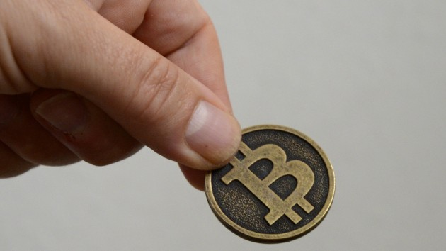
Buy Bitcoins Locally
Buying small amounts of Bitcoins is popular.
  Find a dealer with an acceptable price (price is posted on the internet.)
  Arrange a meeting place that is safe.
  Bring cash since he/she doesn’t accept any form of credit.
  You pay him and he initiates a transfer from his account in a Bitcoin Exchange.
  He gives you a secure code which deposits them in your “wallet.”

Slide 11
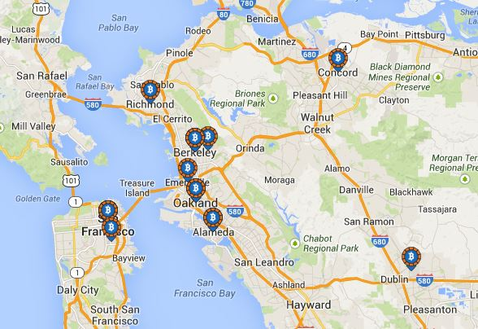
Buy Bitcoins Locally
The number of Bitcoin dealer is growing.
Do a Google search for local Bitcoin dealers.

Slide 12
Buy Bitcoins from ATM
ATM’s that sell Bitcoin are in a very few locations.
First one was in Texas in a gun store.
Bitcoin ATM’s only take cash.
They only sell Bitcoin, you can’t convert Bitcoin to cash.

Slide 13
Actvity Level
Currently there are 60,000 to 70,000 Bitcoin transactions each day
The level hasn’t changed significantly in the last year.
Log into Blockchain.info to see the transaction activity.

Slide 14
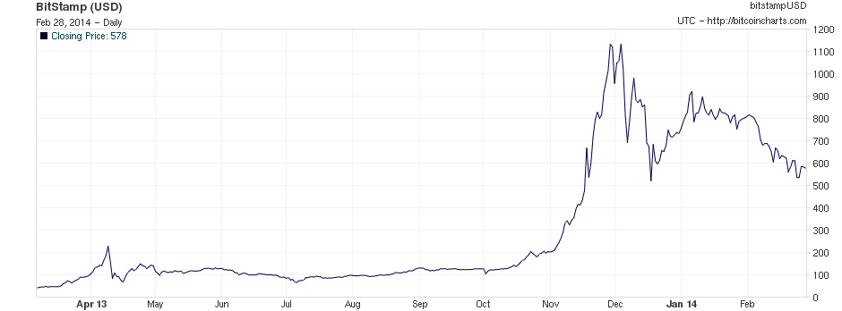
Bitcoin Value – 1 Year History

Slide 15
Why is all the Money Flowing into Bitcoins?
Trading in Bitcoin can make you very rich! (or very poor.)
90% of Bitcoin buyers are speculators.
If people only bought Bitcoins to be used for e-commerce, the price would likely be much lower.

Slide 16
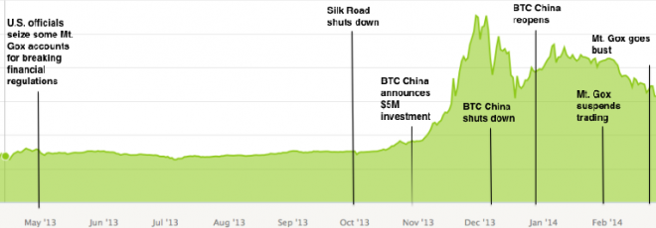
Chinese Speculators Drive the Price

Slide 17
Wall Street wants in on the Action
Wall Street just opened the “Bitcoin Investment Trust” to speculate in Bitcoin prices without owning the currency. Minimum investment is $25,000.
  Currently has $70 Million in assets.
Expect Wall Street to develop leveraging instruments such as calls, shorts, straddles, etc.

Slide 18
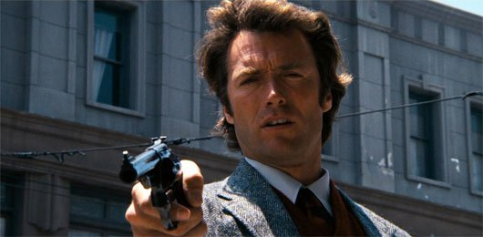
Bitcoin – The New Gold Rush
If you want to invest in Bitcoins ……..
To Quote Dirty Harry:
You've gotta ask yourself a question: "Do I feel lucky?" Well, do ya?

Slide 19
Why Would You Want Some Bitcoin?
It’s a novelty and would be fun to try.
Show your friends that you are a true groundbreaker.
You like to gamble.
You don’t trust Credit Cards and want to buy stuff online.
You want to buy something on the internet that is “unconventional.”
You want to sell something that is “unconventional”

Slide 20
Bitcoin Issues - Legality
Bitcoin transactions are untraceable.
  Seller doesn’t tell the IRS
  Buyer can be anonymous
U.S. Treasury and IRS wants it stopped.
First big user of Bitcoin was Silk Road
  Drug trade proliferated
  No money laundering necessary
It’s very hard to stop Bitcoin – it’s an international scheme.

Slide 21
Bitcoin Outlawed in Some Countries
Russia was first to outlaw Bitcoin transactions
  They have enough corruption without Bitcoin
China is restricting it use
  Too much speculation
Korea outlaws it’s use – claims it’s not a legitimate currency
Thailand shutdown the Bitcoin exchange in their country.

Slide 22
Bitcoin Issues - Safety
Largest Exchange, Mt Gox in Japan just went bankrupt
  Hackers were siphoning off their Bitcoins
  They lost $450 million dollars
  Account holders are the real losers
Electronic Wallets
  Many websites have created “secure” electronic wallets for you.
  There are Wallets for Windows, Mac, iPhone, and Android
  Some “Wallets” deduct a small fee for every transaction
Wallets have proven to be safe, but no guarantees.

Slide 23
Bitcoin is a Target
Proponents claim they have built a safe system and Mt Gox is an exception.
Just remember:
Willie Sutton the famous bank robber was quoted in an interview:
Why do you rob banks?
He replied, Because that’s where the money is.

Slide 24
Who Accepts Bitcoin?
Thousands of online merchants such as:
  Pirate Bay – Online sharing site for questionable materials.
  OKCupid – Online dating site
  Overstock.com – Sells clearance merchandise
  TigerDirect.com – Major electronics retailer
  Lolliphile.com – Wine lollipops with pictures of scantily clad women
50,000 Retail stores (and counting) accept Bitcoin
  Hotels in Las Vegas
  Gift Cards for GAP, Lowes, Burger King, etc.
  Mostly small merchants who want to increase traffic

Slide 25
Will Bitcoin Survive?
JP Morgan Chase filed a patent to address the issues of a cryptocurrency like Bitcoin.
Since most owners are speculators the true price for owning Bitcoin only to use as a currency is unknown.
Hedge Funds and Banks will likely start trading Bitcoins similar to international currencies and gold.
Bank of America announced that Bitcoin could be a major means of payment for commerce.

Slide 26
Bitcoin in a Perfect World
There are many promises to be fulfilled by a universal digital currency.
Lowers the cost of processing.
  Credit cards charge ~5% to the supplier.
  Bitcoin transactions would cost almost nothing.
Reduces Fraud
  Credit card fraud costs billions of dollars each year
  Don’t need to carry plastic in your wallet
  Smartphone Apps can work with Bitcoin

Slide 27
Will Bitcoin Succeed?
Digital currency makes a lot of sense.
  It could eliminate a lot of middle man costs (credit cards, wire fees, etc.)
  It could be extremely easy to use
  It could eliminate billions of dollars in credit card fraud and identity theft.
Bitcoin may utterly fail but some form of digital currency will probably emerge.
  It must be safe
  It must be traceable by government entities
  It must be easy to use.
  People must have trust in it’s value

