Slide 1
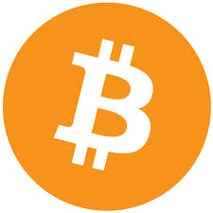
Bitcoin: Fake, Virtual and Real
Partha Dasgupta
Arizona State University
Tempe, AZ, USA
Note: “Current” numbers used are from mid-2015

Slide 2

Trailer and Hype

Slide 3
Overview
What is bitcoin?
What is money and/or currency?
  Real or fake? (Fiat)
Bitcoin properties
Cryptography
Bitcoin logs, mining and transactions
Using Bitcoins
Bitcoin properties, again

Slide 4
Money? Currency?
Money: a store of value. An object that can be traded for any other object
  Gold
  Valuable coins
Currency: A (simpler) medium of exchange of money and goods + policies
  Circulation of money, creation/deletion of money, monetary policy
In most cases >> money = currency
Fiat Currency: A form of currency that has value because someone in authority says it has value. Governments.
  USD, INR, CNY/RMB, EUR, GBP, JPY and so on.
Bitcoin is digital fiat currency
  No authority, users think is has value
  Completely digital

Slide 5
Government Guarantee?
Does government guarantee currency?
Indian Rupees
US Dollars

Slide 6
Bitcoin vs “Real” Currency
“Real” currency is a number in a bank – bitcoin is different
  Every coin has an identity and is verifiably not forged. Every coin has an owner
“Real” currency is made up by governments and banks
  Bank create most of the money in the system
“Real” currency is semi-guaranteed by issuer (typically government)
  “In God we trust”, “This note is legal tender* for all debts…” (USA)
  “This note is legal tender*” (Canada)
  “I promise to pay the bearer the sum of Rs xx” (India)
“Real” currency is limitless
“Real” currency is easy to comprehend
* Legal Tender = coins or banknotes that must be
accepted if offered in payment of a debt

Slide 7
What is BITCOIN?
A (cyber, virtual) currency that is issued, used and controlled by its users
  Not cash, stock, bond, smartcard, stored value wallet.
  Not a digital replacement of paper money (not tied to US Dollar or Chinese RMB)
Bitcoin is money or currency not created or managed by a country or corporation
  Bitcoin users can create bitcoins. (Make money!!)
  Bitcoins can be used for transactions
  Bitcoins cannot be forged, copied, double spent – security is enforced by cryptography and P2P log checking.
  Value?? Ownership?? Control??
  Hard to understand but clearly defined.

Slide 8
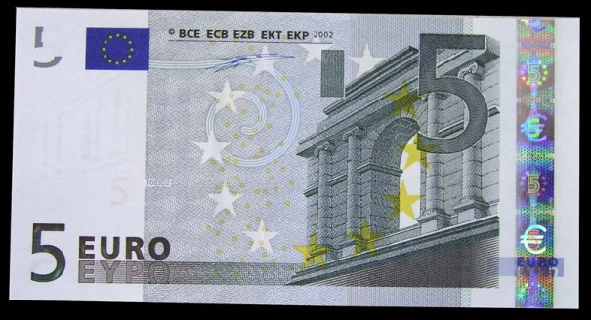
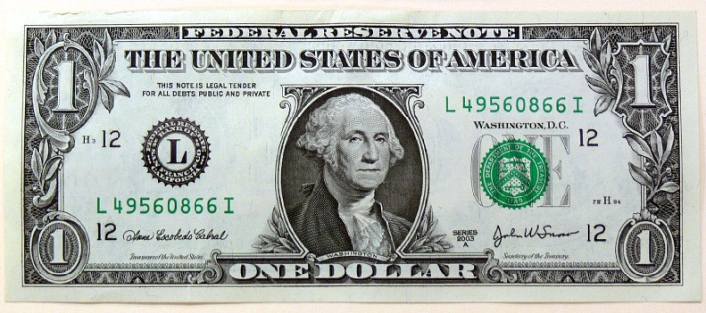
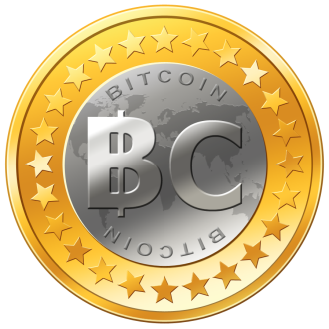

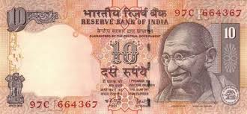

Currency is virtual and fake and real
US dollar is virtual (numbers in a bank)
US Dollar is fake – there is no guaranteed value
  “Fiat Currency”
  1 US$ is defined to be worth
  exactly 1 US$
US Dollar is real
  We use it as real money
Other cyber-currencies:
  Namecoin (2011),
  LiteCoin (2011),
  Peercoin (2012)
  Dogecoin (2013)

Slide 9
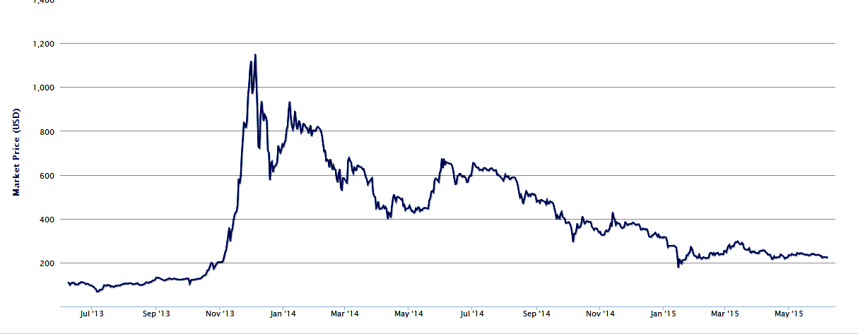
Bitcoin Prices in USD
$1200
$228
$17

Slide 10
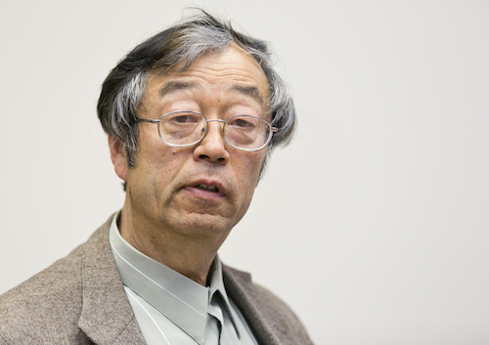
Satoshi?
No, Satoshi Nakamoto is a 64-year-old Japanese man living in California, probably...[NOT]

Slide 11
Where did Bitcoin come from?
A paper that was anonymously sent to a journal. By a person called “Satoshi Nakamoto”. Never published.
No one knows who Satoshi is, real name, age, gender, location.
  Some have claimed to have received emails from Satoshi.
A group of open source developers programmed the Bitcoin software and made it available
  Bitcoin software is easily obtained, servers can be set up
  People have set up bitcoin infrastructure
  Bitcoin exchanges convert national currencies to Bitcoins and vice versa, exchange rates are set by market values.
Bitcoin is P2P
Yes, it is a mystery, yet it is trusted.

Slide 12

Bitcoin Properties (and Gold)
Bitcoin is a digital thing, whose properties are similar to gold.
Bitcoin is difficult to create (or mine)
  In the beginning it was easy
  Now it is hard
  It is going to get harder, finite supply.
The total number of bitcoins is limited. Just like gold.
The value of bitcoin is what people are willing to pay for it.
  Or sell for it
Anyone can “make” a bitcoin. It is like finding gold.
Anyone can verify that a bitcoin is genuine.
  Counterfeiting is impossible

Slide 13
Bitcoin properties
Bitcoin is digital
Bitcoin is easy to transfer
  If Alice has 1 BTC, she can give it to Bob
  Transaction costs are very low
Bitcoin can be used to buy things
Bitcoin is anonymous (like paper money)
Bitcoins are divisible, one bicoin can be divided into 10⁸ smaller units.
Converting Bitcoins and other currencies are done via bitcoin exchanges
  MtGox is the most popular exchange

Slide 14
Finite Supply
The total number of Bitcoins that can be created is 21 million
  About 14.2 million has already been created (06/2015)
  New bitcoins will stop being created in 2140 (approx)
Current creation rate is 6 bitcoins every hour
  Rate in 2012 was 140/hour
  Bitcoin miners race each other to see who can create the coins. Adding compute power helps but not by much
  A self regulating protocol, it gets harder to create bitcoin, the more bitcoins are created
The control of bitcoin supply is not via policy but via protocol
  The bitcoin protocol defines a new coin as a hash value of that has a set of 0s and the number of zeros controls the difficulty

Slide 15
Cryptographic Basic – Large Numbers
Find a particular 256 bit (32 byte) number
Enumerate all numbers (finite) @ 1 billion/sec (1GHz)
2³⁰ | billion = giga 10^9 1,073,741,824 | 1 sec
2⁴⁰ | trillion = tera 10^12 1,099,511,627,776 | 18 mins
2⁵⁰ | 1,125,899,906,842,620 | 13 days
2⁶⁰ | 1,152,921,504,606,850,000 | 36 years
2⁹⁰ | 1*10^27 | 39 billion years
2¹²⁸ | 3*10^38 | 10 million-trillion years
2²⁵⁶ | 1*10^77 | 3*10^60 years
Total Number of Atoms on Earth: 2160

Slide 16
Cryptographic Basics
Nonce: A large (>128 bit) random number. No two nonces are equal
Cryptographic Hash
Not two inputs produce the same output hash!
  If you know the input, you can easily compute the hash
  You cannot find ANY input that produces a particular hash
Input Data Bits, large number
Hash
Function
256
bit hash

Slide 17
Cryptographic Basics
Public Key Encryption
Digital Signatures
Public key (k1)
Input (plaintext)
Encrypt
Output (ciphertext)
Encrypt
Plaintext (same as input)
Private key (k2)
Encrypt hash with private key
Hash of input
Input Document

Slide 18
What is Bitcoin? Again
Bitcoin transaction log
  A log of all transactions using bitcoints
  Contains the bitcoin and the originating wallet and the destination wallet
  A signature (digital signature) from the sending wallet
Bitcoin
  A date, a wallet ID and a segment of a transaction log
  and a hash value
  The last k-bits of the hash are all zeros.
  Changing k makes creating (mining) bitcoins harder

Slide 19
A New Bitcoin
A block of the transaction log, a nonce and a hash value
The has value must be lower than the current “target”
256 bit random number
+
hash
NONCE
0 0 0 0 0 _ _ _ _ _ _
Current Target (6/2015)
0000000000000000171A8B000000000000000000000000000000000000000000
Transaction log block

Slide 20
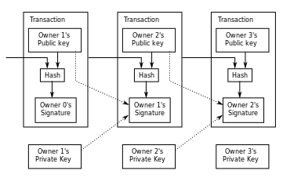
Transferred Bitcoin
Bitcoins are transferred from one wallet to another by adding a chain of transactions, signed by the sender (owner)
Senders and receivers have IDs, same as wallet ID

Slide 21
Global Transaction Log → Blockchain
Alice sends 1 BTC to Bob
Alice creates a log, signs it and this log is sent to Bob, as Bobs bitcoin
The log is also sent to a global log
Global logs are stored at P2P bitcoin log sites
Bob can check if Alice has sent the log to the global log
Global log checks if Alice sends the same bitcoin twice
  Make sure Alice does not cheat
Every transaction is known to everyone

Slide 22
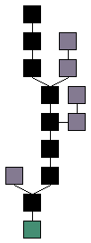
Blockchain
A blockchain is a copy of all transactions ever made on bitcoins
  Each block has a hash of previous block
  Can/will get large
  Can have splits (and orphan chains are merged back)
  Blocks in the main chain (black) are the blocks that go from the genesis block (green) to the current block.
Ensures complete transparency and no double spending
The distributed bitcoin network keeps a lot of copies of blockchains
  Scaling this system has received a lot of research attention

Slide 23
Bitcoin Wallets
Alice has one or more wallets
Wallets store bitcoins
  Alice’s wallet can be stored on Alice’s computer
Every wallet has an ID
The ID is the public key of the wallet, the private key is kept securely inside the wallet
Private key is used to sign transactions, public key is used to identify
  No certificate authorities exist
  “self signed”

Slide 24
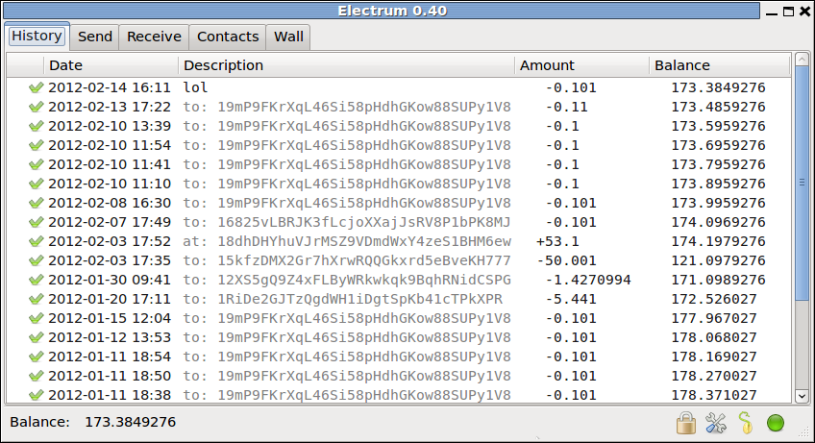
Wallet Transaction Log

Slide 25
Anonymity
Everything is public
  Every bitcoin wallet has an ID
  Every transaction is globally known
  Hence it is possible to know the amount of bitcoins in a wallet
Yet, bitcoins are anonymous?
Yes, if bitcoin wallet ID is not traced to a human ID
  Responsibility of wallet owner
  Multiple wallets/IDs make tracking harder

Slide 26
Security
Bitcoin is cryptographically secure
  Security is maintained by cryptographic functions, hash, public key encryption
All actions are public
  Bitcoin global logs check for fraudulet transactions and reject them
Forging bitcoins and blockchins is hard (infeasible)
No one has shown any flaws in the protocol
Bitcoins can be stolen (cash, gold)
Bitcoin spending is irreversible
Bitcoin wallets can be stolen
Bitcoins can be lost, if the wallet storage is lost
Bitcoins sending has risks, recipient can spoof!

Slide 27
Bitcoin Acceptance
New currency, acceptance is slow
Not many buyers and sellers take bitcoins
  But it is growing
Total value of Bitcoins: $1.5 billion USD
Transaction volume: About $30 million USD/day
Not known:
  Will bitcoins be a global currency some day?
  Will bitcoins replace currencies controlled by governments?

Slide 28
Where is this headed?
Mysterious…. Unknown….(exciting?)

