Slide 1
Chapter 4: Cluster Analysis (想分幾群自己決定， 不需要類別變數)
For use with Hair, Black, Babin and Anderson, Multivariate Data Analysis 8e © 2018 Cengage Learning EMEA

Slide 2
LEARNING OBJECTIVES
Upon completing this chapter, you should be able to do the following:
Define cluster analysis, its roles and its limitations.
Identify the types of research questions addressed by cluster analysis.
V Understand how interobject similarity is measured. (觀測值之間類似狀況，怎麼衡量兩群人相同否？ 要算類別變數distance 但自己要用對方法)
Understand why different distance measures are sometimes used.
Understand the differences between hierarchical（階層） and nonhierarchical clustering techniques. （通常是由下往上）
Know how to interpret the results from cluster analysis.
Follow the guidelines for cluster validation.
Factor重點：賦予每個factor名稱 vs cluster 給每群貼標籤
For use with Hair, Black, Babin and Anderson, Multivariate Data Analysis 8e © 2018 Cengage Learning EMEA

Slide 3
Overview
What is Cluster Analysis?
How Does Cluster Analysis Work?
Cluster Analysis Decision Process
Stage 1: Objectives of Cluster Analysis
Stage 2: Research Design in Cluster Analysis
Stage 3: Assumptions in Cluster Analysis
Stage 4: Deriving Clusters and Assessing Overall Fit
Stage 5: Interpretation of the Clusters
Stage 6: Validation and Profiling of the Clusters
Implications of Big Data Analytics（新名詞:unsupervised learning）
An Illustrative Example
For use with Hair, Black, Babin and Anderson, Multivariate Data Analysis 8e © 2018 Cengage Learning EMEA

Slide 4
What is Cluster Analysis?
Cluster Analysis as a Multivariate Technique
Conceptual Development with Cluster Analysis
Necessity of Conceptual Support in Cluster Analysis
For use with Hair, Black, Babin and Anderson, Multivariate Data Analysis 8e © 2018 Cengage Learning EMEA

Slide 5
Cluster Analysis Defined
Definition
Groups objects (respondents, products, firms, variables, etc.) so that objects in same cluster are similar and different from objects in all the other clusters. 將目標分群，群內變異小，群間變異大
Cluster Analysis as a Multivariate Technique
Cluster variate is the set of clustering variables used to measure similarity
Conceptual Development with Cluster analysis
Data reduction – reduces population to smaller number of homogeneous groups
Hypothesis Generation – means of developing or assessing hypotheses
Necessity of Conceptual Support
Strong conceptual support of existence of clusters helps negate criticisms:
Cluster analysis is descriptive, atheoretical（沒有太多理論）, and non-inferential（非推論的）
Cluster analysis will always create clusters（創造群）, regardless of the actual existence of any structure
The cluster solution is not generalizable because it is totally dependent upon cluster variate 統計方法通常希望有一般性，但分群通常無（?爭議?）
For use with Hair, Black, Babin and Anderson, Multivariate Data Analysis 8e © 2018 Cengage Learning EMEA

Slide 6
What is Cluster Analysis?
Cluster analysis . . . is a group of multivariate techniques whose primary purpose is to group objects based on the characteristics they possess.
It has been referred to as Q analysis(針對觀測值), typology construction, classification analysis, and numerical taxonomy(分類.
The essence of all clustering approaches is the classification of data as suggested by “natural” groupings of the data themselves.
For use with Hair, Black, Babin and Anderson, Multivariate Data Analysis 8e © 2018 Cengage Learning EMEA

Slide 7
How Does Cluster Analysis Work?
A Simple Example
Objective Versus Subjective Considerations
For use with Hair, Black, Babin and Anderson, Multivariate Data Analysis 8e © 2018 Cengage Learning EMEA

Slide 8
Scatter Diagram for Cluster Observations
Fundamental Question: How Many Clusters?
Frequency of eating out
Frequency of going to fast food restaurants
For use with Hair, Black, Babin and Anderson, Multivariate Data Analysis 8e © 2018 Cengage Learning EMEA

Slide 9
Potential Two, Three and Four Cluster Solutions
Frequency of eating out
Frequency of eating out
Frequency of going to fast food restaurants
Frequency of going to fast food restaurants
Frequency of eating out
Which one is correct?
Frequency of going to fast food restaurants
For use with Hair, Black, Babin and Anderson, Multivariate Data Analysis 8e © 2018 Cengage Learning EMEA

Slide 10
Three Basic Questions In A Cluster Analysis
How do we measure similarity?
We require a method of simultaneously comparing observations on the clustering variables. Several methods are possible, including the correlation between objects or perhaps a measure of their proximity in two-dimensional space such that the distance between observations indicates similarity.
How do we form clusters?
No matter how similarity is measured, the procedure must group those observations that are most similar into a cluster, thereby determining the cluster group membership of each observation for each set of clusters formed.
How many groups do we form?（重要的議題 群多要有群多的意義）
The final task is to select one cluster solution (i.e., set of clusters) as the final solution. In doing so, the researcher faces a trade-off: fewer clusters and less homogeneity within clusters versus a larger number of clusters and more within-group homogeneity.
For use with Hair, Black, Babin and Anderson, Multivariate Data Analysis 8e © 2018 Cengage Learning EMEA

Slide 11
Three Cluster Diagram Showing Between-Cluster and Within-Cluster Variation
Between-Cluster Variation = Maximize
Within-Cluster Variation = Minimize
For use with Hair, Black, Babin and Anderson, Multivariate Data Analysis 8e © 2018 Cengage Learning EMEA

Slide 12
Objective Versus Subjective Considerations
Cluster analysis has come under criticism for two key elements:
Subjectivity in selecting final solution
While there are empirical diagnostic measures to assist the researcher in selecting the final solution(s), there are no methods by which one solution is deemed optimal.
Thus, it still falls to the researcher to make the final decision as to the number of clusters
to accept as the final solution.
Judgment required of the researcher
Judgment of the researcher in selecting the characteristics to be used, the methods of combining clusters, and even the interpretation of cluster solutions makes any final solution unique to that researcher.
For use with Hair, Black, Babin and Anderson, Multivariate Data Analysis 8e © 2018 Cengage Learning EMEA

Slide 13
Cluster analysis Decision Process
Stage 1: Objectives of Cluster Analysis
Stage 2: Research Design in Cluster Analysis
Stage 3: Assumptions in Cluster Analysis
Stage 4: Deriving Clusters and Assessing Overall Fit
Stage 5: Interpretation of the Clusters
Stage 6: Validation and Profiling of the Clusters
For use with Hair, Black, Babin and Anderson, Multivariate Data Analysis 8e © 2018 Cengage Learning EMEA

Slide 14
Stage 1: Objectives of Cluster Analysis
Research Questions in Cluster Analysis
Selection of Clustering Variables
For use with Hair, Black, Babin and Anderson, Multivariate Data Analysis 8e © 2018 Cengage Learning EMEA

Slide 15
Primary Goal
to partition a set of objects into two or more groups based on the similarity of the objects for a set of specified characteristics (the cluster variate).
Two key issues:
The research questions being addressed, and
The variables used to characterize objects in the clustering process.
For use with Hair, Black, Babin and Anderson, Multivariate Data Analysis 8e © 2018 Cengage Learning EMEA

Slide 16
Research Questions in Cluster Analysis
How to form the taxonomy
creating an empirically based classification of objects.
How to simplify the data
grouping observations for further analysis.
Which relationships can be identified
revealing relationships among the observations within and between groups.
For use with Hair, Black, Babin and Anderson, Multivariate Data Analysis 8e © 2018 Cengage Learning EMEA

Slide 17
Selection of Clustering Variables
Variable Selection Is Critical Decision(放幾個變數做分群，分群效果會不同)
Clustering variables represent to sole means of measuring similarity among objects
As a result, the analysis is constrained based on the variables included.
Two Issues in Variable Selection . . .
Conceptual considerations 概念上的考量
Variables characterize the objects being clustered.
Relate specifically to the objectives of the cluster analysis.
Practical considerations.
Should always use the “best” variables available (i.e., little measurement error, etc.).
For use with Hair, Black, Babin and Anderson, Multivariate Data Analysis 8e © 2018 Cengage Learning EMEA

Slide 18
Rules of Thumb – Objectives of Cluster Analysis
Cluster analysis is used for:
Taxonomy description – identifying natural groups within the data.
Data simplification – the ability to analyze groups of similar observations instead of all individual observations.
Relationship identification – the simplified structure from cluster analysis portrays relationships not revealed otherwise.
Theoretical, conceptual and practical considerations must be observed when selecting clustering variables for cluster analysis:
Only variables that relate specifically to objectives of the cluster analysis are included, since “irrelevant” variables can not be excluded from the analysis once it begins.
Variables are selected which characterize the individuals (objects) being clustered.
For use with Hair, Black, Babin and Anderson, Multivariate Data Analysis 8e © 2018 Cengage Learning EMEA

Slide 19
Stage 2: Research Design in Cluster Analysis
Types and Number of Clustering Variables
Sample size
Outlier detection
Measuring object similarity
Data standardization
For use with Hair, Black, Babin and Anderson, Multivariate Data Analysis 8e © 2018 Cengage Learning EMEA

Slide 20
Types and Number of Clustering Variables
Types of Variables Included
Can employ either metric or non-metric, but generally not in mixed fashion.
Multiple measures of similarity for each type.
Number of Clustering Variables
Can suffer from “curse of dimensionality” 維度詛咒 when large number of variables analyzed.
Can have impact with as few as 20 variables.
Relevancy of Clustering Variables。（如何在分群獲取相對好的變數 待研究）
No internal method of ascertaining the relevancy of clustering variables.
Researcher should always include only those variables with strongest conceptual support.
For use with Hair, Black, Babin and Anderson, Multivariate Data Analysis 8e © 2018 Cengage Learning EMEA

Slide 21
Is the Sample Size Adequate?
The sample size required is not based on statistical considerations for inference testing, but rather:
Sufficient size is needed to ensure representativeness of the population and its underlying structure.
Of particular interest is the ability to detect small groups within the population.
Minimum group sizes are based on the relevance of each group to the research question and the confidence needed in characterizing that group.
Increasing sample size (e.g., 1000 observations), however, may pose problems for hierarchical clustering methods and require “hybrid” approaches
For use with Hair, Black, Babin and Anderson, Multivariate Data Analysis 8e © 2018 Cengage Learning EMEA

Slide 22
Detecting Outliers
Outliers can severely distort the representativeness of the results if they appear as structure (clusters) that are inconsistent with the research objectives
They should be removed if the outlier represents:
Aberrant observations not representative of the population.
Observations of small or insignificant segments within the population.
They should be retained if the outlier represents:
an under-sampling/poor representation of relevant groups in the population. In this case, the sample should be augmented to ensure representation of these groups.
Outliers can be identified based on the similarity measure by:
Finding observations with large distances from all other observations – pairwise similarities or summated measure of squared differences from mean of each clustering variable. Parcoord(HBAT5, col=rainbow(100))
Graphic profile diagrams or parallel coordinate graphs highlighting outlying cases.
Their appearance in cluster solutions as single-member or very small clusters.
For use with Hair, Black, Babin and Anderson, Multivariate Data Analysis 8e © 2018 Cengage Learning EMEA

Slide 23
Defining and Measuring Interobject Similarity
Interobject similarity
an empirical measure of correspondence, or resemblance, between objects to be clustered.
calculated across the entire set of clustering variables to allow for the grouping of observations and their comparison to each other.
Three methods most widely used in applications of cluster analysis:
Distance measures – most often used.
Correlational measures – less often used as they measure patterns, not distance.
Association measures – applicable for non-metric clustering variables.
For use with Hair, Black, Babin and Anderson, Multivariate Data Analysis 8e © 2018 Cengage Learning EMEA

Slide 24
Types of Distance Measures
Most widely used measure of similarity, with higher values representing greater dissimilarity (distance between cases), not similarity.
Many different distance measures, most common are:
Euclidean (straight line) distance is the most common measure of distance.
Squared Euclidean distance is the sum of squared distances and is the recommended measure for the centroid and Ward’s methods of clustering.
Mahalanobis distance (D²) accounts for variable intercorrelations and weights each variable equally. When variables are highly intercorrelated, Mahalanobis distance is most appropriate.
Given the sensitivity of some procedures to the similarity measure used, the researcher should employ several distance measures and compare the results from each with other results or theoretical/known patterns.
For use with Hair, Black, Babin and Anderson, Multivariate Data Analysis 8e © 2018 Cengage Learning EMEA

Slide 25
Data Standardization
Clustering variables should be standardized whenever possible to avoid problems resulting from the use of different scale values among clustering variables.
Two approaches to standardization
Relative to other cases:
most common standardization is Z scores.
Relative to other responses within an object
If groups are to be identified according to an individual’s response style, then within-case or row-centering standardization is appropriate.
For use with Hair, Black, Babin and Anderson, Multivariate Data Analysis 8e © 2018 Cengage Learning EMEA

Slide 26
Stage 3: Assumptions of Cluster Analysis
Structure Exists
Representativeness of the sample.
Impact of multicollinearity.
For use with Hair, Black, Babin and Anderson, Multivariate Data Analysis 8e © 2018 Cengage Learning EMEA

Slide 27
Three Assumptions Underlying Cluster Analysis
Structure Exists
Since cluster analysis will always generate a solution, researcher must assume that a “natural” structure of objects exists which is to be identified by the technique.
Representativeness of the Sample
Must be confident that the obtained sample is truly representative of the population.
Impact of multicollinearity
Multicollinearity among subsets of variables is an implicit “weighting” of the clustering variables
Potential remedies for multicollinear subsets of variables
Reduce the variables to equal numbers in each set of correlated measures.
Use a distance measure that compensates for the correlation, like Mahalanobis Distance.
Take a proactive approach and include only cluster variables that are not highly correlated.
For use with Hair, Black, Babin and Anderson, Multivariate Data Analysis 8e © 2018 Cengage Learning EMEA

Slide 28
Stage 4: Deriving Clusters and Assessing Overall Fit
Selecting the partitioning procedure.
Potentially respecify initial cluster solutions by eliminating outliers or small clusters.
Determining the number of clusters.
Other clustering approaches.
For use with Hair, Black, Babin and Anderson, Multivariate Data Analysis 8e © 2018 Cengage Learning EMEA

Slide 29
Two Approaches to Partitioning Observations
Hierarchical
Most common approach is where all objects start as separate clusters and then are joined sequentially such that each step forms a new cluster joining by two clusters at a time until only a single cluster remains.
Non-hierarchical
the number of clusters is specified by the analyst and then the set of objects are formed into that set of groupings.
For use with Hair, Black, Babin and Anderson, Multivariate Data Analysis 8e © 2018 Cengage Learning EMEA

Slide 30
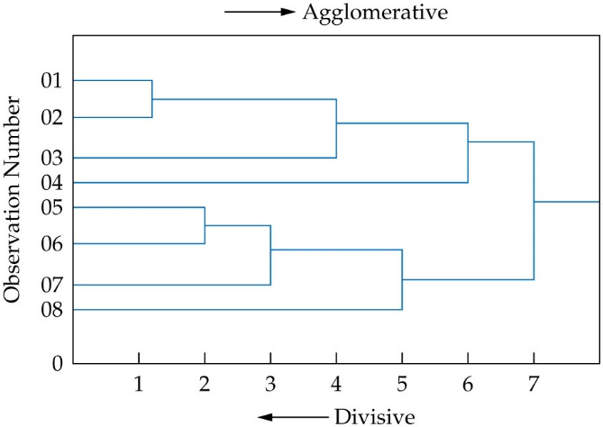
Two Types of Hierarchical Clustering Procedures
Agglomerative Methods
Buildup: all observations start as individual clusters, join together sequentially.
Divisive Methods
Breakdown: initially all observations in a single cluster, then divided into smaller clusters.
For use with Hair, Black, Babin and Anderson, Multivariate Data Analysis 8e © 2018 Cengage Learning EMEA

Slide 31
How Agglomerative Hierarchical Approaches Work?
A multi-step process
Start with all observations as their own cluster.
Using the selected similarity measure and agglomerative algorithm, combine the two most similar observations into a new cluster, now containing two observations.
Repeat the clustering procedure using the similarity measure/agglomerative algorithm to combine the two most similar observations or clusters (i.e., combinations of observations) into another new cluster.
Continue the process until all observations are in a single cluster.
For use with Hair, Black, Babin and Anderson, Multivariate Data Analysis 8e © 2018 Cengage Learning EMEA

Slide 32
Clustering Algorithms -- Agglomerative
Provides a method for combining clusters which have more than one observation
Most widely used algorithms
Single Linkage (nearest neighbor) – shortest distance from any object in one cluster to any object in the other.
Complete Linkage (farthest neighbor) – based on maximum distance between observations in each cluster.
Average Linkage – based on the average similarity of all individuals in a cluster.
Centroid Method – measures distance between cluster centroids.
Ward’s Method – based on the total sum of squares within clusters.
For use with Hair, Black, Babin and Anderson, Multivariate Data Analysis 8e © 2018 Cengage Learning EMEA

Slide 33
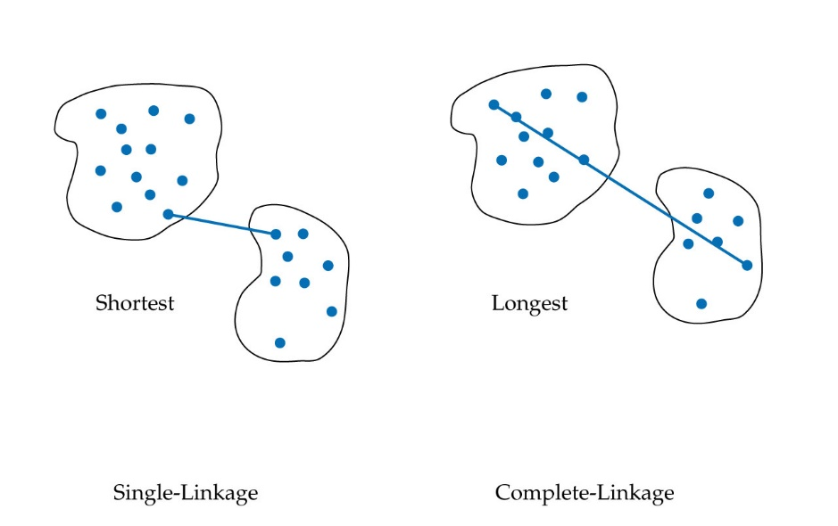
Single-Linkage Versus Complete Linkage
Single linkage: Similarity based only on Complete linkage: Similarity based only on
two closest observations. two farthest observations.
For use with Hair, Black, Babin and Anderson, Multivariate Data Analysis 8e © 2018 Cengage Learning EMEA

Slide 34
Comparing the Agglomerative Algorithms
Single-linkage
probably the most versatile algorithm, but poorly delineated cluster structures within the data produce unacceptable snakelike “chains” for clusters.
Complete linkage
eliminates the chaining problem, but only considers the outermost observations in a cluster, thus impacted by outliers.
Average linkage
generates clusters with small within-cluster variation and less affected by outliers.
Centroid linkage
like average linkage, is less affected by outliers.
Ward’s method
most appropriate when the researcher expects somewhat equally sized clusters, but easily distorted by outliers.
For use with Hair, Black, Babin and Anderson, Multivariate Data Analysis 8e © 2018 Cengage Learning EMEA

Slide 35
How Nonhierarchical Approaches Work?
Determine number of clusters to be extracted
Specify cluster seeds.
Researcher specified.
Sample generated:
SAS FASTCLUS = first cluster seed is first observation in data set with no missing values.
SPSS QUICK CLUSTER = seed points are selected randomly from all observations.
Assign each observation to one of the seeds based on similarity.
Sequential Threshold = selects one seed point, develops cluster; then selects next seed point and develops cluster, and so on. Observation cannot be re-assigned to another cluster following its original assignment.
Parallel Threshold = sets all seed points simultaneously, then develops clusters.
Optimization = allow for re-assignment of observations based on the sequential proximity of observations to clusters formed during the clustering process.
For use with Hair, Black, Babin and Anderson, Multivariate Data Analysis 8e © 2018 Cengage Learning EMEA

Slide 36
Pros and Cons of Hierarchical Methods
Pros
Simplicity – generates tree-like structure which is simplistic portrayal of process.
Measures of similarity – multiple measures to address many situations.
Speed – generate entire set of cluster solutions in single analysis.
Cons
Permanent combinations – once joined, clusters are never separated.
Impact of outliers – outliers may appear as single object or very small clusters.
Large samples – not amenable to very large samples, may require samples of large populations.
For use with Hair, Black, Babin and Anderson, Multivariate Data Analysis 8e © 2018 Cengage Learning EMEA

Slide 37
Pros and Cons of Nonhierarchical Methods
Pros
Results are less susceptible to:
outliers in the data,
the distance measure used, and
the inclusion of irrelevant or inappropriate variables.
Can easily analyze very large data sets
Cons
Best results require knowledge of seed points.
Difficult to guarantee optimal solution.
Generates typically only spherical and more equally sized clusters.
Less efficient in examining wide number of cluster solutions.
For use with Hair, Black, Babin and Anderson, Multivariate Data Analysis 8e © 2018 Cengage Learning EMEA

Slide 38
Selecting Between Hierarchical and Nonhierarchical
Hierarchical clustering solutions are preferred when:
A wide range, even all, alternative clustering solutions is to be examined.
The sample size is moderate (under 300-400, not exceeding 1,000) or a sample of the larger dataset is acceptable.
Nonhierarchical clustering methods are preferred when:
The number of clusters is known and initial seed points can be specified according to some practical, objective or theoretical basis.
There is concern about outliers since nonhierarchical methods generally are less susceptible to outliers.
For use with Hair, Black, Babin and Anderson, Multivariate Data Analysis 8e © 2018 Cengage Learning EMEA

Slide 39
Combining Hierarchical and Nonhierachical Approaches
Combination approach – using a hierarchical approach followed by a nonhierarchical approach is often advisable.
A nonhierarchical approach is used to select the number of clusters and profile cluster centers that serve as initial cluster seeds in the nonhierarchical procedure.
A nonhierarchical method then clusters all observations using the seed points to provide more accurate cluster memberships.
For use with Hair, Black, Babin and Anderson, Multivariate Data Analysis 8e © 2018 Cengage Learning EMEA

Slide 40
Should The Cluster Analysis Be Respecified
Primary focus
Identification of single object or very small clusters that represent disparate observations that do not match the research objectives.
Similar considerations to outlier identification and many times operate on the same conditions in the sample.
If respecification occurs
Should reanalyze remaining data, especially when using hierarchical procedures.
For use with Hair, Black, Babin and Anderson, Multivariate Data Analysis 8e © 2018 Cengage Learning EMEA

Slide 41
Determining the Number of Clusters
Stopping rules
Criteria used with hierarchical techniques to identify potential cluster solutions.
Foundational principle – a natural increase in heterogeneity comes from the reduction in number of clusters.
Common to all stopping rules:
evaluating the trend in heterogeneity across cluster solutions to identify marked increases.
substantive increases in this trend indicate relatively distinct clusters were joined and that the cluster structure before joining is a potential candidate for the final solution.
Issues in applying stopping rules
The ad hoc procedures must be computed by the researcher and often involve fairly complex approaches.
Many times measures are software-specific.
For use with Hair, Black, Babin and Anderson, Multivariate Data Analysis 8e © 2018 Cengage Learning EMEA

Slide 42
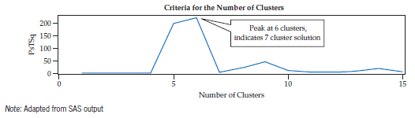
Two Classes of Stopping Rules
Class 1: Measures of Heterogeneity Change
measures heterogeneity change between cluster solutions at each successive decrease in the number of clusters. A cluster solution is a candidate for the final cluster solution when the heterogeneity change measure makes a sudden jump.
Measures of heterogeneity change
Percentage Changes in Heterogeneity – simple percentage change in heterogeneity.
Measures of variance change – use of root mean square standard deviation (RMSSTD) to compare solutions.
Statistical measures of heterogeneity change – pseudo T² statistic compares goodness-of-fit between k and k-1 clusters. Thus, large pseudo T² value at six clusters indicates a seven cluster solution is the possible final solution.
For use with Hair, Black, Babin and Anderson, Multivariate Data Analysis 8e © 2018 Cengage Learning EMEA

Slide 43
Class 2: Direct Measures of Heterogeneity
directly measure heterogeneity of each cluster solution and then allow analyst to evaluate each cluster solution against a criterion measure.
Measures of heterogeneity:
Comparative cluster heterogeneity – the cubic clustering criterion (CCC) is a SAS measure of the deviation of the clusters from an expected multivariate normal distribution. Choose cluster solution(s) with high values of CCC.
Statistical significance of cluster variation – pseudo F statistic measures the separation among all the clusters by the ratio of between-cluster variance (separation of clusters) to within-cluster variance (homogeneity of clusters). Higher values indicate a possible cluster solution.
Internal validation index – characterize a cluster solution on two dimensions: separation and compactness. Common measure is the Dunn index ratio, the ratio between the minimal within-cluster distance to maximal between-cluster distance. Higher values indicate better solutions.
For use with Hair, Black, Babin and Anderson, Multivariate Data Analysis 8e © 2018 Cengage Learning EMEA

Slide 44
Rules of Thumb – Deriving The Final Cluster Solution
No single objective procedure is available to determine the correct number of clusters; rather the researcher can evaluate alternative cluster solutions on two general types of stopping rules:
Measures of heterogeneity change:
These measures, whether they be percentage changes in heterogeneity, measures of variance change (RMSSTD) or statistical measure of change (pseudo T²), all evaluate the change in heterogeneity when moving from k to k - 1 clusters.
Candidates for a final cluster solution are those cluster solutions which preceded a large increase in heterogeneity by joining two clusters (i.e., a large change in heterogeneity going from k to k – 1 clusters would indicate that the k cluster solution is better).
Direct measures of heterogeneity:
These measures directly reflect the compactness and separation of a specific cluster solution. These measures are compared across a range of cluster solutions, with the cluster solution(s) exhibiting more compactness and separation being preferred.
Among the most prevalent measures are the CCC (cubic clustering criterion), a statistical measure of cluster variation (pseudo F statistic) or the internal validation index (Dunn's index).
For use with Hair, Black, Babin and Anderson, Multivariate Data Analysis 8e © 2018 Cengage Learning EMEA

Slide 45
Additional Approaches to Clustering
Density-based approach
Fundamental principle – clusters can be identified by “dense” clusters of objects within the sample, separated by regions of lower object density.
Researcher must decide
ε, the radius around a point that defines a point’s neighborhood, and
the minimum number of objects (minObj) necessary within a neighborhood to define it a cluster.
Has advantages of
Ability to identify clusters of any arbitrary shape
Ability to process very large samples,
Requires specification of only two parameters,
No prior knowledge of number of clusters,
Explicit designation of outliers as separate from objects assigned to clusters,
Applicable to a “mixed” set of clustering variables (i.e., both metric and nonmetric).
For use with Hair, Black, Babin and Anderson, Multivariate Data Analysis 8e © 2018 Cengage Learning EMEA

Slide 46
Additional Approaches to Clustering
Model-Based Approach
varies from other approaches in that it is a statistical model versus algorithmic.
uses differing probability distributions of objects as the basis for forming groups rather than groupings of similarity in distance or high density.
basic model – mixture model where objects are assumed to be represented by a mixture of probability distributions (known as components), each representing a different cluster.
Advantages
Can be applied to any combination of clustering variables (metric and/or nonmetric).
Statistical tests are available to compare different models and determine best model fit to define best cluster solution.
Missing data can be directly handled.
No scaling issues or transformations of variables needed.
Once the cluster solution is finalized, can include antecedent/predictor and outcome/validation variables.
For use with Hair, Black, Babin and Anderson, Multivariate Data Analysis 8e © 2018 Cengage Learning EMEA

Slide 47
Stage 5: Interpretation of the Clusters
For use with Hair, Black, Babin and Anderson, Multivariate Data Analysis 8e © 2018 Cengage Learning EMEA

Slide 48
Cluster Interpretation
Involves examining each cluster in terms of the cluster variate to name or assign a label accurately describing the nature of the clusters.
The cluster centroid, a mean profile of the cluster on each clustering variable, is particularly useful in the interpretation stage.
Interpretation involves examining the distinguishing characteristics of each cluster’s profile and identifying substantial differences between clusters.
Cluster solutions failing to show substantial variation indicate other cluster solutions should be examined.
The cluster centroid should also be assessed for correspondence with the researcher’s prior expectations based on theory or practical experience.
For use with Hair, Black, Babin and Anderson, Multivariate Data Analysis 8e © 2018 Cengage Learning EMEA

Slide 49
Stage 6: Validation and Profiling of the Clusters
Validation
Profiling
For use with Hair, Black, Babin and Anderson, Multivariate Data Analysis 8e © 2018 Cengage Learning EMEA

Slide 50
Validation of the Final Cluster Solution
Validation is essential in cluster analysis since the clusters are descriptive of structure and require additional support for their relevance.
Two approaches
Cross-validation – empirically validates a cluster solution by creating two sub-samples (randomly splitting the sample) and then comparing the two cluster solutions for consistency with respect to number of clusters and the cluster profiles.
Criterion validity – achieved by examining differences on variables not included in the cluster analysis but for which there is a theoretical and relevant reason to expect variation across the clusters.
For use with Hair, Black, Babin and Anderson, Multivariate Data Analysis 8e © 2018 Cengage Learning EMEA

Slide 51
Profiling A Cluster Solution
Describing the characteristics of each cluster on a set of additional variables (not the clustering variables) to further understand the differences between clusters
Examples include descriptive variables (e.g., demographics) as well as other outcome-related measures.
Provides insight to researchers as to nature and character of the clusters.
Clusters should differ on these relevant dimensions. This typically involves the use of discriminant analysis or ANOVA.
For use with Hair, Black, Babin and Anderson, Multivariate Data Analysis 8e © 2018 Cengage Learning EMEA

Slide 52
Rules of Thumb – Deriving the Final Cluster Solution
There is no single objective procedure to determine the ‘correct’ number of clusters.
Rather the researcher must evaluate alternative cluster solutions on the following considerations to select the “best” solution:
Single-member or extremely small clusters are generally not acceptable and should generally be eliminated.
For hierarchical methods, several ad hoc stopping rules are available to indicate the number of clusters based on the rate of change in a total similarity measure as the number of clusters increases or decreases or measures of heterogeneity.
All clusters should be significantly different across the set of clustering variables.
Cluster solutions ultimately must have theoretical validity assessed through external validation.
For use with Hair, Black, Babin and Anderson, Multivariate Data Analysis 8e © 2018 Cengage Learning EMEA

Slide 53
Implications of Big data Analytics
For use with Hair, Black, Babin and Anderson, Multivariate Data Analysis 8e © 2018 Cengage Learning EMEA

Slide 54
Implications for Big Data Analytics
Primary advantage
Simplification by reducing the large number of observations into a much smaller number of groupings from which the general nature and character of the entire dataset can be observed.
Challenges
Increasing sample sizes pose difficulties for clustering methods, particularly hierarchical methods.
Clustering high-dimensional data creates difficulties in:
establishing object similarity.
ensuring variable relevancy.
For use with Hair, Black, Babin and Anderson, Multivariate Data Analysis 8e © 2018 Cengage Learning EMEA

Slide 55
HBAT Cluster Illustrative Example
For use with Hair, Black, Babin and Anderson, Multivariate Data Analysis 8e © 2018 Cengage Learning EMEA

Slide 56
Steps in Cluster Analysis
Select the variables.
Decide how many clusters to use.
Describe the characteristics of the derived clusters using demographics, psychographics, etc.
For use with Hair, Black, Babin and Anderson, Multivariate Data Analysis 8e © 2018 Cengage Learning EMEA

Slide 57
Stage 1: Objectives of Cluster Analysis
Primary Objective
develop a taxonomy that segments objects (HBAT customers) into groups with similar perceptions.
Once identified, strategies with different appeals can be formulated for the separate groups—the requisite basis for market segmentation.
Clustering Variables
surrogate variables based on EFA analysis (Chapter 3)
X₆ product quality (representative of the factor Product Value)
X₈ technical support (representative of the factor Technical Support)
X₁₂ salesforce image (representative of the factor Marketing)
X₁₅ new product development (not included in extracted factors)
X₁₈ delivery speed (representative of the factor Post-sale Customer Service)
For use with Hair, Black, Babin and Anderson, Multivariate Data Analysis 8e © 2018 Cengage Learning EMEA

Slide 58
Stages 2 and 3: Research Design and Assumtpions in Cluster Analysis
Stage 2: Research Design of Cluster Analysis
Detecting Outliers
Two observations – 6 and 87 – are candidates for outlier designation
Defining Similarity
Squared Euclidean distance chosen given that multicollinearity is minimal
Sample Size
Sample of 100 is sufficient to distinguish segments of relevant size (minimum 10%)
Standardization
No standardization employed since all variables on same response scale
Stage 3: Assumptions of Cluster Analysis
Sample Representativeness
Random sampling in data collection ensured sample representativeness
Multicollinearity
Minimized by using surrogate variables for factors found in EFA (see Chapter 3)
For use with Hair, Black, Babin and Anderson, Multivariate Data Analysis 8e © 2018 Cengage Learning EMEA

Slide 59
Stages 4-6: Hierarchical and Nonhierarchical Methods
A Two-Part Procedure
Part 1: Partitioning
A hierarchical procedure was used to identify a preliminary set of cluster solutions as a basis for determining the appropriate number of clusters.
Part 2: Fine Tuning
Use of a nonhierarchical procedures to “fine-tune” the results and then profile and validate the final cluster solution.
The hierarchical and nonhierarchical procedures from IBM SPSS and SAS are used in this analysis, and comparable results would be obtained with most other clustering programs.
For use with Hair, Black, Babin and Anderson, Multivariate Data Analysis 8e © 2018 Cengage Learning EMEA

Slide 60
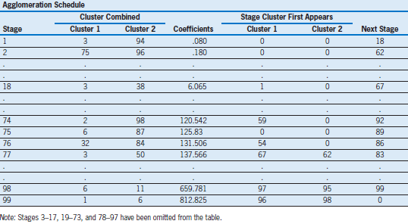
Part 1: A Hierarchical Analysis – Initial Analysis
Initial Cluster Results
Two potential outliers identified earlier (cases 6 and 87) do not form a cluster until stage 75 and then join again at stage 89.
As a result, these two cases are designated as outliers and omitted from the subsequent analysis.
The hierarchical method is performed again with 98 observations included.
For use with Hair, Black, Babin and Anderson, Multivariate Data Analysis 8e © 2018 Cengage Learning EMEA

Slide 61
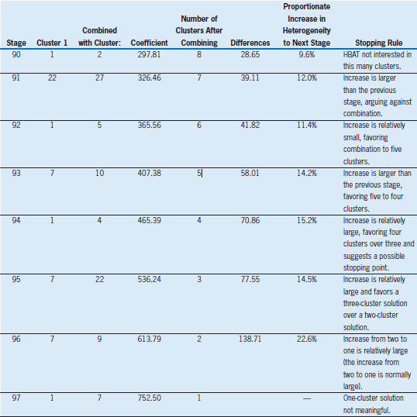
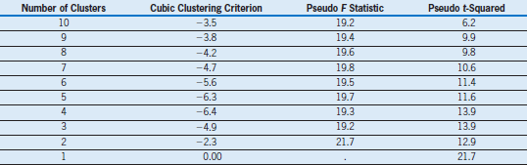
Part 1: A Hierarchical Analysis – Respecified Analysis
Various Stopping Rules:
Proportionate Change in Heterogeneity – four cluster solution seems most distinct, but three and five cluster solutions also possible
Pseudo T² – values indicate 4 or 5 clusters
CCC – does not identify any distinct solution
Pseudo F – little variation, possibly five cluster solution
Result – four cluster solution
For use with Hair, Black, Babin and Anderson, Multivariate Data Analysis 8e © 2018 Cengage Learning EMEA

Slide 62
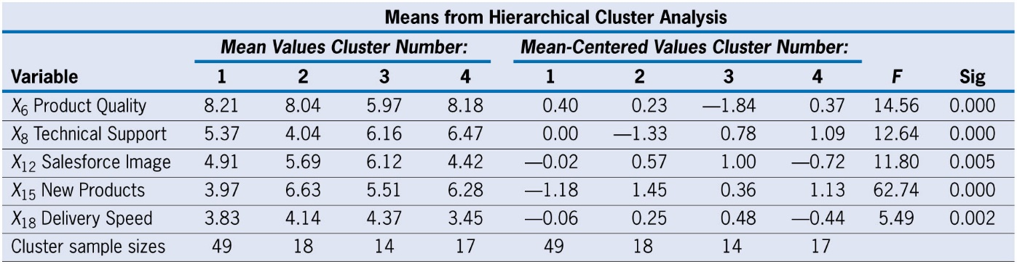
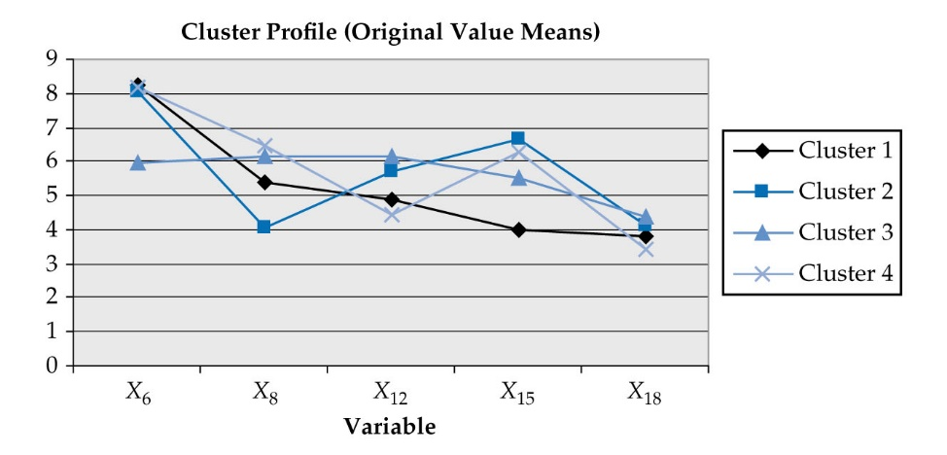
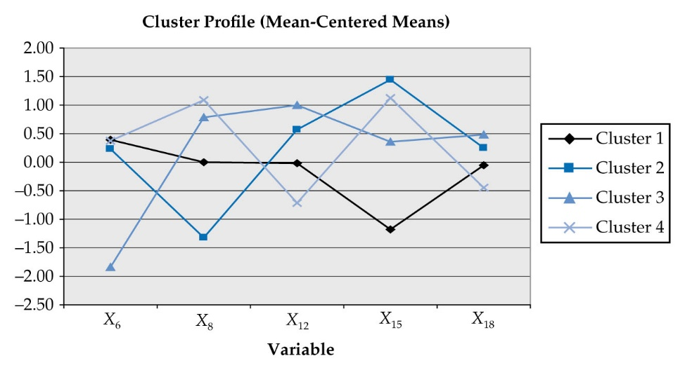
Step 5: Profiling the Hierarchical Cluster Results
Four Cluster Solution
Statistically significant differences across clusters for all five clustering variables.
Profiles
Cluster 1 – 49 observations with relatively lower mean on X₁₅ (New Products) than the other three clusters.
Cluster 2 – 18 observations and is best characterized by two variables: a very low mean on X₈ (Technical Support) and highest score on X₁₅ (New Products).
Cluster 3 – 14 observations and is best characterized by a relatively low score on X₆ (product quality).
Cluster 4 – 17 observations and characterized by a relatively low score on X₁₂ (Salesforce Image)
For use with Hair, Black, Babin and Anderson, Multivariate Data Analysis 8e © 2018 Cengage Learning EMEA

Slide 63
Part 2: A Nonhierarchical Cluster Analysis
The results of Part 1 (Hierarchical Analysis) are used to determine the number of clusters – 4
The nonhierarchical method is used to develop an “optimal” four cluster solution
The resulting four cluster solution will be validated on a series of related outcome measures
For use with Hair, Black, Babin and Anderson, Multivariate Data Analysis 8e © 2018 Cengage Learning EMEA

Slide 64
Stage 4: Deriving Clusters and Assessing Overall Fit
Two factors must be determined:
How will seed points for clusters be determined?
Employed sample-generating process, specifically randomly selected observations to act as seed points.
What clustering algorithm will be used?
K-means optimizing algorithm.
allows for reassignment of observations among clusters until a minimum level of heterogeneity is reached. Using this algorithm, observations are initially grouped to the closest cluster seed. When all observations are assigned, each observation is evaluated to see if it is still in the closest cluster. If it is not, it is reassigned to a closer cluster. The process continues until the homogeneity within clusters cannot be increased by further movement (reassignment) of observations between clusters.
For use with Hair, Black, Babin and Anderson, Multivariate Data Analysis 8e © 2018 Cengage Learning EMEA

Slide 65
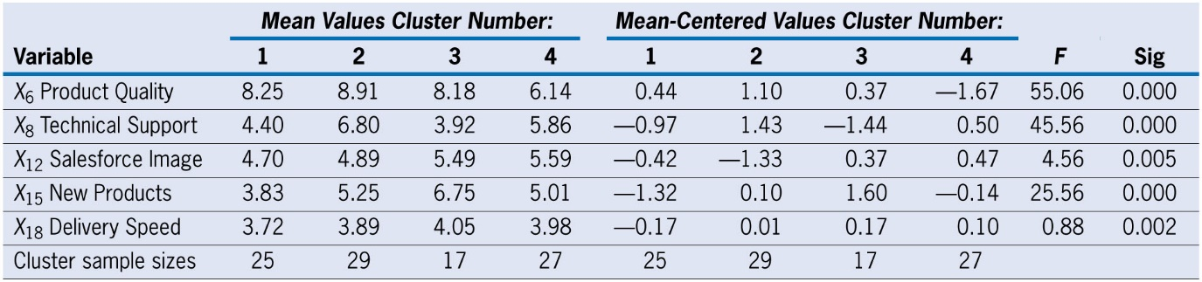
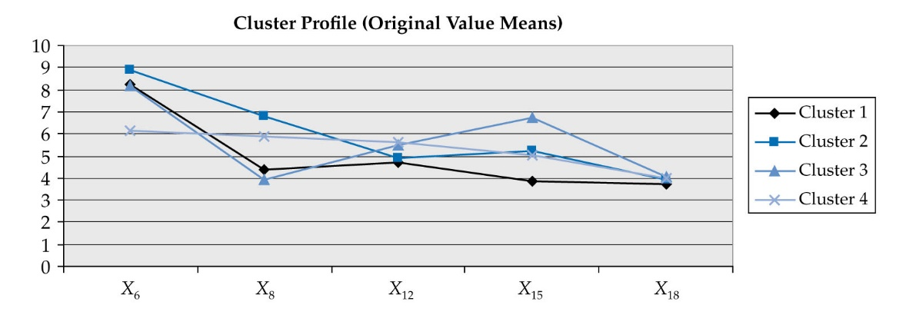
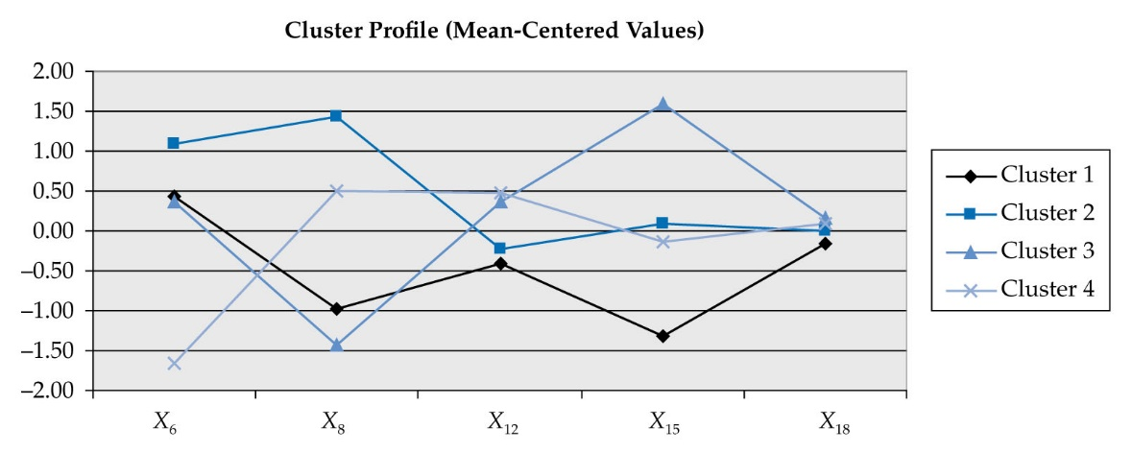
Step 5: Profiling the Nonhierarchical Cluster Results
Four Cluster Solution
Statistically significant differences across clusters for four of the five clustering variables
Profiles
Cluster 1 – 25 observations and most distinguished by a relatively low mean for new products (X₁₅). Means for the other variables (except product quality) also are relatively low.
Cluster 2 – distinguished by relatively higher means on technical support (X₈) and product quality (X₆).
Cluster 3 – 17 observations and is distinguished by a relatively higher mean for new products (X₁₅) and relatively lower mean for technical support (X₈)
Cluster 4 – 27 observations and distinguished by the lowest mean of all clusters on product quality (X₆) and relatively average on other variables
For use with Hair, Black, Babin and Anderson, Multivariate Data Analysis 8e © 2018 Cengage Learning EMEA

Slide 66
Stage 6: Validation and Profiling the Clusters
Validation
Stability – the four-group nonhierarchical cluster solution is examined by comparing two different solutions using sample-generated seed points.
Criterion validity – assess statistical significance of cluster differences on four outcome measures of relevance to research objectives.
MANOVA and individual ANOVAs all significant, indicating criterion validity.
Profiling
Profiling of clusters on variables not included as clustering variables to assess practical significance and theoretical basis of cluster solution.
Five characteristics – X₁ (Customer Type), X₂ (Industry Type), X₃ (Firm Size), X₄ (Region), and X₅ (Distribution System).
Three characteristics (X₁, X₂ and X₄)exhibited significant differences, thus providing additional support to practical relevance and theoretical basis.
For use with Hair, Black, Babin and Anderson, Multivariate Data Analysis 8e © 2018 Cengage Learning EMEA

Slide 67
Cluster Analysis Learning Checkpoint
Why might we use cluster analysis?
What are the three major steps in cluster analysis?
How do you decide how many clusters to extract?
Why do we validate clusters?
For use with Hair, Black, Babin and Anderson, Multivariate Data Analysis 8e © 2018 Cengage Learning EMEA

