Slide 1
Perspective projection
Derivation and explanation of perspective projection matrix in OpenGL

Slide 2


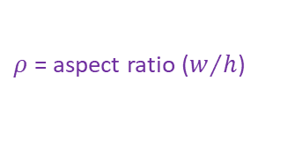






The perspective frustum
$$w$$
$ρ$ = aspect ratio ($w/h$)
$$y$$
$$h$$
$$α$$
$$z={−d}_{far}$$
$$z={−d}_{near}$$
$$C$$
$α$ = vertical FOV
$$x$$
$$z$$

Slide 3













Perspective effect on the Y coordinate
$$y$$
$$\frac{y_{near}}{y_{v}}=\frac{{−d}_{near}}{z_{v}}$$
$$y_{near}=\frac{{−d}_{near}}{z_{v}}y_{v}$$
$$⇒$$
$$\left(1\right)$$
$$y_{v}$$
$$p_{v}=\left(x_{v},y_{v},z_{v}\right)$$
$$y_{near}$$
$$z$$
$$0$$
$$−d_{near}$$
$$z_{v}$$
$${−d}_{far}$$

Slide 4















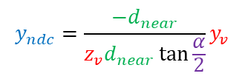
Perspective effect on the Y coordinate
$$y$$
$$\frac{y_{near}}{y_{v}}=\frac{{−d}_{near}}{z_{v}}$$
$$y_{near}=\frac{{−d}_{near}}{z_{v}}y_{v}$$
$$⇒$$
$$\left(1\right)$$
$$y_{v}$$
$$p_{v}=\left(x_{v},y_{v},z_{v}\right)$$
$$y_{max}$$
$$y_{near}$$
$$\frac{α}{2}$$
$$\frac{y_{max}}{d_{near}}=\tan{\frac{α}{2}}$$
$$⇒$$
$$y_{max}=d_{near}\tan{\frac{α}{2}}$$
$$\left(2\right)$$
$$z$$
$$0$$
$$−d_{near}$$
$$z_{v}$$
$${−d}_{far}$$
$$y_{min}$$
$$α$$
$$y_{ndc}=\frac{\frac{{−d}_{near}}{z_{v}}y_{v}}{d_{near}\tan{\frac{α}{2}}}$$
$$y_{ndc}=\frac{y_{near}}{y_{max}}$$
$$y_{ndc}=\frac{{−d}_{near}}{z_{v}d_{near}\tan{\frac{α}{2}}}y_{v}$$
$$y_{ndc}=\frac{y_{v}}{−z_{v}\tan{\frac{α}{2}}}$$
$$\left(3\right)$$
$$⇒$$
$$⇒$$
$$⇒$$

Slide 5


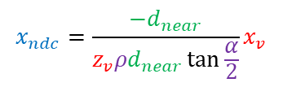


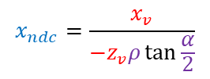

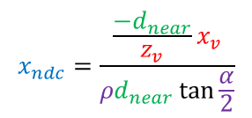




Perspective effect on the X and Y coordinates
$$\frac{x_{near}}{x_{v}}=\frac{{−d}_{near}}{z_{v}}$$
$$⇒$$
$$x_{near}=\frac{{−d}_{near}}{z_{v}}x_{v}$$
$$\left(4\right)$$
$$x_{max}=ρy_{max}$$
$$⇒$$
$$x_{max}=ρd_{near}\tan{\frac{α}{2}}$$
$$\left(5\right)$$
$$x_{ndc}=\frac{\frac{{−d}_{near}}{z_{v}}x_{v}}{{ρd}_{near}\tan{\frac{α}{2}}}$$
$$x_{ndc}=\frac{x_{near}}{x_{max}}$$
$$x_{ndc}=\frac{{−d}_{near}}{z_{v}{ρd}_{near}\tan{\frac{α}{2}}}x_{v}$$
$$x_{ndc}=\frac{x_{v}}{−z_{v}ρ\tan{\frac{α}{2}}}$$
$$\left(6\right)$$
$$⇒$$
$$⇒$$
$$⇒$$

Slide 6



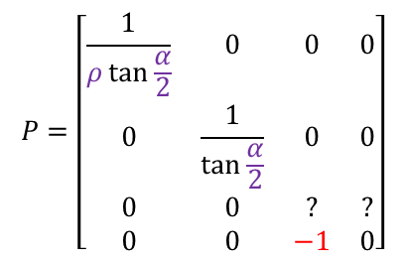


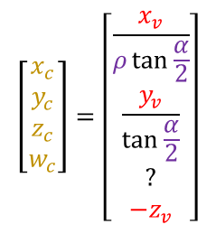
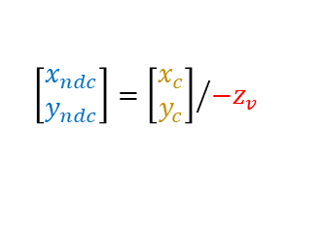
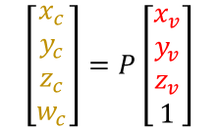
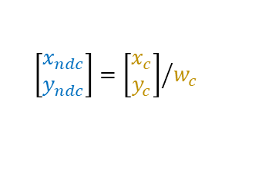
Projection matrix for X and Y
$$P=\left[\begin{matrix}\frac{1}{ρ\tan{\frac{α}{2}}} & 0 & 0 & 0 \\ 0 & \frac{1}{\tan{\frac{α}{2}}} & 0 & 0 \\ 0 & 0 & ? & ? \\ 0 & 0 & −1 & 0\end{matrix}\right]$$
$$\left[\begin{matrix}x_{c} \\ y_{c} \\ z_{c} \\ w_{c}\end{matrix}\right]=\left[\begin{matrix}\frac{x_{v}}{ρ\tan{\frac{α}{2}}} \\ \frac{y_{v}}{\tan{\frac{α}{2}}} \\ ? \\ −z_{v}\end{matrix}\right]$$
$$\left[\begin{matrix}x_{c} \\ y_{c} \\ z_{c} \\ w_{c}\end{matrix}\right]=P\left[\begin{matrix}x_{v} \\ y_{v} \\ z_{v} \\ 1\end{matrix}\right]$$
$$\left(7\right)$$
$$⇒$$
$$\left(8\right)$$
$$\left[\begin{matrix}x_{ndc} \\ y_{ndc}\end{matrix}\right]={\left[\begin{matrix}x_{c} \\ y_{c}\end{matrix}\right]}/{−z_{v}}$$
$$⇒$$
$$\left[\begin{matrix}x_{ndc} \\ y_{ndc}\end{matrix}\right]={\left[\begin{matrix}x_{c} \\ y_{c}\end{matrix}\right]}/{w_{c}}$$
$$\left(9\right)$$

Slide 7
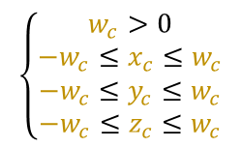



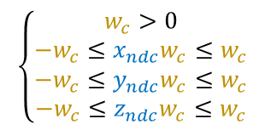
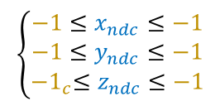

Clipping
Clipping
$$⇒$$
$$\left\{\begin{aligned}−1≤x_{ndc}≤−1 \\ −1≤y_{ndc}≤−1 \\ {−1}_{c}≤z_{ndc}≤−1\end{aligned}\right.$$
$$\left\{\begin{aligned}w_{c}>0 \\ −w_{c}≤x_{ndc}w_{c}≤w_{c} \\ −w_{c}≤y_{ndc}w_{c}≤w_{c} \\ −w_{c}≤z_{ndc}w_{c}≤w_{c}\end{aligned}\right.$$
$$\left\{\begin{aligned}w_{c}>0 \\ −w_{c}≤x_{c}≤w_{c} \\ −w_{c}≤y_{c}≤w_{c} \\ −w_{c}≤z_{c}≤w_{c}\end{aligned}\right.$$
$$⇒$$
$$⇒$$
$$\left(10\right)$$

Slide 8
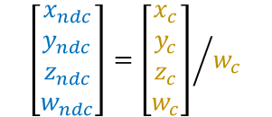


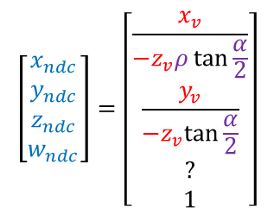
Clip space coordinate
$$\left[\begin{matrix}x_{ndc} \\ y_{ndc} \\ z_{ndc} \\ w_{ndc}\end{matrix}\right]=\left[\begin{matrix}\frac{x_{v}}{−z_{v}ρ\tan{\frac{α}{2}}} \\ \frac{y_{v}}{−z_{v}tan{\frac{α}{2}}} \\ ? \\ 1\end{matrix}\right]$$
$$\left[\begin{matrix}x_{ndc} \\ y_{ndc} \\ z_{ndc} \\ w_{ndc}\end{matrix}\right]={\left[\begin{matrix}x_{c} \\ y_{c} \\ z_{c} \\ w_{c}\end{matrix}\right]}/{w_{c}}$$
$$⇒$$
$$\left(11\right)$$

Slide 9


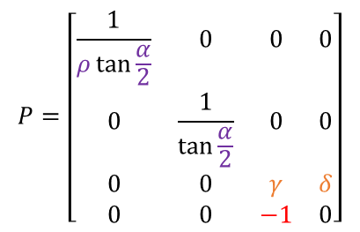

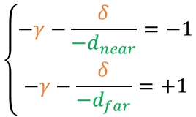

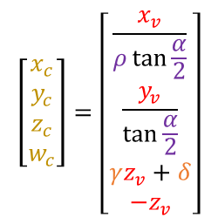

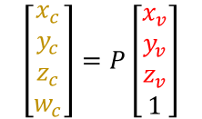




Determining $γ$ and $δ$
$$P=\left[\begin{matrix}\frac{1}{ρ\tan{\frac{α}{2}}} & 0 & 0 & 0 \\ 0 & \frac{1}{\tan{\frac{α}{2}}} & 0 & 0 \\ 0 & 0 & γ & δ \\ 0 & 0 & −1 & 0\end{matrix}\right]$$
$$\left[\begin{matrix}x_{c} \\ y_{c} \\ z_{c} \\ w_{c}\end{matrix}\right]=\left[\begin{matrix}\frac{x_{v}}{ρ\tan{\frac{α}{2}}} \\ \frac{y_{v}}{\tan{\frac{α}{2}}} \\ γz_{v}+δ \\ −z_{v}\end{matrix}\right]$$
$$\left[\begin{matrix}x_{c} \\ y_{c} \\ z_{c} \\ w_{c}\end{matrix}\right]=P\left[\begin{matrix}x_{v} \\ y_{v} \\ z_{v} \\ 1\end{matrix}\right]$$
$$\left(12\right)$$
$$⇒$$
$$\left(13\right)$$
$$z_{ndc}=\frac{z_{c}}{w_{c}}=\frac{γz_{v}+δ}{w_{c}}=\frac{γz_{v}+δ}{{−z}_{v}}=−γ−\frac{δ}{z_{v}}$$
$$\left(14\right)$$
$$\left\{\begin{aligned}−γ−\frac{δ}{−d_{near}}=−1 \\ −γ−\frac{δ}{−d_{far}}=+1\end{aligned}\right.$$
$$\left\{\begin{aligned}z_{ndc}\left(−d_{near}\right)=−1 \\ z_{ndc}\left(−d_{far}\right)=+1\end{aligned}\right.$$
$$≡$$
$$\left(15\right)$$

Slide 10

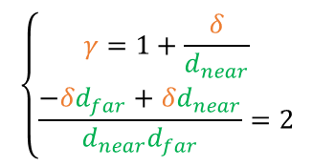

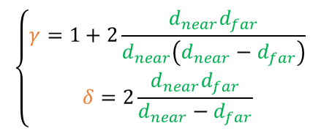



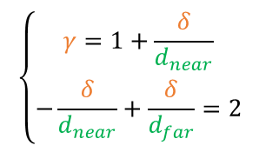



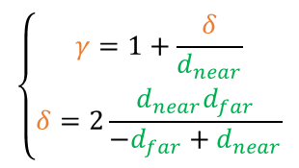

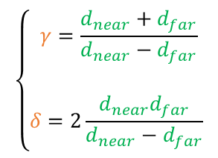
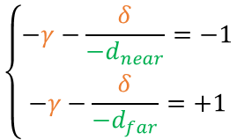
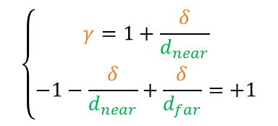


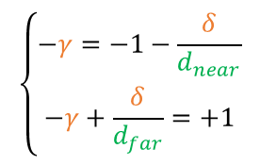
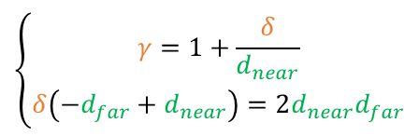

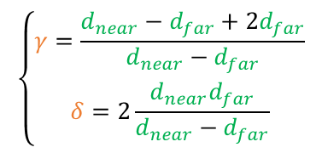



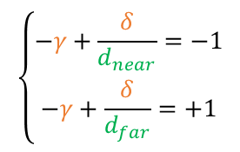

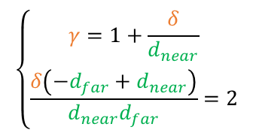

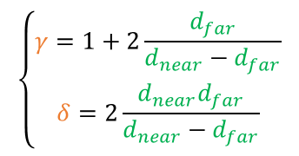

Determining $γ$ and $δ$
$$\left\{\begin{aligned}−γ−\frac{δ}{−d_{near}}=−1 \\ −γ−\frac{δ}{−d_{far}}=+1\end{aligned}\right.$$
$$\left\{\begin{aligned}−γ+\frac{δ}{d_{near}}=−1 \\ −γ+\frac{δ}{d_{far}}=+1\end{aligned}\right.$$
$$\left\{\begin{aligned}−γ=−1−\frac{δ}{d_{near}} \\ −γ+\frac{δ}{d_{far}}=+1\end{aligned}\right.$$
$$\left\{\begin{aligned}γ=1+\frac{δ}{d_{near}} \\ \\ −γ+\frac{δ}{d_{far}}=+1\end{aligned}\right.$$
$$⇒$$
$$⇒$$
$$⇒$$
$$\left(16\right)$$
$$\left\{\begin{aligned}γ=1+\frac{δ}{d_{near}} \\ −1−\frac{δ}{d_{near}}+\frac{δ}{d_{far}}=+1\end{aligned}\right.$$
$$\left\{\begin{aligned}γ=1+\frac{δ}{d_{near}} \\ −\frac{δ}{d_{near}}+\frac{δ}{d_{far}}=2\end{aligned}\right.$$
$$\left\{\begin{aligned}γ=1+\frac{δ}{d_{near}} \\ \frac{−δd_{far}+δd_{near}}{d_{near}d_{far}}=2\end{aligned}\right.$$
$$\left\{\begin{aligned}γ=1+\frac{δ}{d_{near}} \\ \frac{δ\left(−d_{far}+d_{near}\right)}{d_{near}d_{far}}=2\end{aligned}\right.$$
$$⇒$$
$$⇒$$
$$⇒$$
$$⇒$$
$$\left\{\begin{aligned}γ=1+\frac{δ}{d_{near}} \\ δ\left(−d_{far}+d_{near}\right)=2d_{near}d_{far}\end{aligned}\right.$$
$$\left\{\begin{aligned}γ=1+\frac{δ}{d_{near}} \\ δ=2\frac{d_{near}d_{far}}{−d_{far}+d_{near}}\end{aligned}\right.$$
$$\left\{\begin{aligned}γ=1+\frac{δ}{d_{near}} \\ \\ δ=2\frac{d_{near}d_{far}}{d_{near}−d_{far}}\end{aligned}\right.$$
$$⇒$$
$$⇒$$
$$⇒$$
$$\left(17\right)$$
$$\left\{\begin{aligned}γ=1+2\frac{d_{near}d_{far}}{d_{near}\left(d_{near}−d_{far}\right)} \\ δ=2\frac{d_{near}d_{far}}{d_{near}−d_{far}}\end{aligned}\right.$$
$$\left\{\begin{aligned}γ=1+2\frac{d_{far}}{d_{near}−d_{far}} \\ δ=2\frac{d_{near}d_{far}}{d_{near}−d_{far}}\end{aligned}\right.$$
$$\left\{\begin{aligned}γ=\frac{d_{near}−d_{far}+2d_{far}}{d_{near}−d_{far}} \\ δ=2\frac{d_{near}d_{far}}{d_{near}−d_{far}}\end{aligned}\right.$$
$$\left\{\begin{aligned} γ=\frac{d_{near}+d_{far}}{d_{near}−d_{far}} \\ \\ δ=2\frac{d_{near}d_{far}}{d_{near}−d_{far}}\end{aligned}\right.$$
$$⇒$$
$$⇒$$
$$⇒$$
$$\left(18\right)$$

Slide 11


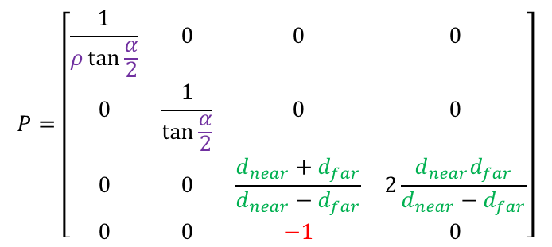

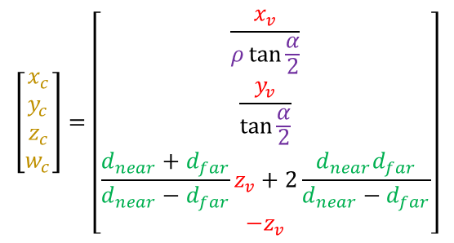
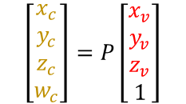
Projection matrix and clip position
$$P=\left[\begin{matrix}\frac{1}{ρ\tan{\frac{α}{2}}} & 0 & 0 & 0 \\ 0 & \frac{1}{\tan{\frac{α}{2}}} & 0 & 0 \\ 0 & 0 & \frac{d_{near}+d_{far}}{d_{near}−d_{far}} & 2\frac{d_{near}d_{far}}{d_{near}−d_{far}} \\ 0 & 0 & −1 & 0\end{matrix}\right]$$
$$\left(19\right)$$
$$\left[\begin{matrix}x_{c} \\ y_{c} \\ z_{c} \\ w_{c}\end{matrix}\right]=\left[\begin{matrix}\frac{x_{v}}{ρ\tan{\frac{α}{2}}} \\ \frac{y_{v}}{\tan{\frac{α}{2}}} \\ \frac{d_{near}+d_{far}}{d_{near}−d_{far}}z_{v}+2\frac{d_{near}d_{far}}{d_{near}−d_{far}} \\ −z_{v}\end{matrix}\right]$$
$$\left[\begin{matrix}x_{c} \\ y_{c} \\ z_{c} \\ w_{c}\end{matrix}\right]=P\left[\begin{matrix}x_{v} \\ y_{v} \\ z_{v} \\ 1\end{matrix}\right]$$
$$⇒$$
$$\left(20\right)$$

Slide 12
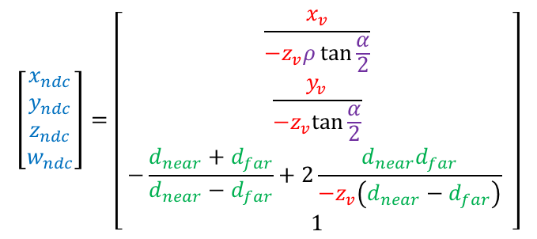
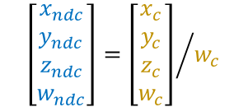


General expression for z as NDC
$$\left[\begin{matrix}x_{ndc} \\ y_{ndc} \\ z_{ndc} \\ w_{ndc}\end{matrix}\right]=\left[\begin{matrix}\frac{x_{v}}{−z_{v}ρ\tan{\frac{α}{2}}} \\ \frac{y_{v}}{−z_{v}tan{\frac{α}{2}}} \\ −\frac{d_{near}+d_{far}}{d_{near}−d_{far}}+2\frac{d_{near}d_{far}}{{−z}_{v}\left(d_{near}−d_{far}\right)} \\ 1\end{matrix}\right]$$
$$\left[\begin{matrix}x_{ndc} \\ y_{ndc} \\ z_{ndc} \\ w_{ndc}\end{matrix}\right]={\left[\begin{matrix}x_{c} \\ y_{c} \\ z_{c} \\ w_{c}\end{matrix}\right]}/{w_{c}}$$
$$⇒$$
$$\left(21\right)$$

Slide 13








Verification for near plane
$$z_{ndc}\left(−d_{near}\right)=−\frac{d_{near}+d_{far}}{d_{near}−d_{far}}+2\frac{d_{near}d_{far}}{−\left(−d_{near}\right)\left(d_{near}−d_{far}\right)}$$
$$z_{ndc}\left(−d_{near}\right)=\frac{−d_{near}−d_{far}}{d_{near}−d_{far}}+2\frac{d_{near}d_{far}}{−\left(−d_{near}\right)\left(d_{near}−d_{far}\right)}$$
$$z_{ndc}\left(−d_{near}\right)=\frac{−d_{near}−d_{far}}{d_{near}−d_{far}}+2\frac{d_{near}d_{far}}{d_{near}\left(d_{near}−d_{far}\right)}$$
$$z_{ndc}\left(−d_{near}\right)=\frac{−d_{near}−d_{far}}{d_{near}−d_{far}}+2\frac{d_{far}}{d_{near}−d_{far}}$$
$$z_{ndc}\left(−d_{near}\right)=\frac{{−d}_{near}−d_{far}+2d_{far}}{d_{near}−d_{far}}$$
$$z_{ndc}\left(−d_{near}\right)=\frac{{−d}_{near}−d_{far}+2d_{far}}{d_{near}−d_{far}}$$
$$z_{ndc}\left(−d_{near}\right)=\frac{{−d}_{near}+d_{far}}{d_{near}−d_{far}}$$
$$z_{ndc}\left(−d_{near}\right)=\frac{−\left(d_{near}−d_{far}\right)}{d_{near}−d_{far}}$$
$$z_{ndc}\left(−d_{near}\right)=−1$$

Slide 14








Verification for far plane
$$z_{ndc}\left(−z_{far}\right)=−\frac{z_{near}+z_{far}}{z_{near}−z_{far}}+2\frac{z_{near}z_{far}}{−\left(−z_{far}\right)\left(z_{near}−z_{far}\right)}$$
$$z_{ndc}\left(−z_{far}\right)=\frac{−z_{near}−z_{far}}{z_{near}−z_{far}}+2\frac{z_{near}z_{far}}{−\left(−z_{far}\right)\left(z_{near}−z_{far}\right)}$$
$$z_{ndc}\left(−z_{far}\right)=\frac{−z_{near}−z_{far}}{z_{near}−z_{far}}+2\frac{z_{near}z_{far}}{z_{far}\left(z_{near}−z_{far}\right)}$$
$$z_{ndc}\left(−z_{far}\right)=\frac{−z_{near}−z_{far}}{z_{near}−z_{far}}+2\frac{z_{near}}{z_{near}−z_{far}}$$
$$z_{ndc}\left(−z_{far}\right)=\frac{{−z}_{near}−z_{far}+2z_{near}}{z_{near}−z_{far}}$$
$$z_{ndc}\left(−z_{far}\right)=\frac{{−z}_{near}−z_{far}+2z_{near}}{z_{near}−z_{far}}$$
$$z_{ndc}\left(−z_{far}\right)=\frac{{−z}_{far}+z_{near}}{z_{near}−z_{far}}$$
$$z_{ndc}\left(−z_{far}\right)=\frac{z_{near}−z_{far}}{z_{near}−z_{far}}$$
$$z_{ndc}\left(−z_{far}\right)=−1$$

Slide 15
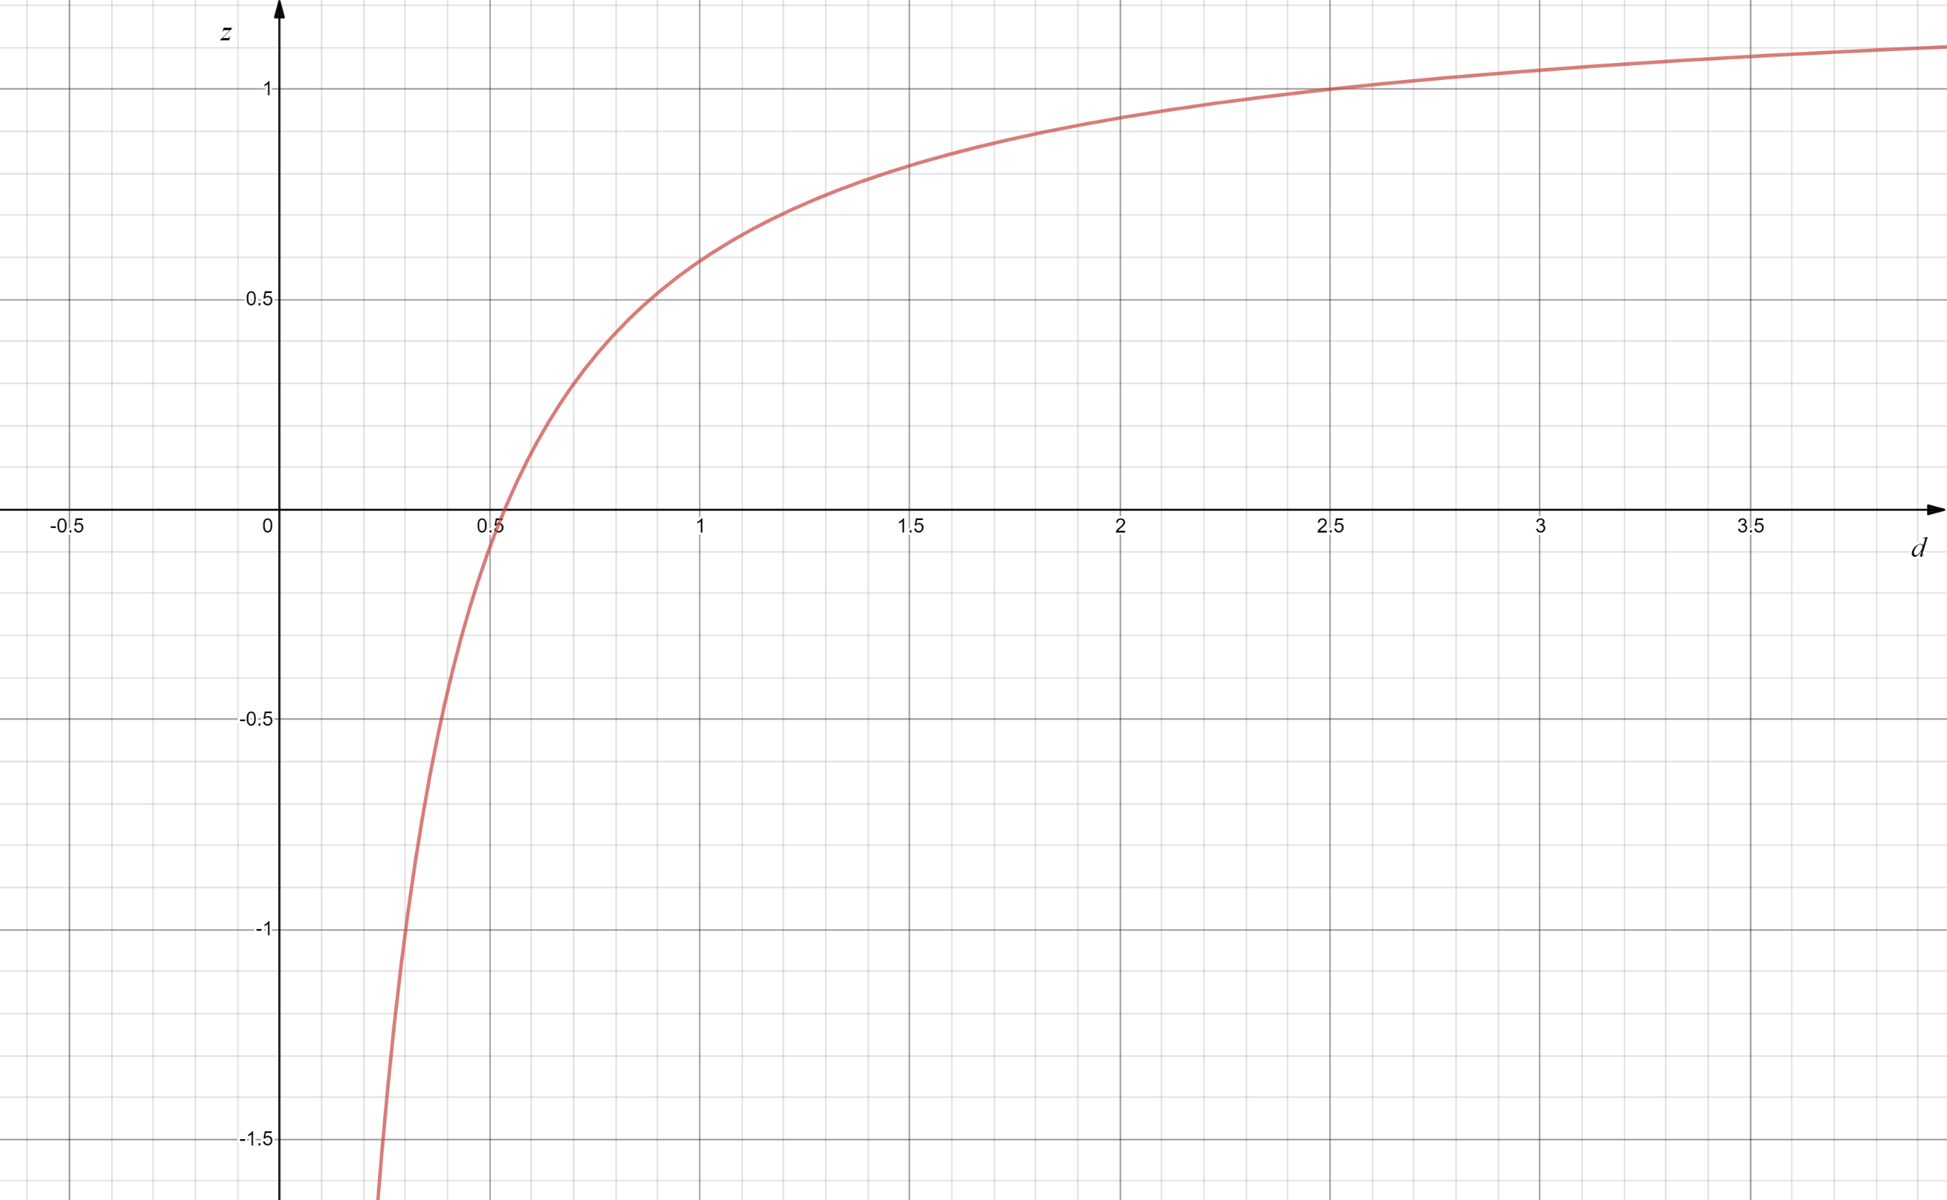




NDC transformation graph
$$d_{near}=0.3$$
$$d_{far}=2.5$$
$$d_{near}$$
$$d_{far}$$
https://www.desmos.com/calculator/zryhutoz0v

