Slide 1
Skyboxes
Layout and folding

Slide 2

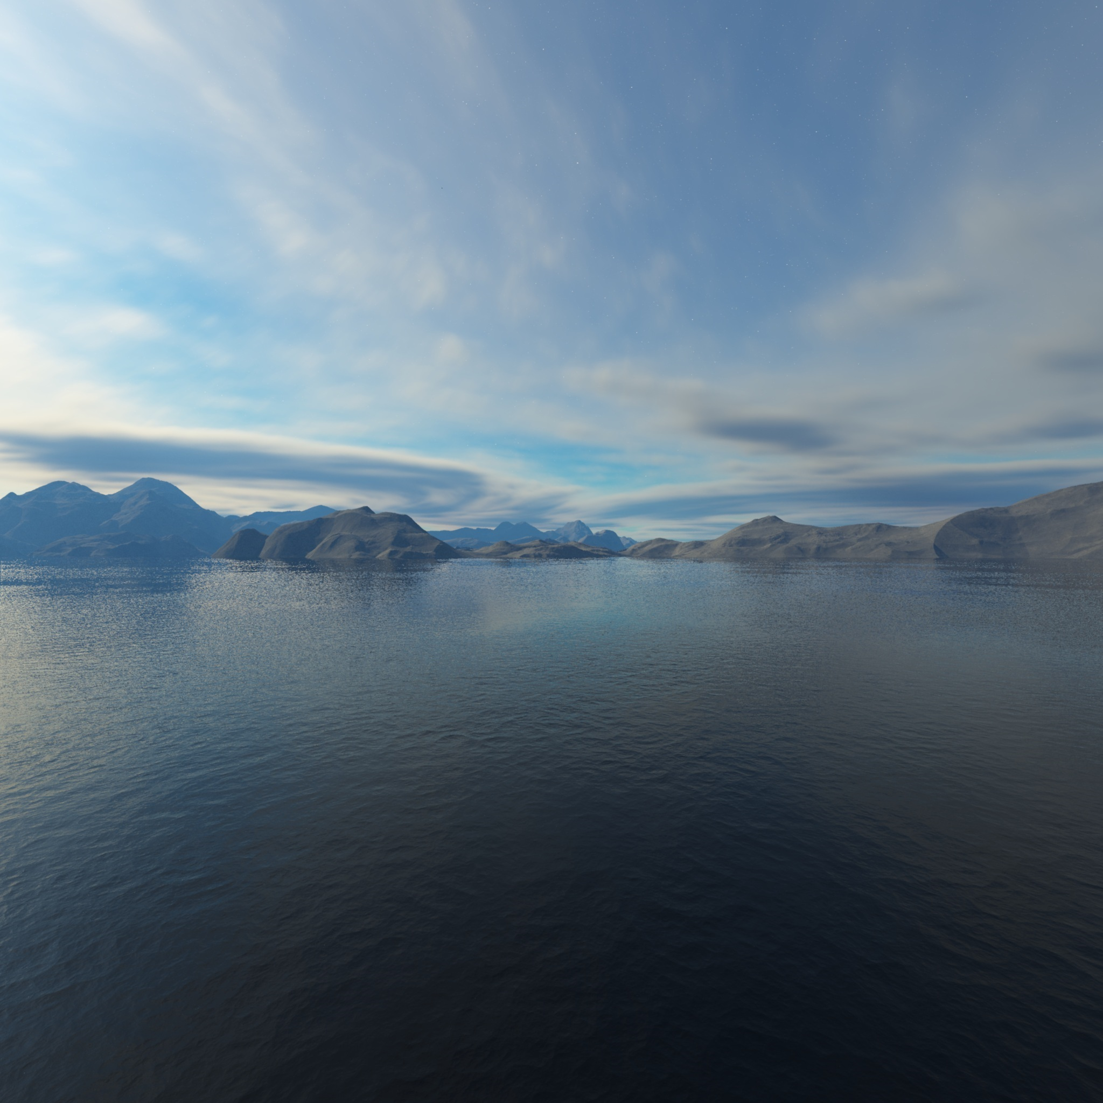
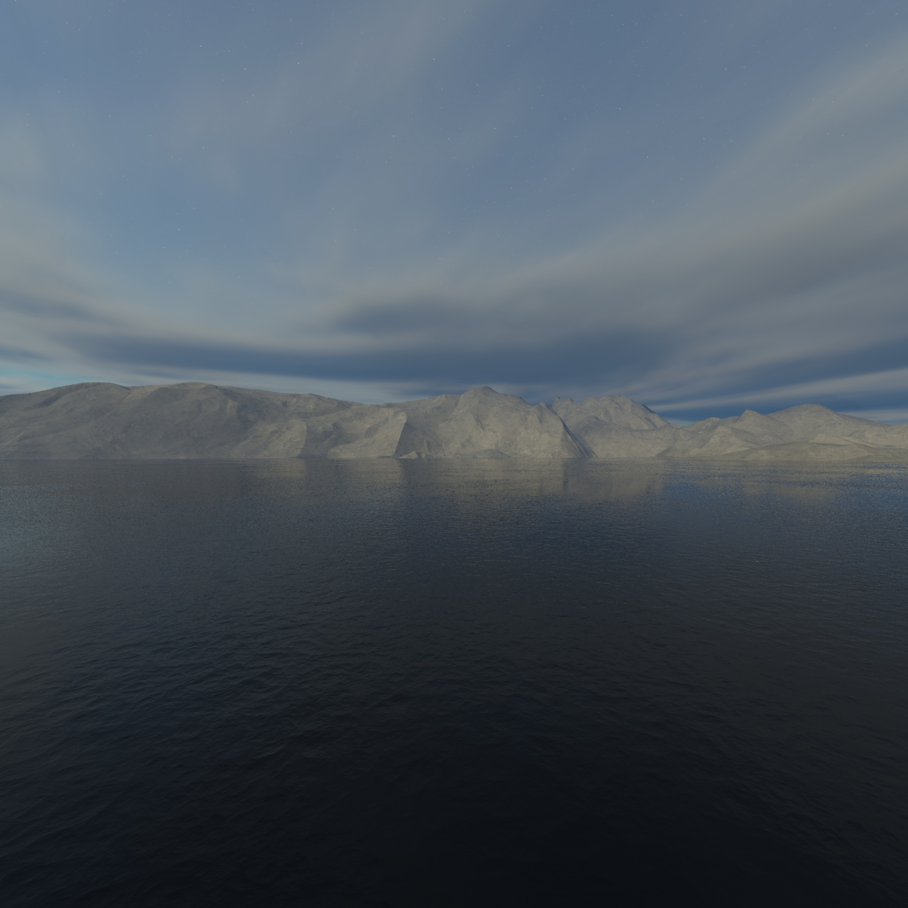
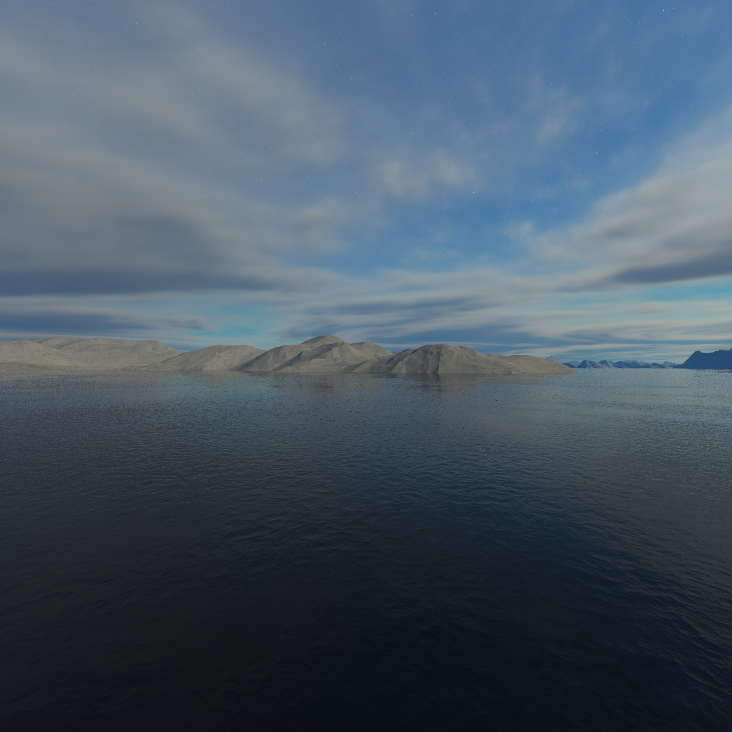
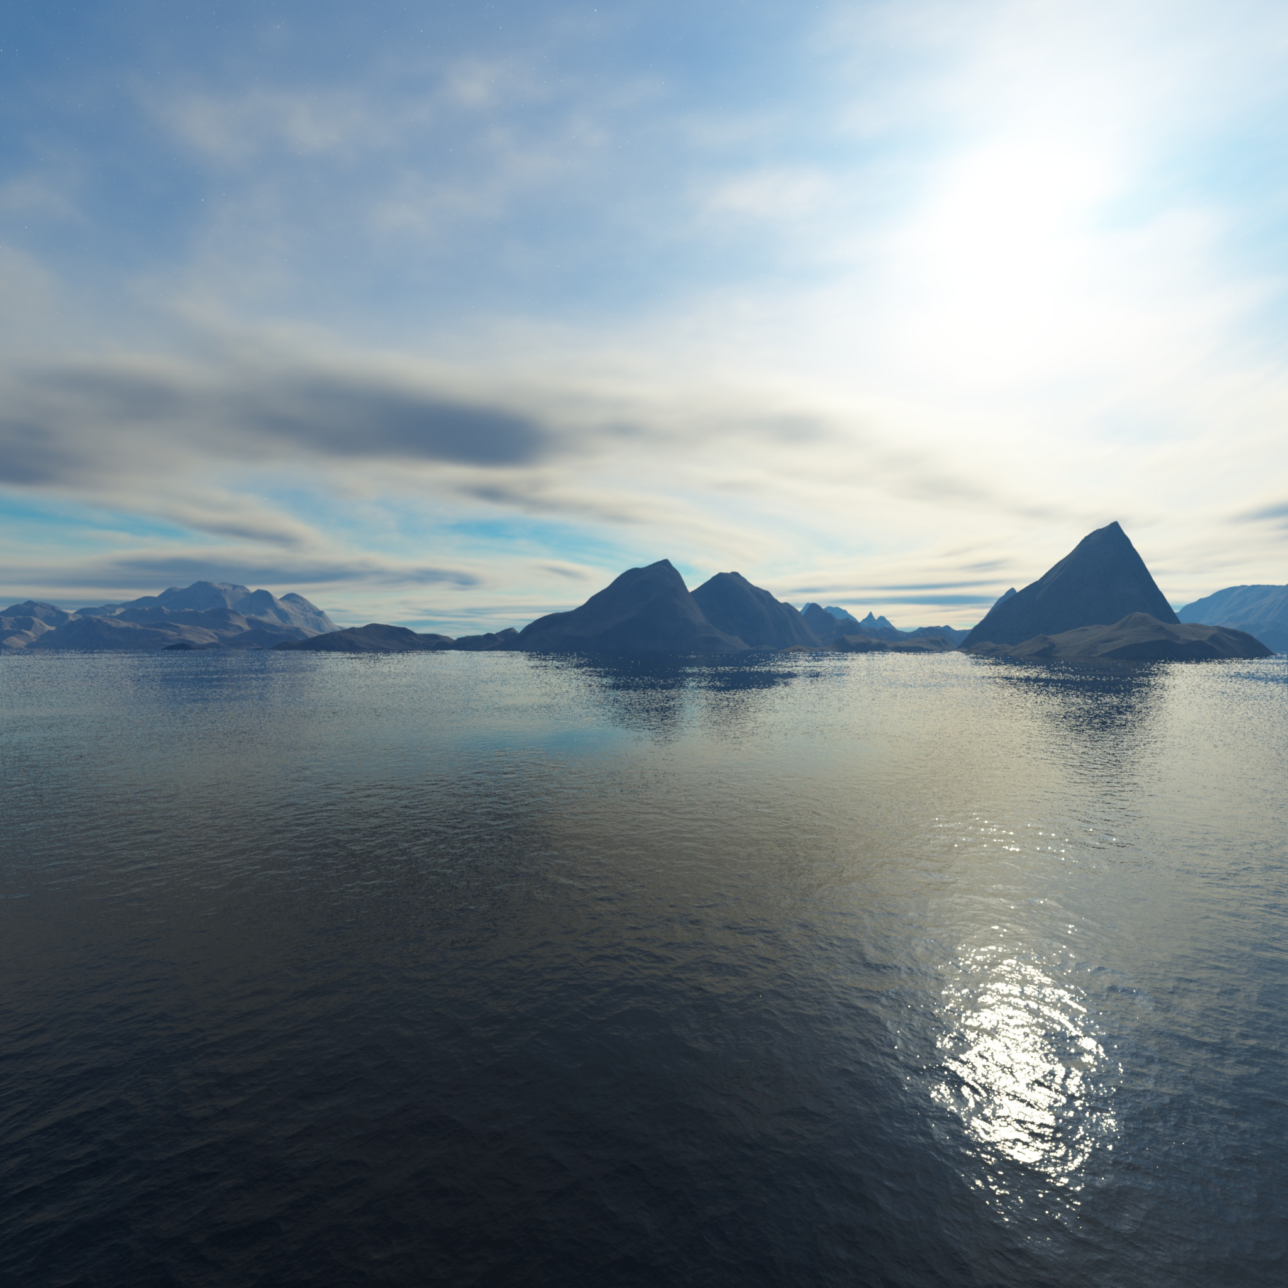
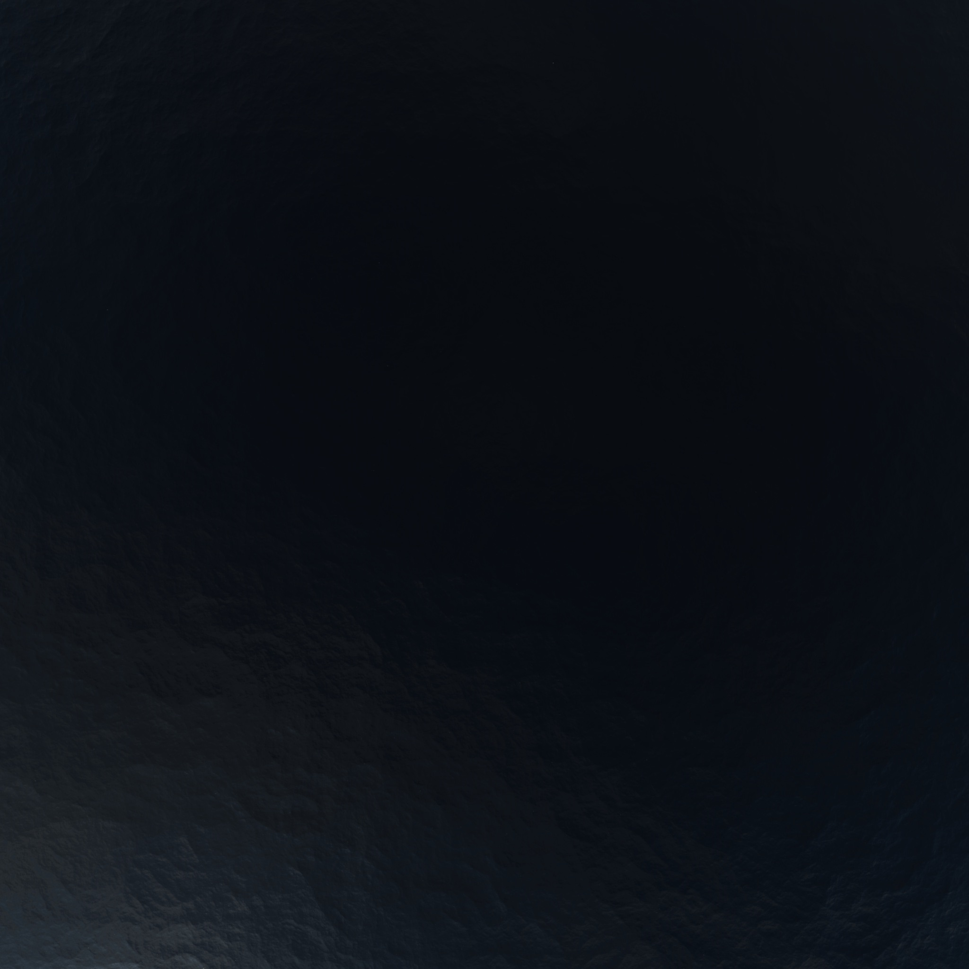
Skybox textures

Slide 3
Skybox layout
TOP
LEFT
FRONT
RIGHT
BACK
BOTTOM

Slide 4



Skybox folding
$$y$$
TOP
$$x$$
LEFT
FRONT
RIGHT
BACK
$$z$$
BOTTOM

Slide 5
Skybox folding
$$y$$
TOP
TOP
BACK
$$x$$
LEFT
RIGHT
LEFT
FRONT
RIGHT
BACK
BOTTOM
$$z$$
BOTTOM

Slide 6
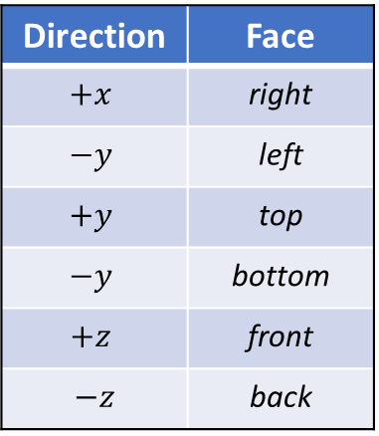
Face mapping
$$y$$
Direction | Face
$$+x$$ | right
$$−y$$ | left
$$+y$$ | top
$$−y$$ | bottom
$$+z$$ | front
$$−z$$ | back
TOP
BACK
$$x$$
LEFT
RIGHT
FRONT
BOTTOM
$$z$$

Slide 7
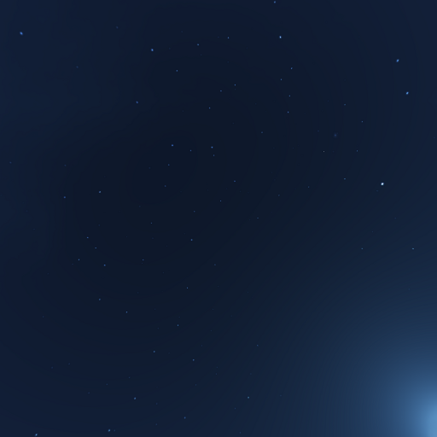
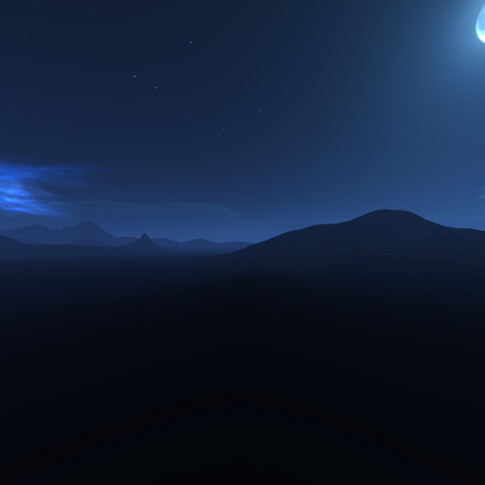
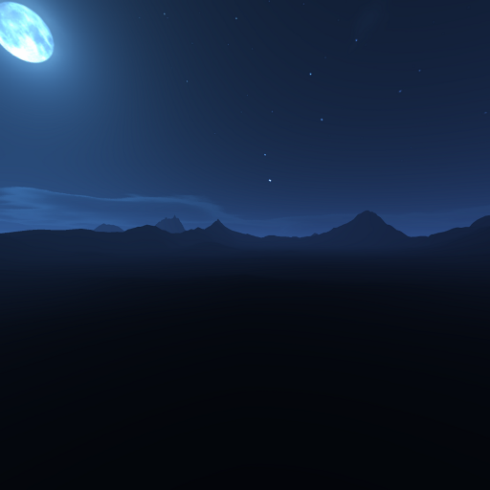
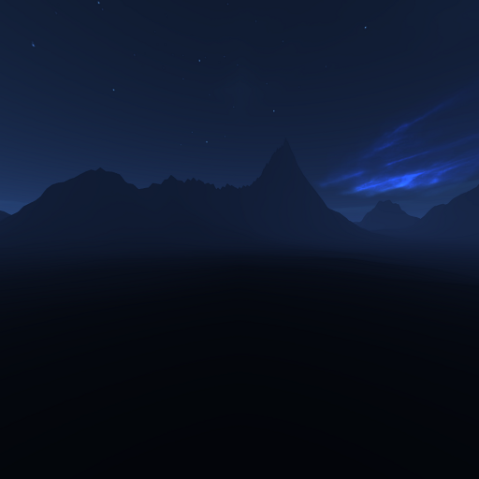
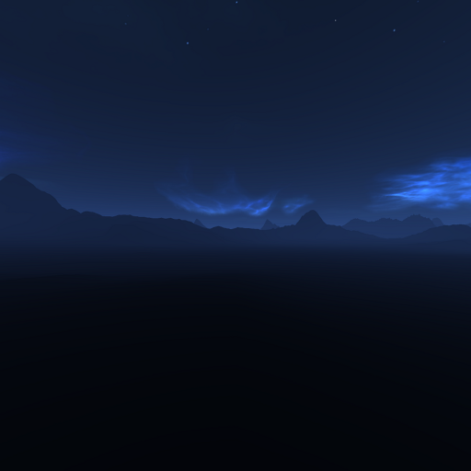
Skybox textures

Slide 8
Skybox textures
TOP
RIGHT
FRONT
LEFT
BACK
BOTTOM

