Slide 1
TODO
Intro Slide

Slide 2
TODO
Search tools

Slide 3
start your search engines!
indexing
querying
relevance
elasticsearch
Notes:
1. A survey of elasticsearch and apache lucene, with some fundamental search theory to start.

Slide 4
invert the index
traditional index
id | document
doc1 | Agile at scale!
doc2 | Healthy Agile teams
doc3 | How to scale mongoDB!
inverted index
terms | documents
agile | doc1, doc2, doc3
at | doc1
scale | doc1, doc3
…
Notes:
If we’re going to build a search engine, we need a data structure. Search engines use an inverted index.
Consider traditional index.
Inverted index, maps terms to documents.
Inverted? It doesn’t really matter, to invert is to turn upside down, so it depends on what the right side up is, it just matters in the search engines we retrieve docuements with terms.

Slide 5
indexing
raw content
build document
analyze document
index
Notes:
Building the inverted index ca

Slide 6
analysis
“The quick brown fox”
full text
tokenize
“The, quick, brown, fox”
filter
filter
terms
terms
Notes:
Building the inverted index ca

Slide 7
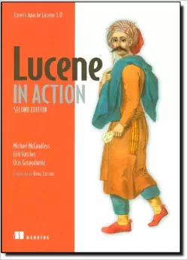
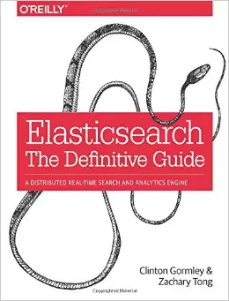
sources
Notes:
Need to cite some sources I referenced in spots.
Lucene in Action is a good book, might be targeted more lucene development, so it would be redundant if you’re mostly going to use elasticsearch.
Elasticsearch the definitive guide is top notch and in-depth, but good portion of the info is online. Elasticsearch has a great guide, so unless you’re really trying to ramp up your knowledge of the innerworkings of elasticsearch or tackling some significantly challenging search problems, might be overkill as well.

Slide 8
?
Notes:
Thank you for attending. Hope you enjoyed. Any questions!

