Slide 1
start your search engines!
Andy Pryor
Software Engineer at Hudl

Slide 2

Notes:
Era of information explosion.
Our software applications are getting bigger, doing more, generating more data.
Putting software in everything, creating what is being called the “internet of things”, literally from tea-pots to light bulbs.
Disk space is a commodity, it’s cheap, and has been getting cheaper.
More software, more logs, more uses, more data in general.
Data is increasing.

Slide 3

Notes:
This is creating and IT landscape that resembles mountain ranges. Mountains of data. Mountains are big, they take skill to climb. Each is a bit different, but similar too. If you can climb one, you can probably climb another one, but you need to chart a distinct route to the top of each one.
While there is challenges in many aspects of managing large data sets, what if we consider search. How can we “find” what we’re looking for in such large data sets, how can we solve the search problem.
If we look to open source, we have a few options.

Slide 4






Notes:
Examining open source search software, a common theme is easily spotted. Apache Lucene sits at the core of most open source search technologies.
Open source. Java. Search Engine. Started by Doug Cutting in 1999.
Wifes middle name.
Elasticsearch and SOLR are search servers. They provide API’s over http. Let Lucene handle writing/reading indexes. (for the most part).
Elasticsearch is the new kid on the black, 1.0 release was in 2012. built to scale from start. Easy to setup, easy to run. Often paired with Kibana for data visualization and Logstash, for log parsing/collecting.
This talk will focus on elasticsearch. Tika / Nutch / OpenNLP are cool projects, if you like search, check those out too.

Slide 5
start your search engines!
indexing
querying
relevance
elasticsearch
Notes:
welcome.
A survey of elasticsearch and apache lucene, with some fundamental search theory to start.
Questions any time.
Indexing / querying / relevance then elasticsearch is sprinkled throughout with some greater focus at the end.

Slide 6
invert the index
traditional index
id | document
doc1 | Agile at scale!
doc2 | Healthy Agile teams
doc3 | How to scale mongoDB!
inverted index
terms | documents
agile | doc1, doc2
scale | doc1, doc3
healthy | doc2
…
Notes:
If we’re going to build a search engine, we need a data structure. Search engines use an inverted index.
Consider traditional index.
Inverted index, maps terms to documents.
Inverted? It doesn’t really matter, to invert is to turn upside down, so it depends on what the right side up is, it just matters in the search engines we retrieve docuements with terms.

Slide 7
indexing
raw content
build document
analyze document
index
Notes:
Building the inverted index ca

Slide 8
analysis
“The quick brown fox.”
“The”,“quick”,“brown”,“fox.”
(whitespace tokenizer)
“the”, “quick”, “brown”, “fox.”
(lowercase filter)
“the”, “quick”, “brown”, “fox.”
(distinct terms)
full text
tokenize
filter
terms
Notes:
Building the inverted index ca

Slide 9
standard analyzer
“The quick brown fox.”
“The”,“quick”,“brown”,“fox”
(standard tokenizer)
“quick”, “brown”, “fox”
(lowercase filter, stop word filter)
“quick”, “brown”, “fox”
(distinct terms)
Notes:
The white space tokenizer replaced with standard toekenizers.
The standard analyzer uses “Unicode Text Segmentation algorithm”, it’s very good for most “European languages. (find examples)
Step back, consider how hard this can be for variations in data across languages and other contexts.
This is default elasticsearch analyzer, very good for general use cases.

Slide 10
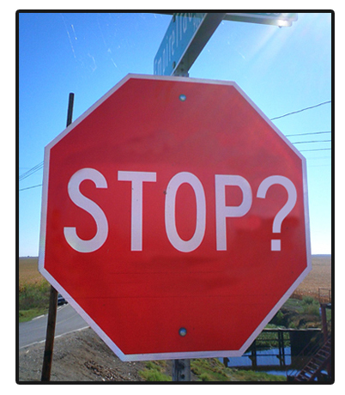
stop words
“to stop or not to stop?”
“awesome”or “not awesome”
Notes:
There is some serious pros and cons to stop words. Sounds like a simple thing, but some real things to consider.
PRO Performance and relevancy.
Reduces index bloat.
High frequency terms, offer little to relevancy are expensive to process. Load all docs with that term.
CONS loss of context and meaning destruction
You just strip out a ton of meaning, Consider “to stop or not to stop”, shakespear saying, this one, phrase searching.
Some pronouns are offer context, awesome or not awesome.
Alternatives
Custom stop words. There is a default list.
Ignoring high frequency terms at search time.
I’d suggest cutoff frequency, I’ll have an example of that in a second.

Slide 11
n-grams
“The quick brown fox.”
“The”,“quick”,“brown”,“fox”
(standard tokenizer)
“quick”, “brown”, “fox”
(lowercase, stop word, ngram)
q,u, i, c, k, qu, ui, ic, ck, qui, uic, ick, quic, quick, ...
(distinct terms)
Notes:
Sometimes you might want to search for only part of a token, in that case, you need to index part of the token, one way to do is with n-grams.
“contiguous sequence of items from a sequence”.
Variations, left n-gram, right n-gram. Min-gram, max-gram.
Obviously the risk here is term bloat, index size, the advantage is searching for incomplete tokens, think, search as you type kind of performance.

Slide 12
shingles
“The quick brown fox.”
“The”,“quick”,“brown”,“fox”
(standard tokenizer)
“quick”, “brown”, “fox”
(lowercase, stop word, shingle)
“quick”, “quick brown”, “brown fox”
(distinct terms)
Notes:
Shingles are like word grams. Can be good for phrase searching. Exact match queries.
Also can good to boost relevancy, which we can dive in a bit.

Slide 13
word stemming
running
run
Notes:
Synonyms at filter time.
Find root word. Do same thing at query time, you have a hit.
Dictionary vs algorithmic.
Snowball token filter, snowball analyzer. Algorithmic.

Slide 14
phonetic analyzers
jon / john
jn,an
(double metaphone)
Notes:
Synonyms at filter time.
Do more than just break up the text.
Dictionary vs algorithmic.
Snowball token filter, snowball analyzer. Algorithmic.

Slide 15
lemmatization
better
good
Notes:
Groups words by meaning.
Mice / mouse would be missed by stemming.
Stanford has an open source NLP project, ships under GPL license, many free uses but some restrictions on commercial use.

Slide 16
elasticsearch basics
index = database
type = table
mapping = schema
document = row
Notes:
Synonyms at filter time.
Do more than just break up the text.
Dictionary vs algorithmic.
Snowball token filter, snowball analyzer. Algorithmic.

Slide 17
create index
{
"settings": {
"analysis": {
"analyzer": {
"ngram-tokenizer":{
"type":"custom",
"tokenizer":"whitespace",
"filter":[ "lowercase", "ngram-filter" ]
},
"lowercase-keyword":{
"type":"custom",
"tokenizer":"whitespace",
"filter":[ "lowercase"]
}
},
"filter":{
"ngram-filter":{
"type":"ngram",
"min_gram":1,
"max_gram":200
}
}
}
},
"mappings": {
"tweet": {
"properties": {
"id": {
"index": "not_analyzed",
"type": "string"
},
"text": {
"type": "string",
"search_analyzer" : "lowercase-keyword",
"index_analyzer" : "ngram-tokenizer"
}
}
}
}
}
Notes:
Synonyms at filter time.
Do more than just break up the text.
Dictionary vs algorithmic.
Snowball token filter, snowball analyzer. Algorithmic.

Slide 18
test analyzer
c:\>curl -X GET http://localhost:9200/tweets/_analyze?pretty=true^&analyzer=ngram-tokenizer -d "quick"
{
"tokens" : [ {
"token" : "q",
"start_offset" : 0,
"end_offset" : 5,
"type" : "word",
"position" : 1
}, {
"token" : "qu",
"start_offset" : 0,
"end_offset" : 5,
"type" : "word",
"position" : 1
}, {
"token" : "qui",
"start_offset" : 0,
"end_offset" : 5,
"type" : "word",
"position" : 1
}
...
Notes:
Synonyms at filter time.
Do more than just break up the text.
Dictionary vs algorithmic.
Snowball token filter, snowball analyzer. Algorithmic.

Slide 19
put document
c:\>curl -X PUT http://local:9200/tweets/tweet/123 -d {"id":"123","text":"tweet text!"}
{
"_index" : "tweets",
"_type" : "tweet",
"_id" : "123",
"_version" : 1,
"created" : true
}
Notes:
Synonyms at filter time.
Do more than just break up the text.
Dictionary vs algorithmic.
Snowball token filter, snowball analyzer. Algorithmic.

Slide 20
query
c:\>curl -X PUT http://local:9200/tweets/tweet/123 -d {"id":"123","text":"tweet text!"}
{
"_index" : "tweets",
"_type" : "tweet",
"_id" : "123",
"_version" : 1,
"created" : true
}
Notes:
Synonyms at filter time.
Do more than just break up the text.
Dictionary vs algorithmic.
Snowball token filter, snowball analyzer. Algorithmic.

Slide 21
queries vs filters!
queries
scoring + relevance ranking
analyzed
filters
fast, cacheable
no scoring
Notes:
They are going to merge in 2.0

Slide 22
match query
{
“match”: {
“firstName”: “Jon”
}
}
Notes:
The default, go to query. Defaults to a Boolean query with multiple fields,

Slide 23
dis max query
{
“dis_max”: {
“queries”: [
{“term”: {“name”: “elasticsearch”},
{“term”: {“desc”:“elasticsearch”}
]
}
}
Notes:
The default, go to query. Defaults to a Boolean query with multiple fields,

Slide 24
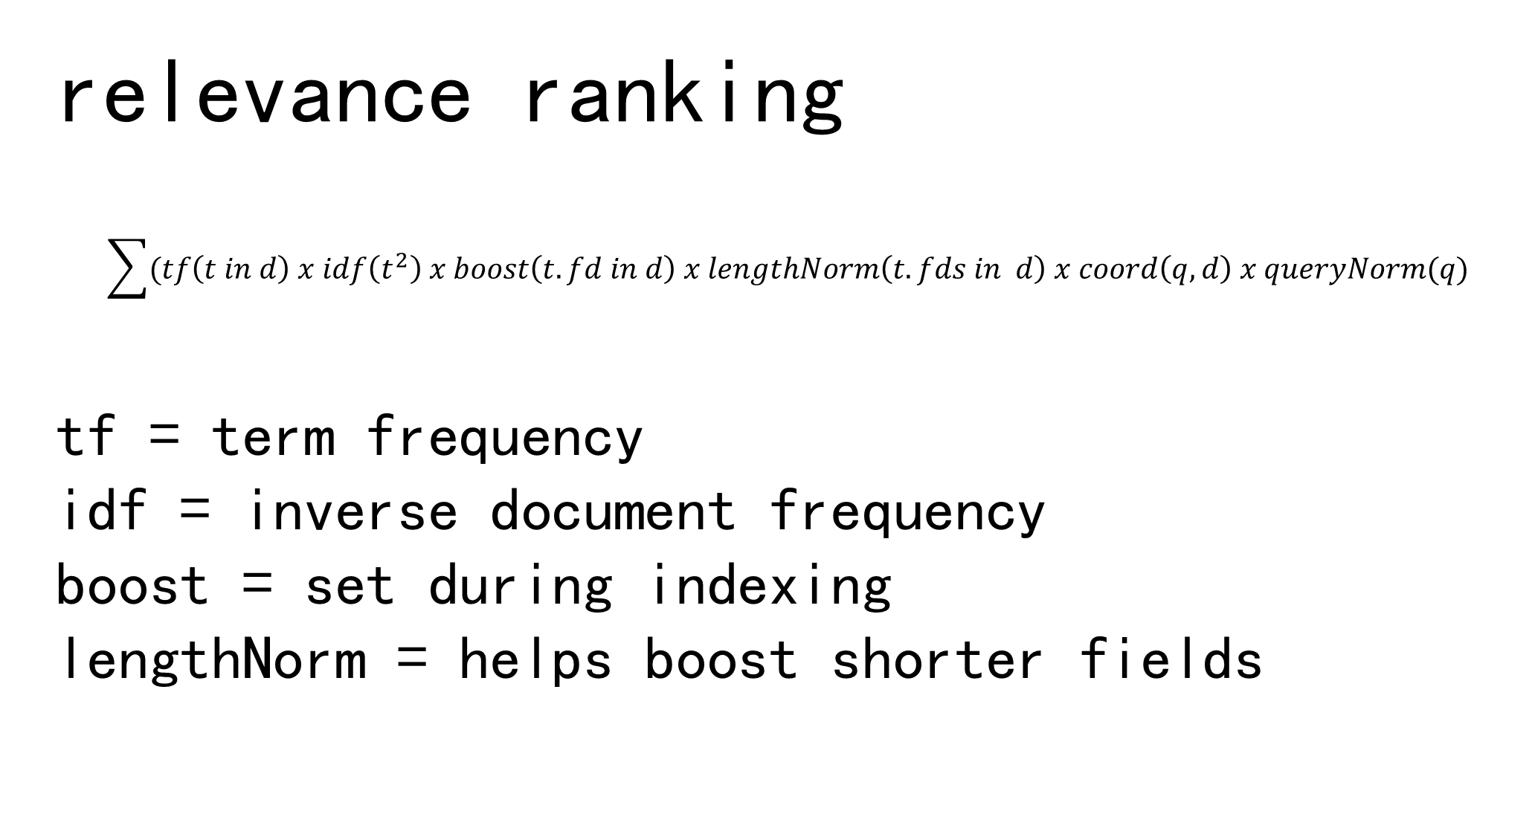
relevance ranking
$$\sum{(tf\left(t in d\right) x idf\left(t^{2}\right) x boost\left(t.fd in d\right) x lengthNorm\left(t.fds in d\right) x coord\left(q,d\right) x queryNorm(q)}$$
tf = term frequency
idf = inverse document frequency
boost = set during indexing
lengthNorm = helps boost shorter fields
Notes:
Score is raw floating point number >= 0.
Tf = how many times does term appear in doc.
Idf, how “unique” is the term to the document.
Distributed frequencies in elasticsearch.

Slide 25
distributed search
shards
replicas
Notes:
Synonyms at filter time.
Do more than just break up the text.
Dictionary vs algorithmic.
Snowball token filter, snowball analyzer. Algorithmic.

Slide 26
essential extensions
facets
highlighting
fuzzy queries
geo search
Notes:
Synonyms at filter time.
Do more than just break up the text.
Dictionary vs algorithmic.
Snowball token filter, snowball analyzer. Algorithmic.

Slide 27
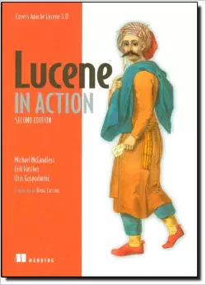
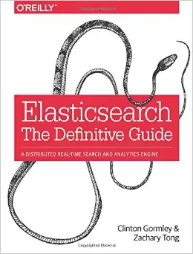
sources
Notes:
Need to cite some sources I referenced in spots.
Lucene in Action is a good book, might be targeted more lucene development, so it would be redundant if you’re mostly going to use elasticsearch.
Elasticsearch the definitive guide is top notch and in-depth, but good portion of the info is online. Elasticsearch has a great guide, so unless you’re really trying to ramp up your knowledge of the innerworkings of elasticsearch or tackling some significantly challenging search problems, might be overkill as well.

Slide 28
?
Notes:
Thank you for attending. Hope you enjoyed. Any questions!

