Slide 1
TODO
Intro Slide

Slide 2
TODO
Search tools

Slide 3
start your search engines!
indexing
querying
relevance
elasticsearch
Notes:
1. A survey of elasticsearch and apache lucene, with some fundamental search theory to start.

Slide 4
invert the index
traditional index
id | document
doc1 | Agile at scale!
doc2 | Healthy Agile teams
doc3 | How to scale mongoDB!
inverted index
terms | documents
agile | doc1, doc2, doc3
at | doc1
scale | doc1, doc3
…
Notes:
If we’re going to build a search engine, we need a data structure. Search engines use an inverted index.
Consider traditional index.
Inverted index, maps terms to documents.
Inverted? It doesn’t really matter, to invert is to turn upside down, so it depends on what the right side up is, it just matters in the search engines we retrieve docuements with terms.

Slide 5
indexing
raw content
build document
analyze document
index
Notes:
Building the inverted index ca

Slide 6
analysis
“The quick brown fox”
“The”,“quick”,“brown”,“fox”
(whitespace tokenizer)
“the”, “quick”, “brown”, “fox”
(lowercase filter)
“the”, “quick”, “brown”, “fox”
(distinct terms)
full text
tokenize
filter
terms
Notes:
Building the inverted index ca

Slide 7
standard analyzer
“The quick brown fox.”
“The”,“quick”,“brown”,“fox”
(standard tokenizer)
“quick”, “brown”, “fox”
(lowercase filter, stop word filter)
“quick”, “brown”, “fox”
(distinct terms)
Notes:
The white space tokenizer replaced with standard toekenizers.
The standard analyzer uses “Unicode Text Segmentation algorithm”, it’s very good for most “European languages.
Step back, consider how hard this can be for variations in data across languages and other contexts.
This is default elasticsearch analyzer, very good for general use cases.

Slide 8
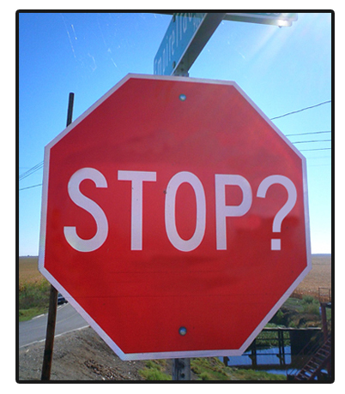
stop words
“to stop or not to stop?”
“awesome”or “not awesome”
Notes:
There is some serious pros and cons to stop words. Sounds like a simple thing, but some real things to consider.
PRO Performance and relevancy.
Reduces index bloat.
High frequency terms, offer little to relevancy are expensive to process. Load all docs with that term.
CONS loss of context and meaning destruction
You just strip out a ton of meaning, Consider “to stop or not to stop”, shakespear saying, this one, phrase searching.
Some pronouns are offer context, awesome or not awesome.
Alternatives
Custom stop words. There is a default list.
Ignoring high frequency terms at search time.
I’d suggest cutoff frequency, I’ll have an example of that in a second.

Slide 9
n-grams
“The quick brown fox.”
“The”,“quick”,“brown”,“fox”
(standard tokenizer)
“quick”, “brown”, “fox”
(lowercase, stop word, ngram)
q,u, i, c, k, qu, ui, ic, ck, qui, uic, ick, quic, quick, ...
(distinct terms)
Notes:
Sometimes you might want to search for only part of a token, in that case, you need to index part of the token, one way to do is with n-grams.
“contiguous sequence of items from a sequence”.
Variations, left n-gram, right n-gram. Min-gram, max-gram.
Obviously the risk here is term bloat, index size, the advantage is searching for incomplete tokens, think, search as you type kind of performance.

Slide 10
shingles
“The quick brown fox.”
“The”,“quick”,“brown”,“fox”
(standard tokenizer)
“quick”, “brown”, “fox”
(lowercase, stop word, shingle)
“quick”, “quick brown”, “brown fox”
(distinct terms)
Notes:
Shingles are like word grams. Can be good for phrase searching. Exact match queries.
Also can good to boost relevancy, which we can dive in a bit.

Slide 11
you know, for search!
Es part one.
Notes:
Shingles are like word grams. Can be good for phrase searching. Exact match queries.
Also can good to boost relevancy, which we can dive in a bit.

Slide 12
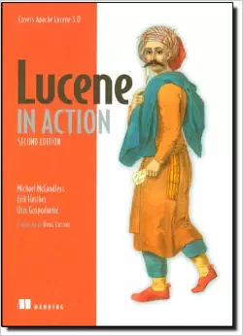
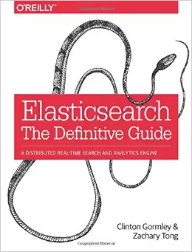
sources
Notes:
Need to cite some sources I referenced in spots.
Lucene in Action is a good book, might be targeted more lucene development, so it would be redundant if you’re mostly going to use elasticsearch.
Elasticsearch the definitive guide is top notch and in-depth, but good portion of the info is online. Elasticsearch has a great guide, so unless you’re really trying to ramp up your knowledge of the innerworkings of elasticsearch or tackling some significantly challenging search problems, might be overkill as well.

Slide 13
?
Notes:
Thank you for attending. Hope you enjoyed. Any questions!

