Slide 1
start your search engines!
Andy Pryor
Software Engineer at Hudl

Slide 2

Notes:
Era of information explosion.
Bigger software, more complex.
Disk space is a commodity, it’s cheap, and has been getting cheaper.
More data. Everyone has more data.

Slide 3

Notes:
IT landscape that resembles a mountain range right.
Everyones mountain is different, but similar too.
Skills to climb one.
Consider search.
Look to open source.

Slide 4






Notes:
Examining open source search software, a common theme is easily spotted. Apache Lucene sits at the core of most open source search technologies.
Open source. Java. Search Engine. Started by Doug Cutting in 1999.
Elasticsearch and SOLR are search servers. They provide API’s over http. Let Lucene handle writing/reading indexes. (for the most part).
Elasticsearch is the new kid on the black, 1.0 release was in 2012. built to scale from start. Easy to setup, easy to run. Often paired with Kibana for data visualization and Logstash, for log parsing/collecting.
Tika, nutcha, open NLP desire their own talks, beyond our scope but they exist.
This talk will focus on elasticsearch. Tika / Nutch / OpenNLP are cool projects, if you like search, check those out too.

Slide 5









who uses elasticsearch?
Notes:
Ever used elasticsearch?
Elasitcon 2015.
Goldman Sachs’ 700 nodes.
Verizon has over 500 billion documents.
Yale for cancer research. USGS for earthquake detection, tweets travel faster than seismic energy. Extremely accurate.

Slide 6
start your search engines!
indexing
querying
relevance
distribution
Notes:
welcome.
A survey of elasticsearch and apache lucene, with some fundamental search theory to start.
Questions any time.
Indexing / querying / relevance then elasticsearch is sprinkled throughout with some greater focus at the end.

Slide 7
invert the index
traditional index
id | Session name
doc1 | Agile at scale!
doc2 | Healthy Agile teams
doc3 | How to scale mongoDB!
inverted index
terms | documents
agile | doc1, doc2
scale | doc1, doc3
healthy | doc2
…
Notes:
Start with data structure.
Consider traditional index.
Inverted index, maps terms to documents.
Search unit.
Logarithmic retrieval times, much better than scanning entire document set.
Inverted? It doesn’t really matter, to invert is to turn upside down, so it depends on what the right side up is, it just matters in the search engines we retrieve docuements with terms.

Slide 8
indexing
raw content
build document
analyze document
index
Notes:
Indexing
Indexing is expensive, cpu and memory but a necessary evil.
3. Analyze is most complex of these phases, at least for you when you’re using Lucene. Lets talk a bit more about analysis.

Slide 9
analysis
“The quick brown fox.”
“The”,“quick”,“brown”,“fox.”
(whitespace tokenizer)
“the”, “quick”, “brown”, “fox.”
(lowercase filter)
“the”, “quick”, “brown”, “fox.”
full text
tokenizer
analyzer
filters
terms
Notes:
Input full text, for example every field you want searchable in your document. Output imagination.
In lucene, two distinct phases.
Filters, inject synonyms, lots of creative things.
Consider simple example.
Distinct terms, ready to be put into the inverted index.

Slide 10
install
elastic.co/downloads/
/config/elasticsearch.yml (optional)
cluster.name: search_talk
node.name: “andysmac“
network.host: localhost
bin/elasticsearch (.bat on windows)
Notes:
Crazy easy.
Download extract.
Have atleast JRE 6.0 installed and on the path.
Edit config. (optional)
Run elasticsearch.

Slide 11
hello elasticsearch
curl http://localhost:9200/
{
"status" : 200,
"name" : "andysmac",
"cluster_name" : "search_talk",
"version" : {
…
},
"tagline" : "You Know, for Search"
}
Notes:
Ping port 9200. hello 9300 is used for node->communication, 9200 is the http API.
All interactions, json over http. Curl rocks.

Slide 12
elasticsearch vs relational db
index = database
type = table
mapping = schema
document = row
fields = column
Notes:
Let’s look at elasticsearch vs a relationship db
No SQL data store. Sometimes even used as primary store.

Slide 13
create index
curl –X POST http://localhost:9200/tweets/ -d ‘{
"settings": {
"analysis": {
"analyzer": {
"whitespace-lowercase":{
"type":"custom",
"tokenizer":"whitespace",
"filter":[ "lowercase"]
}
}
}},
"mappings": {
"tweet": {
"properties": {
"id": {
"index": "not_analyzed",
"type": "string”},
text": {
"type": "string",
"analyzer" : "whitespace-lowercase"}
}}}}’
Notes:
Create index.
Define analyzers. (choose tokenizer, list filters).
Mappings, this is where we define our types and how they will be indexes.
Schema-less, so you don’t need to map every field. You could use the default analyzer
Schema templates, index templates.

Slide 14
put document
curl -X PUT http://localhost:9200/tweets/tweet/123 -d '{
"id":"123",
"text":"tweeting from Nebraska code!"
}‘
{
"_index" : "tweets",
"_type" : "tweet",
"_id" : "123",
"_version" : 1,
"created" : true
}
Notes:
Synonyms at filter time.
Do more than just break up the text.
Dictionary vs algorithmic.
Snowball token filter, snowball analyzer. Algorithmic.

Slide 15
search
curl -X POST http://localhost:9200/tweets/_search?q=text:nebraska
{
"took" : 3,
"timed_out" : false,
"_shards" : {
"total" : 1,
"successful" : 1,
"failed" : 0
},
"hits" : {
"total" : 1,
"max_score" : 0.15342641,
"hits" : [ {
"_index" : "tweets",
"_type" : "tweet",
"_id" : "123",
"_score" : 0.15342641,
"_source":{"id":"123","text":"tweeting from Nebraska code!"}
} ] }}
Notes:
_search end point
Query text is Nebraska.
Notice searched with lower-case n.

Slide 16
“q=code”?
curl -X POST /tweets/_search?q=text:code
{
"took" : 1,
"timed_out" : false,
"_shards" : {
"total" : 1,
"successful" : 1,
"failed" : 0
},
"hits" : {
"total" : 0,
"max_score" : null,
"hits" : [ ]
}}
Notes:
So we searched for Nebraska, and found our document, now what about “code”.
not found. This is one of the most frustrating things to encounter.
search query entered, no hits, and you don’t know why!

Slide 17
test analyzer
curl -X POST /tweets/_analyze?analyzer=whitespace-lowercase
-d "tweeting from Nebraska code!“
{
"tokens" : [
"tweeting",
"from",
“nebraska",
"code!"
} ]
}
Notes:
Understand terms extracted from our text.
Lets try new tokenizer.

Slide 18
standard tokenizer
curl –X POST http://localhost:9200/tweets/ -d '{
"settings": {
"analysis": {
"analyzer": {
“stand-low":{
"type":"custom",
"tokenizer":"standard",
"filter":[ "lowercase"]
}
}
}},
…
Notes:
Back to create index, change tokenizer to “standard.
Standard tokenizer uses

Slide 19
standard tokens
curl -X GET /tweets/_analyze?analyzer=stand_low
-d "tweeting from Nebraska code!"
{
"tokens" : [ {
"token" : "tweeting"}, {
"token" : "from"}, {
"token" : "nebraska"}, {
"token" : "code"}
]
}
Notes:
If we text the analyzer now that it uses the standard tokenizer, we see it produces the fourth token as “code” removing punctioation.
Unicode text segementation algorithm. (open standard algoirth, works well for more eurpeon languages.).
Step back, whenever considering analyzers, context of the data important.
Others tokenizers/filters you want to use.? STOP WORDS NEXT

Slide 20
stop words
{
"settings": {
"analysis": {
"analyzer": {
"standard-lowercase":{
"type":"custom",
"tokenizer":"standard",
"filter":[ "lowercase", "stop"]
}
},
"filter": {
"stop": {
"type": "stop",
"stopwords": ["and","is","the"]
}
}}},
…
Notes:
Common to reject stop words.

Slide 21

stop words
“to stop or not to stop?”
“awesome”or “not awesome?”
Notes:
PRO Performance and relevancy.
Reduces index bloat.
High frequency terms, offer little to relevancy are expensive to process. Load all docs with that term.
CONS loss of context and meaning destruction
Alternatice, cutoff frequency.

Slide 22
n-gram filter
"analyzer": {
"ngram-tokenizer":{
"type":"custom",
"tokenizer":"whitespace",
"filter":[ "lowercase", "ngram" ]
},
"lowercase-keyword":{
"type":"custom",
"tokenizer":"standard",
"filter":[ "lowercase"]
}},
"filter":{
"ngram":{
"type":"ngram",
"min_gram":1,
"max_gram":200
}
}
Notes:
Ngram is. Apply the n-gram filter as a filter during analysis, after the lowercase filter, will result in the ngrams of every being placed into the
Ngram filter comes after lowercase.

Slide 23
ngram tokens
curl -X GET /tweets/_analyze?analyzer=ngram
-d “q"
{
"tokens" : [ {
"token" : “t"}, {
"token" : “w"}, {
"token" : “e"}, {
..
"token" : “tw"},{
"token" : “we"}.{
..
"token" : “twe"}
]
}
Notes:
BENEFIT , partial text match
Not practical on large amount of text

Slide 24
edge n-gram
"filter":{
"ngram":{
"type":“edgeNgram",
"min_gram":3,
"max_gram":20
}
}
Notes:
Can be applied to left or right side of terms.
Think search as type auto population, you’re going to accomplish that with a left-ngram, and it’s less terms than the full on n-gram.
Still use with caution.

Slide 25
n-gram search analyzer
"tweet": {
"properties": {
"id": {
"index": "not_analyzed",
"type": "string"
},
"text": {
"type": "string",
"search_analyzer" : "lowercase-keyword",
"index_analyzer" : "ngram-tokenizer"
}
}
}
Notes:
One more thing, when searching by ngrams. Query string needs parsed differently than

Slide 26
n-gram search
curl -X POST /tweets/_search?q=text:neb
{
"took" : 56,
"timed_out" : false,
"_shards" : {
"total" : 1,
"successful" : 1,
"failed" : 0
},
"hits" : {
"total" : 1,
"max_score" : 0.15342641,
"hits" : [ {
"_index" : "tweets",
"_type" : "tweet",
"_id" : "123",
"_score" : 0.15342641,
"_source":{"id":"123","text":"tweet me at Nebraska code!"}
} ]
}}
Notes:
One more thing, when searching by ngrams. Query string needs parsed differently than

Slide 27

So... we’re just
chopping words up?
... no
Notes:
Synonyms at filter time.
Find root word. Do same thing at query time, you have a hit.
Dictionary vs algorithmic.
Snowball token filter, snowball analyzer. Algorithmic.

Slide 28
word stemming
curl -X GET /tweets/_analyze?pretty=true^&analyzer=snowball
-d 'tweeting'
{
"tokens" : [ {
"token" : "tweet"
} ]
}
Notes:
STEMMING
SNOWBALL ANALYZER, open source.
Must apply to query too! (obviously)
algorithmic/dictionary

Slide 29
phonetic analyzers
jon / john
jn,an
(double metaphone)
Notes:
Synonyms at filter time.
Do more than just break up the text.
Dictionary vs algorithmic.
Snowball token filter, snowball analyzer. Algorithmic.

Slide 30
lemmatization
better
good
Notes:
Groups words by meaning.
Mice / mouse would be missed by stemming.
This can be at concept level too, “rash -> skin eruption”
Stanford has an open source NLP project, ships under GPL license, many free uses but some restrictions on commercial use.
Open NLP sorta. But this is hard.

Slide 31
query theory
“just give me what I’m looking for now.”
- every search user ever
Notes:
Give user exactly what he wants, no need to display multiple results, just top result. “I’m feeling lucky”.
Interpret what they type. Measure it against your documents, display strongest link.
First we need to know how we’re going to interpret what they want?

Slide 32
term query
curl –X POST /tweets/_search –d
{
"term": {"text": "tweet"}
}
Notes:
Simple
No analysis.
Not suitable for user input. Will search for exact term in Index, and order by score.
Posting query, no params. Previous samples was using string query parser, which assumed to many defaults. To get control of your queries, you need to learn the search DSL.

Slide 33
bool query
curl –X POST /tweets/_search -d
{
"bool" : {
"must" : {
...
},
"must_not" : {
...
},
"should" : [
...
]
}
}
Notes:
Bool query. Container of other queries. Can be nested to get arbitrary Boolean logic. s
All the musts, exclude the must nots, and at least one of the should!

Slide 34
match query
curl –X POST /tweets/_search -d
{
"match" : {
"text": {
"query":"nebraska",
"cutoff_frequency": 100
}
}
Notes:
Analyzed! Probably the “go to”.
Suitable for user input. Turns into a bool query, will all of the terms being SHOULDS. (Can be turned to musts).
Cutoff frequency: exclude top 100 most frequency terms. Can also be percentages. Automatic, dynamic, domain specific, stop words.

Slide 35
phrase query
curl –X POST /tweets/_search -d
{
"match_phrase" : {
"text": "Nebraska code"
}
}
Notes:
Asserts that all terms occur in order. Can be configured with a slop variable, to allow some variance.

Slide 36
dis max query
curl –X POST /tweets/_search -d
{
"dis_max": {
"queries": [
{"term": {"name": "search engines"},
{"term": {"desc":"search engines"}
]
}
}
Notes:
Union of all documents
Uses highest score per field in document. Image searhing multiple fields.

Slide 37
queries vs filters!
queries
scoring + relevance ranking
analyzed (usually)
filters
fast, cacheable
no scoring
Notes:
They are going to merge in 2.0

Slide 38
filter types
term
range
type
indices
geo-distance
...
Notes:
They are going to merge in 2.0

Slide 39
filtered queries
{
"filtered": {
"query": {
"match": { "tweet": "tweets" }
},
"filter": {
...
}
}
}
Notes:
Union of all documents
Uses highest score per field in document. Image searhing multiple fields.

Slide 40
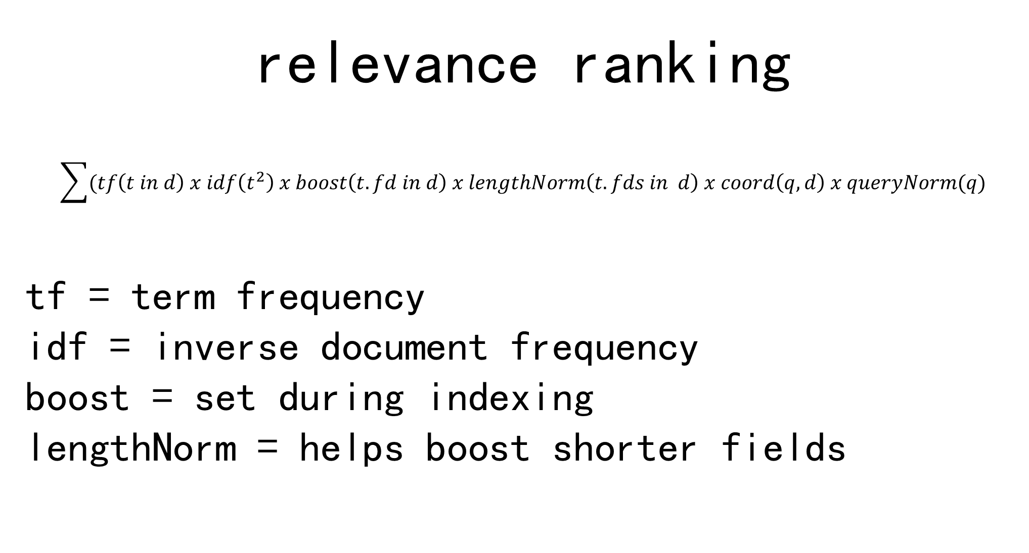
relevance ranking
$$\sum{(tf\left(t in d\right) x idf\left(t^{2}\right) x boost\left(t.fd in d\right) x lengthNorm\left(t.fds in d\right) x coord\left(q,d\right) x queryNorm(q)}$$
tf = term frequency
idf = inverse document frequency
boost = set during indexing
lengthNorm = helps boost shorter fields
Notes:
Score is raw floating point number >= 0.
Tf = how many times does term appear in doc.
Idf, how “unique” is the term to the document.
Distributed frequencies in elasticsearch.

Slide 41
distributing search
/config/elasticsearch.yml
#default shards / replicas
index.number_of_shards: 2
index.number_of_replicas: 1
Notes:
Configured default
Per index.
Queries are same
Default is 5.
Maybe we could get 3 nodes in this cluster.

Slide 42
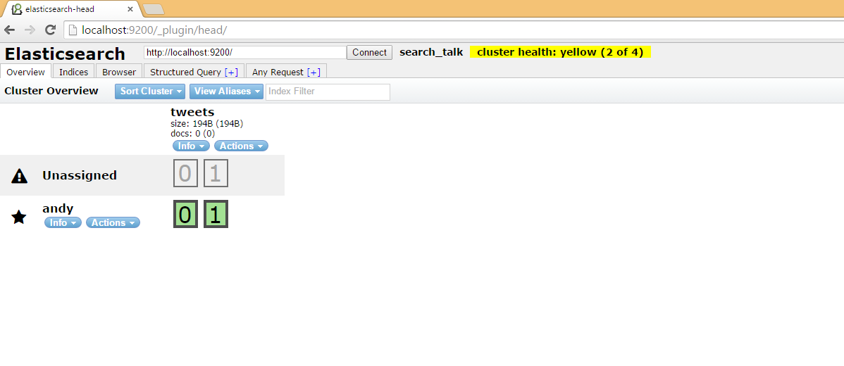
elasticsearch head
bin/plugin --install mobz/elasticsearch-head
Notes:
To create an index, we post a json string to elasticsearch. For my code samples I’m going to show windows curl commands. Escaping is replaces for readability. Full code samples will be published to github with my talk and slides if you’d like to use any of them.

Slide 43
yellow cluster health?
Notes:
To create an index, we post a json string to elasticsearch. For my code samples I’m going to show windows curl commands. Escaping is replaces for readability. Full code samples will be published to github with my talk and slides if you’d like to use any of them.

Slide 44
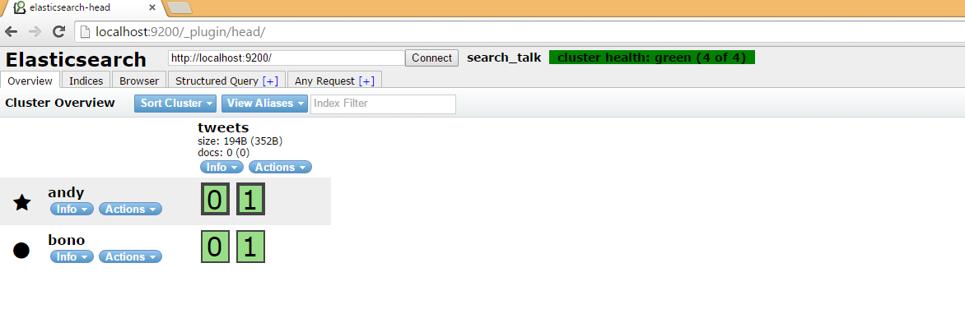
we need bono!

Slide 45
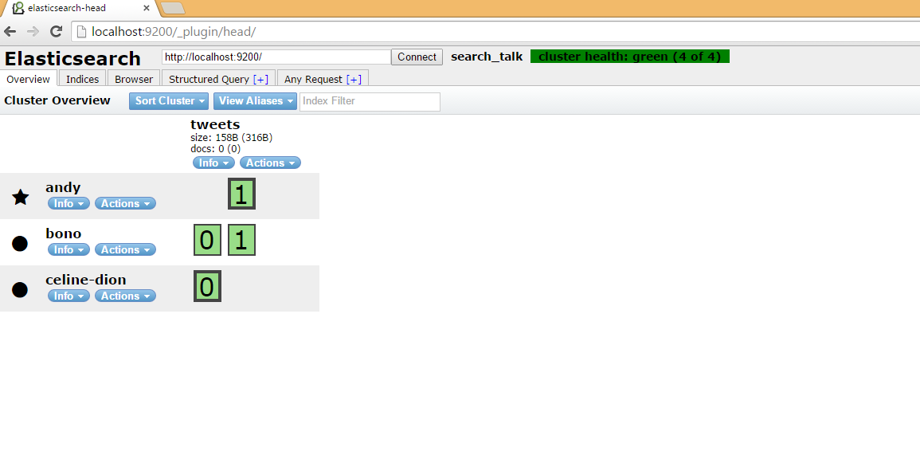
and celine?
Notes:
To create an index, we post a json string to elasticsearch. For my code samples I’m going to show windows curl commands. Escaping is replaces for readability. Full code samples will be published to github with my talk and slides if you’d like to use any of them.

Slide 46
add replica
curl -X PUT /tweets/_settings –d "{
"index.number_of_replicas": 2
}"
Notes:
To create an index, we post a json string to elasticsearch. For my code samples I’m going to show windows curl commands. Escaping is replaces for readability. Full code samples will be published to github with my talk and slides if you’d like to use any of them.

Slide 47
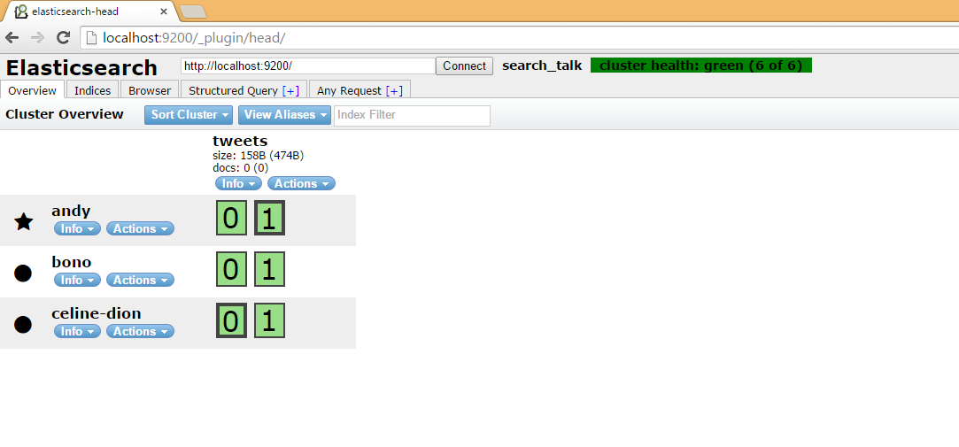
ahh
Notes:
To create an index, we post a json string to elasticsearch. For my code samples I’m going to show windows curl commands. Escaping is replaces for readability. Full code samples will be published to github with my talk and slides if you’d like to use any of them.

Slide 48
the best of the rest
facets / aggregations
term high-lighting
fuzzy queries
geo search
rivers
client libraries
scrolls
Notes:
Synonyms at filter time.
Do more than just break up the text.
Dictionary vs algorithmic.
Snowball token filter, snowball analyzer. Algorithmic.

Slide 49

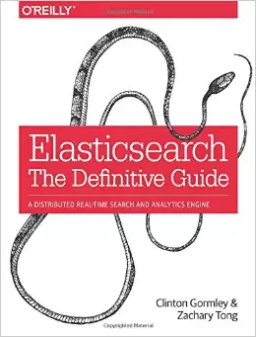
sources
Notes:
Need to cite some sources I referenced in spots.
Lucene in Action is a good book, might be targeted more lucene development, so it would be redundant if you’re mostly going to use elasticsearch.
Elasticsearch the definitive guide is top notch and in-depth, but good portion of the info is online. Elasticsearch has a great guide, so unless you’re really trying to ramp up your knowledge of the innerworkings of elasticsearch or tackling some significantly challenging search problems, might be overkill as well.

Slide 50
?
Notes:
Thank you for attending. Hope you enjoyed. Any questions!

