Slide 1
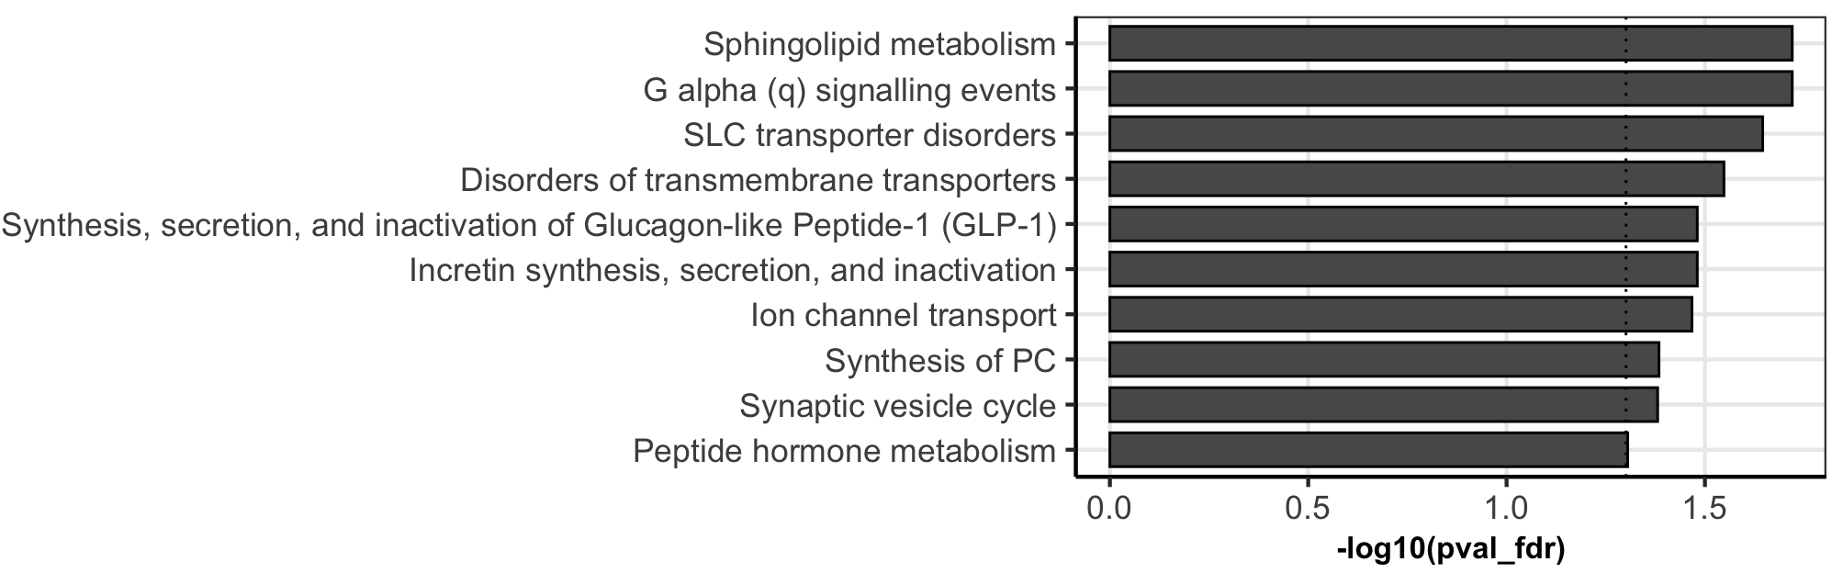
Novel
Method
Conventional
Method

Slide 3
Cell lines
Metabolon (481 metabolites)
UHPLC/MS/MS
Global, targeted metabolomic panel
Proprietary peak calling, alignment & peak identification
MDM2 Higher (Lipo224, Lipo141, Lipo246)
Metabolite level =
Cell line + Independent variable
MDM2 Lower (Lipo224B, Lipo863, Lipo815)
Examine MDM2 driven differences in the metabolome
FDR < 0.05,
log2FC > 0.75

Slide 4
Cell lines
Metabolon (481 metabolites)
UHPLC/MS/MS
Global, targeted metabolomic panel
Proprietary peak calling, alignment & peak identification
MDM2 Higher (Lipo224, Lipo141, Lipo246)
Metabolite level =
Cell line + Independent variable
MDM2 Lower (Lipo224B, Lipo863, Lipo815)
Observed differences in lipid metabolism, examine MDM2/atorvastatin driven differences in lipidome
SCIEX 5600 TripleTOF (430 lipids)
LC/MS/MS
Untargeted lipidomic panel
Mzmine for peak calling, LipidMatch for identification
Examine MDM2 driven differences in the metabolome
FDR < 0.05,
log2FC > 0.75

Slide 5
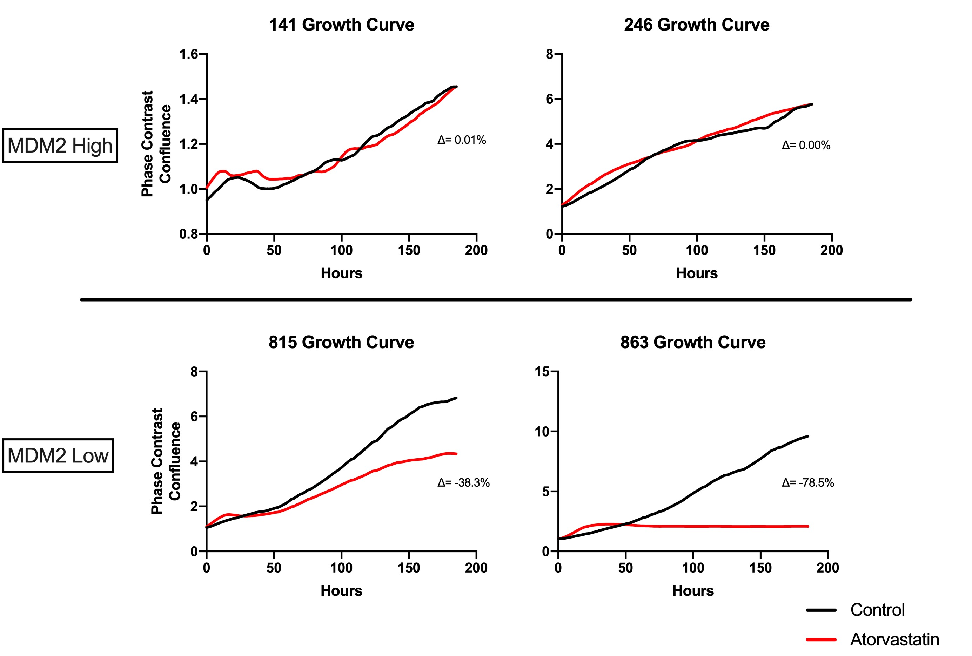

Slide 6
Cell stress
De novo synthesis
SPT
Sphinganine
Synthesis through hydrolysis
Glucosyl-ceramide
GCS
Sphingomyelin
Ceramide
Galactosyl-ceramide
GCDase
SMase
CERT
Increased survivability
Tumor suppression through apoptosis

