Slide 1
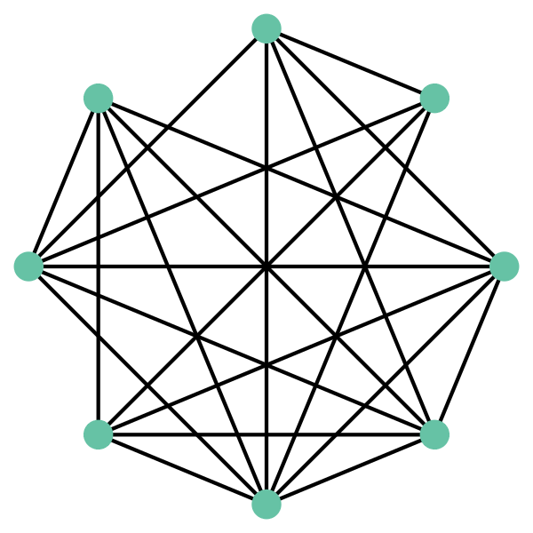
Node:
Glucose
Edge:
Pathways shared by nodes
1 shared
(KEGG map00520)
= 0.09
11 pathway associations total
Node:
Fructose

Slide 2
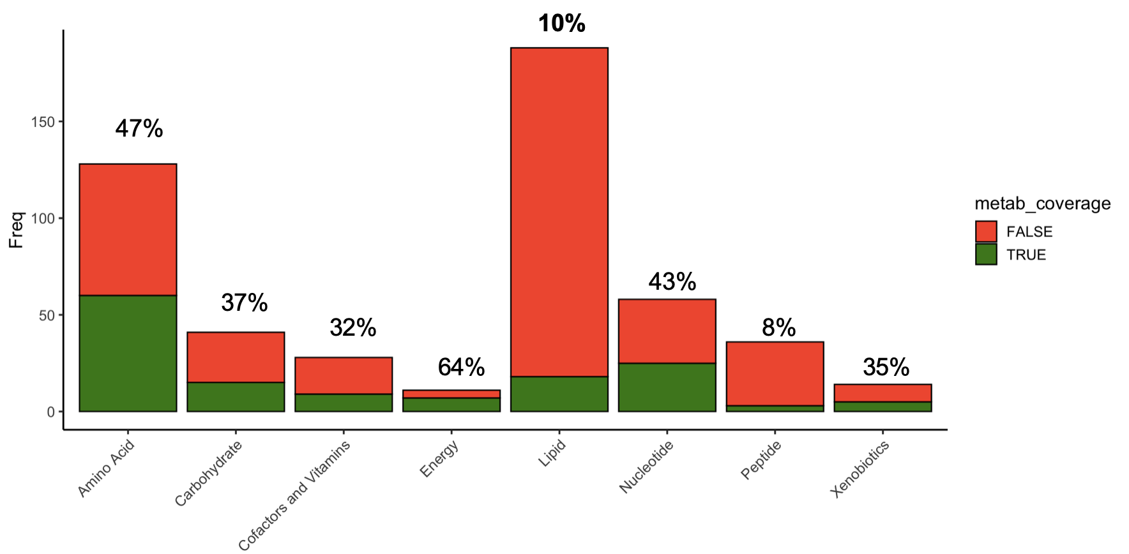
Pathway coverage in sample Metabolon data set by chemical class
10%
Maps in RaMP
Energy
Lipid
Peptide
Amino Acid
Cofactors and Vitamins
Nucleotide
Xenobiotic
Carbohydrate

Slide 3
