Slide 1
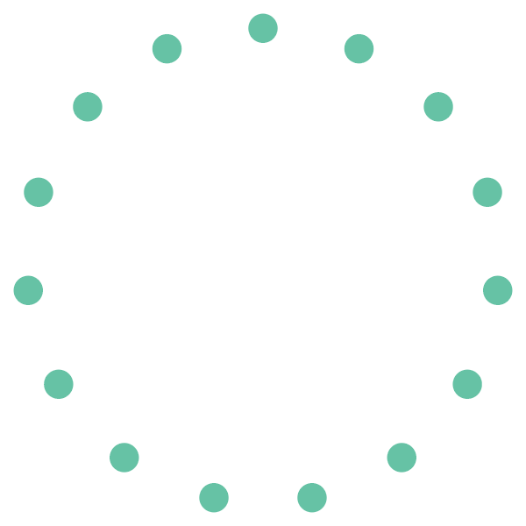
1) Build node list
(Each node is a metabolite in RaMP)

Slide 2
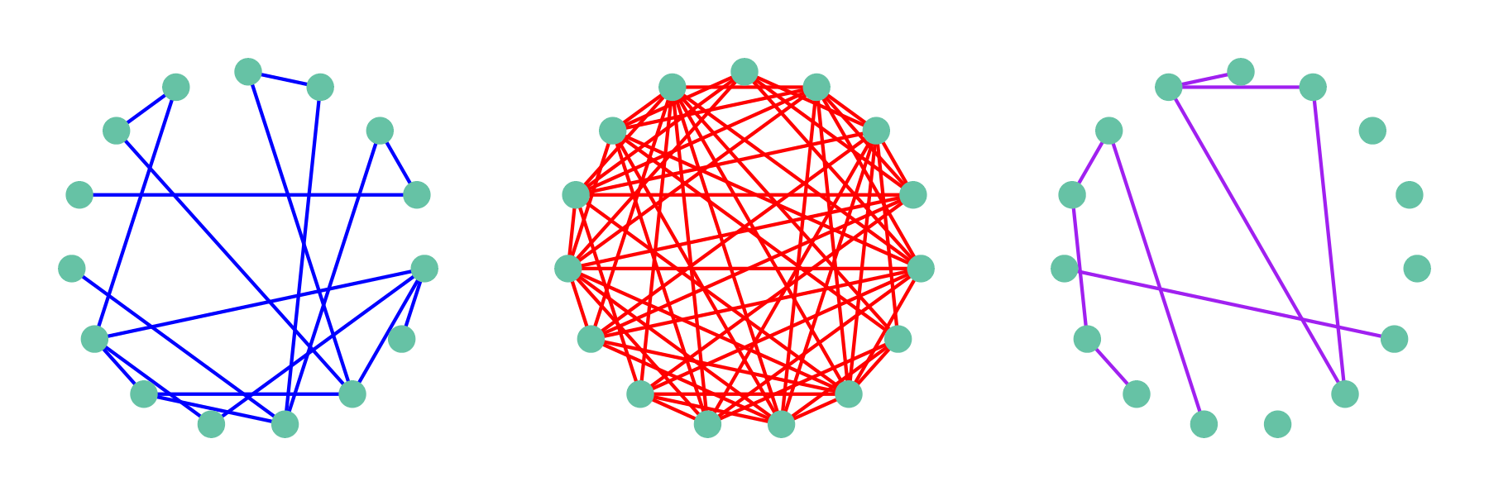
1) Build node list
(Each node is a metabolite in RaMP)
2) Calculate weighted, undirected edges by information level
Shared Pathway Activity
Chemical similarity
Other functional annotations

Slide 3
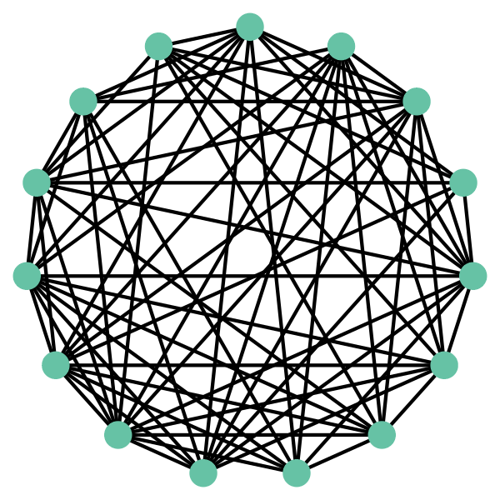
1) Build node list
(Each node is a metabolite in RaMP)
2) Calculate weighted, undirected edges by information level
Shared Pathway Activity
Chemical similarity
Other functional annotations
3) Unite separate models into consensus model

Slide 4
1) Build node list
(Each node is a metabolite in RaMP)
2) Calculate weighted, undirected edges by information level
Shared Pathway Activity
Chemical similarity
Other functional annotations
3) Unite separate models into consensus model
4) Analyze topology & calculate enrichment scores

