Slide 1

Other Chart Types

Slide 2
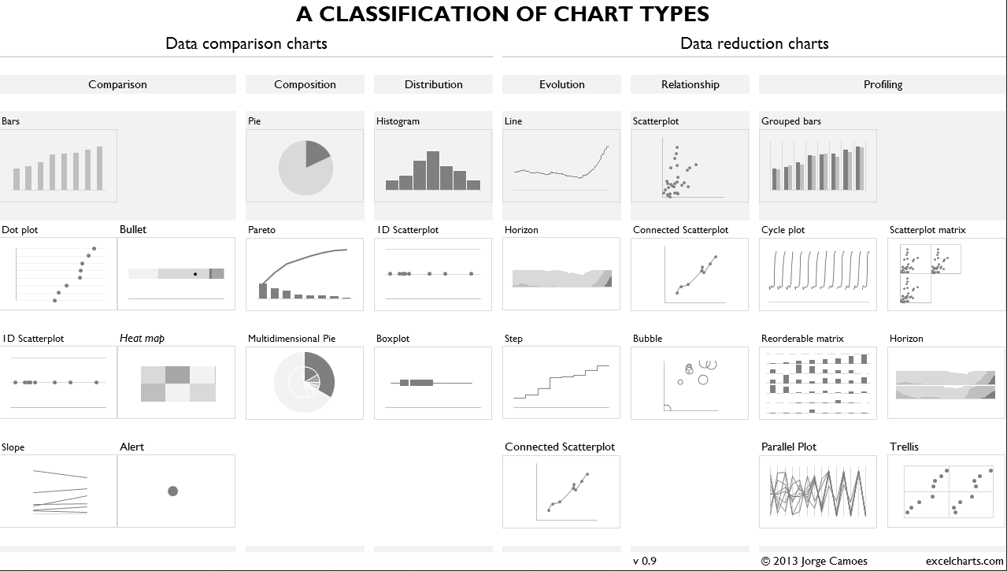
[Placeholder example for image]
Notes:
Add more in table – show basic charts first then add others in table.
Edward Tufte and Stephen Few often cover a lot in , you’ll notice that there sure are a lot of scatter plots, bar charts, and line charts. This is for good reason, but other chart types serve their purpose as well. We’ll be coming back to some of these later on the semester as we address time and place and other areas more specifically but it’s good to get accustomed to looking at them through the encoding lens.

Slide 3
Evaluating
Other Charts

Slide 4
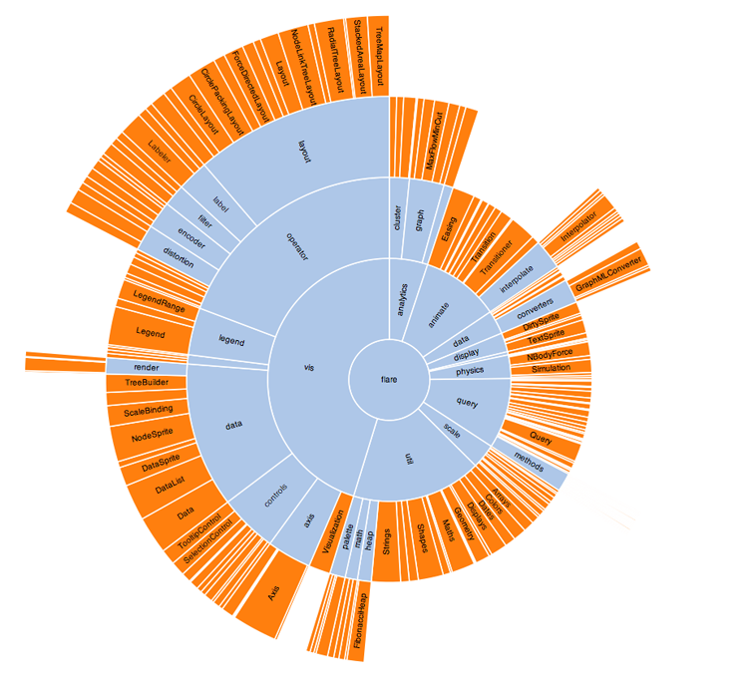
Notes:
http://www.litcharts.com/blog/images/chart-board-guardian-example.png

Slide 5
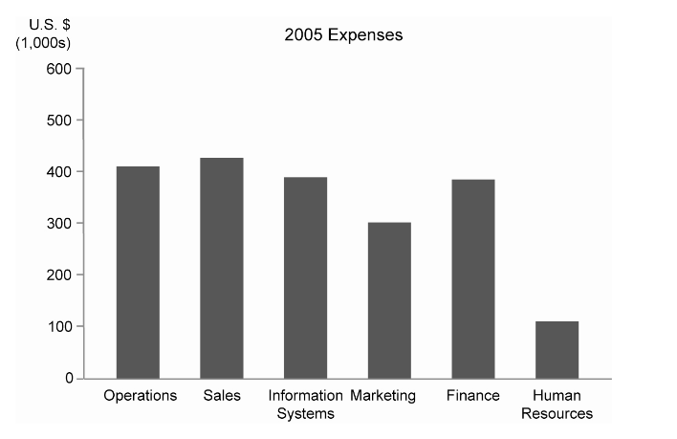
[Placeholder Example Image]
Notes:
UNFURLED

Slide 6
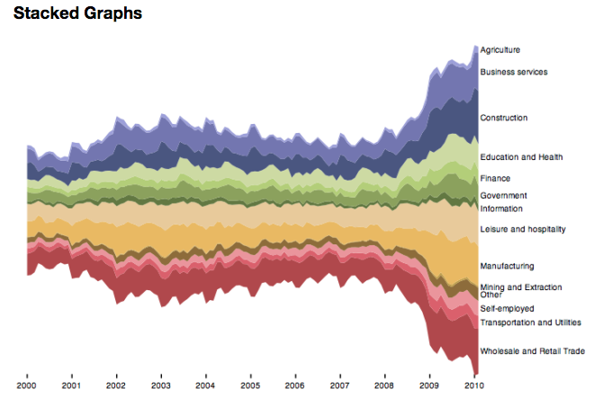
[Placeholder Example Image]

Slide 7
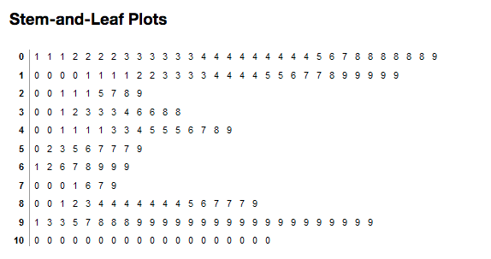

Slide 8
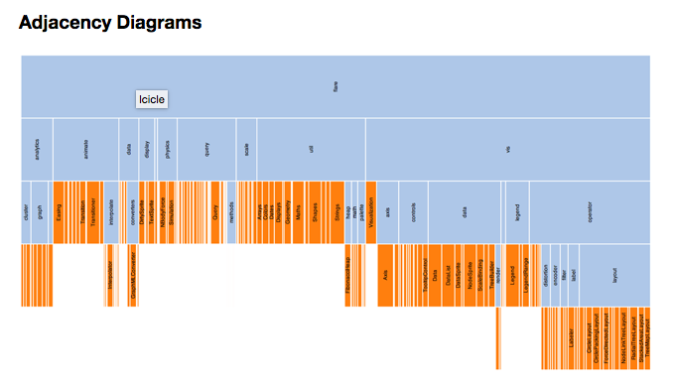

Slide 9
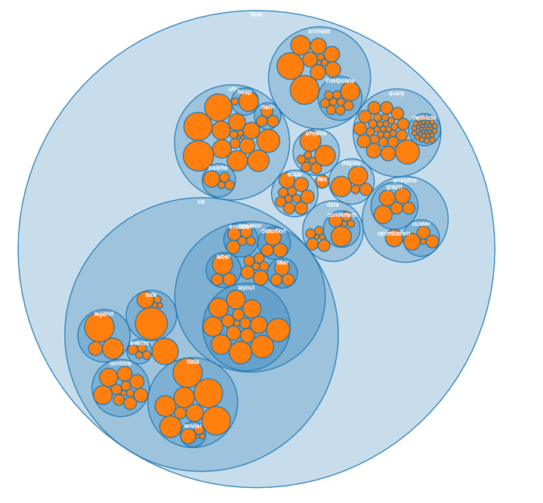

Slide 10
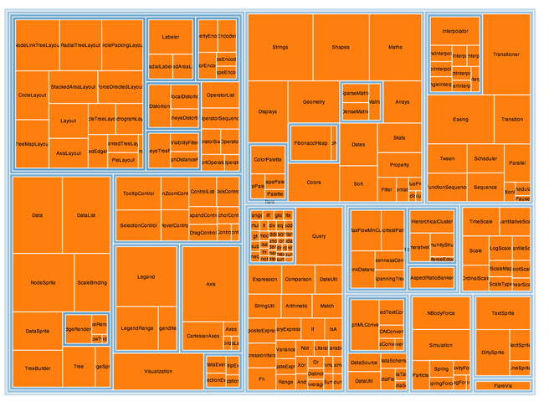

Slide 11
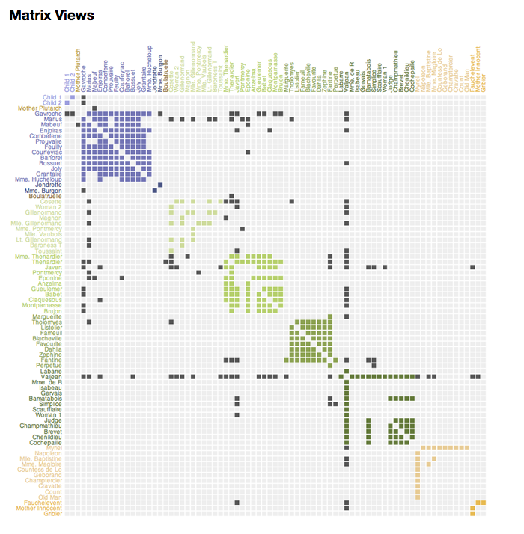
[Placeholder Example Image]

Slide 12


