Slide 1

Optimization

Slide 2
Optimizing with goals in mind

Slide 3
Formats
Web (of course!)
TIFF
PDF
GIF
PNG
Notes:
Things to keep in mind: bandwidth issues for all formats (load time!)
For rasters (and TIFF), DPI matters as well as resolution
GIF, framerate and resolution matter
ghostscript optimization of PDF

Slide 4
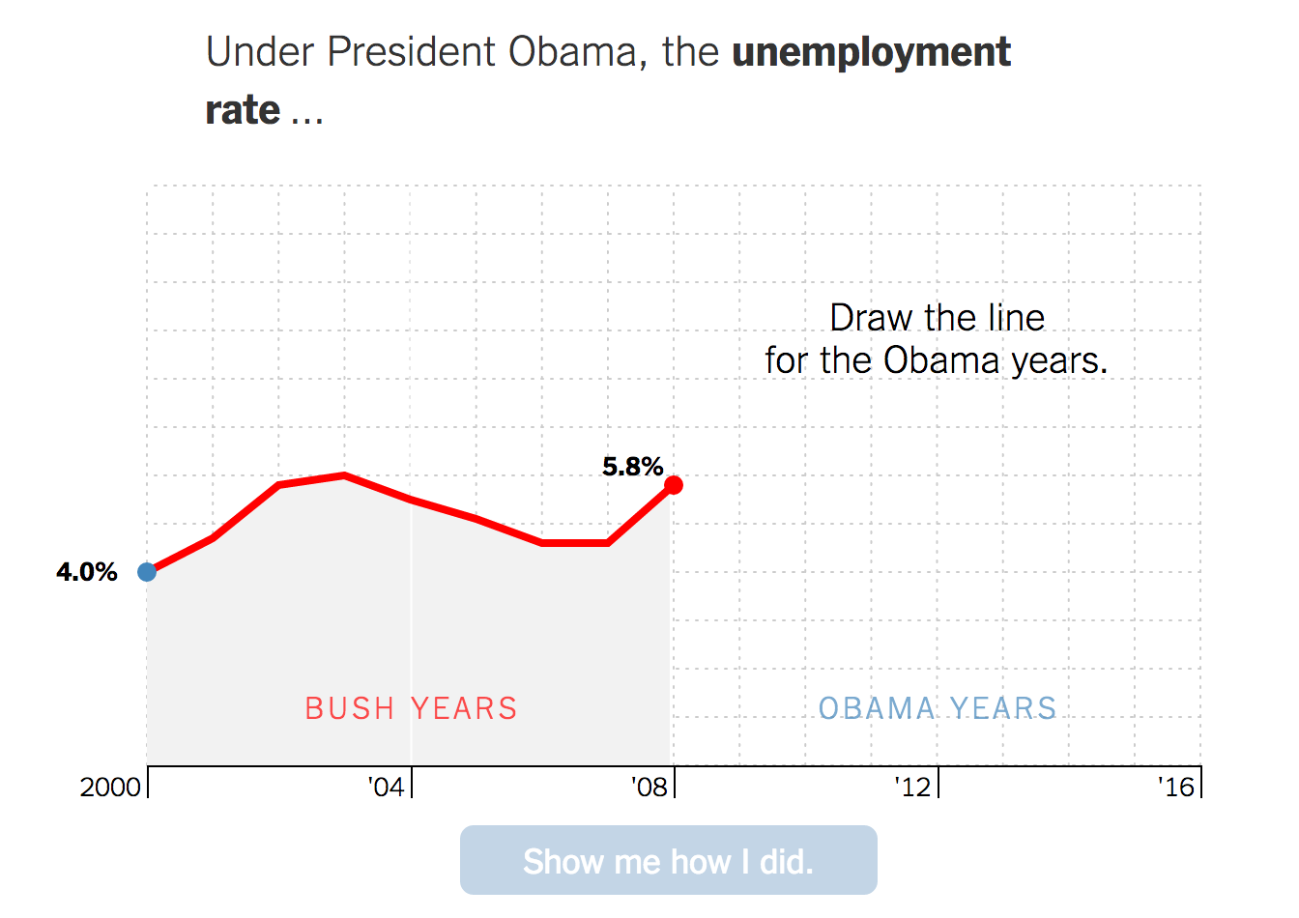
Good Enough?

Slide 5
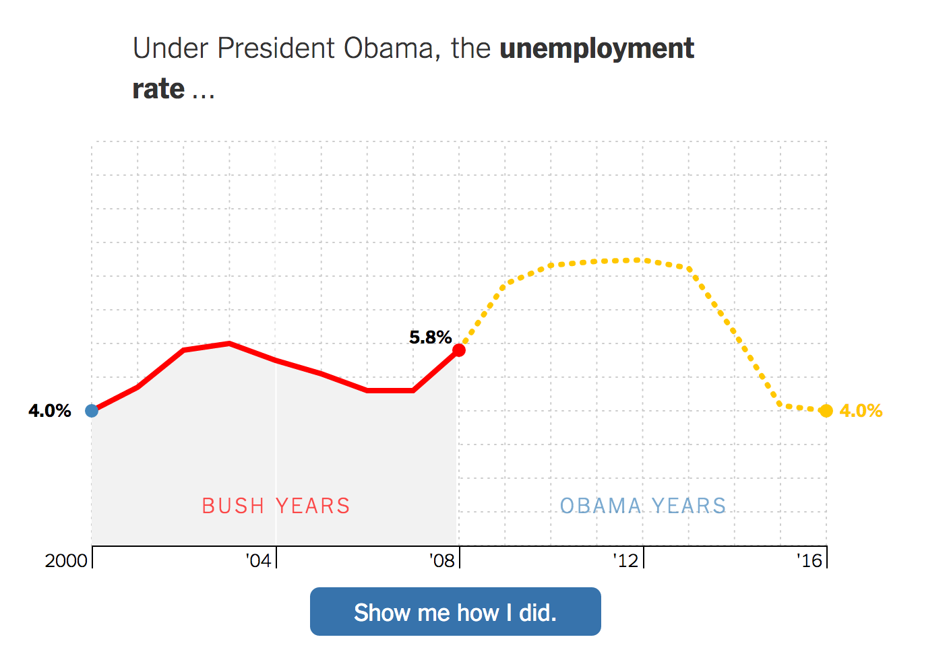
Good Enough?

Slide 6
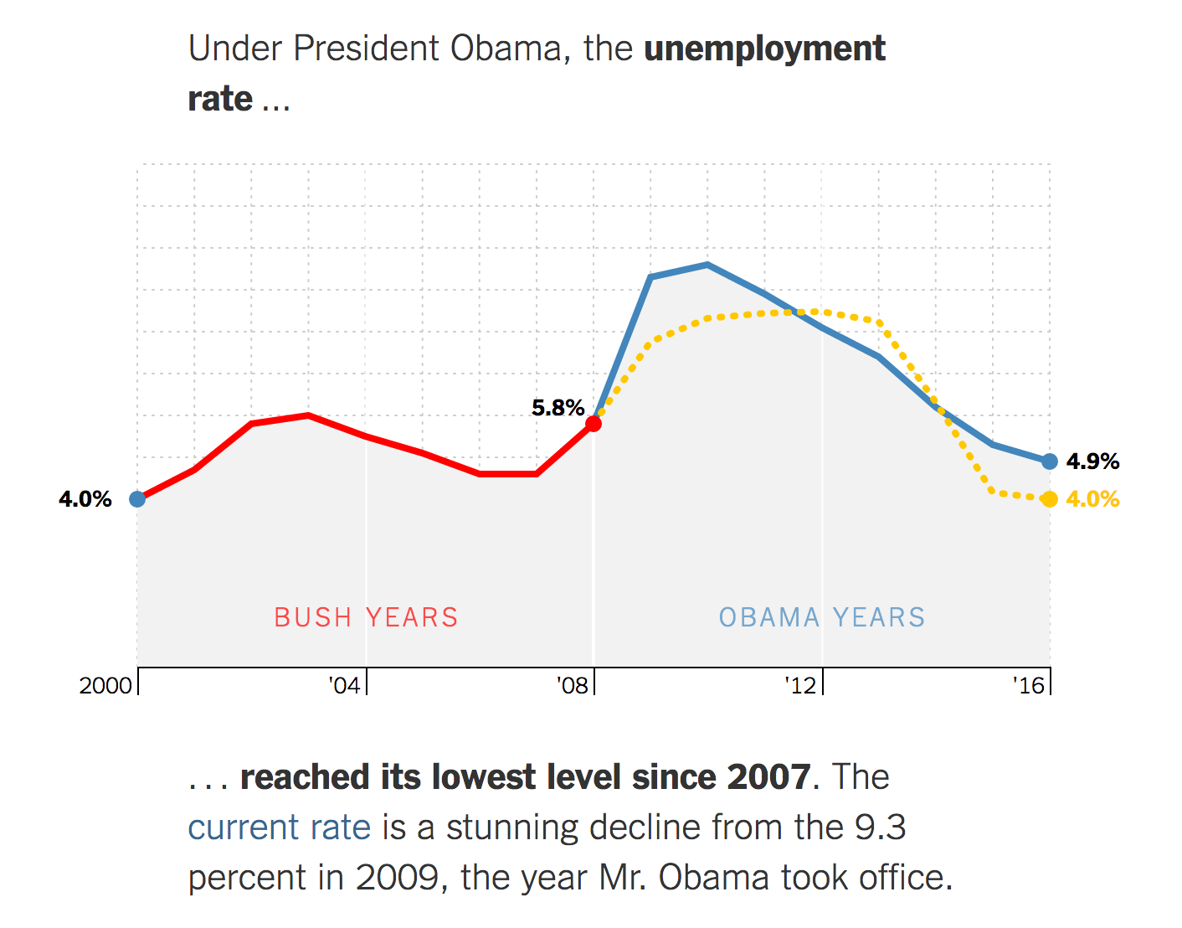
Good Enough?

Slide 7
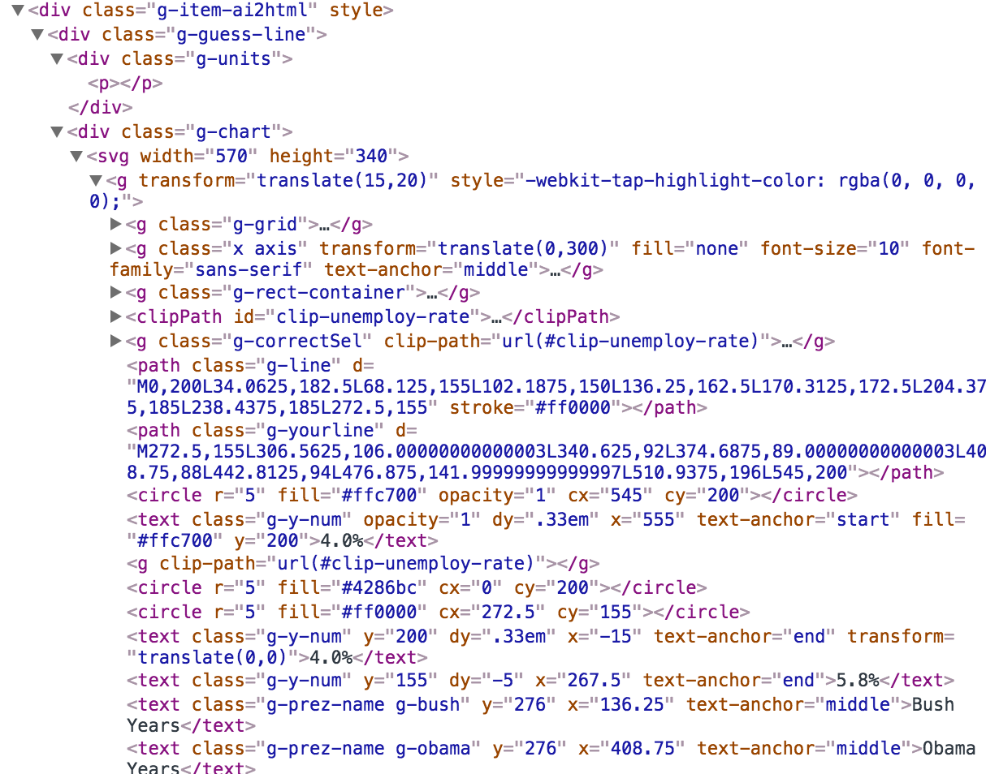
Good Enough?
Notes:
it’s a mess!
https://www.nytimes.com/interactive/2017/01/15/us/politics/you-draw-obama-legacy.html?_r=0

Slide 8
The optimal graphic
Notes:
There is none! Of course it depends upon the audience and how it’s consumed.

Slide 9


