Slide 1
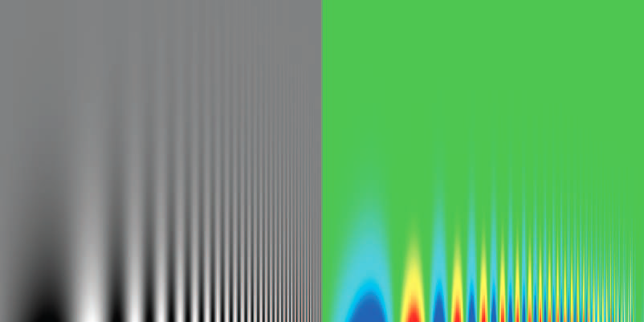
Contrast Sensitivity
Decreasing Contrast
Increasing Spatial Frequency

Slide 2
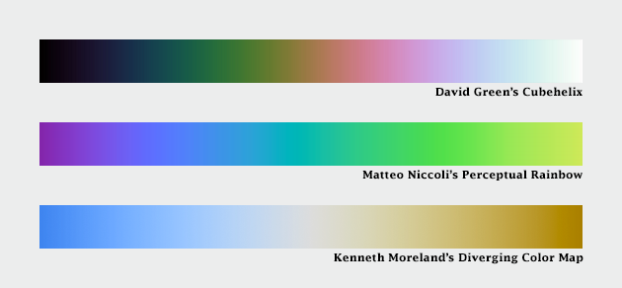
Alternatives
Notes:
alternatives spiral scales luminance varies evenly Cubehelix perceptual rainbow good for high-frequency ordinal data
diverging good for ratio data, with zero +/- (sea levels)

Slide 3
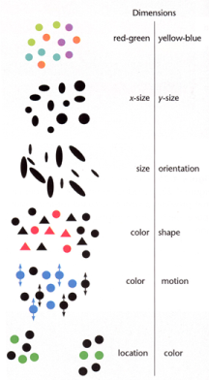
Integral and Separable Dimensions
Integral
(correlated)
Separable
(orthogonal)

Slide 4
Stevens’s Power Law
ψ(I) = kIª
Perceived intensity is proportional to actual intensity to some power.
The exponent varies with the type of stimulus.
Notes:
Stevens’ Power Law ψ(I) = kIª sensation(intensity) = constant x (intensity ^ power) perceived intensity is proportional to real intensity to some power
Exponent is the key, depends on type of stimulus

Slide 5
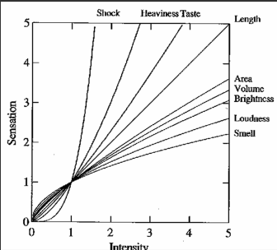
Stevens’s Power Law
Wilkinson, 1999
Notes:
power < 1, we underestimate
power > 1, we overestimate
Length seems to be accurate

Slide 6
Weber’s Law
ΔS/S = k
Ratio of change in stimulus to magnitude of stimulus is roughly constant
Notes:
Weber’s law δελταS/S = k “stimulus” = darkness ratio of (change to make JND) to initial stimulus is ~constant ratios more important than magnitude

Slide 7
Modal/Amodal Completion
Triangle = modal
Circles = amodal
Notes:
Closure modal completion – triangle in front of pacman amodal – rock behind person (blue circles) not just visual

Slide 8
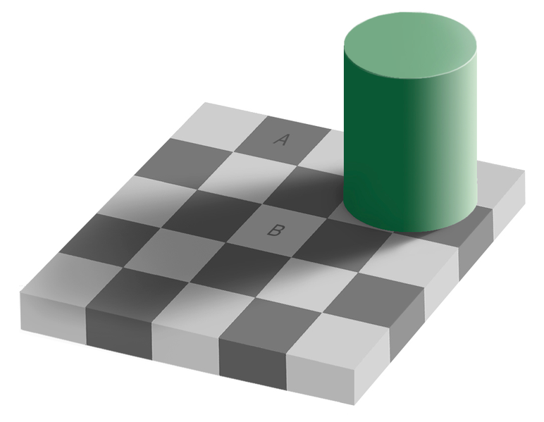
Color Constancy
Source: Wikimedia Commons
Notes:
color constancy checkerboard A and B squares same color we discount the illuminant

Slide 9
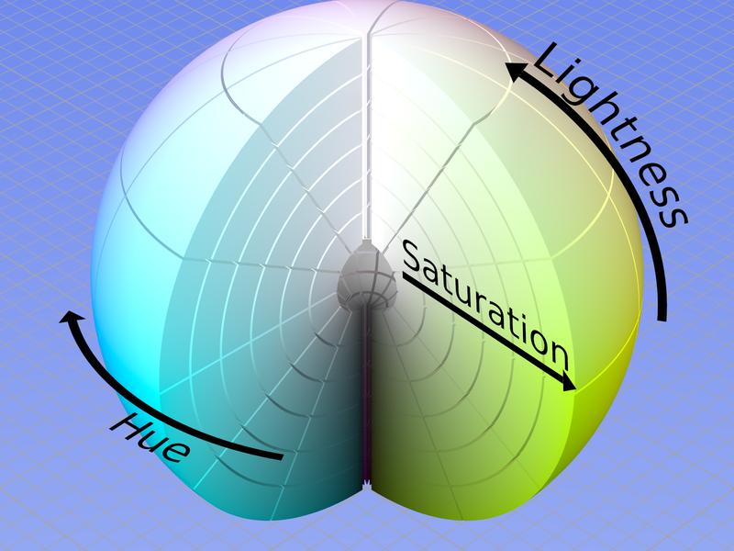
Spiral Color Maps

Slide 10
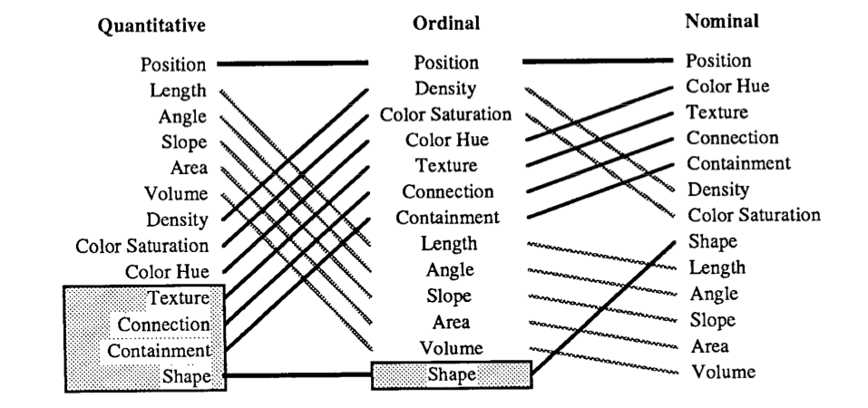
More Hierarchies of Accuracy
Mackinlay, 1986
Notes:
Hierarchies for ordinal and nominal data

Slide 11
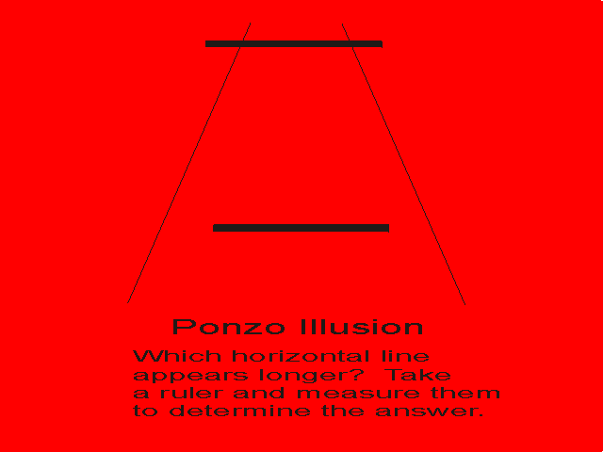
Ponzo Illusion
http://www.yorku.ca/eye/JoyCopyrite.htm

Slide 12
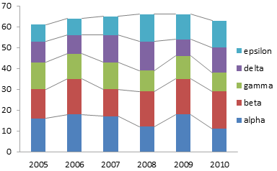
http://peltiertech.com/images/2012-01/ColSeriesLines.png

Slide 13
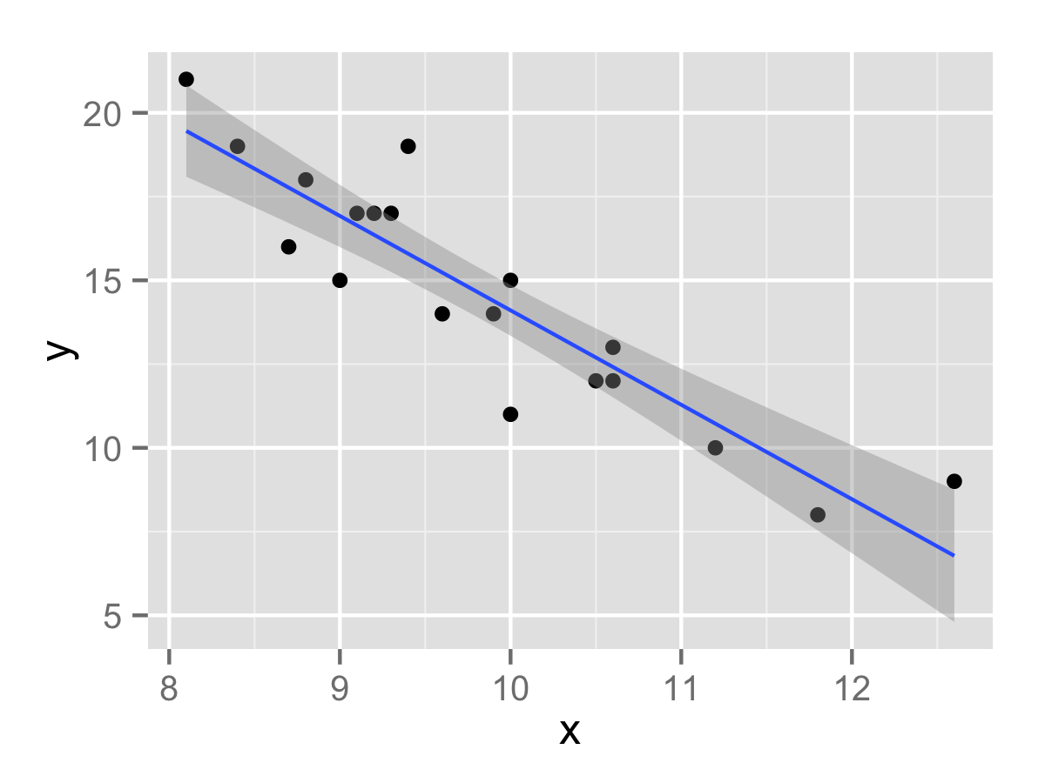
http://minimaxir.com/2015/09/bootstrap-resample/

Slide 14
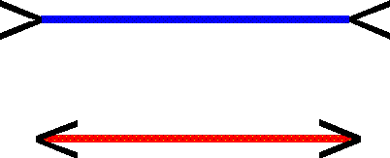
Muller-Lyer Illusion
http://www.yorku.ca/eye/JoyCopyrite.htm

Slide 15
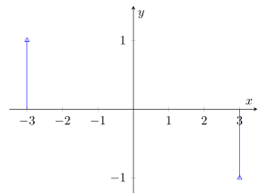
http://tex.stackexchange.com/questions/20296/how-can-i-draw-dirac-deltas-with-arrow-heads-with-pgfplots

Slide 16
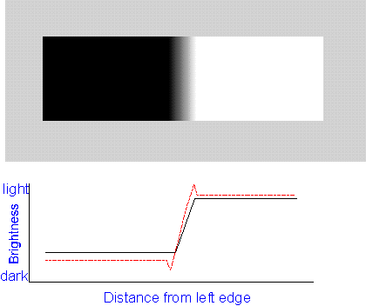
Mach Bands
http://www.yorku.ca/eye/JoyCopyrite.htm

Slide 17
Mach Bands
http://www.yorku.ca/eye/JoyCopyrite.htm

Slide 18
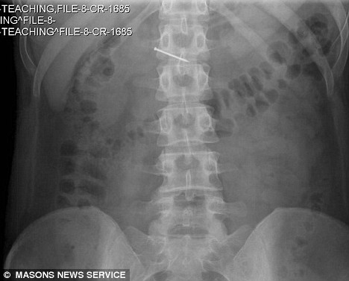
http://www.dailymail.co.uk/news/article-1050133/Bride-hospital-swallowing-inch-nail-Tesco-Value-macaroni-cheese.html

Slide 19
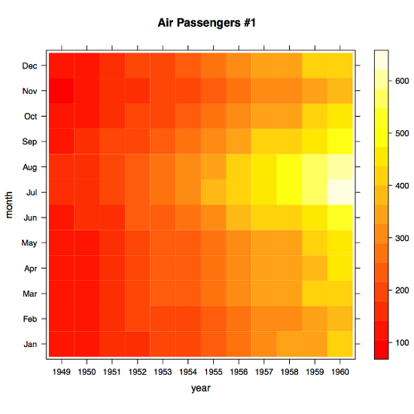
https://www.packtpub.com/books/content/creating-your-first-heat-map-r

Slide 20
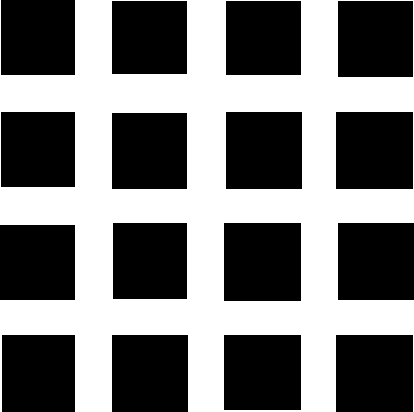
Hermann Grid
http://www.yorku.ca/eye/JoyCopyrite.htm

Slide 21
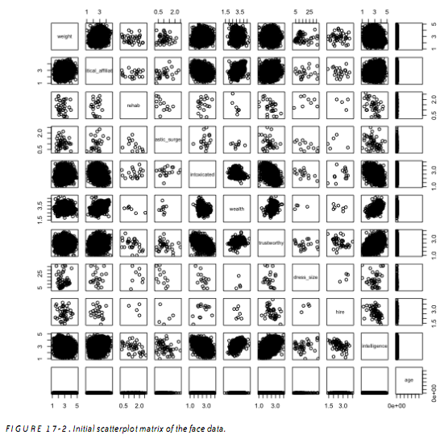
http://www.s-anand.net/blog/r-scatterplots/

