Slide 1

Course Topics

Slide 2
Part One
Fundamental techniques
for encoding data
Notes:
Artist's palette

Slide 3
Components
Data structure to visual form
Selecting chart types
Perception and patterns
Color and contrast
Interactions

Slide 4
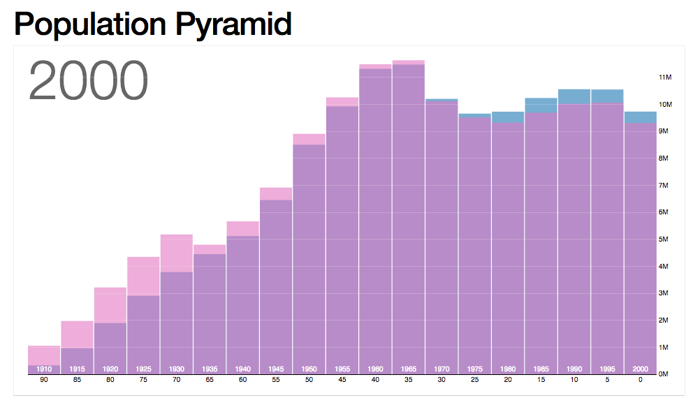
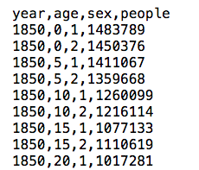
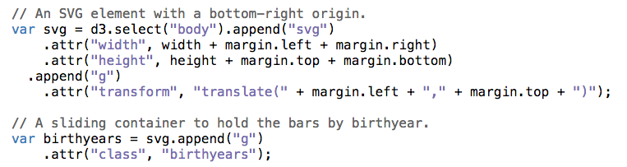
http://bl.ocks.org/
mbostock/4062085
Notes:
D3 javascript library. Takes data in arrays. Manipulates HTML, works in a way that parallels nicely the visualization process itself.

Slide 5
Part Two
Design and Build
Notes:
process

Slide 6
Components
Exploratory data analysis
Design and evaluation process
Python visualization tools

Slide 7
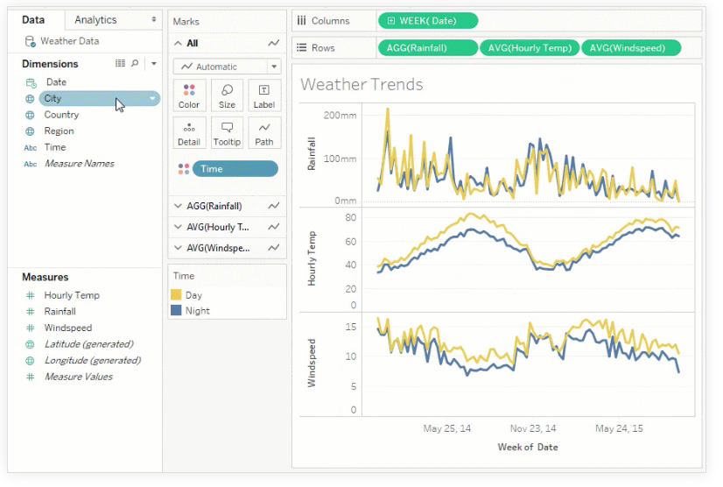
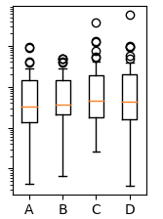
Components
plt.boxplot(data)
Notes:
Tableau – exploratory, GUI
Python, plotting libraries.

Slide 8
Part Three
Specialized Topics

Slide 9
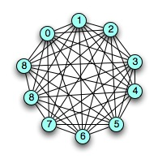
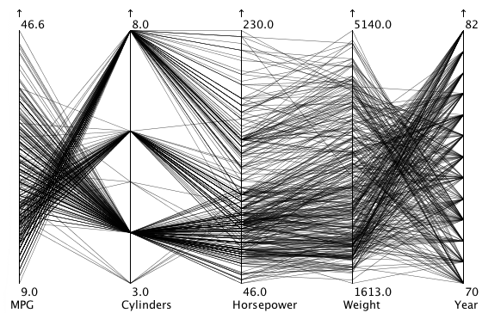
Components
Time and place
Multidimensional data
Performance
Networks
Narrative
Notes:
time series,
geographic,
high-dimensional
performance,
networks,
storytelling

Slide 10

Hands-On
Approach
Notes:
apply the concepts you’re learning.

Slide 11


