Slide 1

Principles of Visualization

Slide 2
What makes for a good visualization?

Slide 3
Graphical excellence is the well-designed presentation of interesting data—a matter of substance, of statistics, and of design.
(Tufte, 1983)
Notes:
Substance - Not just nice art.
Stats - The right statistical models and transformations
Design – should be effective.

Slide 4
complex ideas communicated with
clarity
precision
and efficiency

Slide 5
Efficient
the greatest number of ideas
in the shortest time
with the least ink
in the smallest space

Slide 6
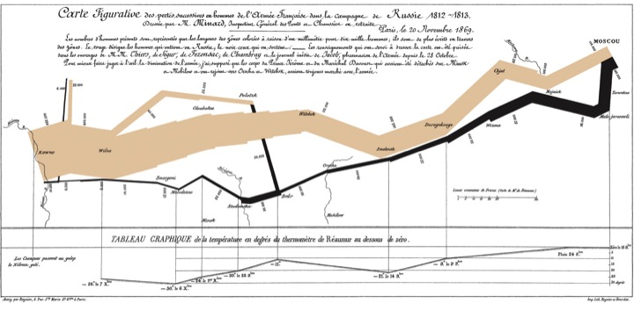
Multivariate
Notes:
Joseph Minard

Slide 7
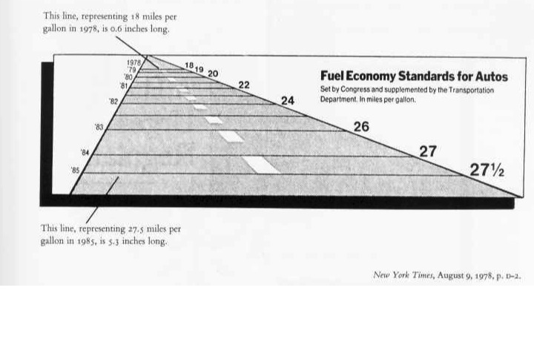
Truthful

Slide 8
Graphical integrity

Slide 9
Representations of numbers directly proportional to their numeric quantities

Slide 10
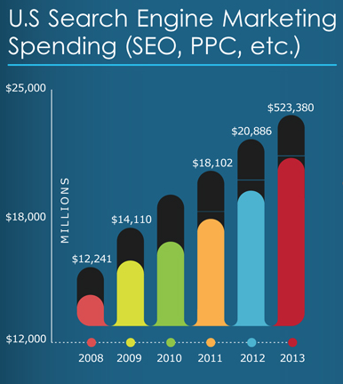
Annex Core
Notes:
Black bars or colored bars?
scale is closer to the colored bars.
Linear representation, nonlinear data

Slide 11
Lie factor = (size of effect shown in graphic) / (size of effect in data)
Notes:
Tufte’s definition, says a lie factor less than 0.85 is dishonest.

Slide 12
183 px tall
35 px tall
Annex Core
Notes:
lie factor:
2008 is 35 px tall.
2013 is 183 px tall.
183 – 35 = 148 is the size of the effect as represented.
148/35 = 4.22,
Correct scale: (523,380 – 12,241)/12,241 = 41.76.
effect shown/effect in data: 4.22/41.76 = 0.101. Tufte cautions against lie factors less than 0.85!

Slide 13
Clear and thorough labeling

Slide 14
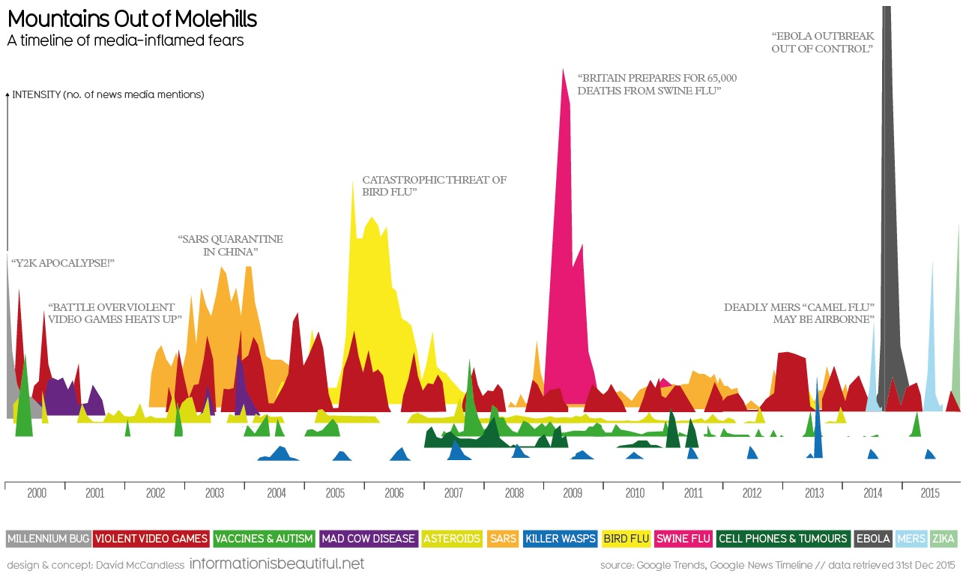
[placeholder for image]
http://www.informationisbeautiful.net/visualizations/mountains-out-of-molehills/
Notes:
NO y scale
Ebola peak goes off top
Hover shows full scale

Slide 15
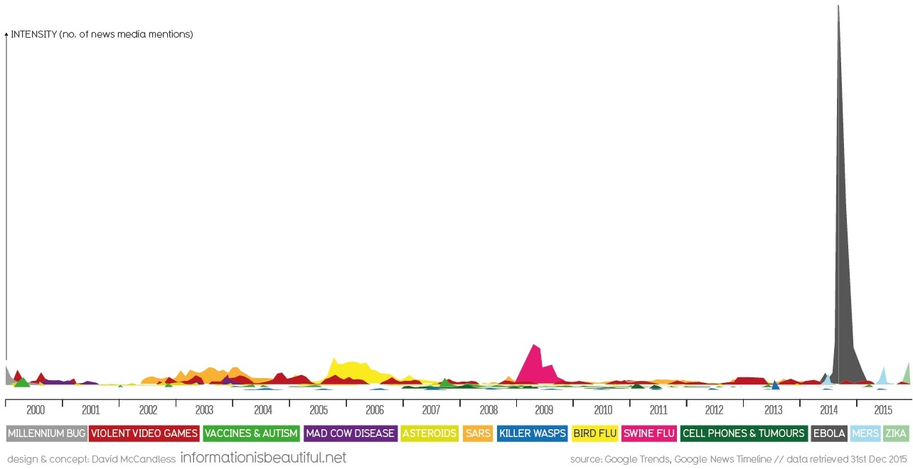
[placeholder for image]
http://www.informationisbeautiful.net/visualizations/mountains-out-of-molehills/
Notes:
Looks pretty different!

Slide 16
Provide context

Slide 17
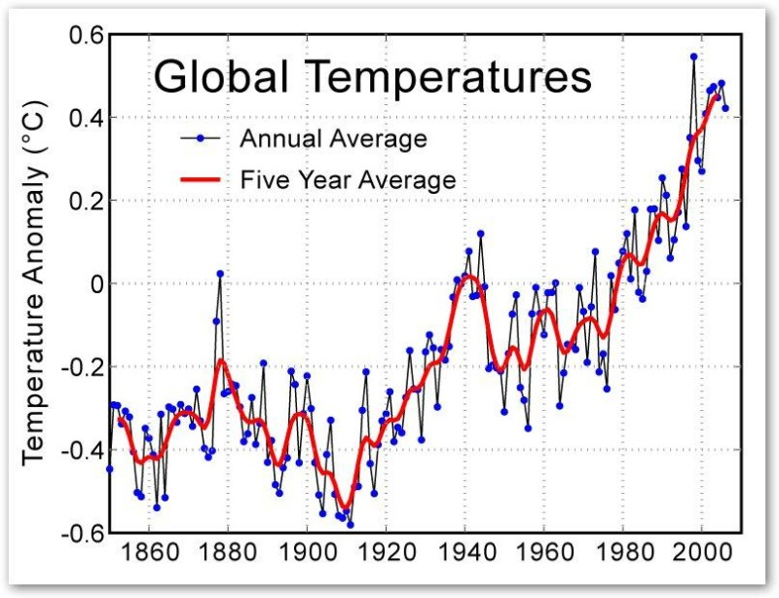
[placeholder for image]
(Image: Global Warming Art)

Slide 18
Show data variation, not design variation

Slide 19
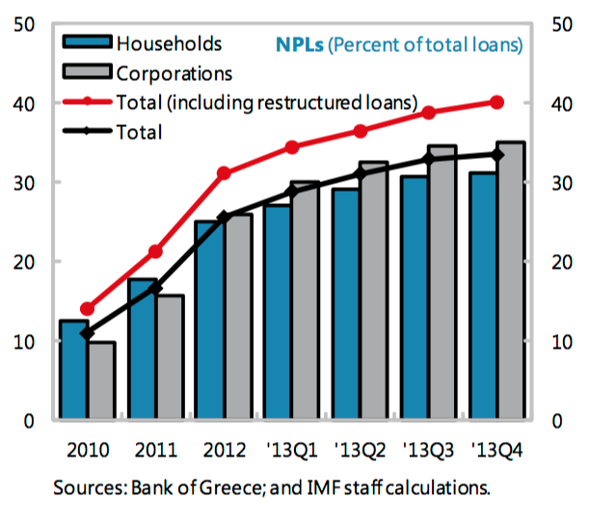
[placeholder for image]
https://www.imf.org/external/pubs/ft/scr/2014/cr14151.pdf

Slide 20
data-ink ratio = (data ink) / (total ink to print graphic)

Slide 22
Notes:
Tufte’s principles provide good guide posts but Tufte does not have the last word. An evolving field.

Slide 23
Beyond Tufte
User-centered design (study user needs, prototype, test, iterate)
Interaction (can update data and manipulate views)
Aesthetics (minimalism can be taken too far)

Slide 24


