Slide 1

A Reference Model

Slide 2
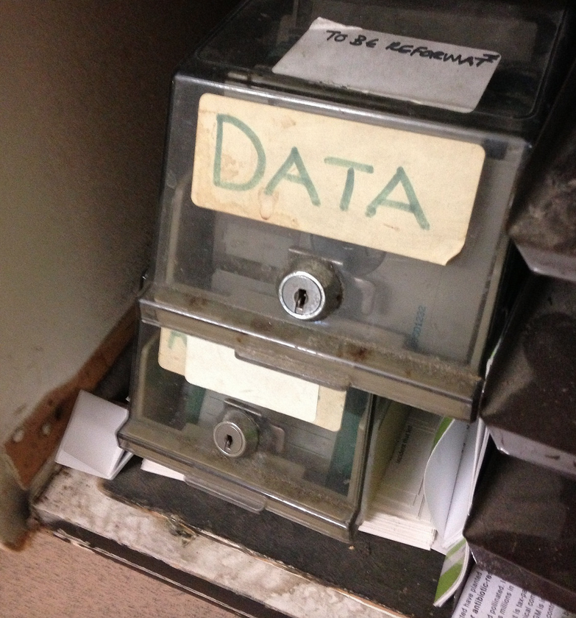
flickr cc 2.0
DATA by Janet McKnight
]
Notes:
One of the primary goals of visualization is getting data, which can be ungainly and need cleaning,

Slide 3
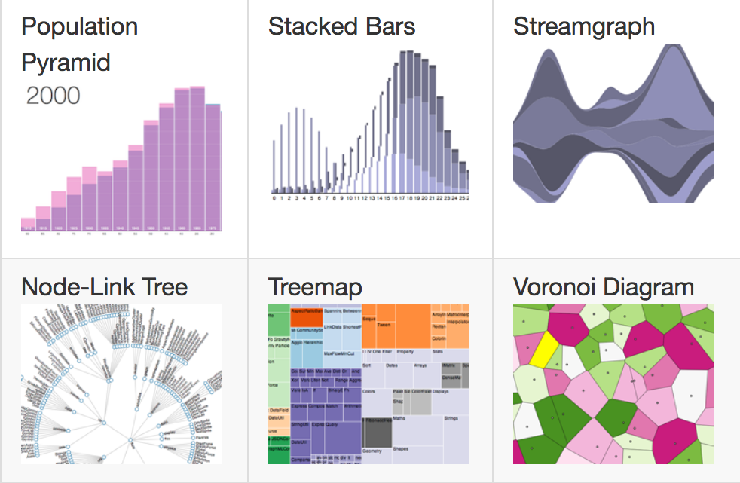
Source: https://github.com/d3/d3/wiki/Gallery
Notes:
and connecting it to a visual representation that is elegant and easily perceivable by the human perceptual system.

Slide 4
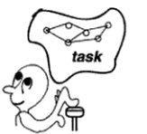
A Reference Model
Data
Visual Form
Task
Redrawn from Card, Mackinlay, & Shneiderman, 1999.
Readings in Information Visualization: Using Vision to Think
Notes:
There’s a model developed by Stuart Card, Jock Mackinlay, and Ben Shneiderman that has a useful way of thinking about this model. RAW DATA whether that’s numerical spreadsheets, streaming sensor outputs, or unstructured text are transformed into more structured forms within a DATA TABLE, which has relational mappings of the data along with metadata about those mappings, when it’s in more structured form it can be transformed using Visual Mappings into VISUAL STRUCTURES, the graphical marks and visual properties, these structures are then transformed into VIEWS that specify the position, scaling and other parameters – these are then translated by the viewer’s perceptual capabilities into meaningful insights for tasks. If it’s a computer supported tool, there’s going to be interactions that could be supported along the way, so the analyst here could transform these views (VIEW TRANSFORMATIONS), so that only certain data variables are shown data is filtered for certain ranges, or change some of the VISUAL MAPPINGS or even the way the is DATA TRANFORMED by say uploading a different data set. Our primary focus in the next few weeks is to understand how to make informed decisions about to getting from a data table, to these visual encodings to views.

Slide 5


