Slide 1

Data Tables and Types
Notes:
One of the most fundamental aspects of visualization is getting abstract data into a visual language that makes perceptual sense to a viewer. To do this, an understanding of the characteristics of the data is incredibly useful.

Slide 2
Primitive Data Types
.0034
455,600
true, false
Notes:
There are several ways we can look at data types. One of the most basic levels you can think about are primitive data typessuch as floats, integer, boolean, real etc. These are the way a programming languages, and this is sort of how your computer thinks about how it can manipulate data.

Slide 3
Scales of Measurement
Nominal
Ordinal
Interval
Ratio
Stevens,1946. On the Theory of Scales in Measurement.
Notes:
At a higher level we also have conceptual data types that help us construct mental models about our data, characterize it, and organize it. One of these conceptual models is the scales of measurement originally developed by Stanley Smith Stevens an American psychologist out of Harvard in the mid twentieth century.

Slide 4
Scales of Measurement
Nominal: data are classified with no inherent order or ranking
Stevens, 1946. On the Theory of Scales in Measurement.
Notes:
NOMINAL also called CATEGORICAL DATA is what Stevens called the most unrestricted assignment of data, in which words, letters, or numbers act as labels. One example might be numbers on basketball jerseys, which aren’t really meaningful in any ordered sense but simply act as a way to label and identify the player. Or flavors of ice cream (though I might have my own particular ranking).

Slide 5
Scales of Measurement
Nominal: data are classified with no inherent order or ranking
Ordinal: data are ranked
Stevens, 1946. On the Theory of Scales in Measurement.
Notes:
Ordinal a ranked ordering, such as the number of grades or the results of a race.

Slide 6
Scales of Measurement
Nominal: data are classified with no inherent order or ranking
Ordinal: data are ranked
Interval: meaningful difference between values (temp.)
Stevens, 1946. On the Theory of Scales in Measurement.
Notes:
INTERVAL: common with statistical measures, the scale remains true with the addition of a constant. If you think about temperature when it’s at zero that doesn’t mean there’s no temperature, or how we mark the the calendar year could be moved up or down.

Slide 7
Scales of Measurement
Nominal: data are classified with no inherent order or ranking
Ordinal: data are ranked
Interval: meaningful difference between values (temp.)
Ratio: meaningful 0 point and ratio between values
Stevens, 1946. On the Theory of Scales in Measurement.
Notes:
RATIO: is data with an implied absolute zero point. commonly found in physics, so measures such as weight, height, age, have an absolute zero, and ratio data allows you to say things like ‘twice as much’ or ‘three times as high’. There are some gray areas here, let’s take income earned as an example, one would certainly hope that this had an absolute zero point and that ones’ employer is not taking money from them – though a bank account can certainly go into the negative, or a company have negative net income. So it’s better to think about these as a guide than pulling your hair out too much, you might get negative hair.

Slide 8
Data Type Taxonomy for Info Vis
1-Dimensional (sequences, lists)
2-Dimensional (map, planar)
3-Dimensional (real world objects)
N-Dimensional (relational data)
Trees (hierarchies)
Networks (graphs)
Temporal (time series)
[Shneiderman, 1996]
Notes:
Another conceptual way to organize data as offered by Shneiderman is seven data types that include
1D: Text documents, lists of names, so a scroll display going through items of a list might be one way to display these data, or now 2D: that I’m thinking about it the data I’m showing you is 1 D
3D: Real world objects as shapes and volumes. Computer assisted design systems for architecture use these
Nd: Things get a bit more exciting with mutldimensional data, most relational and statistical databases are manipulated as multiple dimensions in which n attributes are represented as points within n dimensional space. We’ll talk much further about multidimensional data througout the course and ways of supporting tasks such as finding patterns between variables.
Trees: parent child structure with various levels to a tree
Networks: relationships between items that aren’t captured in Tree

Slide 9
Dimension and Measures
Notes:
In the sense of a data warehouse, dimensions and measures as a model for understanding the data.

Slide 10
Dimension: discrete variables such as dates and categories
Measure: data values that can be aggregated (average, sum, count, standard deviation, etc.)
Notes:
In Tableau when you initially connect to the data source the system gives it’s best guess at assigning data this way, so fields that have strings or boolean values are assigned dimension, and any data that has numerical information are assigned as Measures. How the data is assigned in this way can change how you’re able to work with it. We’ll come back to that.

Slide 11
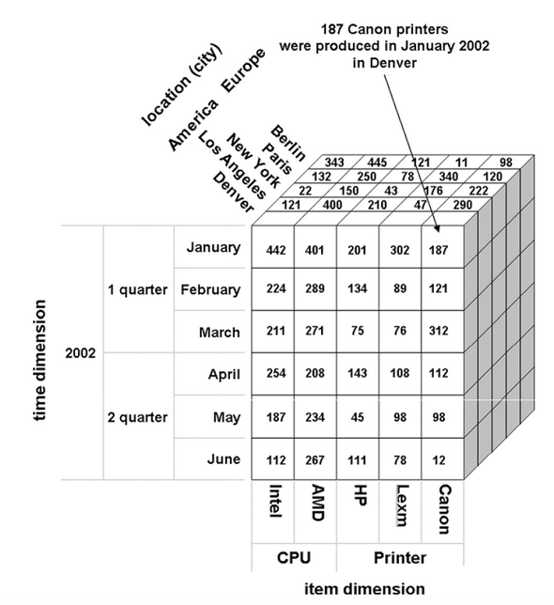
The Data Cube
Source: Krzysztof et al., 2010. Data Mining: A Knowledge Discovery Approach.
Notes:
The data cube is likely familiar from working with analytic data stores. While it’s represented here as three dimensions with times, locations, and items it can of course be many more as well

Slide 12
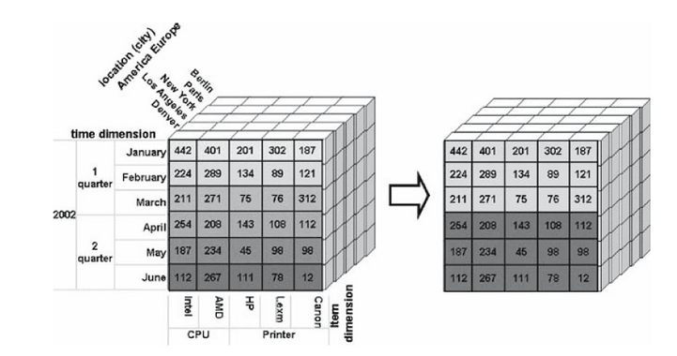
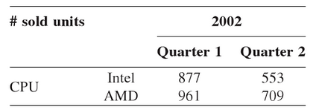
Roll Up
Source: Krzysztof et al., 2010. Data Mining: A Knowledge Discovery Approach.
Notes:
Roll up allows you to summarize data into a more general level in the data hierarchy. Here if data were aggregated by quarter.

Slide 13
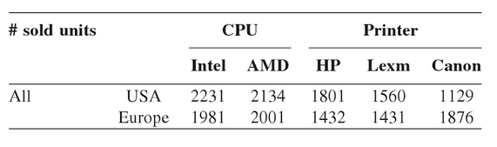

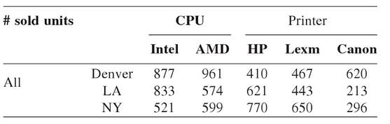
Drill Down
Source: Krzysztof et al., 2010. Data Mining: A Knowledge Discovery Approach.
Notes:
The drill down command gives a more detailed breakdown of information from lower in the hierarchy, here we can see more details of sales for specific cities within the US. Deciding how data is grouped and what level of detail to provide is an essential process before encoding it.

Slide 14
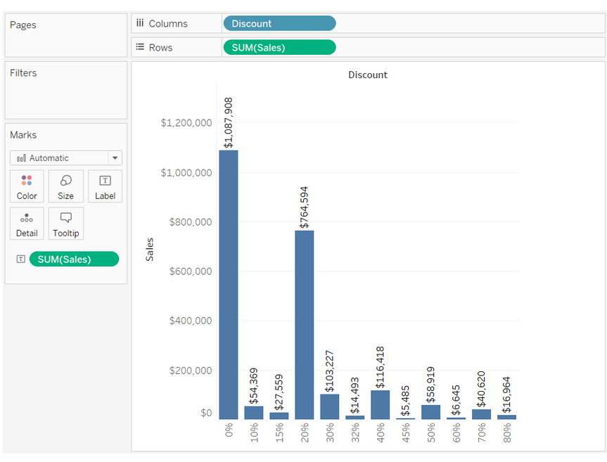
Notes:
When you connect to a data source, Tableau assigns each field in the data source as playing one of two possible data roles: dimension or measure. any fields that contain discrete categorical information (for example, fields where the values are strings or Boolean values) to the Dimensions area in the Data pane.

Slide 15
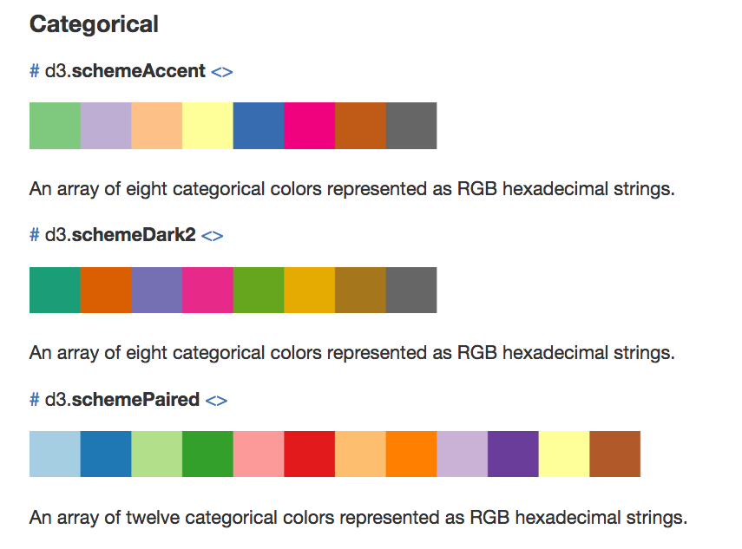
https://github.com/d3/d3-scale-chromatic

Slide 16


