Slide 1

Visual Encodings

Slide 2
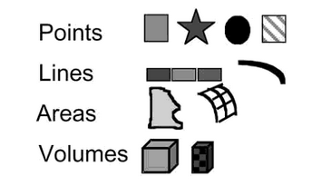
Types of Marks
Source: Card, Mackinlay, & Shneiderman, 1999. Readings in Information Visualization: Using Vision to Think
Notes:
We talked previously about different ways to conceptualize types as it sits within a data table. This being data visualization, it makes sense that next we want to go from that data to the graphical marks and properties to visualize them. Marks provide one of the most basic types of visible things that occur in space with 4 elementary types: points, lines, areas, and volumes. Unlike in geometry, points and lines for our purposes actually do take space and have additional properties such as shape.

Slide 3
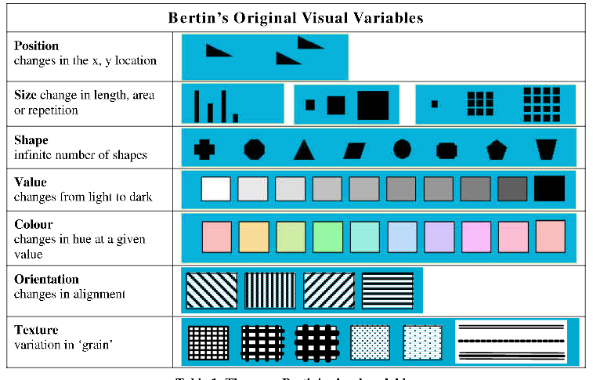
Diagram Source: Carpendale, 2003
Notes:
Visualizations would be pretty boring, and not as effective without some additional ways to encode data, and French cartogropher and early data vis theorist Jacques Bertin offers several other properties of these basic marks including position, size, shape, value (also called brightness or how light or dark something is) color or hue, orientation, and texture.
As we’re working with D3 in this course, we’ll be taking data points and encoding them with these various properties.

Slide 4
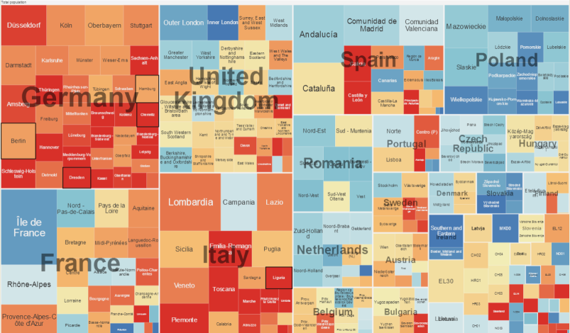
Additional Encodings
Enclosure and connection
(e.g., treemaps, network graphs)
Image Source: http://ncva.itn.liu.se/education-geovisual-analytics/treemap?l=en
Notes:
There are a few other ways we can think about representing marks as well, including enclosure and connection, allowing for a relationship between variables to be mapped based on proximity. Here we have a treemap showing the elderly population in Europe. Can see regions linked within the country based on being enclosed with the same parent square.

Slide 5
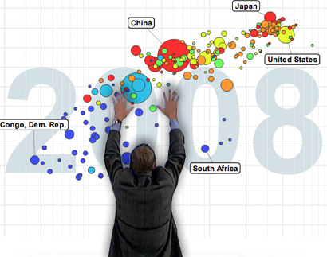
Additional Encodings
Time
(e.g., animation)
Image Source:
http://www.gapminder.org
Notes:
And last but certainly not least, time is another way we can encode data, since perceptually as human we’re sensitive to changes of the position of the marks.

Slide 6


Slide 7
Dissecting a Visualization

Slide 8
A Process Model
1) Decide which variables to map into spatial positions
2) Combine mappings (transform as needed)
3) Use visual encoding for variables
4) Decide on controls for interaction
5) Apply attention-reactive features
[Card, 1999]
Notes:
Check this model!

Slide 9
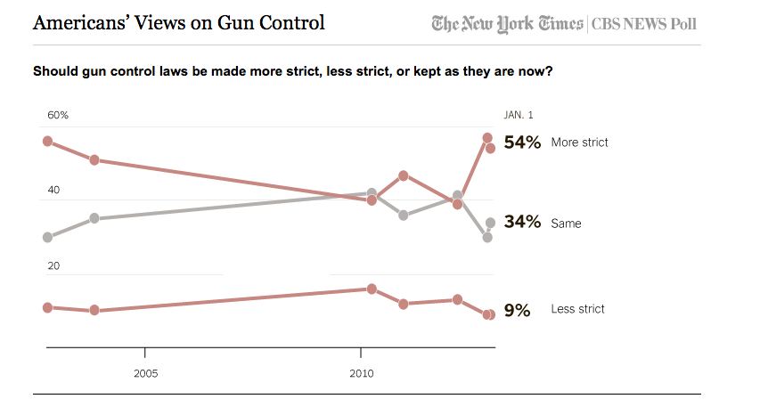

Slide 10
Notes:
REDESIGN TABLE (with additional varaibles)

