Slide 1

Dissecting a Visualization

Slide 2
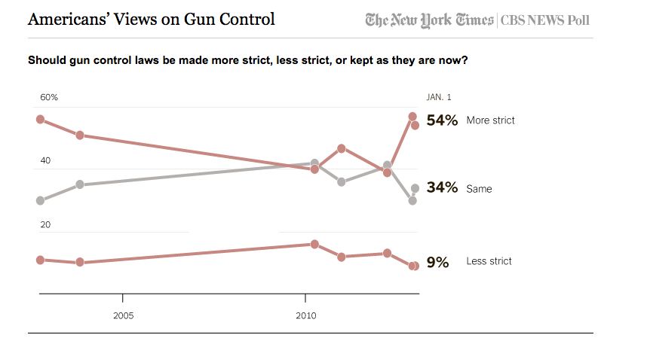
Position | Size | Shape | Value | Color | Orientation | Texture
Notes:
We’ll be apply these marks and properties to data a lot in this course, and it can be helpful to develop an eye for how data is encoded in existing diagrams. Let’s take a look at this chart from the NYTimes and CBSa News poll on whether gun control laws should be made more strict or left as they are. We’ll think about how these properties are mapped to provide an understanding of the data. It’s at first glance a rather simple chart, but there’s a fair amount there to get us thinking.
Position as changes in the x, y location yes can see the points and also the line itself; Shape no; Value or brightness, perhaps, looks like the gray; shape yes circles are used, color, yes; orientation – change in alignment, well not officially encoded as such, though the position does use this as a feature as we can perceive slope, no; texture no.

Slide 3


