Slide 1

Working With D3 Recap

Slide 2
D3’s Data Model
visual form
data
selection

Slide 3
D3’s Data Model
bind with
.data()
visual form
data
selection

Slide 4
D3’s Data Model
encode with
.enter(), .attr(), etc
bind with
.data()
visual form
data
selection

Slide 5
D3’s Data Model
encode with
.enter(), .attr(), etc
bind with
.data()
visual form
data
selection

Slide 6
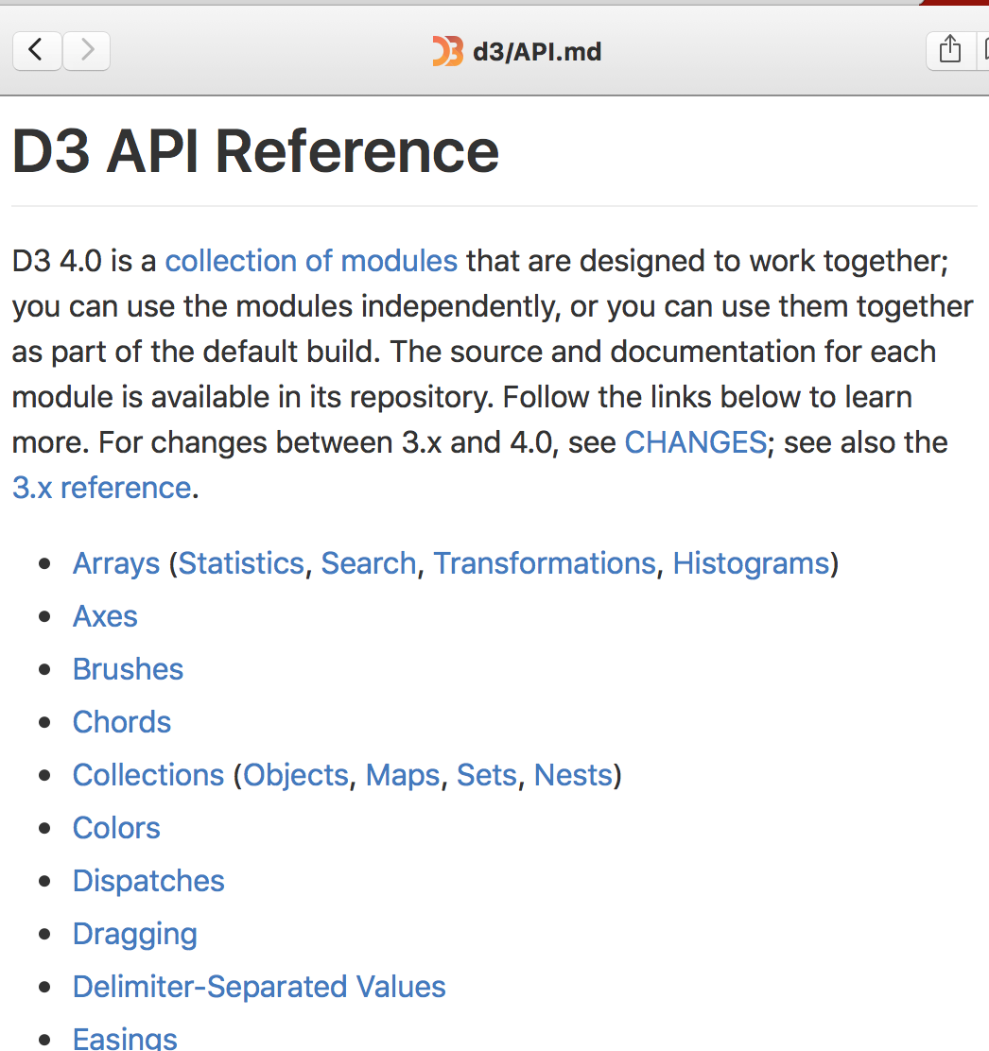
Notes:
the reference is your friend
start here! (you’ll save lots of time and headaches from using google+stack)

Slide 7


