Slide 1

Encoding Data Models
Notes:
We’re going to be talking about ways of encoding various data types.

Slide 2


Order these
Notes:
REMAKE IMAGE

Slide 3
Order these
Notes:
Turns out this works pretty well for ordinal data.

Slide 4

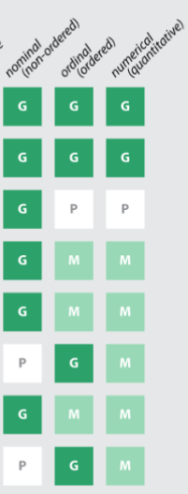
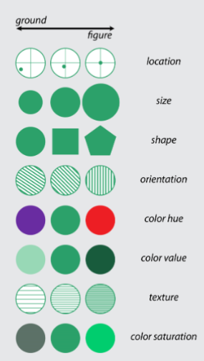
Source: Roth, R.E. (web preprint) Visual Variables. In The International Encyclopedia of Geography: People, The Earth, Environment, and Technology.
Notes:
Here we have Bertin’s seven original variables along saturation from MacEachren’s additional work with variation from background (ground) to figure (makes them stand out in the forefround) and whether they most appropriate for nominal, ordinal or quantitative data (interval and ratio fit into quantitative here).
There have been others added by researchers since Bertin including MacEachren and others. arrangement, resolution, and transparency and enclosure and time.
We can see here how they
https://www.geography.wisc.edu/faculty/roth/publications/Roth_2015_EG.pdf

Slide 5
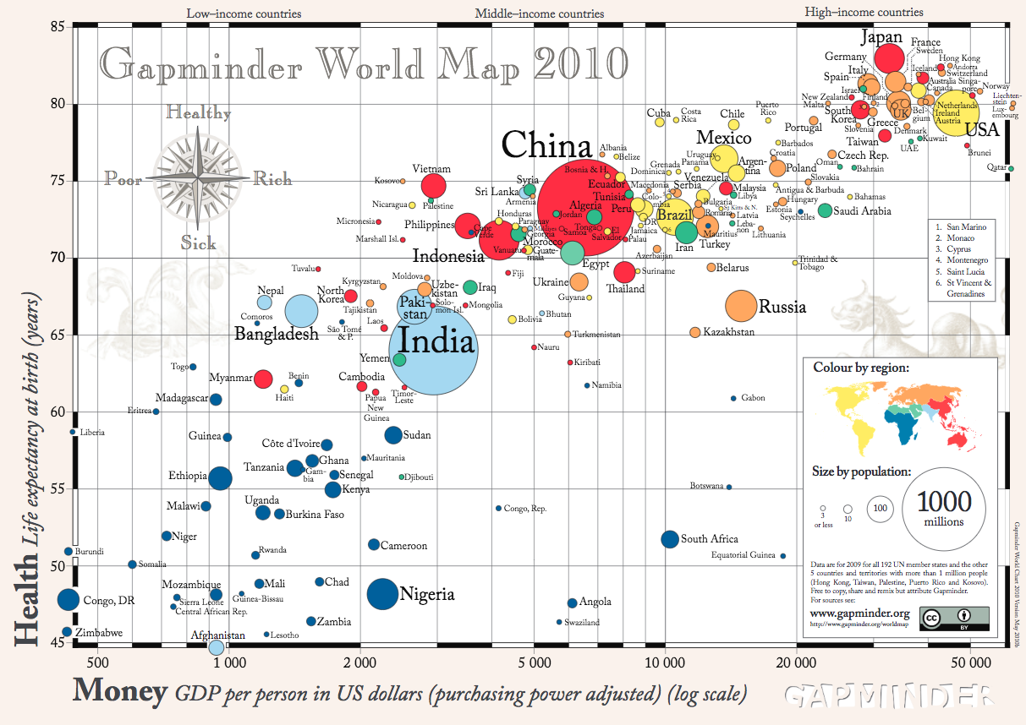
Notes:
We will talk about perception of these properties later in the course. But for now it’s helpful to think about these marks and properties and how they can be mapped together.
Multivariate Data: Two variables map to points (e.g., scatter plot) Third variable map to color, size, shape
Fourth?

Slide 6


