Slide 1

Encoding Data Effectively
Notes:
Let’s talk about some of the research in making decisions about the best shapes, areas, lines, and encodings for your data.

Slide 2
Expressiveness:
Encodes all the facts in the set,
and encodes only the facts in the set of data.
[Mackinlay, 1987]
Notes:
Jock Mackinlay developed a number of criteria for good encodings based on his work on the aptly named ‘a presentation tool’ or APT. one of these was expressiveness, let’s look at a few examples.

Slide 3
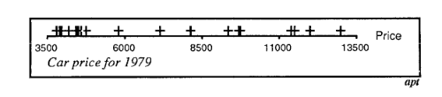
Unable to express the facts!
One to many cannot be adequately expressed using a single horizontal position.
Notes:
Here we have car prizes for the year 1979. The facts are not expressible for a one to many relations across a horizontal position. Since a mark cannot have two positions on the same axis.

Slide 4
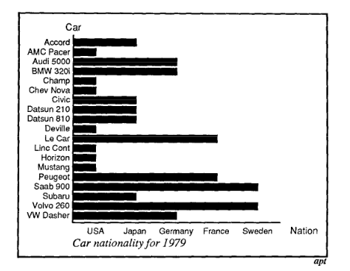
Expresses more than the facts!
Bar length expresses a false position and rank.
Notes:
Car nationality, here suggests that there is a rank to nation. While position might be OK, by using the area and length associated with the bar it suggests that there is a rank. Might sound similar to the principle of showing the data and not extra variation, you’re right.

Slide 5
Effectiveness:
Encoding data in a visualization so that information is readily perceived by a human to perform a task.
[Mackinlay, 1987]
Notes:
While expressiveness is only dependent on the syntax and syntax of the graphical language, effectiveness is dependent on the perceptual abilities of the vis viewer. Comes out of research by Cleveland and McGill showing that people have different degrees of accuracy based on the

Slide 6
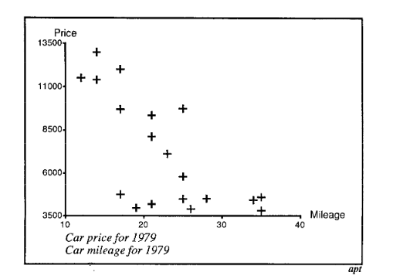
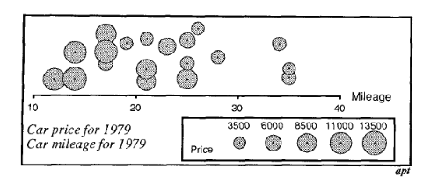
Which Is More Effective?
[Mackinlay, 1987]
Notes:
One visualization is more effective than the other. There’s some occlusion in the first but this goes into an understanding of chart types.

Slide 7
How much bigger is the larger circle, by area?
Notes:
How many times bigger is big circle? 4 times as big We tend to underestimate the area bigger the circle, the more we underestimate

Slide 8
How much bigger is the larger bar, by length?
Notes:
4 times

Slide 9
Stevens’s Power Law
ψ(I) = kIª
Perceived intensity is proportional to actual intensity to some power.
The exponent varies with the type of stimulus.
Notes:
Stevens’ Power Law ψ(I) = kIª sensation(intensity) = constant x (intensity ^ power) perceived intensity is proportional to real intensity to some power
Exponent is the key, depends on type of stimulus

Slide 10
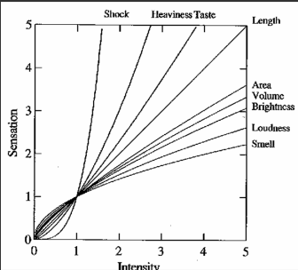
Stevens’s Power Law
Wilkinson, 1999
Notes:
power < 1, we underestimate
power > 1, we overestimate
Length seems to be accurate

Slide 11
Stevens’s Power Law
Measurements of a
Length .9 to 1.1
Area .6 to .9
Volume .5 to .8
Notes:
relationship between the magnitude of a physical stimulus and its perceived intensity or strength
higher dimensionality seems less accurate

Slide 12
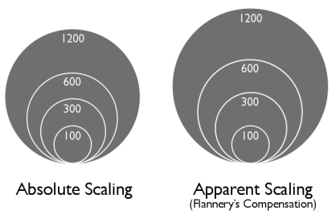
Estimating Circular Areas
Flannery’s appearance compensation
Diagram Source: http://makingmaps.net/2007/08/28/perceptual-scaling-of-map-symbols/
Notes:
James Flannery a cartographer who in the mid 1950s devised scheme for compensation only for circular areas questionable value (what if user measures?)

Slide 13
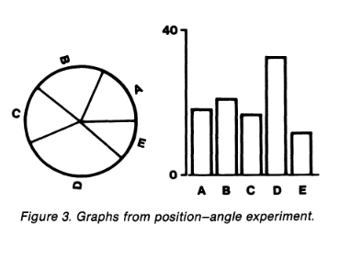
[Cleveland & McGill, 1987]

Slide 14
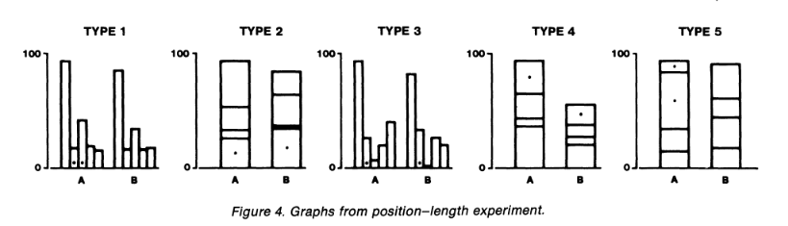
[Cleveland & McGill, 1987]

Slide 15
A Hierarchy of Accuracy
Position
Length
Angle, slope
Area
Volume
Color, density
Decreasing quantitative accuracy
Notes:
a hierarchy of accuracy – quantitative, that is position length angle, slope area volume color, density

Slide 16
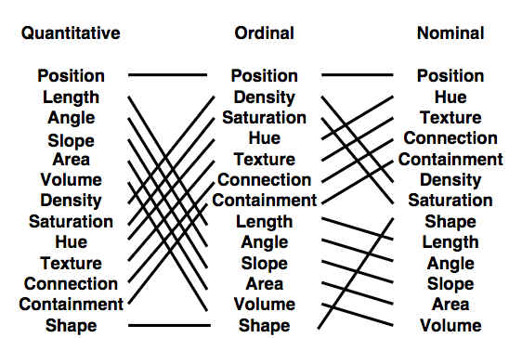
[Mackinlay, 1987]
Notes:
REMAKE TABLE. Mackinlay extended the original Cleveland and McGill ranking for ordinal and nominative data based on the analyses of perceptual tasks in other research. You’ll notice that that the ordering changes for many of these as the data type changes.

Slide 17
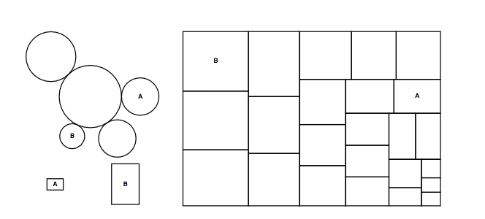
Diagram Source: Heer & Bostock, 2010

Slide 18
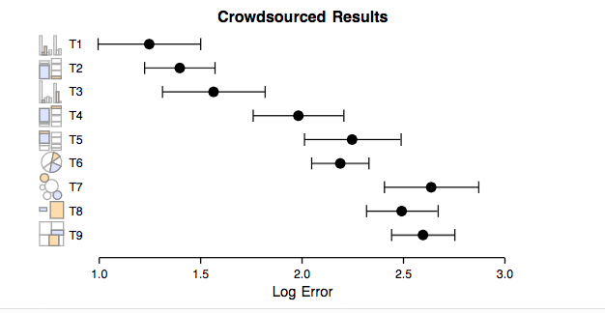
[Heer & Bostock, 2010]

Slide 19


