Slide 1

Basic Chart Types
Notes:
Established previously that there are multiple ways of encoding. We’ll talk about how to make the most effective choices and chart types that support these choices.

Slide 2
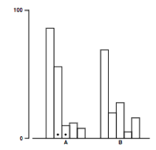
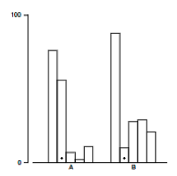
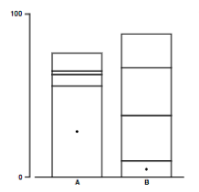
Which One?
Heer & Bostock, 2010
Notes:
Different bars. Quant data.

Slide 3
Bar Charts

Slide 4
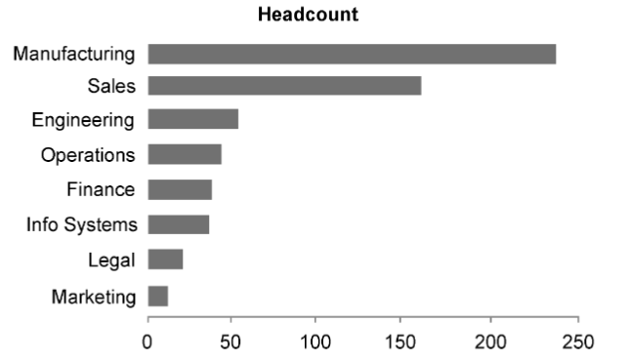
Categorical + Ranked
Source: https://www.perceptualedge.com/articles/Whitepapers/Communicating_Numbers.pdf
Notes:
Categorical comparison

Slide 5
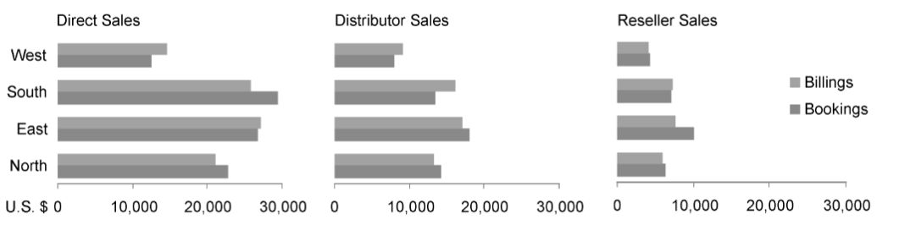
Splitting Comparison
Source: https://www.perceptualedge.com/articles/Whitepapers/Communicating_Numbers.pdf
Notes:
Show total.
What’s bigger smaller.
Interaction
For ordering be aware of whether data is categorical OK, times series be clear

Slide 6
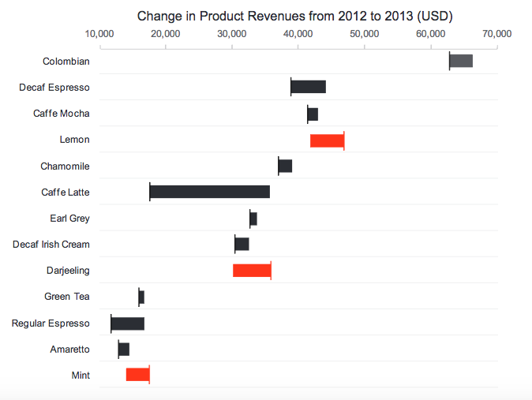
Compare Change
https://www.perceptualedge.com/
Notes:
Range bar graph here – compare positive and negative
Line at starting value, uses hue / color

Slide 7
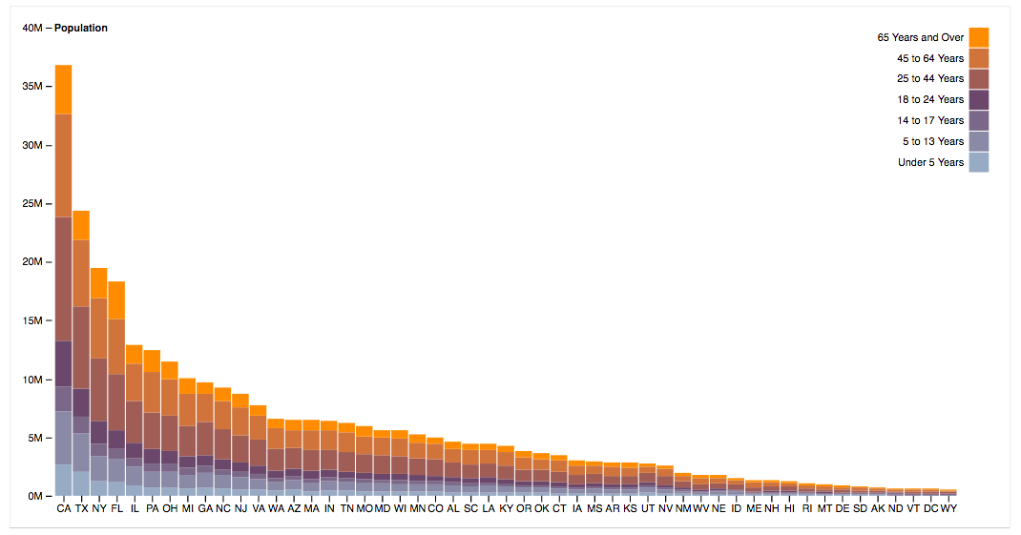
Stacked & Ranked
https://bl.ocks.org/mbostock/3886208
Notes:
Show total.
What’s bigger smaller.
Interaction
For ordering be aware of whether data is categorical OK, times series be clear

Slide 8
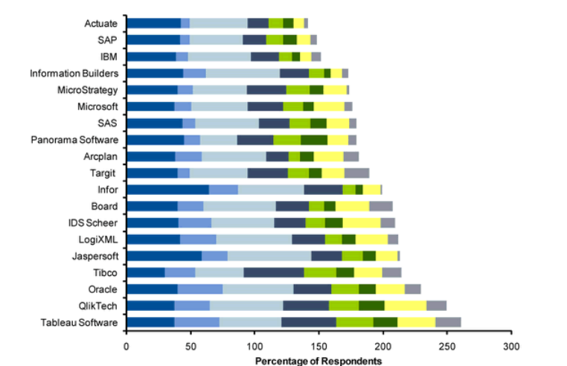
Stacked & Ordered
Source: https://www.tableau.com/blog/gartner-vendors-bi-activities

Slide 9
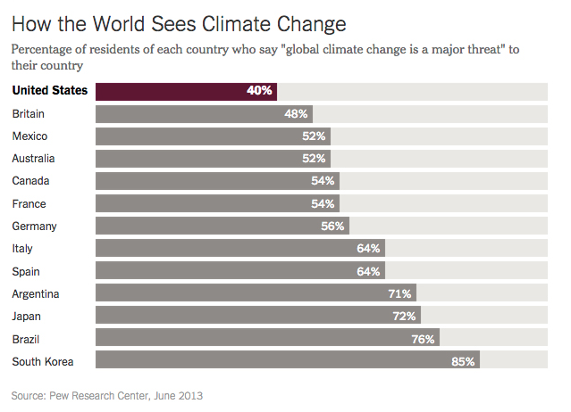
Parts to Whole
Notes:
Parts to whole relationships. Quant data - values

Slide 10
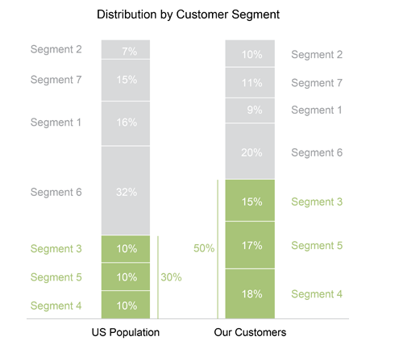
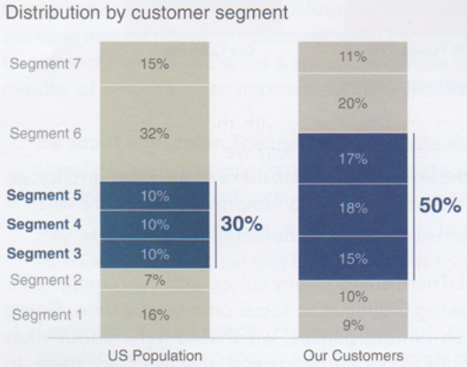
Parts to Whole
https://www.perceptualedge.com/

Slide 11
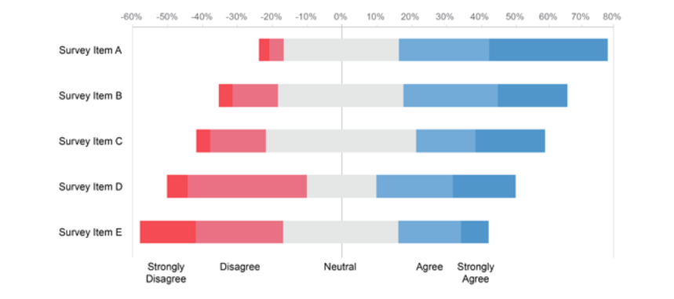
Parts to Whole
https://www.perceptualedge.com/
Notes:
Survey data

Slide 12
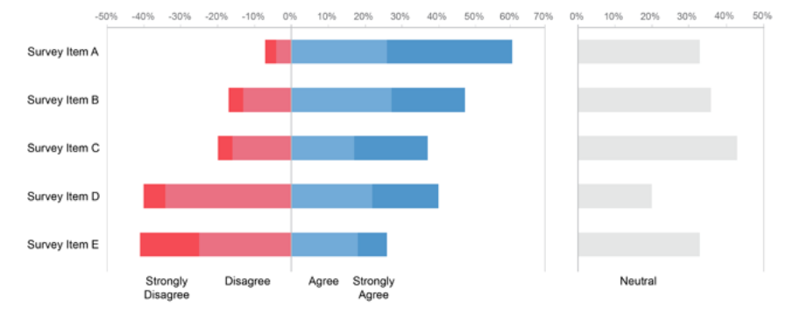
Parts to Whole
https://www.perceptualedge.com/
Notes:
Do you need it?

Slide 13
Parts to Whole
https://www.perceptualedge.com/

Slide 14
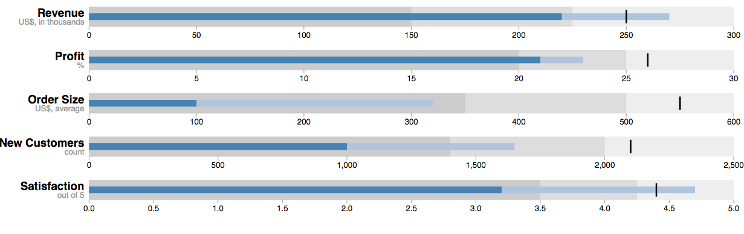
Bullet Graph
https://bl.ocks.org/mbostock/4061961
Notes:
Improve on gauges: BACKGROUND FILL = QUAL RANGE (good bad); BAR ENCODES PERFORMANCE MEASURE, marker compares to target or other comparitive measure

Slide 15
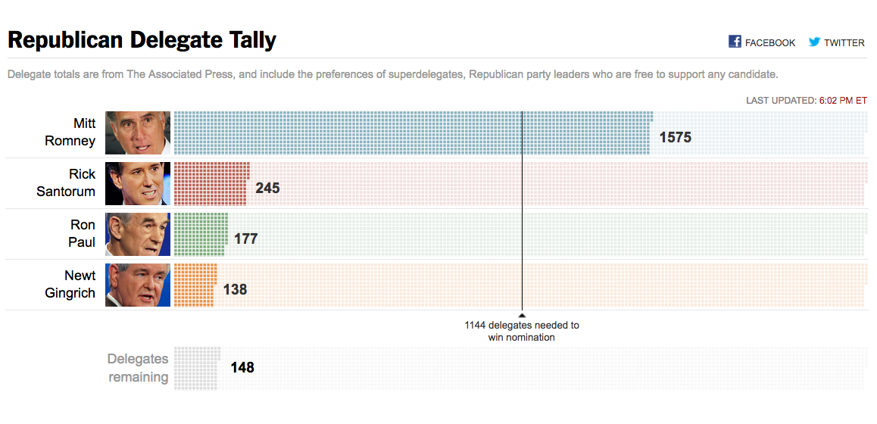

http://www.nytimes.com/elections/2012/primaries/delegates.html
Notes:
Standard bar consists of tiny rectangles = one delegate

Slide 16
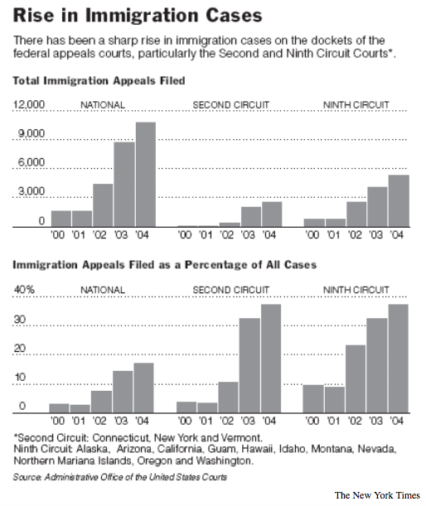
Time Series Comparison
Notes:
not as interested in trend but comparison

Slide 17
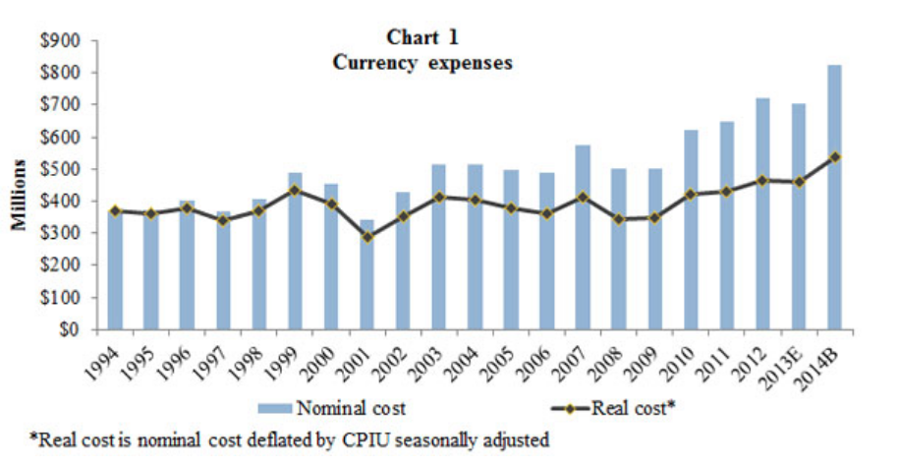
Time Series Comparison + Trend
Source: https://www.federalreserve.gov/foia/2014currency.htm

Slide 18
Line Charts

Slide 19
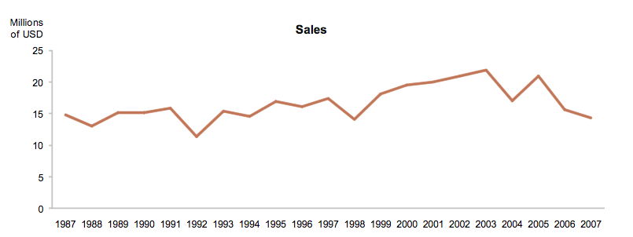
Source: https://www.perceptualedge.com/
Notes:
Shows trends
When have equal intervals of data

Slide 20
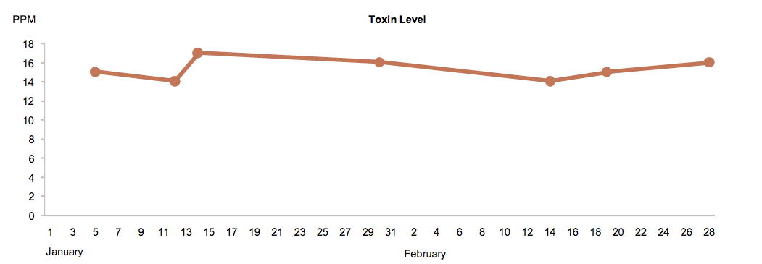
Irregular Intervals
Source: https://www.perceptualedge.com/
Notes:
Toxin levels irregular intervals
Could potentially plot dots
Is there really a pattern?

Slide 21
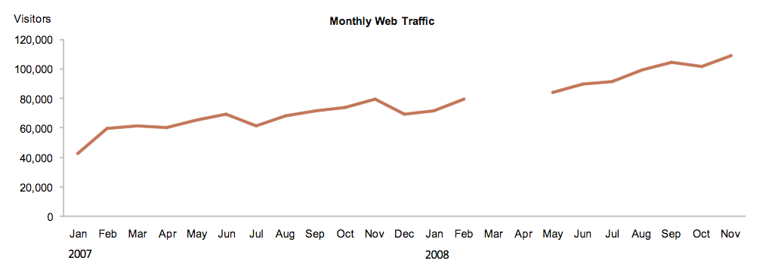
Irregular Intervals
Source: https://www.perceptualedge.com/
Notes:
Toxin levels irregular intervals

Slide 22
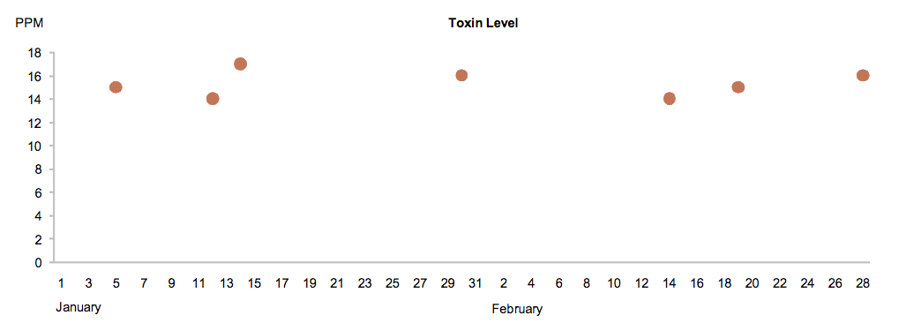
Irregular Intervals
Source: https://www.perceptualedge.com/
Notes:
Toxin levels irregular intervals

Slide 23
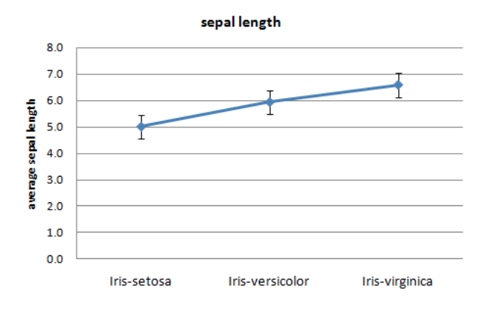
Be careful of this!
Source: http://www.saedsayad.com/categorical_numerical.htm

Slide 24
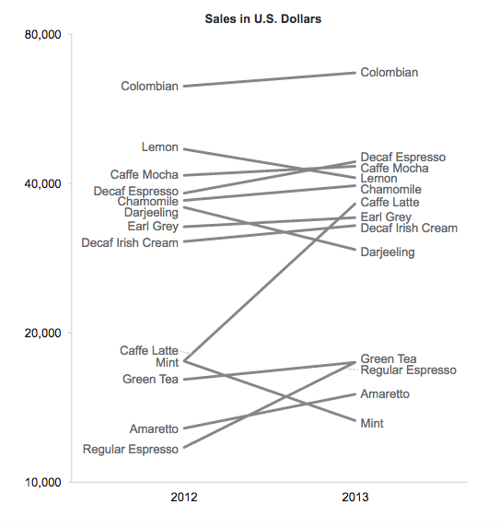
Two Point Change
This works!
Source: https://www.perceptualedge.com/
Notes:
Compare magnituide based on slope
Compare direction

Slide 25
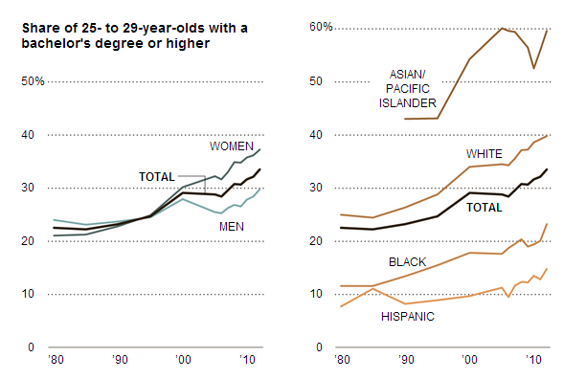
Trend Comparison
Source: https://tcf.org/
Notes:
Compare magnituide based on slope
Compare direction

Slide 26
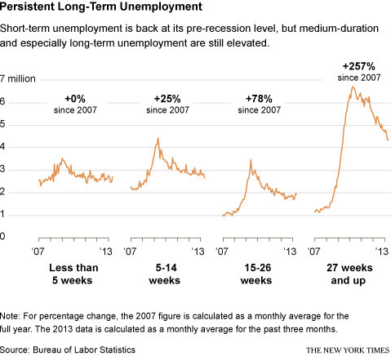
Trend Comparison
Notes:
Compare magnituide based on slope
Compare direction

Slide 27
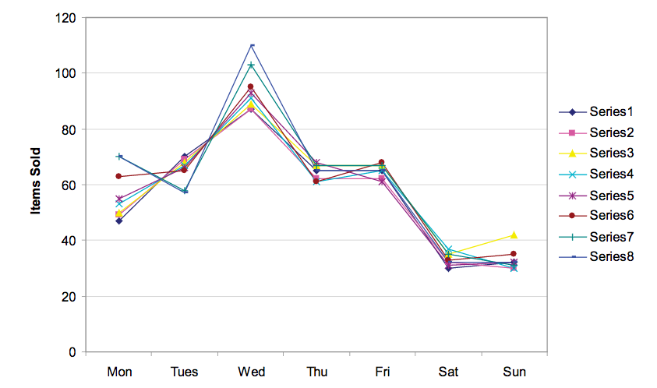
Source:https://www.perceptualedge.com/articles/guests/intro_to_cycle_plots.pdf

Slide 28
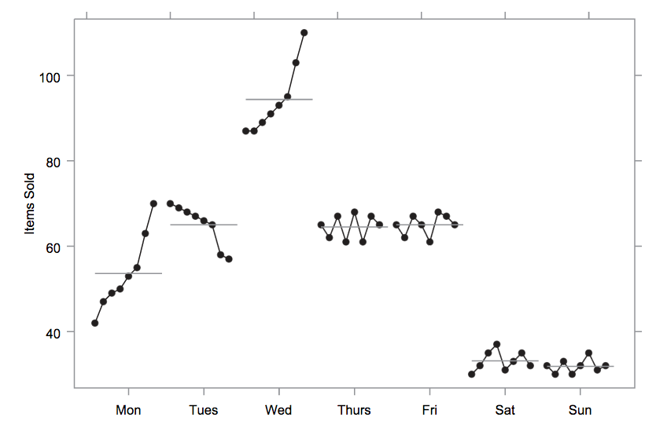
Cycle Plot
Source:https://www.perceptualedge.com/articles/guests/intro_to_cycle_plots.pdf
Notes:
Horizontol line means
Cleveland, Dunn, and Terpenning (1978) introduced cycle plots to study the behavior of
seasonal time series.

Slide 29
Scatter & Dot Plot

Slide 30
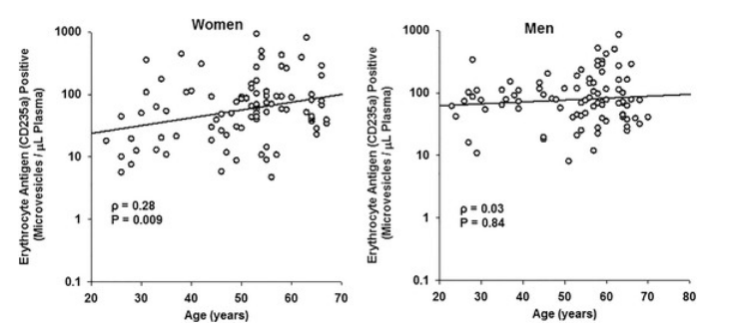
Source: Gustafson et al., 2015
Notes:
age-associated changes in red blood cell dervied microvesicles
By gender

Slide 31
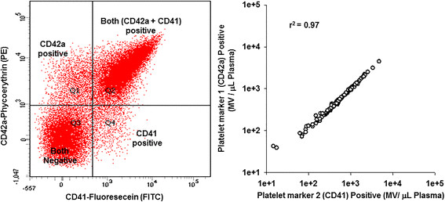
Source: Gustafson et al., 2015
Notes:
fluorescence dot plot and correlation relationships BOTH positive, BOTH negative
Quadrants

Slide 32
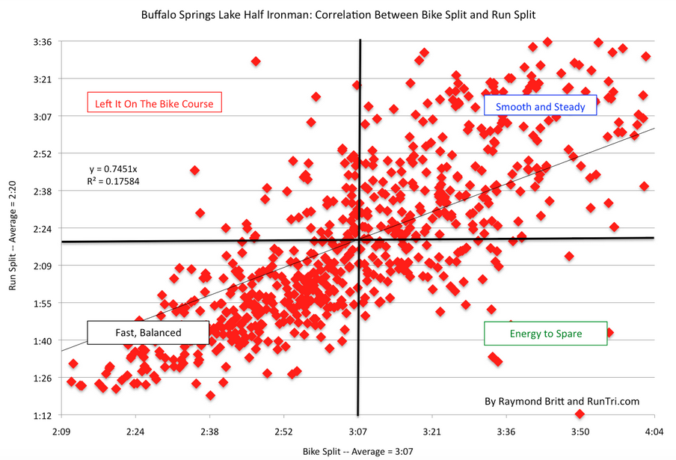
Notes:
Make sure those are meaningful quadrants

Slide 33
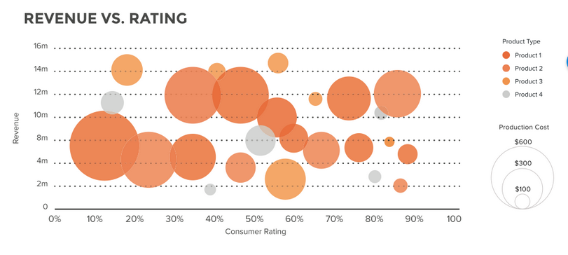
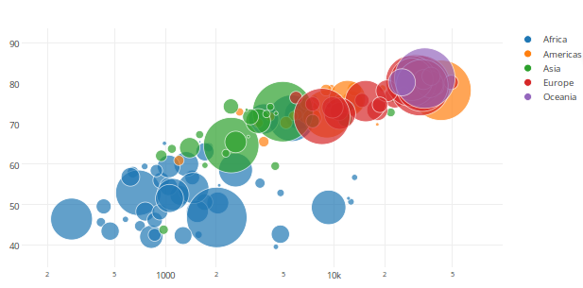
Bubble Plot
Top Source: https://visage.co
Bottom Source: http://help.plot.ly/
Notes:
Easier to pick out color or using brightness or saturation

Slide 34
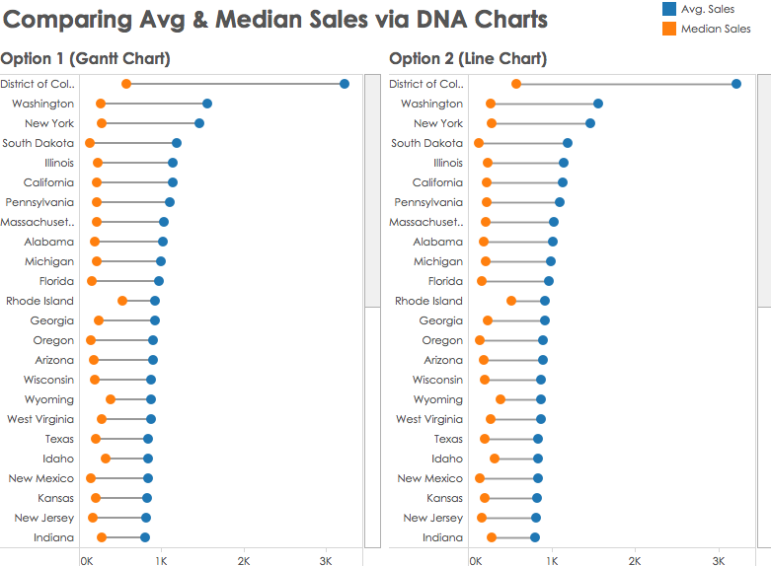
Dumbbell / DNA Chart
Source: https://public.tableau.com/views/DNACharts/
Notes:
Dot plot often encodes similar data effectively as bar chart
Change between two data points

Slide 35
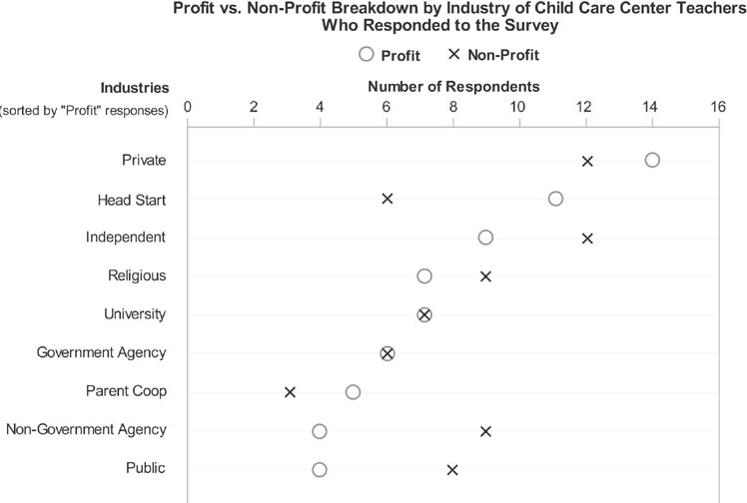
Source: https://www.perceptualedge.com/
Notes:
Alternative to bar chart; shows when the values are the same quickly
Get to practice in D3, while the simple bar, line, and dor or correlation plot can be excellent, hopefully these variations on the basics provided some good thought for building out your first chart in D3.

Slide 36


