Slide 1

Core Modules in D3

Slide 2
Greater data flexibility
Notes:
GET IMAGE OF STRETCHING. Have loaded data and generated new elements, but what about using data in a more flexible way. What if we wanted to …
http://blog.theclymb.com/wp-content/uploads/2014/04/Yoga_Man_On_Beach.jpg

Slide 3
d3-selection
Recall, this is the core object we’ll be working with in D3!

Slide 4
The Circle of D3
select
attr
data
append
enter

Slide 5
The Circle of D3
select
attr
data
append
update

Slide 6
Why did we need D3?

Slide 7
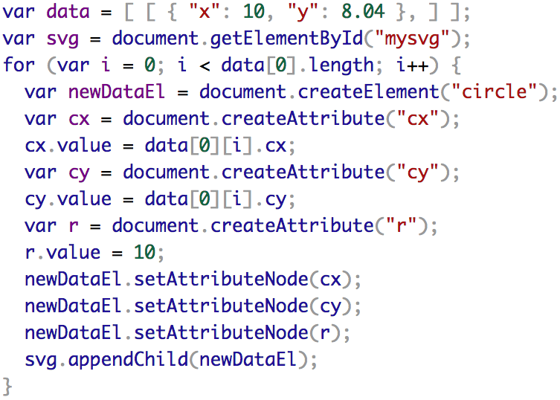
why did we use D3?

Slide 8
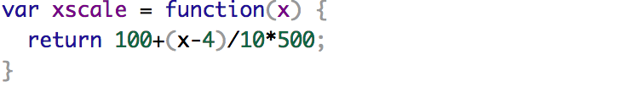

Slide 9
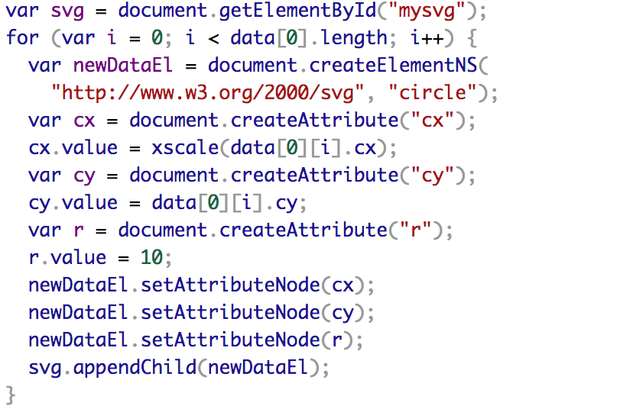

Slide 10
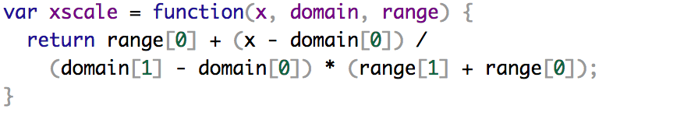

Slide 11
d3-scale
data: .003 -> 16
data space
pixels: 0 -> 500
ink space

Slide 12
d3-scale
data: .003 -> 16
data space
pixels: 0 -> 500
ink space
Notes:
linear

Slide 13
d3-scale
data: .003 -> 16
data space
pixels: 0 -> 500
ink space
Notes:
ah! bezier curve?

Slide 14
d3-scale
data: .003 -> 16
domain([.003,16])
d3.scaleLinear
range([0,500])
pixels: 0 -> 500

Slide 15
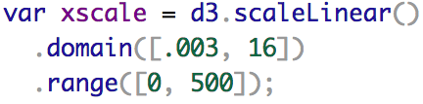
d3-scale
data: .003 -> 16
data space
pixels: 0 -> 500
ink space

Slide 16


d3-axis

Slide 17
d3-path, d3-shape, d3-polygon

Slide 18


