Slide 1

Detection in Visual Search
Notes:
Discuss what graphical perception of patterns is in intro.

Slide 2
Which data features are the focus?
Notes:
What are you looking for in the data? You’ll want to use graphical elements that are more visually salient for the more important data. Sounds obvious but realize that when working with large data sets with multiple dimensions and measure you will need to make decisions.

Slide 3
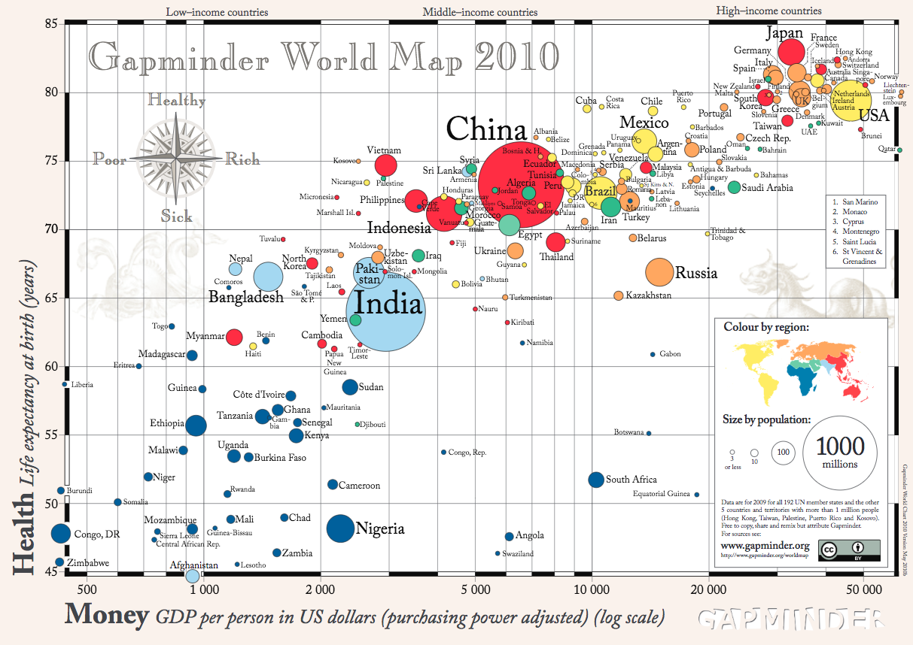
Notes:
If you recall, when we were looking at comparing quantitative data

Slide 4
Preattentive
200–250 milliseconds
Notes:
Properties detected very rapidly and accurately by the low-level visual system.
their detection seemed to precede focused attention.
We now know that attention plays a critical role in what we see, even at this early stage of vision.

Slide 5

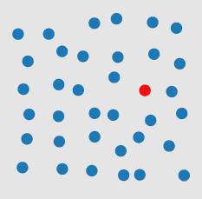
Color/Hue
Diagram Healey
https://www.csc2.ncsu.edu/faculty/healey/PP/index.html
Notes:
https://www.csc2.ncsu.edu/faculty/healey/download/tvcg.12a.pdf

Slide 6
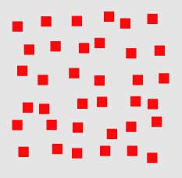
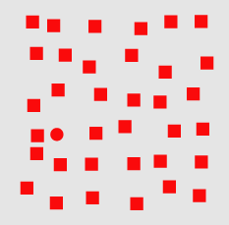
Shape
Diagram Healey
https://www.csc2.ncsu.edu/faculty/healey/PP/index.html
Notes:
shape is preattentive , see the red circle

Slide 7

Line Orientation
Diagram Healey
https://www.csc2.ncsu.edu/faculty/healey/PP/index.html
Notes:
angle of orientation is preattentive cockpit dials work if most aligned same

Slide 8

Curvature
Diagram Healey
https://www.csc2.ncsu.edu/faculty/healey/PP/index.html
Notes:
curvature is preattentive

Slide 9
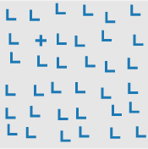
Intersection
Diagram Healey
https://www.csc2.ncsu.edu/faculty/healey/PP/index.html
Notes:
intersection is preattentive

Slide 10
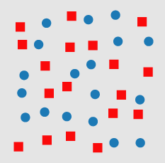
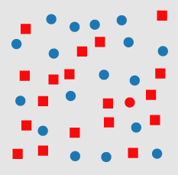
Both Hue and Shape
Diagram Healey
https://www.csc2.ncsu.edu/faculty/healey/PP/index.html
Notes:
combined attributes are not preattentive, did you see the red circle here?
One of these features (e.g., red and circular) is present in each of the distractor objects (red squares and blue circles). This means the visual system has no unique visual property to search for when trying to locate the target.

Slide 11
Preattentive Attributes
Hue
Shape
Orientation
Curvature
Intersection
Length
Width
Closure
Size
Density
Color intensity
Terminators (Ts)
3-D depth cues
Stereoscopic depth
3-D orientation
Lighting direction
Flicker
Direction of motion
Velocity of motion
Number estimation
Artistic properties
Notes:
other things: length, width, closure, size, density, color intensity, terminators (Ts), depth cues, lighting direction, flicker, direction of motion, velocity of motion, number estimation

Slide 12
What is it good for?
Target detection
Boundary detection
Counting or estimation
Notes:
TARGET DETECTION: rapidly and accurately detect whether a target element is there using unique visual features; BOUNDARY DETECTION between two groups of elements where share visual feature;
Where users try to count elements with the unique feature

Slide 13
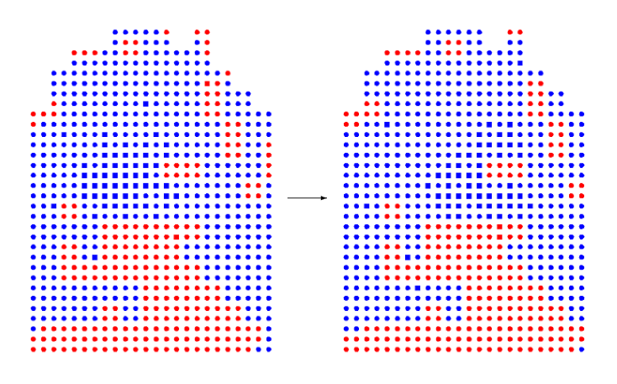
Diagram Source: Healey, Booth, & Enns, 1995
Notes:
No this isn’t a video game from the 90s it’s a real time scientific simulation of salmon moving around a warm flow of water, with the water temperature represented by color and the fish presence represented by squares. See them?

Slide 14
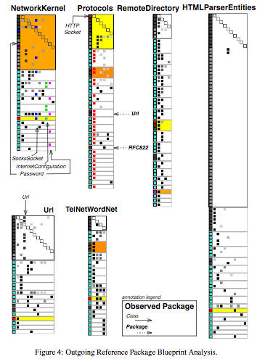
Source: Abdeen, H., Ducasse, S., Pollet, D., Alloui, I., & Falleri, J. R. (2014). The Package Blueprint: Visually analyzing and quantifying packages dependencies. Science of Computer Programming, 89, 298-319.
Notes:
The preattentive visual features that are used in pack-
age blueprints are “length”, “width”, “filed”, “intensity” and
“color” (Sections
5.2
and
5.3
summarize how these features are
employed).

Slide 15
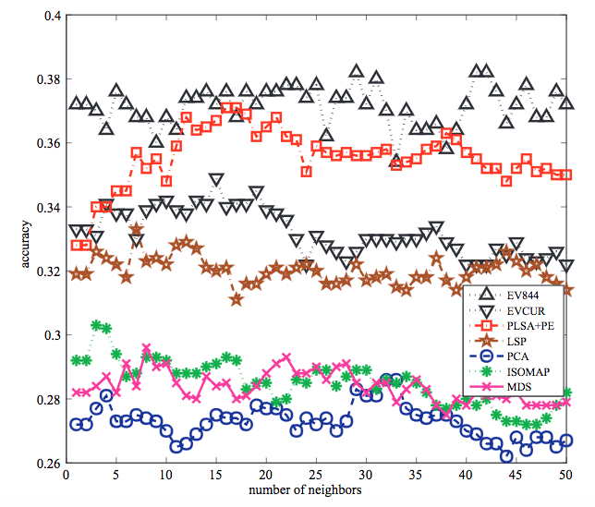
Source: Chen, Y., Wang, L., Dong, M., & Hua, J. (2009). Exemplar-based visualization of large document corpus (infovis2009-1115). IEEE Transactions on Visualization and Computer Graphics, 15(6).
Notes:
http://www-personal.umich.edu/~chenyanh/research_project3.html green up
Exemplar-based visualization is to visualize an extremely large data sets based on multidimensional projection technique, making the visualization highly efficient and flexible

Slide 16
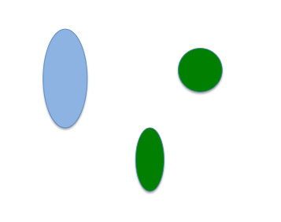
How would you group these?
Notes:
Difficult ? Trying to make a decision about one feature e.g., color, but shape also factors into the cognitive equation. Sometimes, people are asked to make a decision about one dimension, but the stimulus also varies along a second dimension.

Slide 17
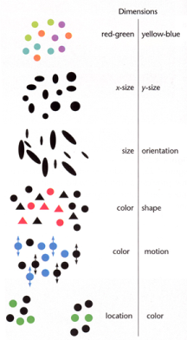
Integral and Separable Dimensions
Integral
Separable
Notes:
example of separable: size and color, yet some cause interference
a hierarchy of separability

Slide 18
Tips for Visual Detection
Possible data features to encode: target, boundaries, rapid count
Identify any conflicting dimensions
Check for intended or unintended attention
Notes:
Does it help you detect patterns, are those targets are boundaries useful? Or should encodings be thought out again?

Slide 19
Notes:
If you recall, when we were looking at comparing quantitative data

Slide 20


