Slide 1
Gestalt Principles

Slide 2
Sum of its parts
A functional unit
Notes:
aids to visual grouping, object percept, surface percept

Slide 3
Gestalt Principles
Proximity
Notes:
Proximity nearness

Slide 4
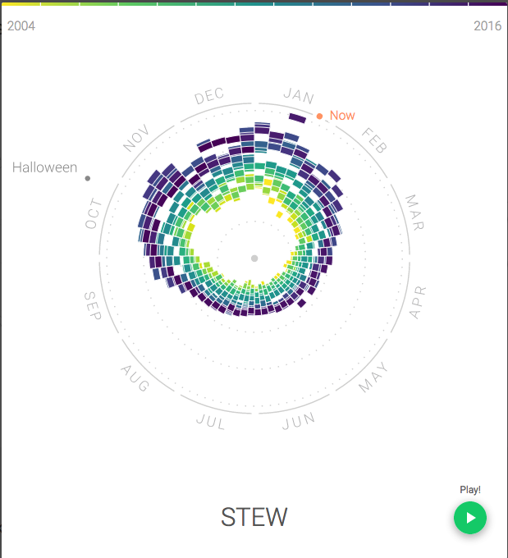
http://rhythm-of-food.net/stew
Notes:
Food consumption by year.
Seasonality

Slide 5
Gestalt Principles
Similarity
Notes:
Similarity shape, color, size, etc.

Slide 6
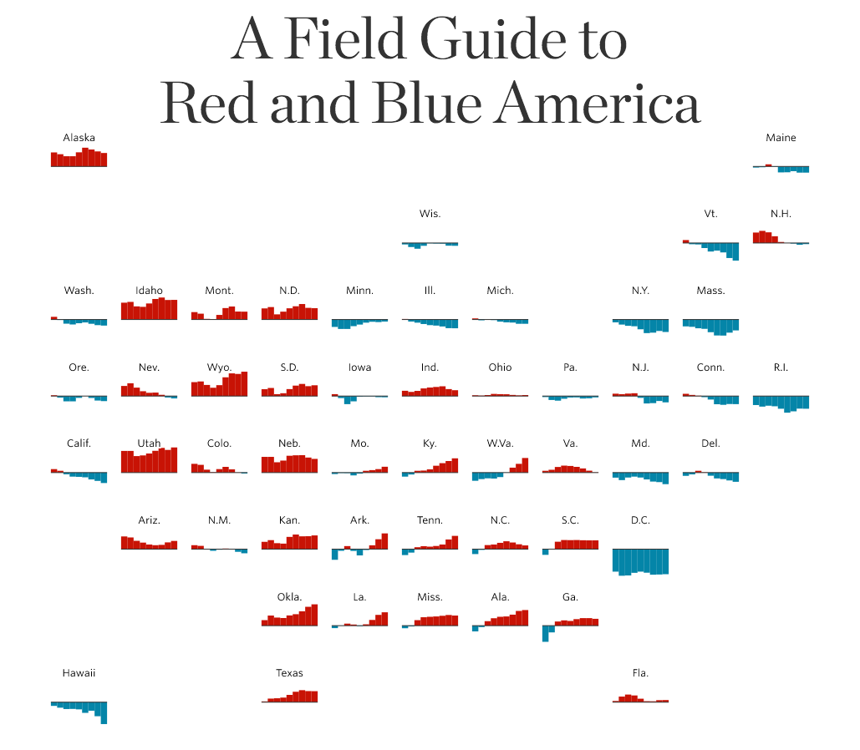
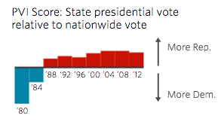
http://graphics.wsj.com/elections/2016/field-guide-red-blue-america/
Notes:
color for political leaning

Slide 7
Gestalt Principles
Connectedness
Notes:
connectedness connecting lines, or enclosure

Slide 8
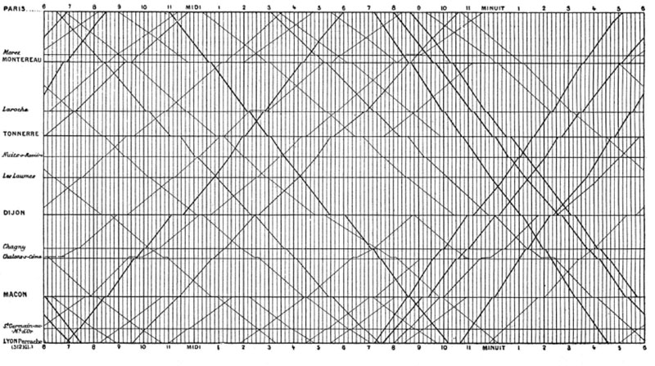
E.J. Marey
Notes:
E.J. Marey

Slide 9
Gestalt Principles
Good continuation
Notes:
Good continuation smoothness, connection items along unseen line or curve seem connected

Slide 10
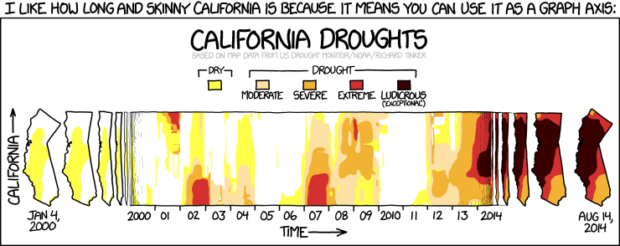
https://xkcd.com/1410/

Slide 11
Gestalt Principles
Good form
Notes:
Good form simplicity of shape

Slide 12
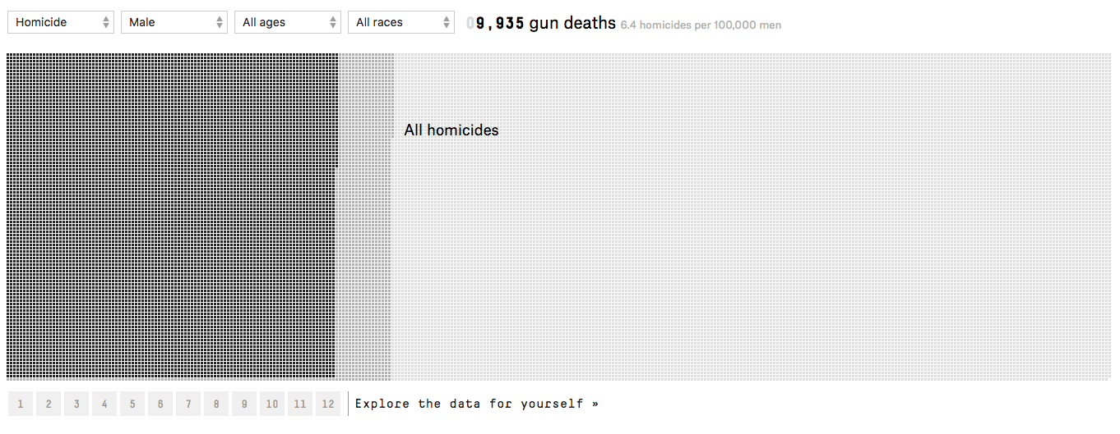
https://fivethirtyeight.com/features/gun-deaths/
Notes:
One square per gun death
10s of thousands of points

Slide 13
Gestalt Principles
Common fate
Notes:
Common fate common movement consider driving in traffic overrides most others

Slide 14
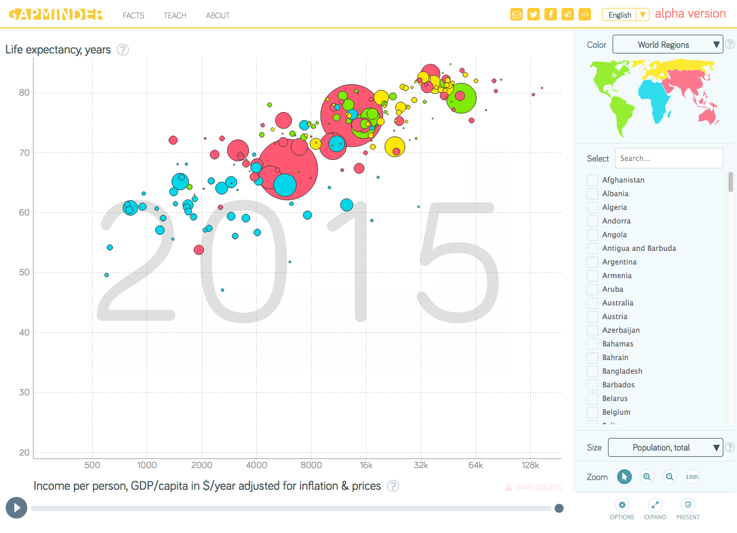
http://www.gapminder.org/tools/#_chart-type=bubbles
Notes:
Life expectancy vs. income

Slide 15

Gestalt Principles
Figure/ground
Notes:
figure/ground what’s in image/background?

Slide 16
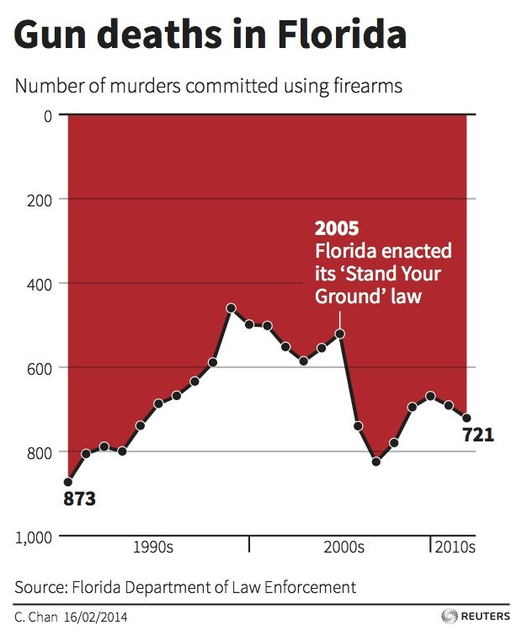
Notes:
confusing
goes against convention

Slide 17
Gestalt Principles
Symmetry
Notes:
symmetry symmetric arrows look related

Slide 18
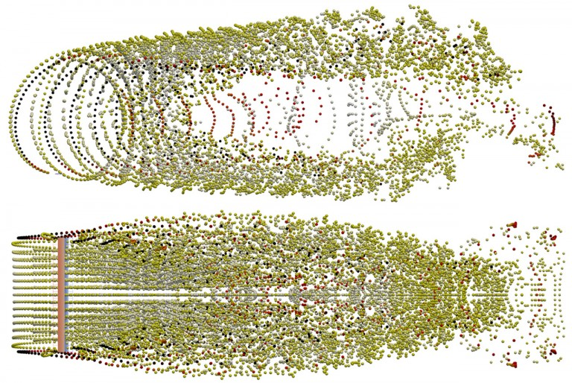
http://robertwilliams.ca/engineering/
Notes:
Vortex particle wake of a straight-blade rotor

Slide 19
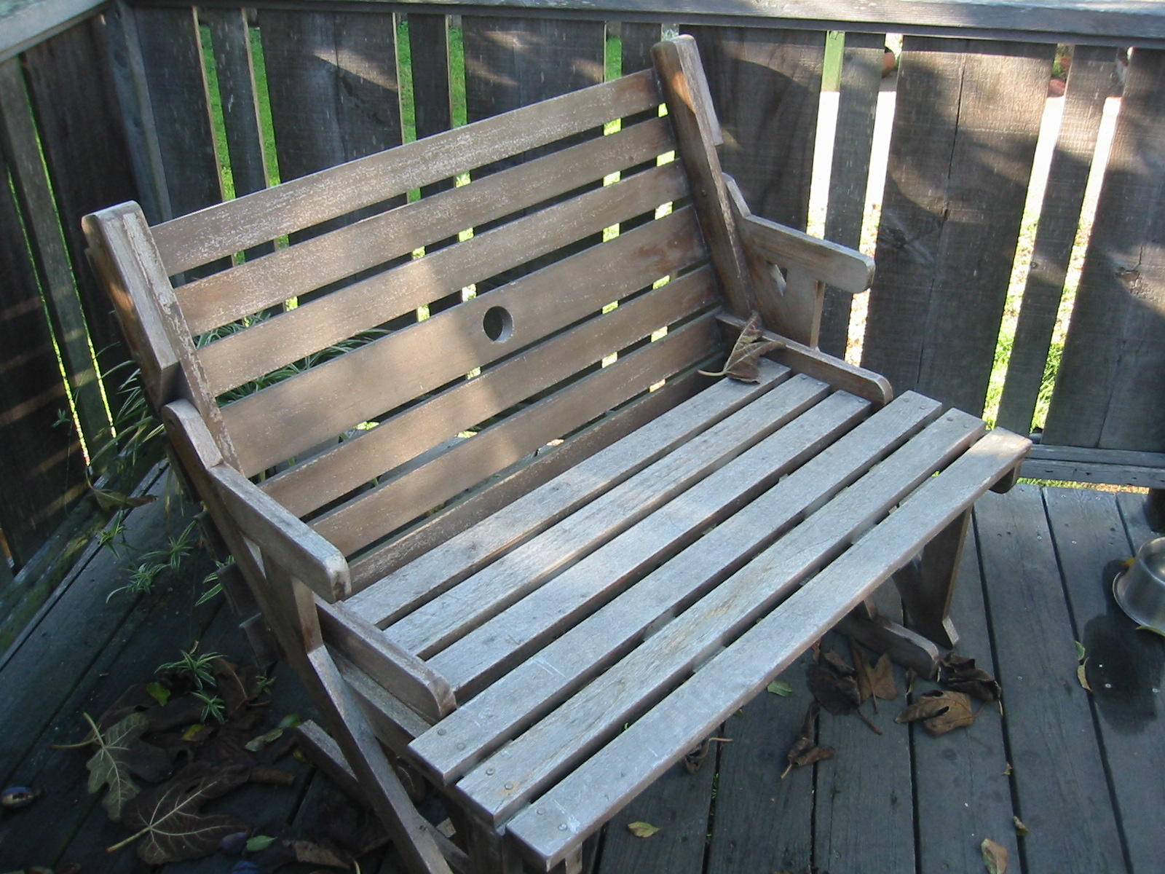
Gestalt Principles
Transparency
Notes:
transparency same change to background colors

Slide 20
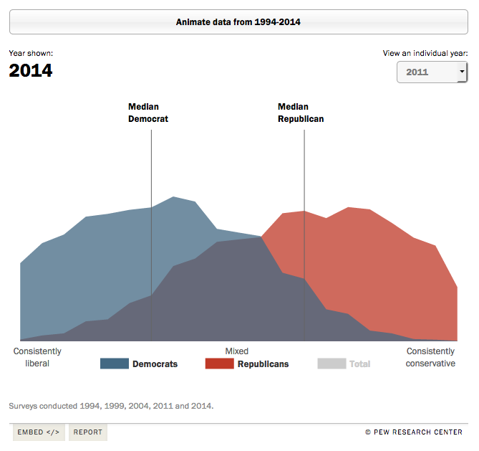
http://www.people-press.org/2014/06/12/section-1-growing-ideological-consistency/#interactive

Slide 21
Gestalt Principles
Closure
1 3 5 _ 9
Notes:
Closure modal completion – triangle in front of pacman amodal – rock behind person (blue circles) not just visual

Slide 22
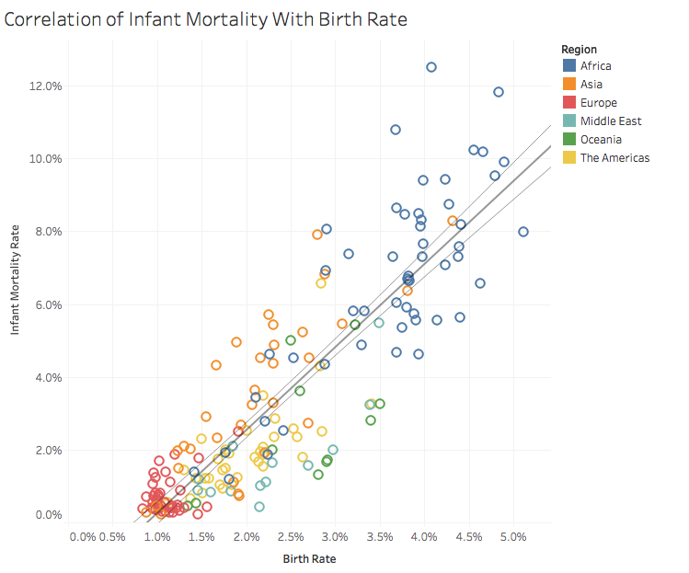
Notes:
axis values
Marks behind others

Slide 23


