Slide 1

Labels and Guiding Marks
Notes:
The use of labels, tick marks, trend lines and similar graphical elements help provide important context about the data guide the viewer to see patterns. Patterns are only as useful as the viewer being able to translate these into meaningful information.

Slide 2

flickr cc 2.0
The Thinker by Gaby Av
Notes:
Found a pattern
But what are you looking at?
Reduce cognitive load – labels and guiding marks

Slide 3
title
and axis labels

Slide 4
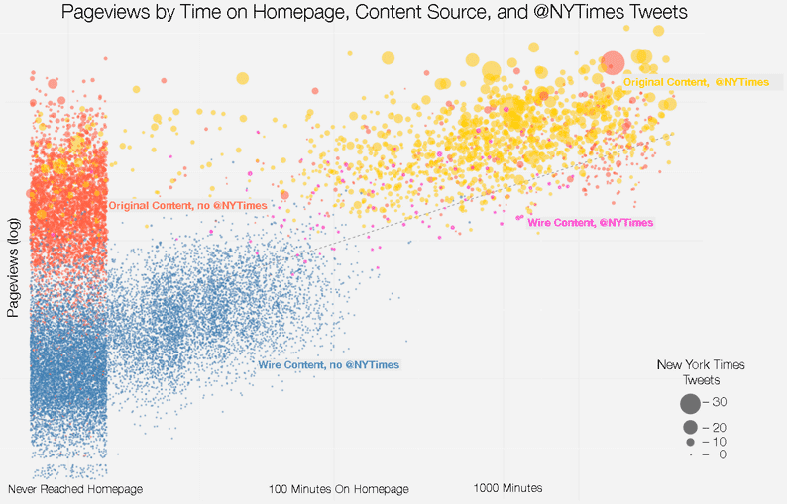
Source: https://source.opennews.org/en-US/articles/promotion-pageviews/
Notes:
Very descriptive title
How many minutes did the orange mark in the upper right have?
Right level of detail of axes labels

Slide 5
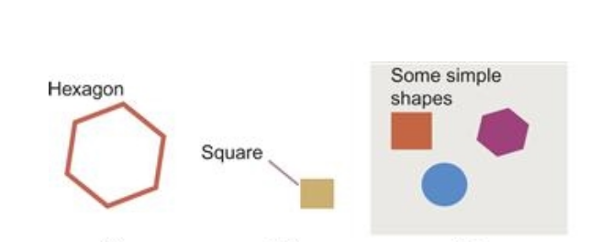
Use Gestalt Principles
Diagram from Ware, 2013
Notes:
Use of Gestalt principle proximity – connect text to graphical elements

Slide 6
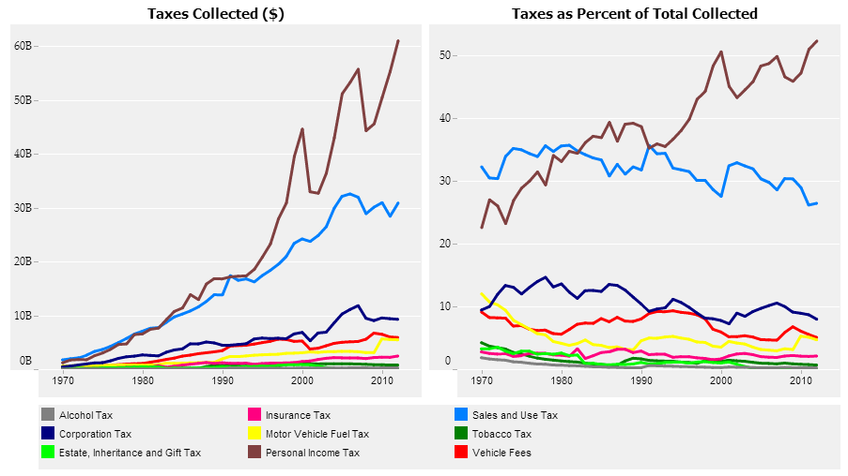
Poor
Source: https://public.tableau.com/
Notes:
https://public.tableau.com/s/sites/default/files/California%20Revenue%20History.png

Slide 7
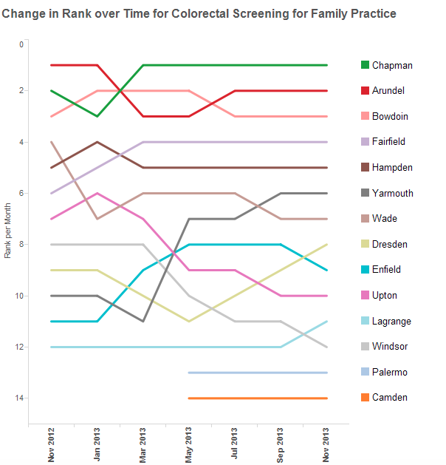
A Bit Better
Source: https://public.tableau.com/
Notes:
https://public.tableau.com/s/sites/default/files/rank11.png

Slide 8
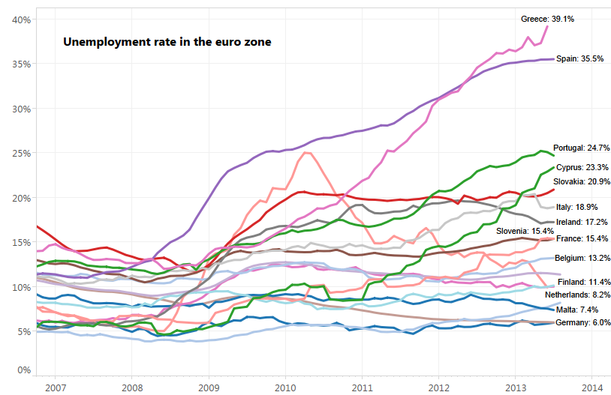
Best
Source: https://www.dataz.io/
Notes:
https://www.dataz.io/display/Public/2013/09/16/How+to+Create+a+Small+Multiple+Masterpiece+in+Tableau

Slide 9
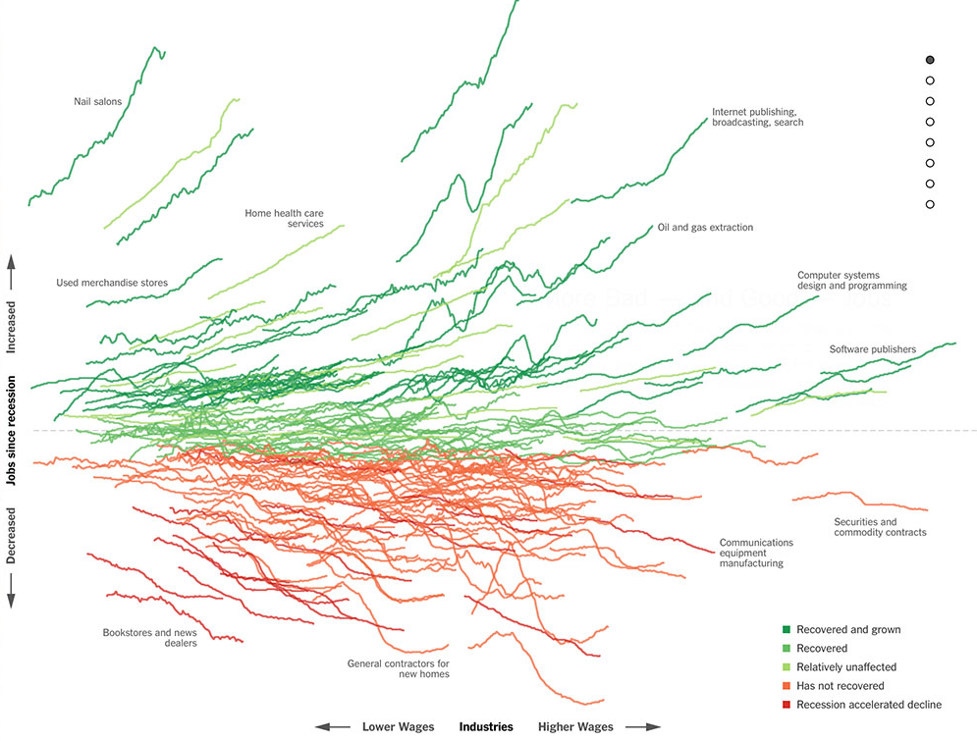
Source: http://www.nytimes.com/interactive/2014/06/05/upshot/how-the-recession-reshaped-the-economy-in-255-charts.html
Notes:
Used well labels, tick marks, and trend lines impart critical information.

Slide 10
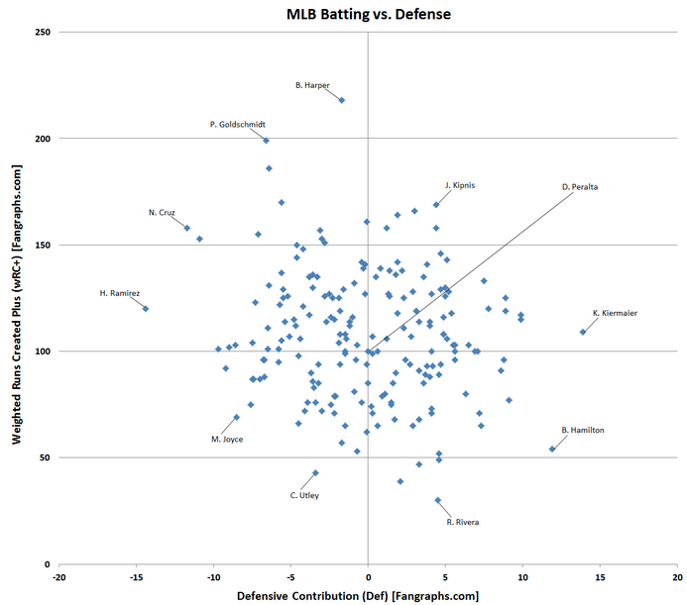
https://www.reddit.com/r/baseball/comments
/3b36et/2015_individual_player_hitting_vs_defense_scatter/
Notes:
Outliers

Slide 11
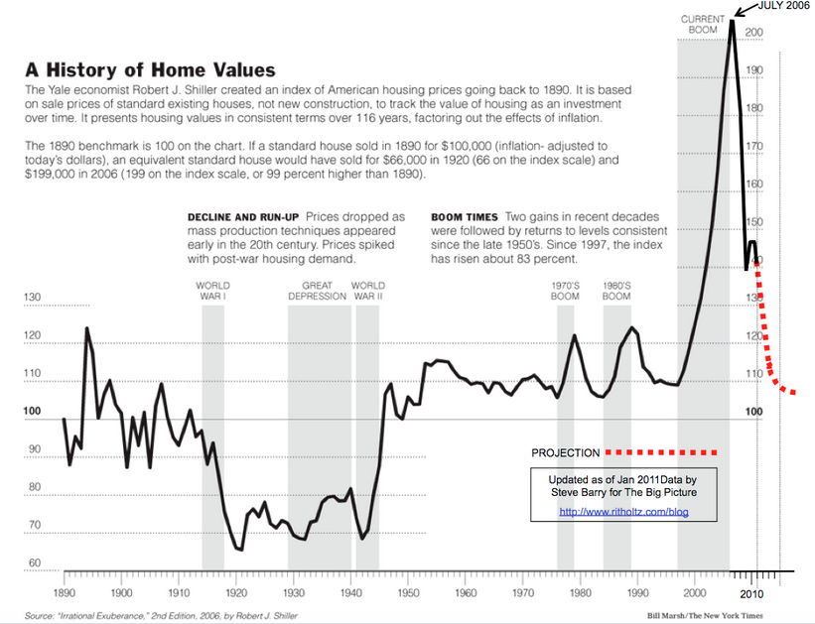
Notes:
Showing event periods for the y axis,
Closure gestalt
Doesn’t interfere! Don’t want labels to interfere with seeing data!

Slide 12
Help Perceptual Comparison

Slide 13
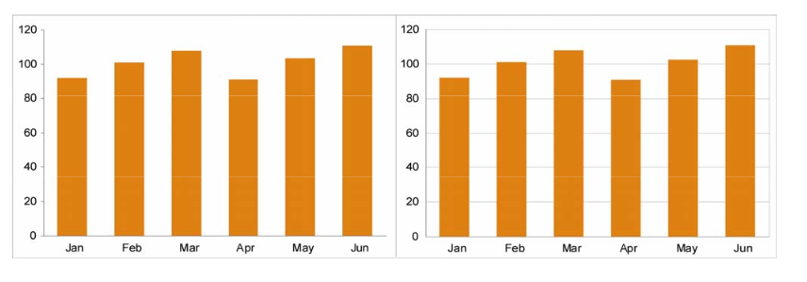
Grid Lines
Source: https://www.perceptualedge.com/
Notes:
Small differences for quantitative comparison.
Subtle lines
Compare the months Feb. and May. This is due to Weber’s Law which states that we perceive differences between variations of a visual attributes, in this case height, as a ratio and not an absolute value. Image from https://www.perceptualedge.com/articles/dmreview/grid_lines.pdf

Slide 14
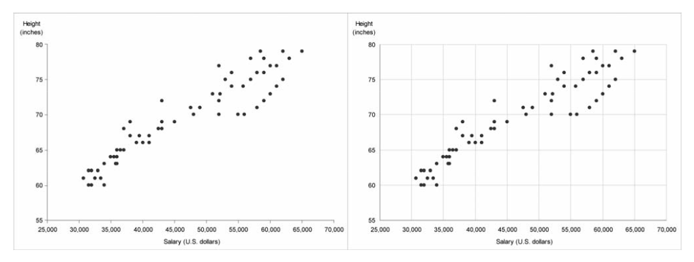
Source: https://www.perceptualedge.com/
Notes:
Particularly for the scatterplot when you have quantitative data want to focus on group

Slide 15
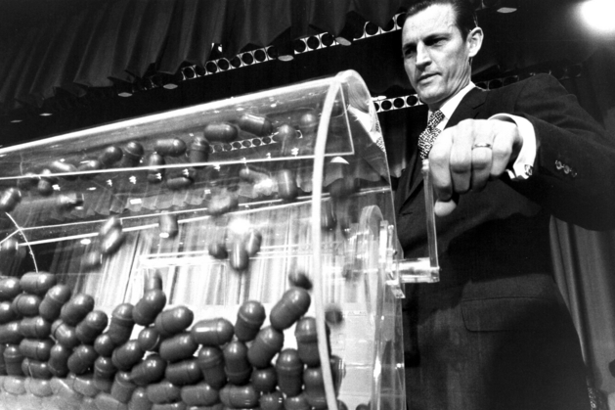
Showing
patterns
Photo by
Selective Service System
]
Notes:
https://www.milwaukeemag.com/2013/06/27/FormerVietnamDraftChiefDies/

Slide 16
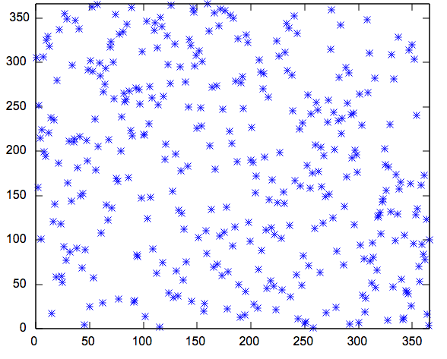
Draft
Number
Birthdays (day number in year)
Source: https://upload.wikimedia.org/wikipedia/commons/6/61/1969_draft_lottery_scatterplot.svg

Slide 17
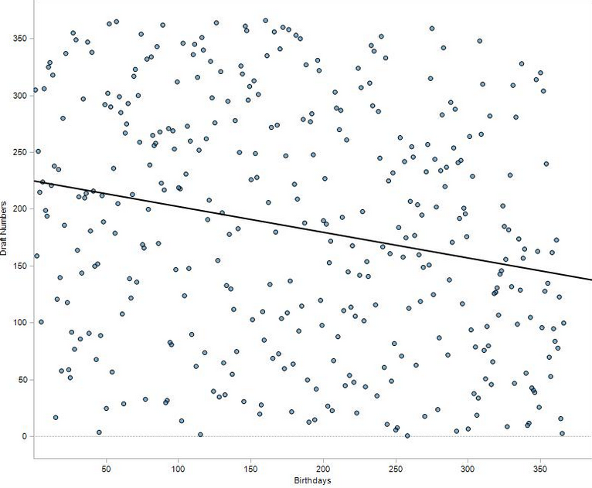
Draft
Number
Birthdays (day number in year)
Source: http://pharma-bi.com/2009/10/expanding-our-visual-vocabulary/
Notes:
Otherwise hard to see the pattern

Slide 18
Provide right detail level for axes
Use direct labeling for emphasis or perceptual ease
Show important trends or patterns with lines and graphical marks
Keep it clean!
Notes:
Make sure the data stands out and that you are showing this first and foremost;
Provide adequate context through the use of labels, keys, and notes
Show trends when relevant through the use of reference lines or marks – don’t be shy
Don’t clutter

Slide 19


