Slide 1

Scales and Data Transformations
Notes:
Decisions about how to scale the data inform the context.

Slide 2
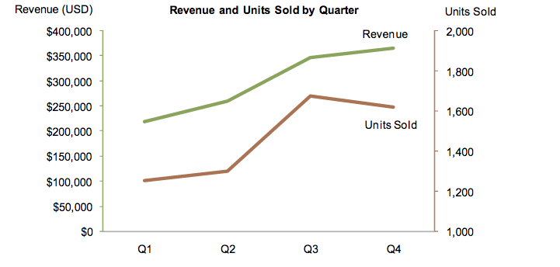
Image from https://www.perceptualedge.com

Slide 3
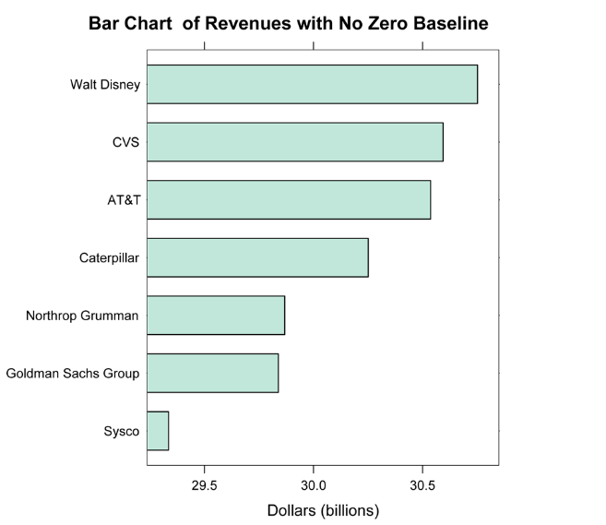
What’s missing?
Source: https://www.perceptualedge.com/articles/b-eye/dot_plots.pdf
Notes:
Revenues shown but missing 0 point.

Slide 4
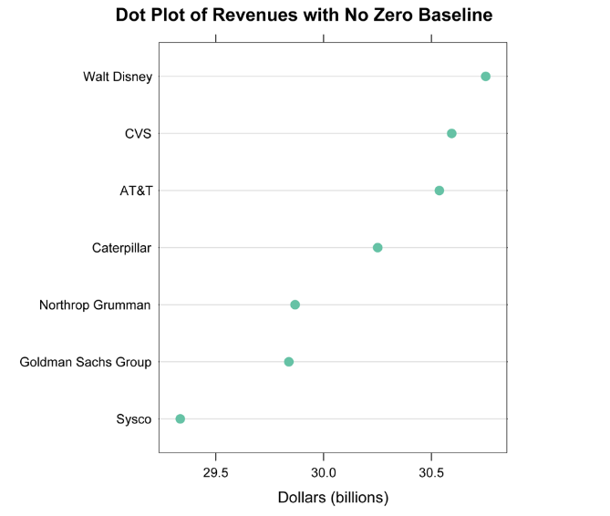
Source: https://www.perceptualedge.com/articles/b-eye/dot_plots.pdf

Slide 5
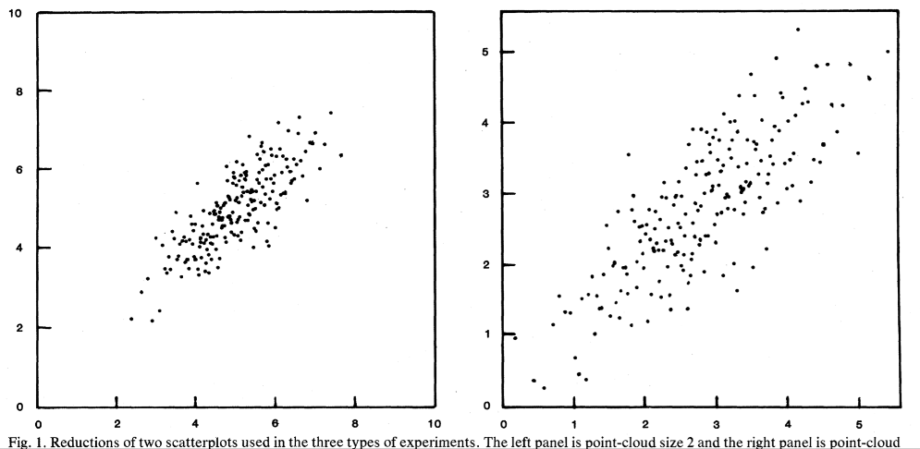
Scale impacts perception
[Cleveland et al., 1982]
Notes:
Chose the right scale. Cleveland and coauthors found that viewers’ conclusions about correlation in scatterplots is in part determined by the scale. Which one do you think looks like there is more of a correlation?

Slide 6
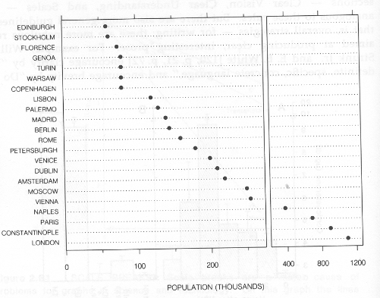
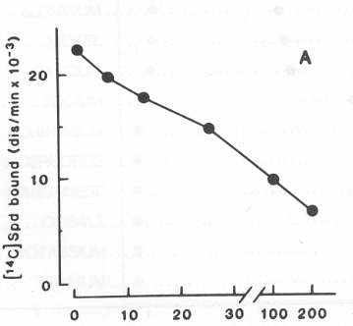
Scale Breaks
Poorly marked Better
[Cleveland et. al., 1985]
Notes:
Tread carefully. Often you want to avoid scale break but if you do use it make sure that scale breaks.

Slide 7
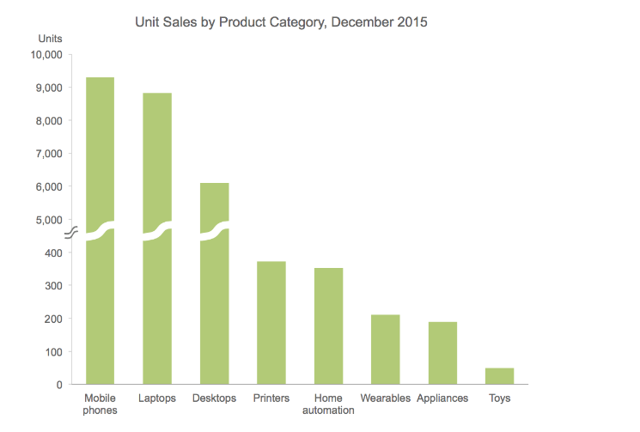
Scale Breaks
https://www.perceptualedge.com/

Slide 8
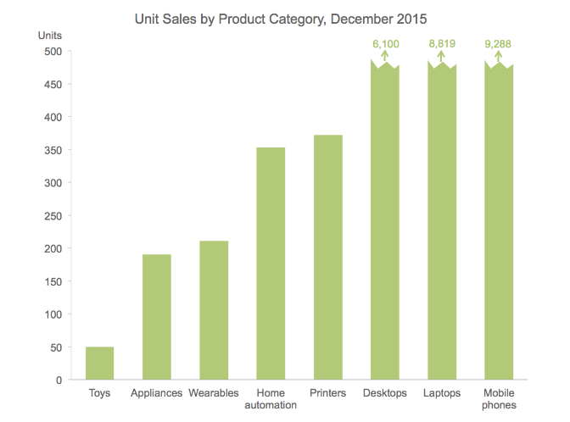
Truncate Larger Values
https://www.perceptualedge.com/
Notes:
Use with caution. Could work if the larger values are not important, but want to ensure the viewer knows that you’re truncating.

Slide 9
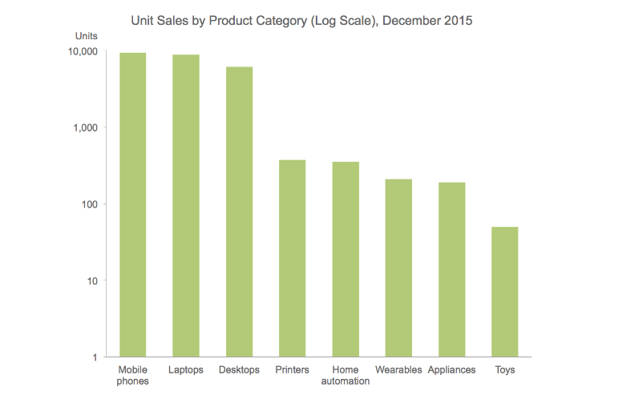
Log Scale
https://www.perceptualedge.com/
Notes:
Transform the data to log scale. In some fields this is more common place than others.
Mindful of audience

Slide 10
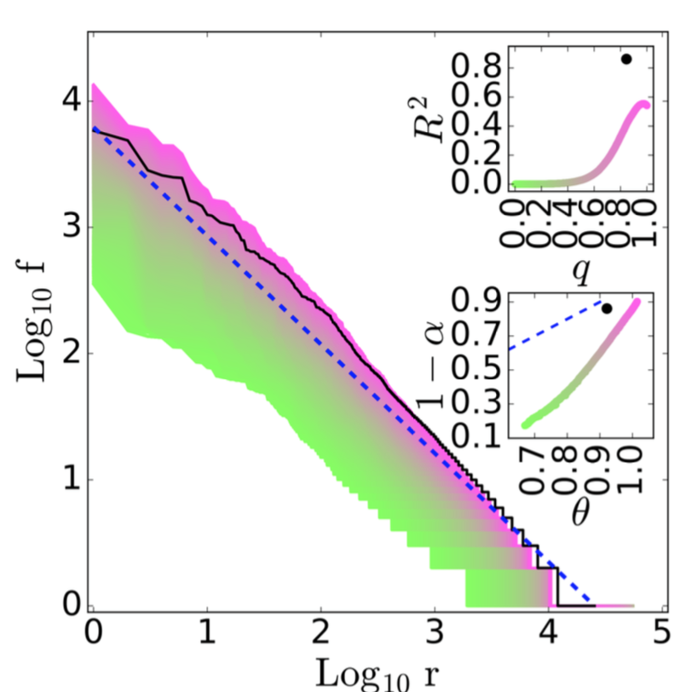
[Williams, et. al.. 2016]

Slide 11
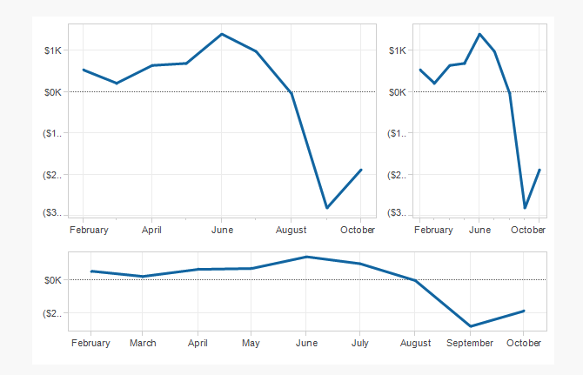
What Is the “Correct” Aspect Ratio?
Image source: https://eagereyes.org/
Notes:
Image from https://eagereyes.org/basics/banking-45-degrees
There were some issues with the original 45 degree study.

Slide 12
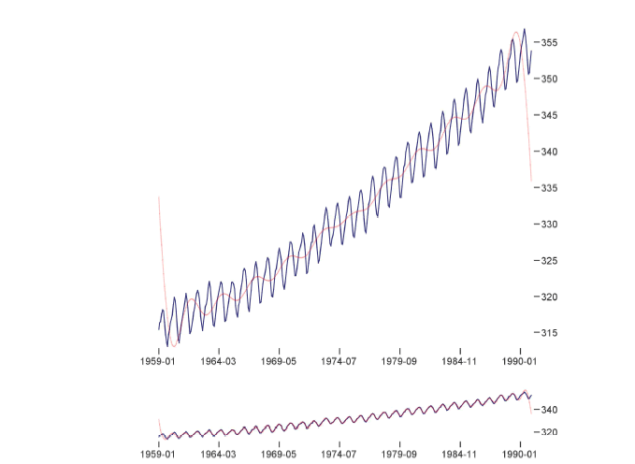
Banking Techniques
http://vis.berkeley.edu/papers/banking/
Notes:
Jeff Heer and Maneesh Agrawala came up with techniques for optimizing banking …

Slide 13


