Slide 1

Multiple Views
Notes:
Discuss supporting comparison and pattern detection across multiple views

Slide 2
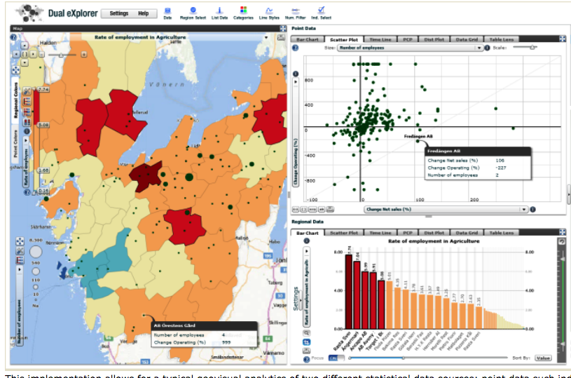
Image source: http://ncva.itn.liu.se/r
Notes:
Two plus views of the same conceptual entity.

Slide 3
Why use multiple views?
Data diversity (attributes, models, etc.)
Want to find correlations or disparities
Improve user performance when one view overwhelms
[Wang Baldonado et al., 2000]
Notes:
Baldonado et al. discuss some guidelines coming out of research at Xerox PARC and HP Labs.
https://www.researchgate.net/profile/Michelle_Baldonado/publication/2635114_Guidelines_for_Using_Multiple_Views_in_Information_Visualization/links/0912f512c4063132a1000000.pdf

Slide 4
Diversity of data

Slide 5
Diverse Attributes
Attributes (e.g., dates traveled, histogram of countries visited)
Subsets or aggregate views shown simultaneously

Slide 6
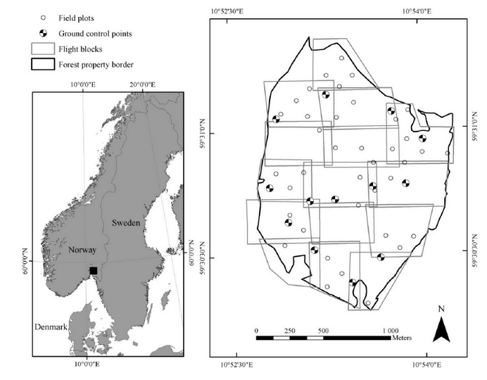
Level of Abstraction
Layers of detail (e.g., entire city vs. detail of streets)
Image Source: Puliti, S., Ørka, H. O., Gobakken, T., & Næsset, E. (2015). Inventory of small forest areas using an
unmanned aerial system. Remote Sensing, 7(8), 9632-9654.

Slide 7
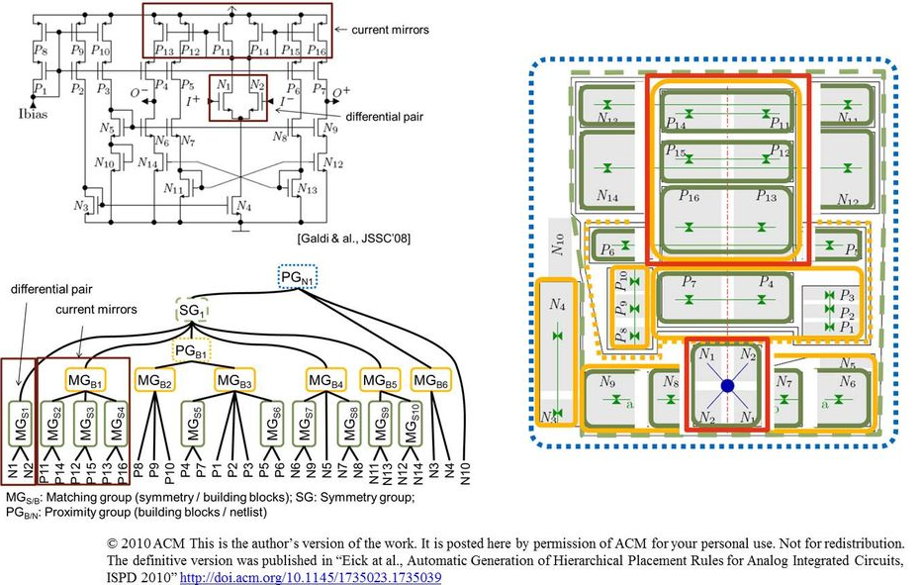
Multiple Data Models
Notes:
e.g., logical structure vs. a geometric layout of circuit.
https://www.eda.ei.tum.de/fileadmin/_processed_/csm_AnLay.png_52a105866b.jpg

Slide 8
Design Considerations

Slide 9
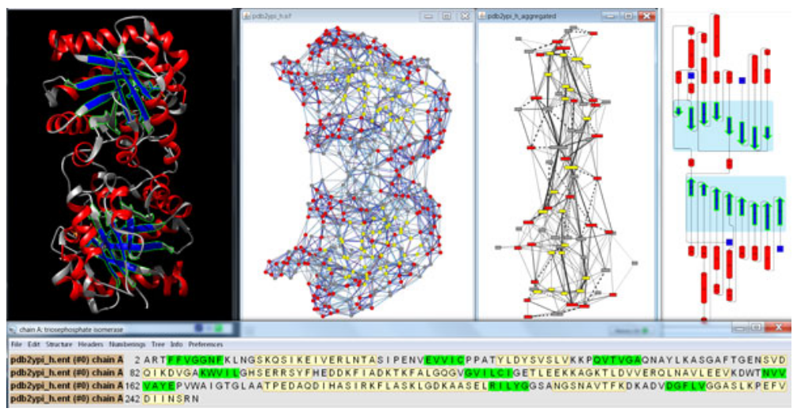
Correlations/ Disparities
Image Source: Doncheva, N. T., Klein, K., Morris, J. H., Wybrow, M., Domingues, F. S., & Albrecht, M. (2014). Integrative visual analysis of protein sequence mutations. In BMC Proceedings.
Notes:
Use multiple views to show correlations and disparities between data.
Showing complementary views to look at different aspects of the protein structure.

Slide 10
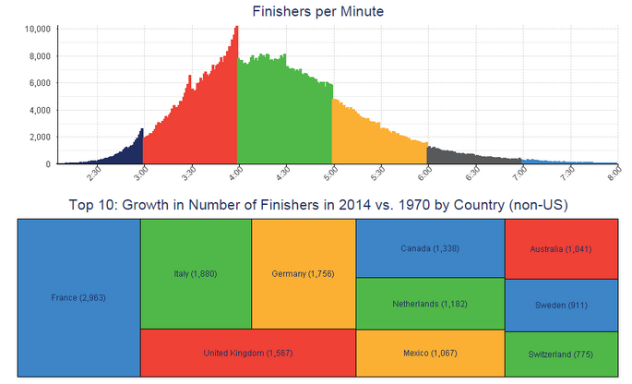
Consistent Encodings
Chart Source: http://dataremixed.com/2015/11/avoiding-data-pitfalls-part-3-confusing-colors/
Notes:
Similarity - principles that if you are showing the same data variables across multiple views use the same encodings and be careful of conflict. This chart showing NYC Marathoners uses the same color encoding for the different minutes and the country.

Slide 11
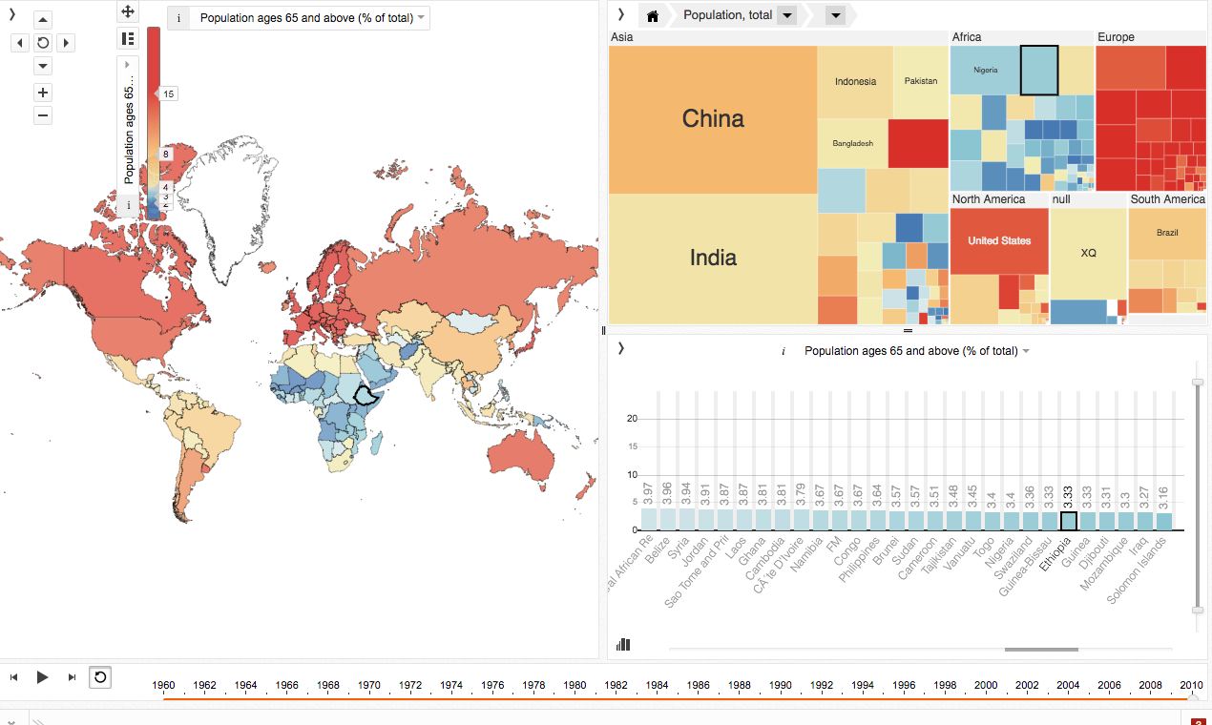
http://mitweb.itn.liu.se/GAV/dashboard/
Notes:
Makes good use of a consistent color encoding across views.
different tools or libraries a cohesive look and feel
Dashboard design

Slide 12
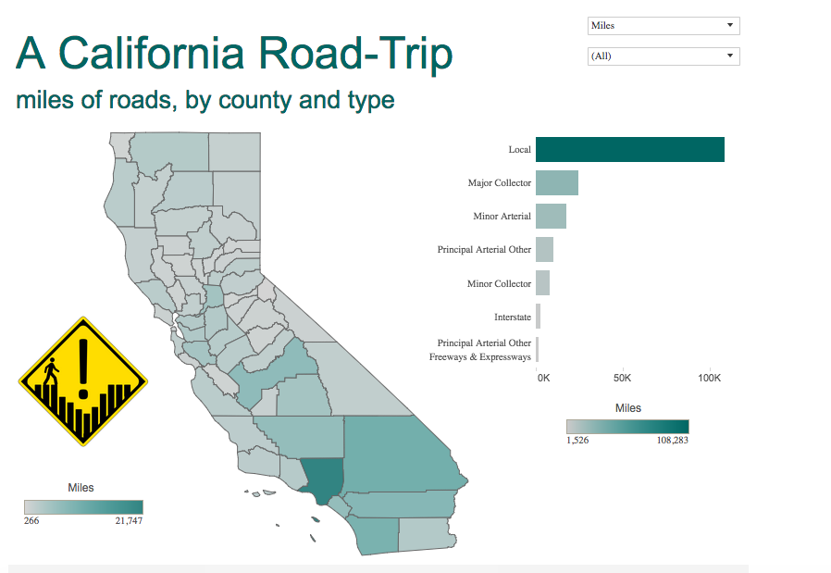
Source: http://dataremixed.com/2015/11/avoiding-data-pitfalls-part-3-confusing-colors/
Notes:
If using the same saturation here
Keep it consistent or remove
No need to double encode

Slide 13
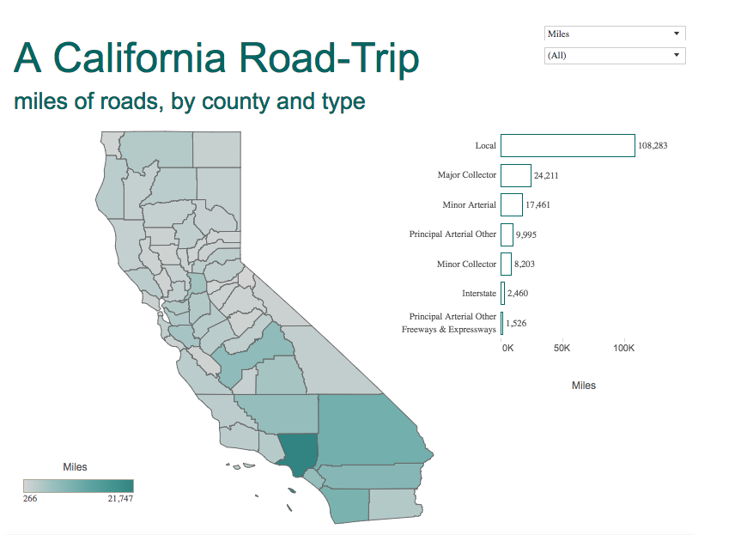
Source: http://dataremixed.com/2015/11/avoiding-data-pitfalls-part-3-confusing-colors/
Notes:
Saturation removed

Slide 14
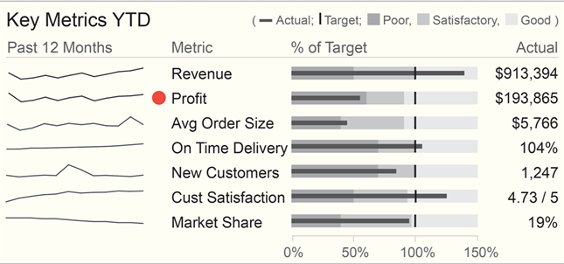
Perceptual Cues
Source: http://www.dashboardinsight.com/news/news-articles/interview-with-stephen-few-dashboard-design-challenges.aspx
Notes:
Remember that with more on the page, there’s more that needs to be attended to visually so help the use process what’s most important. Here actual profit is doing poorly and it’s been given greater visual salience with the addition of the red dot mark next to it.

Slide 15
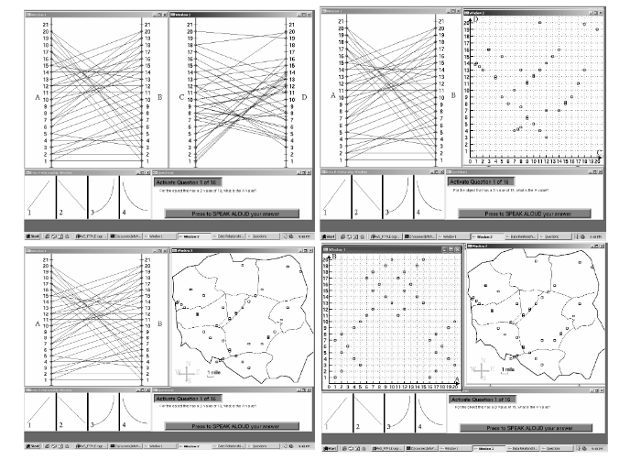
Similar View Placement
Examined context switching
Dual-view similar charts made for poor pattern search
[Convertino et al, 2003]
Convertino et al., 2003. Exploring context switching and cognition in dual-view coordinated visualizations. In Coordinated and Multiple Views in Exploratory Visualization, 2003. Proceedings. International Conference on (pp. 55-62). IEEE.
Notes:
Eye tracking
Results for parallel corrdinates
Was brushing and linking interaction between dimensions
Note difference than small multiples

Slide 16
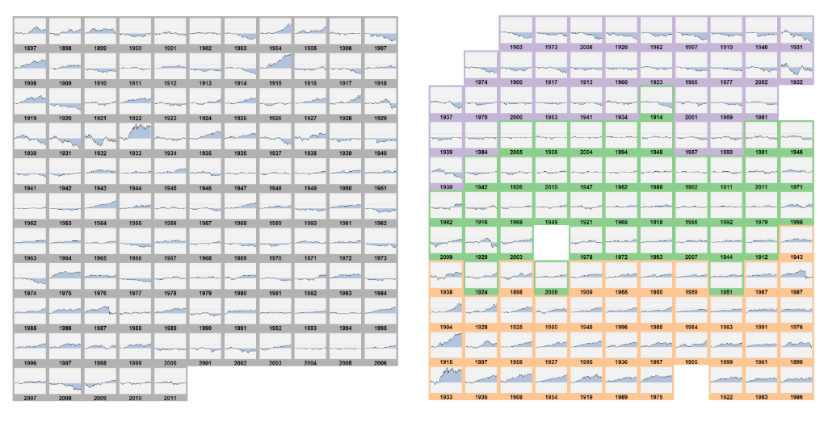
Small Multiple Placement
Correlated small multiple views perform well for visual search & comparison
[Liu et al., 2015]
Source: Liu, X., Hu, Y., North, S., & Shen, H. W. 2015. Correlated Multiples: Spatially Coherent Small Multiples With Constrained Multi‐Dimensional Scaling.
Notes:
When showing data with the same axes and scale correlate views

Slide 17
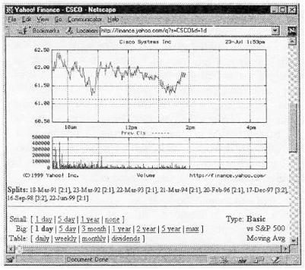
Display & Task Time Optimization
Notes:
Optimizing space and time for the user. Side by side or sequentially. Same axis maximizing space use.
Optimizes user time here

Slide 18
Code Optimization
Making your code:
Reusable
Cleaner
Scalable
Modular
Notes:
For multiple views, system optimization .

Slide 19


