Slide 1

Perception of Color

Slide 2
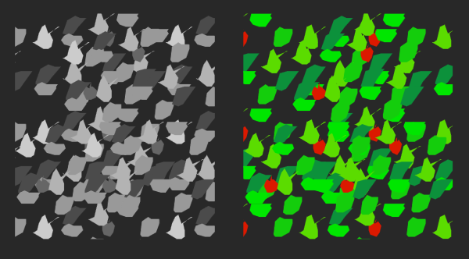
Image source: Ware, C. (2012). Information visualization: perception for design. Elsevier.
Notes:
Color aids discrimination

Slide 3
Uses of Color
Label
Measure
Represent/imitate reality
Enliven/decorate
(Tufte, 1990)
Notes:
Label = tag

Slide 4
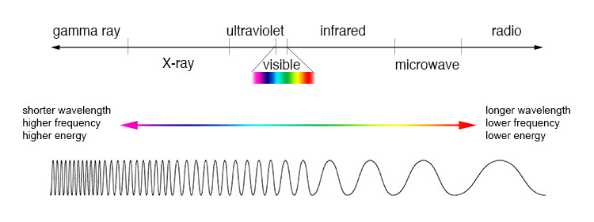
Electromagnetic Spectrum
Source: NASA
Notes:
EM spectrum light is just a small section
trichromatic theory make any color by combining 3

Slide 5
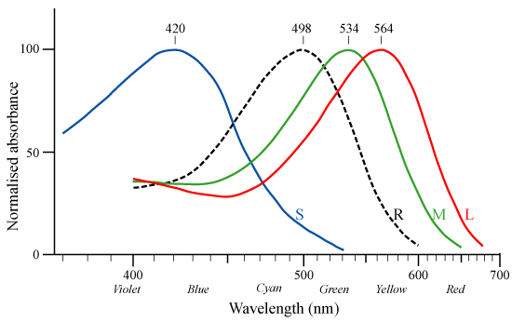
Rods and Cones
Source: Wikimedia Commons, after Bowmaker and Dartnall, 1980
Notes:
frequency response curves really short, medium, long wavelength normalized, usually more red and green than blue

Slide 6
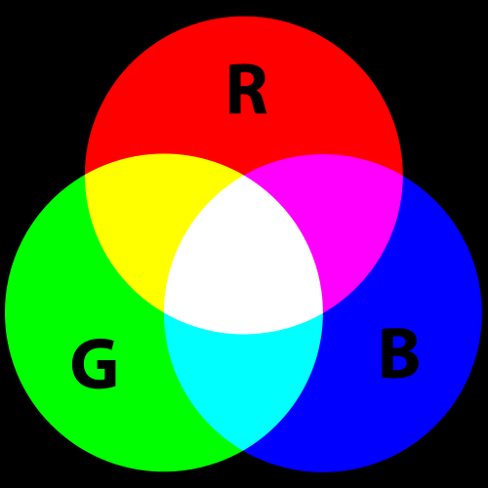
Additive Color
Source: Wikimedia Commons
Notes:
additive color – projector red + green = yellow
Addition of colors of light

Slide 7
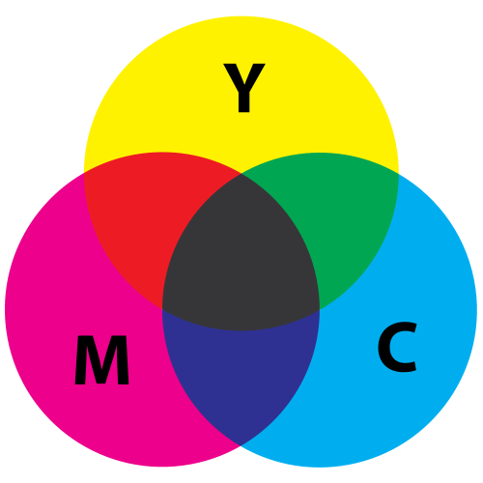
Subtractive Color
Source: Wikimedia Commons
Notes:
subtractive color – paint yellow + blue = green
Pigment absorbs wavelengths, subtracts them from what our eye receives.

Slide 8
Color Opponency
Notes:
opponent colors hard to imagine a reddish green, bluish yellow specific neurons - ganglion cells R+ G- big response to red R- G+ big response to green also Yellow/Blue opponency
also Black/White opponency

Slide 9
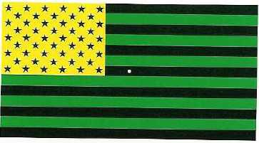
Color Opponency
Notes:
American flag illusion stare for 30 sec

Slide 10
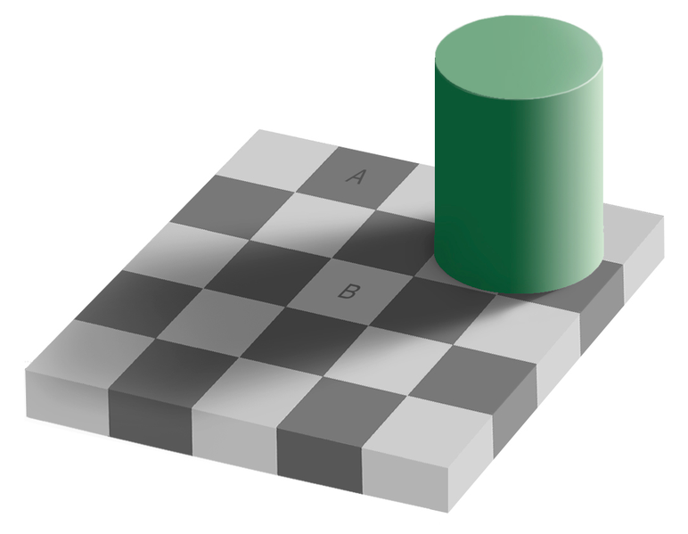
Color Constancy
Source: Wikimedia Commons
Notes:
We account for shading checkerboard A and B squares same color we discount the illuminant

Slide 11
Color Models

Slide 12
Terminology
Hue Dominant wavelength, named color
Saturation Intensity or purity of color Distance from gray/white/black
Lightness Light to dark

Slide 13
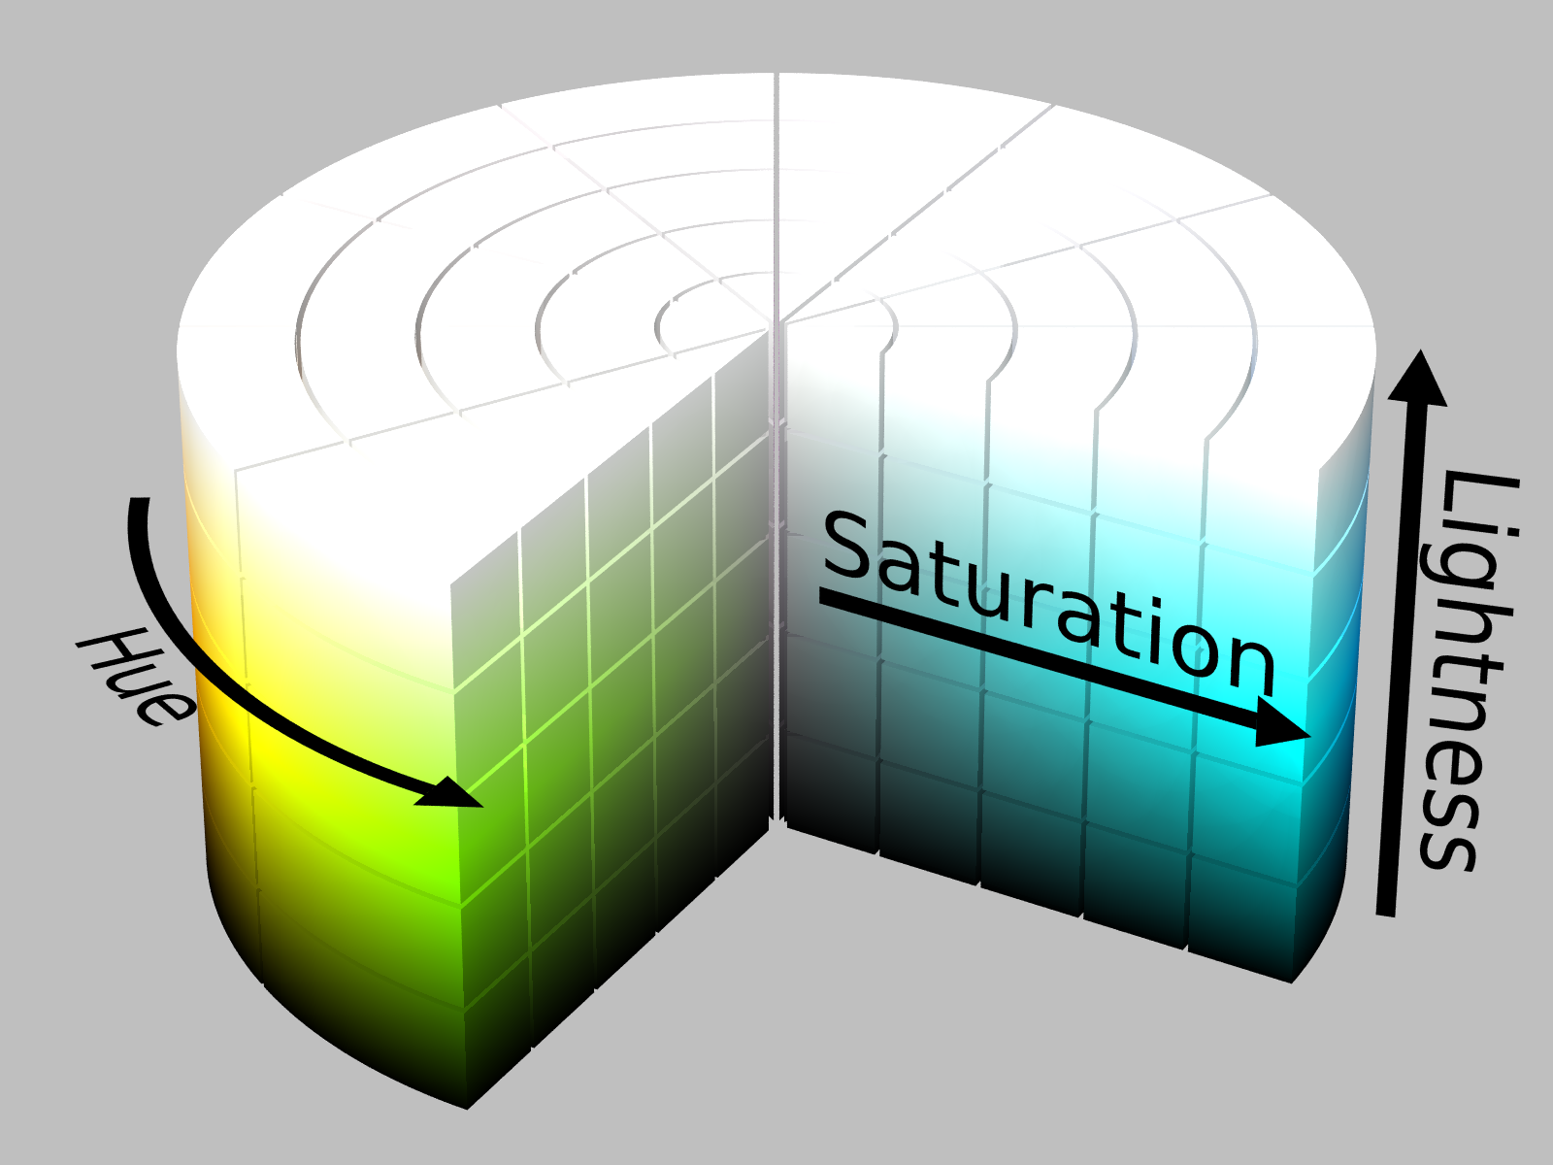
HSL Color Model
By SharkD, derivative work, CC BY-SA 3.0,
https://commons.wikimedia.org/w/index.php?curid=9801661
Notes:
Other models exist
Lightness + saturation -> brigthness + crhoma

Slide 14
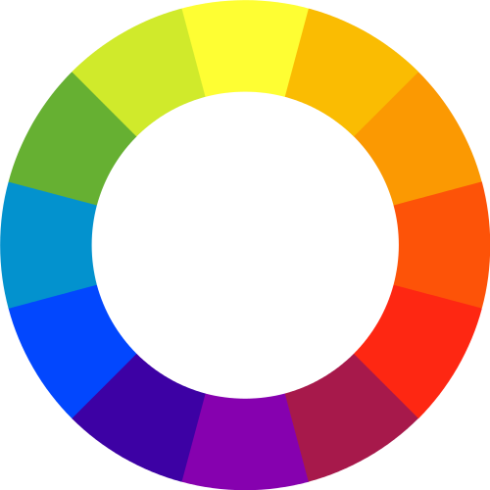
Color Wheel

Slide 15
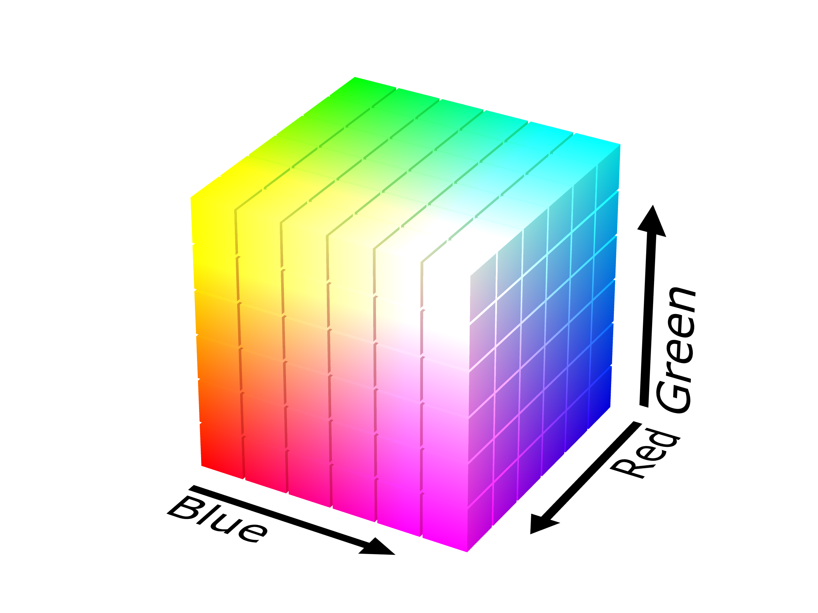
RGB Color Model
By SharkD - Own work, GFDL, https://commons.wikimedia.org/w/index.php?curid=3375025
Notes:
HSL is really the RGB color model, just made easier to work with
White = ffffff or 255, 255, 255
Black = 000000

Slide 16
Other Models
Designed for perceptual uniformity
HCL
CIE Lab
Munsel

Slide 17
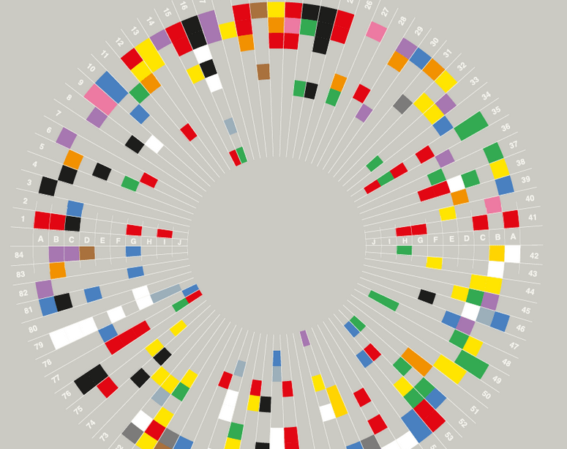
Culture and Emotion
Notes:
Some universality
But also differences
Green=go, red=stop works in U.S., not Yunnan Province, china

Slide 18
Color Harmony
Difficult to study
Conflicting results
Confounding of preference and harmony
Notes:
people prefer contrast
people prefer analogous colors
sometimes people like unharmonious pairings

Slide 19
Individual Colors
Yellow < orange < purple < green < red < blue (Eysenck, 1941)
Color preference based on affective response to objects of that color. (Palmer & Schloss, 2010)
Pairing of colors to emotions is consistent.
Hue is not the main influence on emotion;
saturation is. (D'Andrade & Egan, 1974; Kieffer, 1974; Johnson, Johnson, & Baksh, 1986)
Notes:
Eysenck – across genders (except women preferred yellow to orange)
across races
very bright, saturated = good, happy
pale = weak, frightened

Slide 20
Emotional Responses
Blue, green, white: peaceful, gentle, calming (beautiful, pleasant in some countries)
Black, brown: sad, stale (formal, masculine in some countries)
Gold, orange, yellow: no strong associations
Purple: similar to brown for Asian countries
Red: active, hot, vibrant, emotional, sharp (pleasant in PRC and Taiwan) (Madden, Hewett, & Roth, 2000)
Notes:
Madden, Hewett, and Roth, 2000
Associations across 8 countries
Not all consistent, but pretty close!

Slide 21


