Slide 1

Perception of Contrast

Slide 2
Brightness: The perceived amount of light results in a nonlinear function.

Slide 3
Just Noticeable Difference
144, 144, 144
132, 132, 132
12 units different
Notes:
just noticeable difference grey squares – which is darker? 12 RGB units different = same

Slide 4
Just Noticeable Difference
144, 144, 144
128, 128, 128
16 units different
Notes:
16 units different = different

Slide 5
Just Noticeable Difference
244, 244, 244
232, 232, 232
12 units different
Notes:
lighter squares (less stimulus) 12 units diff = diff

Slide 6
Just Noticeable Difference
244, 244, 244
236, 236, 236
8 units different
Notes:
even 8 units diff = diff

Slide 7
Weber’s Law
ΔS/S = k
Ratio of change in stimulus to magnitude of stimulus is roughly constant
Notes:
Weber’s law δελταS/S = k “stimulus” = darkness ratio of (change to make JND) to initial stimulus is ~constant ratios more important than magnitude

Slide 8
Just Noticeable Difference
244, 244, 244
236, 236, 236
8 units different
Notes:
what if we make background black? “stimulus” = lightness same light grey squares, hard to tell

Slide 9
Continuous Variation
Most continuous variations are perceived as discrete steps
Notes:
most continuous variation perceived as discrete steps

Slide 10
Color Contrast
After Josef Albers
Notes:
make 2 colors look like 1. Simultaneous contrast. Color is relative!

Slide 11
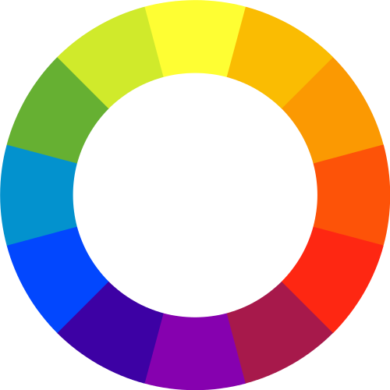
Complementary Colors
Notes:
complementary colors opposite on color wheel

Slide 12
Complements vibrate
Notes:
they vibrate!
Can be annoying, but can also be useful for getting attention (judiciously)

Slide 13
Color Differentiation
Rapidly identify data elements using color

Slide 14
Color Differentiation
Color distance: the Euclidian distance between colors in the model
Linear separation: ability to separate targets from nontargets when one can or cannot draw a straight line between the target and nontargets
Color category: named color regions occupied by both target and nontarget elements
Notes:
C.G. Healey, 1996
Several factors

Slide 15
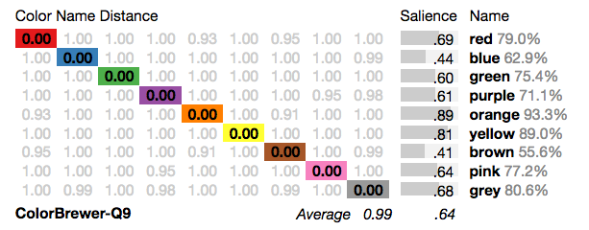
Distinct Nameable Colors
Source: http://vis.stanford.edu/color-names/analyzer/
Notes:
nameable colors are best
Color Pallette Analyzer

Slide 16
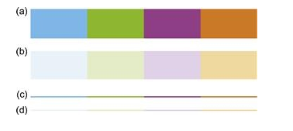
Saturation and Size
Source: Ware, C. Information visualization, perception for design, 2013

Slide 17
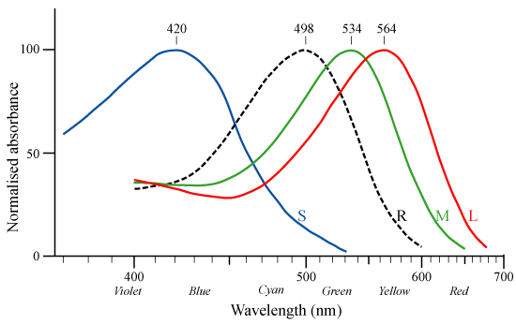
Color Blindness: Cones
Notes:
missing usually high or medium frequency receptors “red-green” color blindness ~8% of men, ~0.5% of women
good to avoid dependence on color, esp. red vs. green

Slide 18
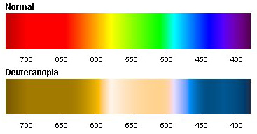
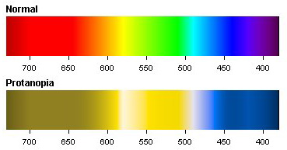
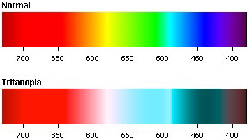
Color Blindness: Types
Notes:
deuteranopia most common missing “green” cones
protanopia missing “red” cones
tritanopia missing “blue” cones

Slide 19
"Traffic Light" Indicators
Notes:
“traffic light” indicators
avoid using hue alone for labeling
http://www.vischeck.com/examples/

Slide 20
Color Scales

Slide 21
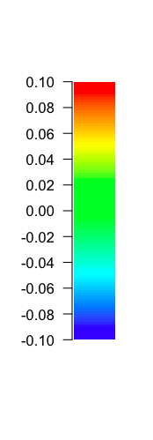
Typical Rainbow Color Scale
Notes:
rainbow scales are common bad: no inherent ordering in hue bad: hard to distinguish fine detail not ordered by luminance good: easy to read value from scale

Slide 22

Contrast Sensitivity Function
Decreasing Contrast
Increasing Spatial Frequency
Notes:
We're more sensitive to contrast in greyscale
But gray scales can be trouble too luminance values near each other interfere

Slide 23
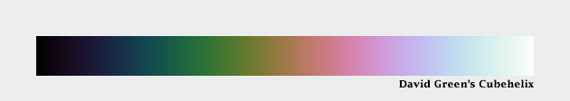

Alternatives
d3.cubehelix()
divergent scales
Notes:
alternatives spiral scales luminance varies evenly Cubehelix
diverging good for ratio data, with zero +/- (sea levels)

Slide 24
Design Tips
First ask: Is color necessary?
Use colors that are separable and nameable when possible
Scale appropriately
Beware of poor contrast effects
Design for color blindness

Slide 25


