Slide 1

Interaction and Perception
Notes:
Krish and Maglio (1994) -epistemic actions = activities that uncover new information.
Otherwise, just clutter.

Slide 2
Taxonomy of Infoviz Tasks
Overview: See overall patterns, trends
Zoom: See subset
Filter: See subset based on attributes
Details on demand: See more about specific object
Relate: See relationships, compare values
History: Keep track of actions and insights
Extract: Mark and capture specific data

Slide 3
Visual Information Seeking Mantra
Overview first,
zoom and filter,
details on demand.
—Ben Shneiderman

Slide 4
Three Types of Feedback Loops
Data selection and manipulation
Most important for interactive visualization
Exploration and navigation
Problem solving

Slide 5
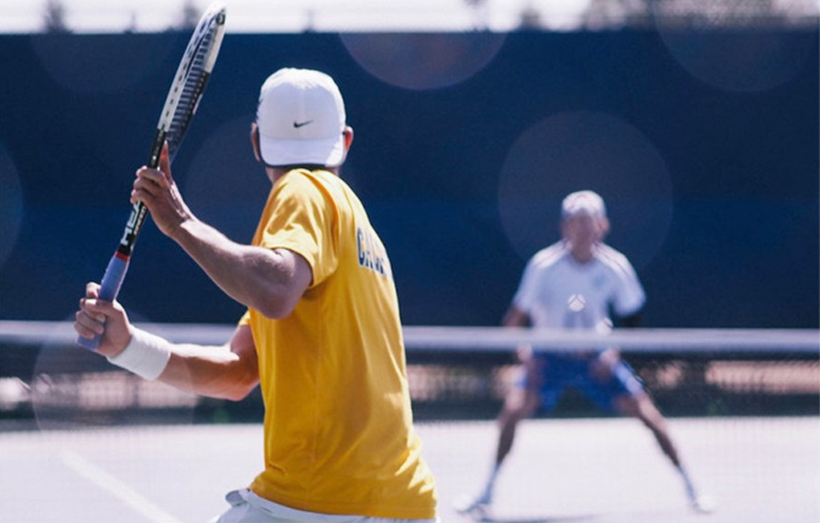
Reaction times
Daily Cal
Notes:
Photo: http://www.dailycal.org/2015/02/24/no-14-cal-mens-tennis-falls-stanford-defeats-gaels-gauchos/

Slide 6
Simple Reaction Times
Optimal (finger at the ready)
~130 ms (Kohlberg, 1971)
Infrequent (still at the ready)
Up to 700 ms (Warrick et al., 1964)
Notes:
= no choice

Slide 7
Choice Reaction Times
Hick-Hyman law:
Reaction Time = a + blog₂(C)
Where C = number of choices,
and a and b are constants.
log₂(C) is information processed by humans in bits.

Slide 8
Choice Reaction Times
Hick-Hyman law:
Dealing with choice is expensive

Slide 9
Minimize visual noise
Notes:
Impacts on reaction time: visual noise, degree of accuracy.

Slide 10
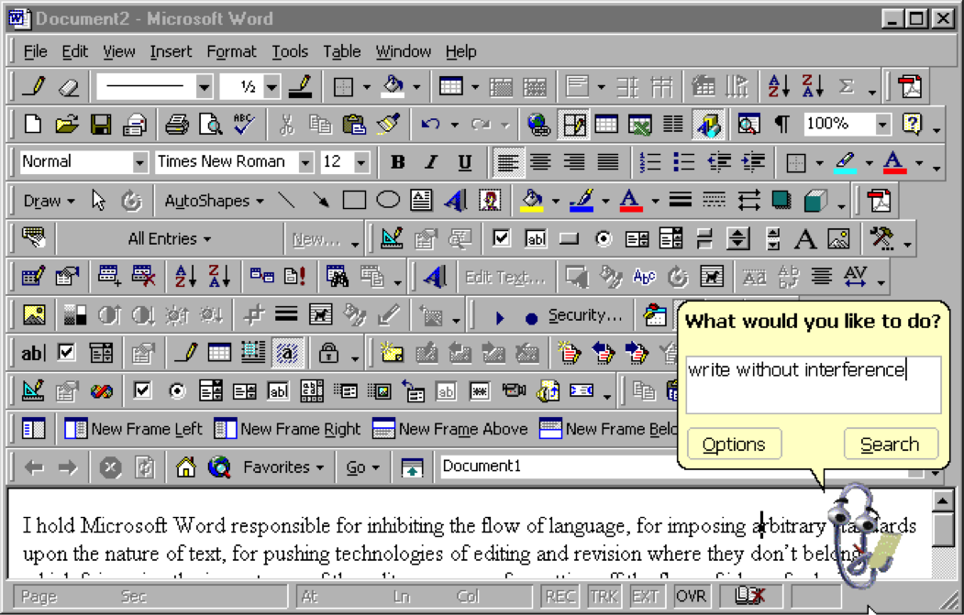
@ftrain

Slide 11
System Response Times

Slide 12
Three Thresholds
0.1 s for visual continuity, feels like real time:
animations, sliders
1 s for reasonable system response:
pause in conversation
10 s for process expected to be slow:
cognitive response
threshold for suspecting system is broken

Slide 13
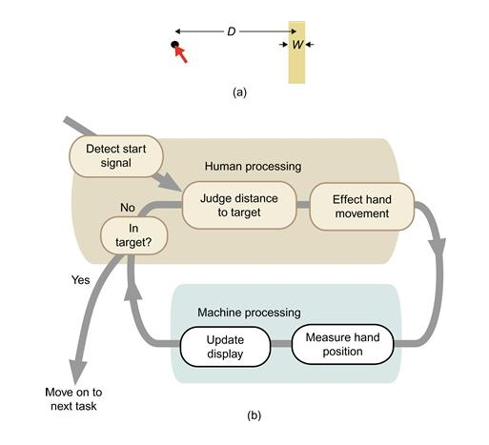
Diagram source: Ware, 2010

Slide 14
Fitts’s Law
Selection time = a + b log₂(D/W + 1)
D = distance to target
W = width of target
log₂(D/W + 1) is index of difficulty (in bits)
1/b = index of performance (in bits/s), roughly constant, typically ~4

Slide 15
Fitts’s Law
Time increases as distance to target increases
Time increases as width of target gets smaller
Notes:
Paul Fitts

Slide 16
Fitts’s Law
Keep controls that you want users to easily move between near each other.
Make click targets large.
Keep controls that users should use rarely away from commonly used controls.

Slide 17
Fitts’s Law
Submit
Delete All

Slide 18
Visual Information Seeking Mantra
Overview first, zoom and filter, details on demand.
Overview first, zoom and filter, details on demand.
Overview first, zoom and filter, details on demand.

Slide 19


