Slide 1
Common Interaction Techniques

Slide 2
Explore
Notes:
communicated clearly.

Slide 3
Taxonomy of Interactive Dynamics
Data and View Specification | Visualize data by choosing visual encodings. Filter out data to focus on relevant items. Sort items to expose patterns. Derive values or models from source data.
(Heer & Shneiderman, 2012)
Notes:
Written for tool devs

Slide 4
Taxonomy of Interactive Dynamics
View Manipulation | Select items to highlight, filter, or manipulate them. Navigate to examine high-level patterns and low-level detail. Coordinate views for linked, multidimensional exploration. Organize multiple windows and workspaces.
(Heer & Shneiderman, 2012)

Slide 5
Taxonomy of Interactive Dynamics
Process and Provenance | Record analysis histories for revisitation, review and sharing. Annotate patterns to document findings. Share views and annotations to enable collaboration. Guide users through analysis tasks or stories.
(Heer & Shneiderman, 2012)

Slide 6
Data and View Specification | Visualize data by choosing visual encodings. Filter out data to focus on relevant items. Sort items to expose patterns. Derive values or models from source data.
View Manipulation | Select items to highlight, filter, or manipulate them. Navigate to examine high-level patterns and low-level detail. Coordinate views for linked, multidimensional exploration. Organize multiple windows and workspaces.
Process and Provenance | Record analysis histories for revisitation, review and sharing. Annotate patterns to document findings. Share views and annotations to enable collaboration. Guide users through analysis tasks or stories.
(Heer & Shneiderman, 2012)
Notes:
Not all inclusive,
good areas to think about

Slide 7
Fundamental Interactions
Notes:
We talk about navigation in a different segment.

Slide 8
Filter
Filter to focus on certain data
(e.g., time segment, categories)

Slide 9
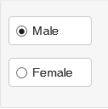
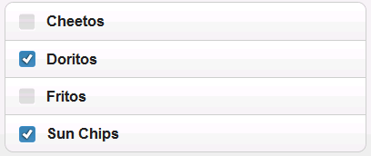
Filter
When a small number of items:
Radio buttons
Check boxes

Slide 10
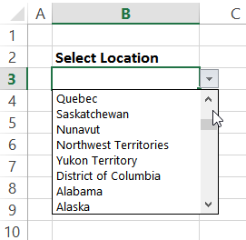
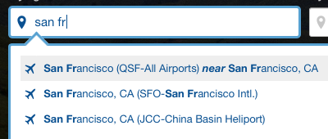
Filter
When a large number of items:
Scroll
Hierarchy
Search with autocomplete

Slide 11
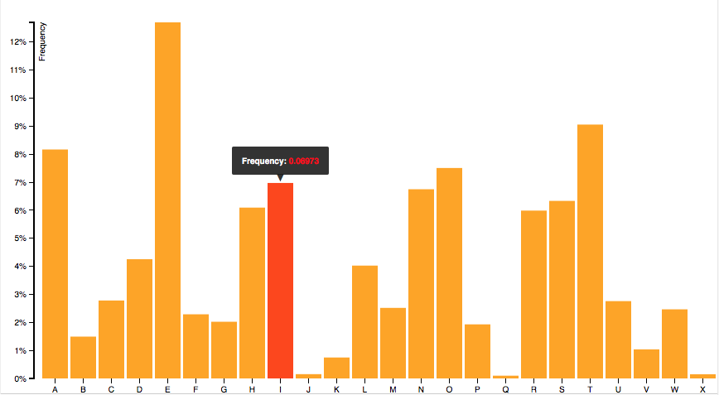
Selection
Mouseover/hover
Sticky mouseover
Tap/click
Drag
Keyboard (tab, keyboard cursor)
Notes:
Selection = mark something as interesting

Slide 12
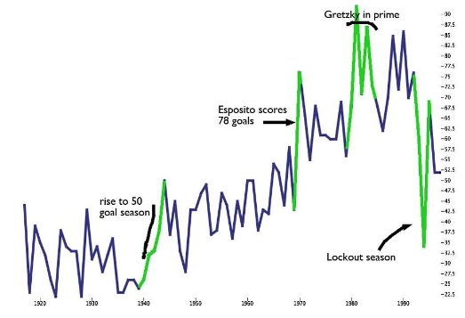
Perceptual Annotation
[Kong & Agrawala, 2009]

Slide 13
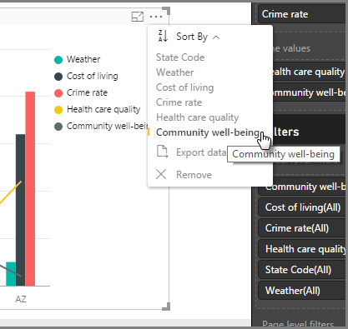
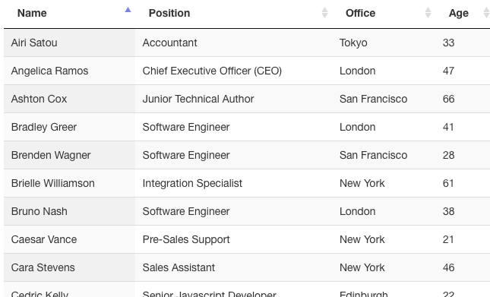
Sort
Drag
Keyboard (e.g., arrow keys)
Sort by selection

Slide 14
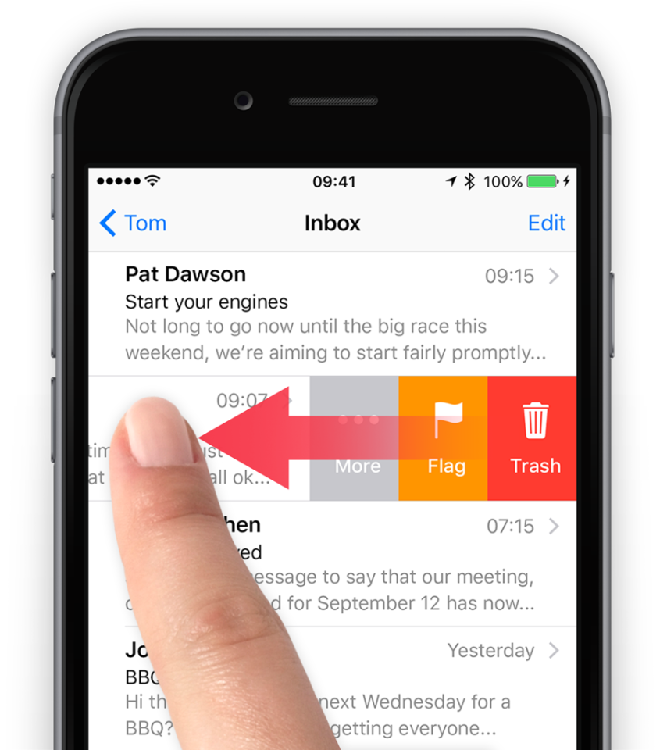
Deletion
Select and apply
Select and use keyboard (e.g., delete key)
Drag out
Swipe right or left
Notes:
Not mentioned in the taxonomy.

Slide 15


