Slide 1
Evolving Interactions

Slide 2
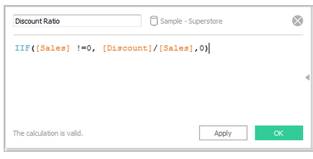
Dynamic Query
Text-based dynamic query:
Programmatic
Not as flexible with matches
https://onlinehelp.tableau.com/current/pro/desktop/en-us/calculations_calculatedfields_ex1create.html
Notes:
Requires programming, have to know the syntax; produces exact matches and might produce too few or too many hits, often returned as table, but can be applied to visual language too!

Slide 3
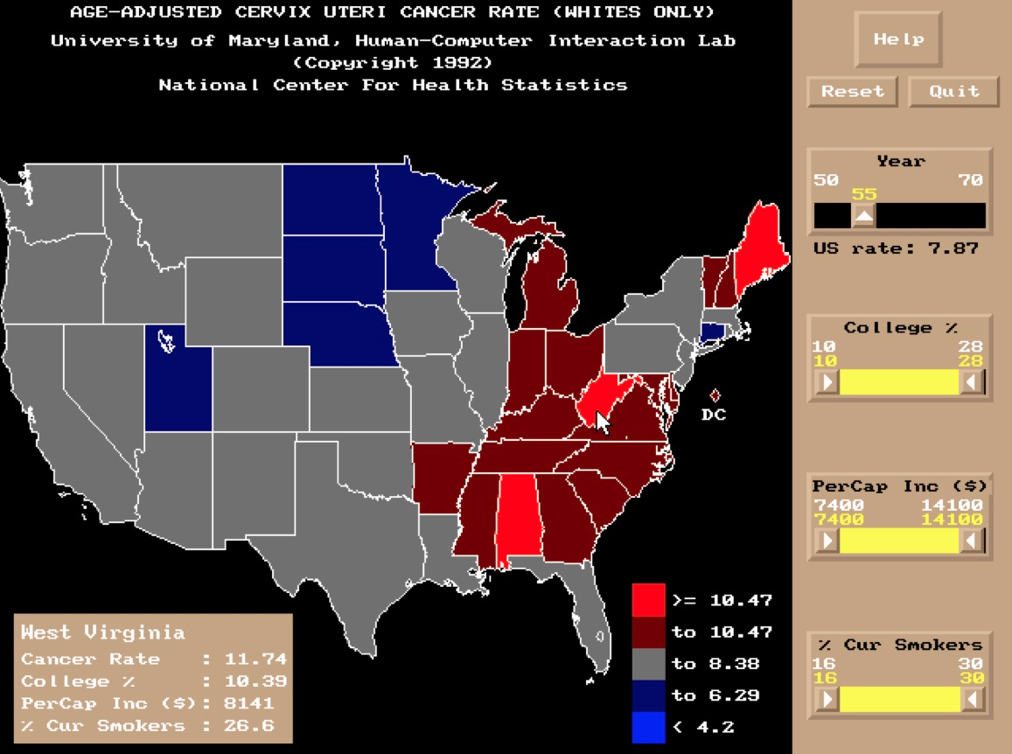
Jain & Plaisant, 1992
Notes:
http://www.cs.umd.edu/hcil/spotfire/
In the early 1990’s (1992?) Vinit Jain worked with Catherine Plaisant to build the first dynamic queries on Choropleth maps for the National Center for Health Statistics, using data from the Cancer Atlas. animate the map over 20 years of cancer rate data and filter the map by various demographic parameters such as income or college education HCIL TR 93-21, and HCIL TR 94-16.

Slide 4
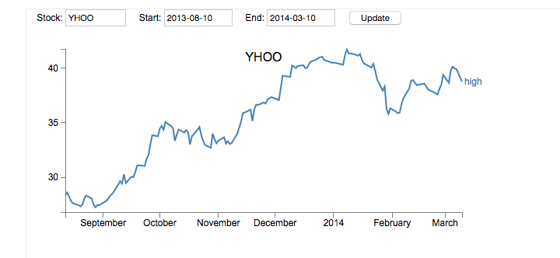
D3 Dynamic Stock Data
http://bl.ocks.org/d3noob/9576689

Slide 5
Supporting iterative analysis
and sharing

Slide 6
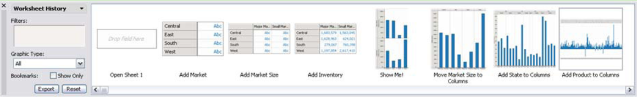
Visual History

Slide 7
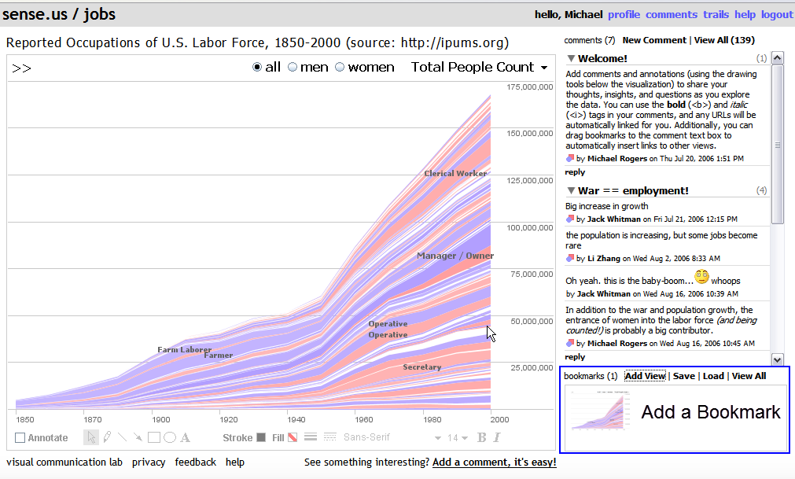
Sharing
http://vis.berkeley.edu/papers/sense.us/video/
Notes:
How to add information but also how to make sharing easy. provided a shareable url link?

Slide 8
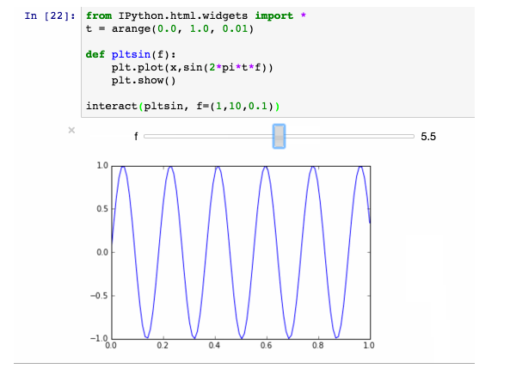
Interaction in Jupyter
https://blog.dominodatalab.com/
interactive-dashboards-in-jupyter
Notes:
To get real interaction need JS, still a bit limiting. Write your own or use a package

Slide 9
Changing Expectations
Notes:
Can be domain or culturally specific. User expectations change – don’t assume!

Slide 10

Image from http://www.webdesignerdepot.com
Notes:
http://www.webdesignerdepot.com/2014/06/how-to-solve-the-hamburger-icon-problem/

Slide 11
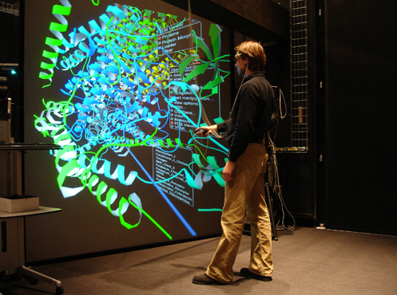
Image from https://www.nsf.gov/
news/mmg/mmg_disp.jsp?med_id=62893&
Notes:
Virtual reality and augmented reality. Is it actually helping perceptually? Protein Data Bank Browser Software
https://www.nsf.gov/news/mmg/mmg_disp.jsp?med_id=62893&

Slide 12


