Slide 1

Exploratory Analysis

Slide 2
Data Transformations
You’ve already done this with DataFrames in Pandas or R.
They look like this:
Notes:
Already seen this in week 2

Slide 3
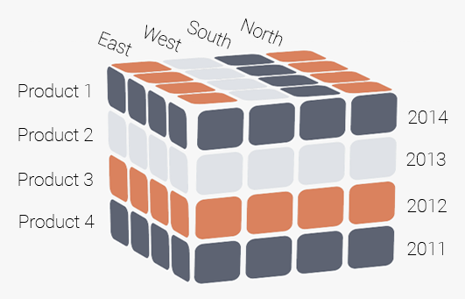
Data Transformations
But you think of them like this:
Notes:
Already seen this in week 2

Slide 4
Common Transformations
Normalize
Log
Power
Binning
Grouping

Slide 5
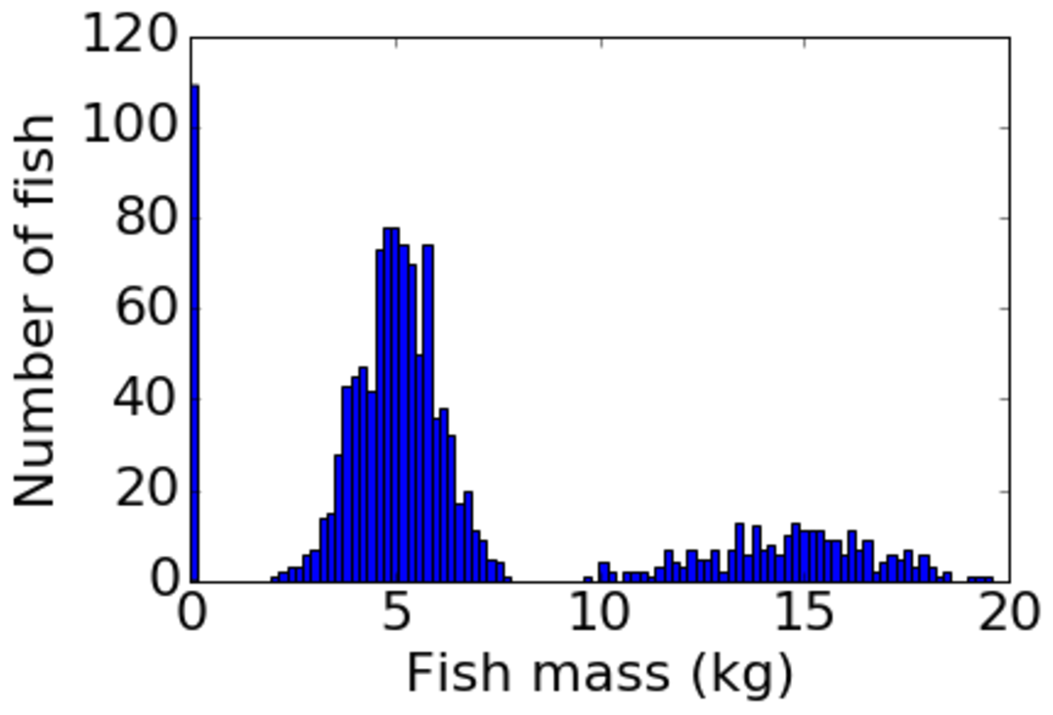
What Does A Look Like?
Notes:
histogram

Slide 6
Histograms, Histograms, Histograms
An cornerstone in the EDA toolbox!
“Above all else, show the data”
Notes:
Tufte p. 105.
Univariate first

Slide 7
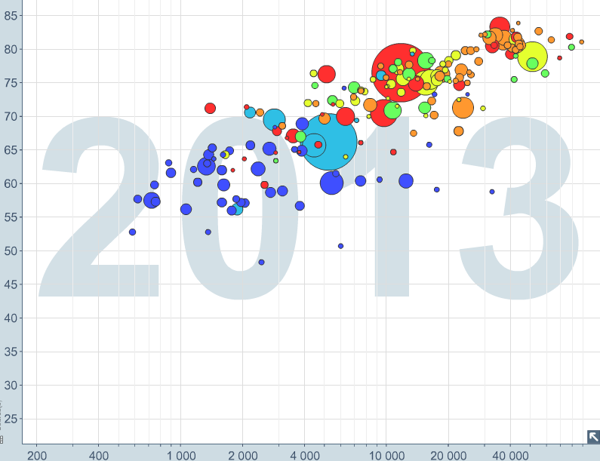
What’s the Relationship Between A and B?
Notes:
scatterplot- x,y positions (best encodings) to make comparisons
see Gapminder
http://www.gapminder.org/world/

Slide 8
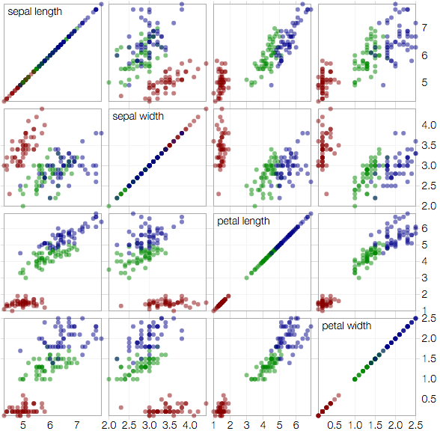
Hypothesis Generation
Notes:
wider petals are longer?

Slide 9
Hypothesis Testing
E.g., given
we find R^2=… and p=...
Notes:
high R^2 == predictive
low p-value == statistically significant (unlikely due to random variation)

Slide 10
Mantras
Be skeptical: What assumptions have been made?
Explore iteratively: Start simple, keep asking questions.
Avoid fixation: Use a variety of graphics to inspect more angles.

Slide 11
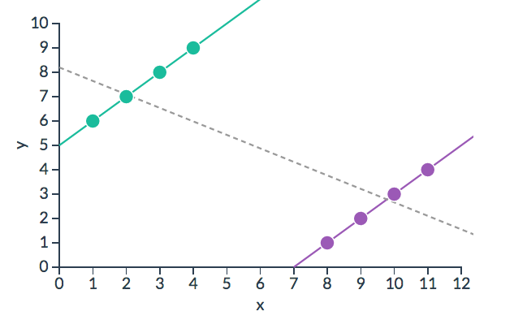
Simpson (Yule)
http://vudlab.com/simpsons/
Notes:
http://vudlab.com/simpsons/

Slide 12
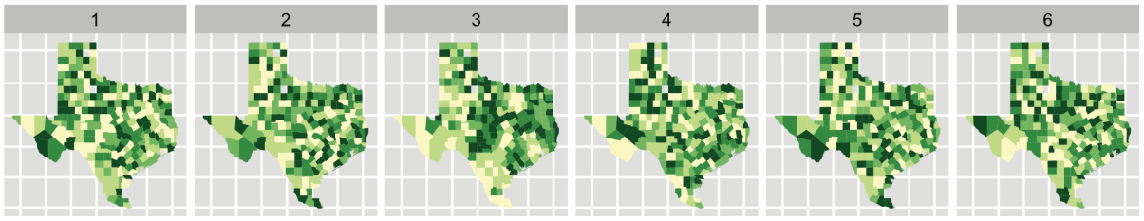
Find the Real Data
Wickham, et al. 2010
Notes:
(it’s panel 3)
http://jonathanstray.com/papers/wickham.pdf

Slide 13
Iterating
[ example exploratory iteration ]

Slide 14
Iterating

Slide 15
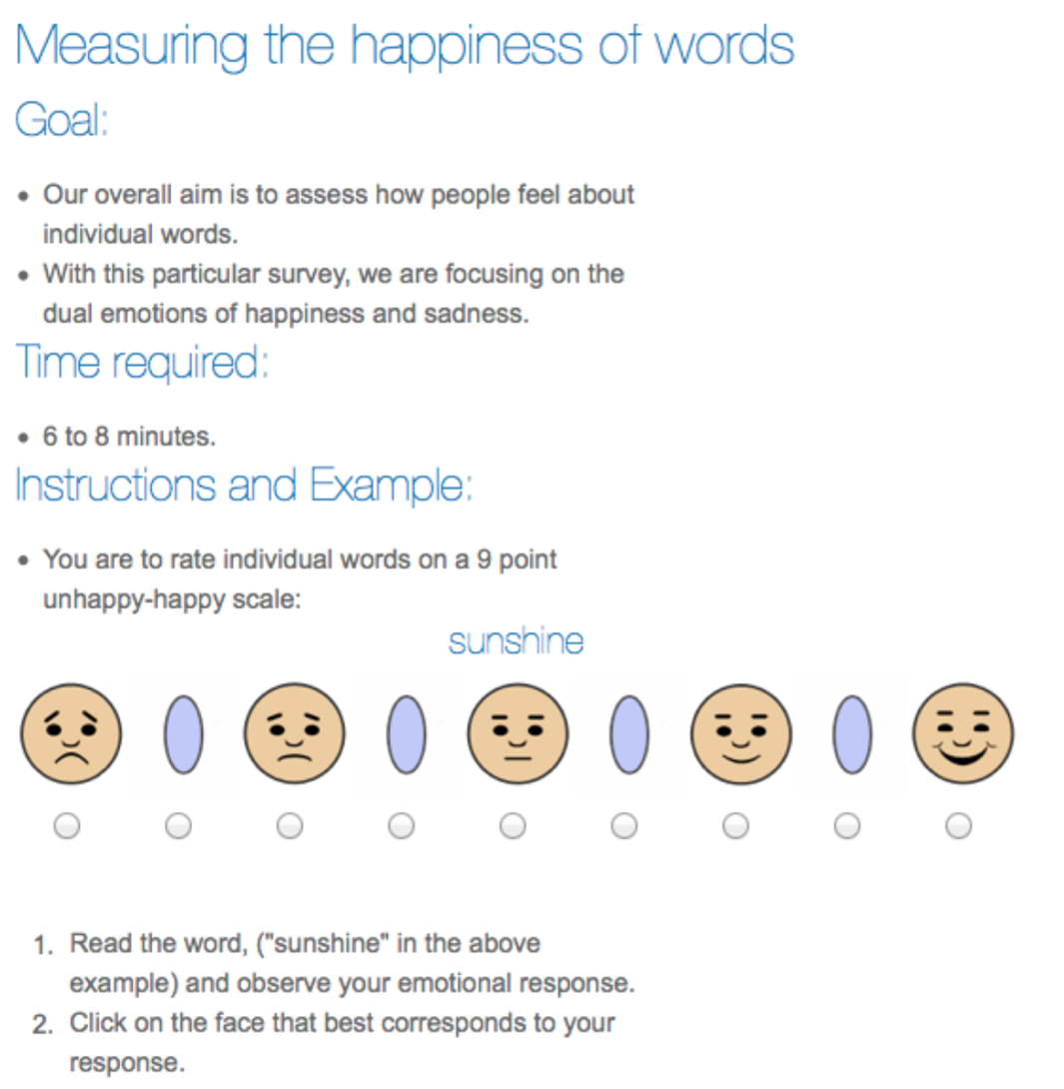

Slide 16
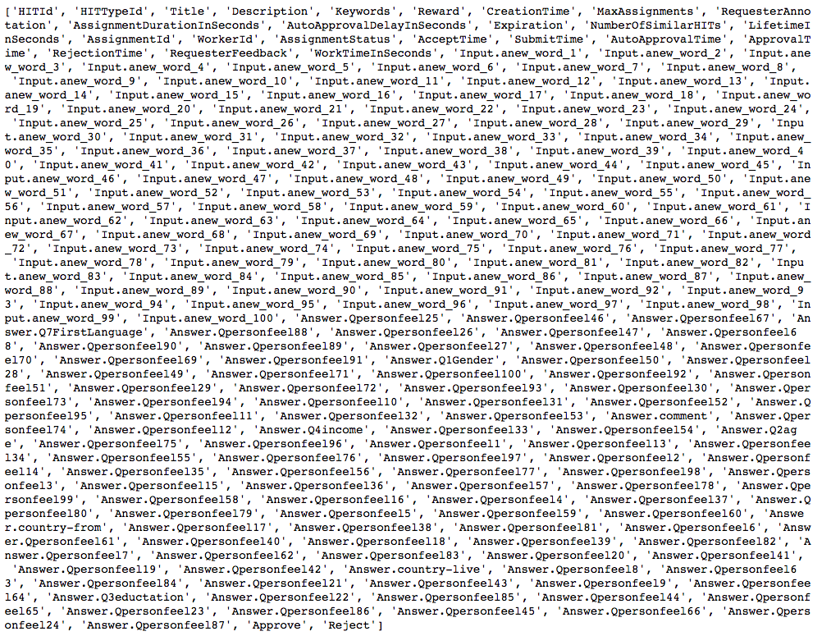

Slide 17
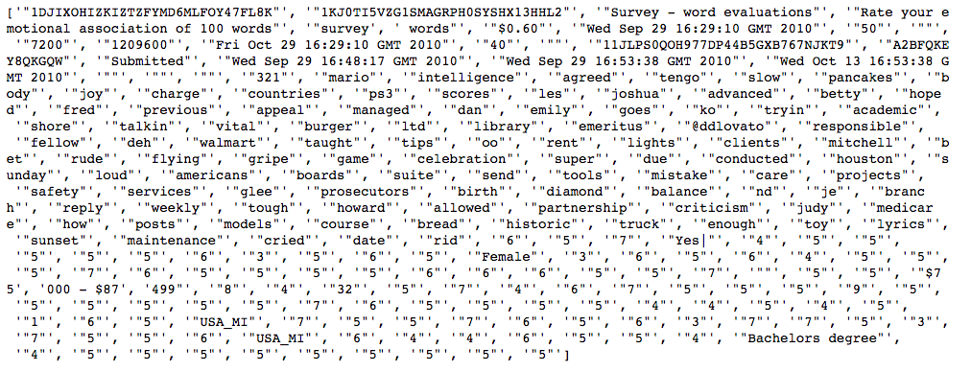

Slide 18
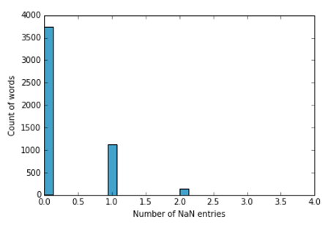
Check on the NaNs…

Slide 19
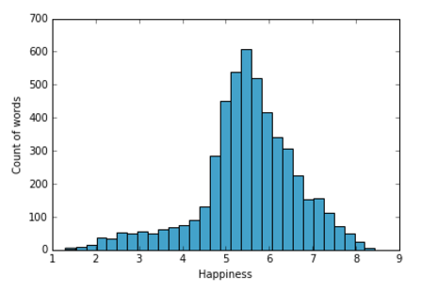
The Pollyanna Hypothesis Holds!

Slide 20
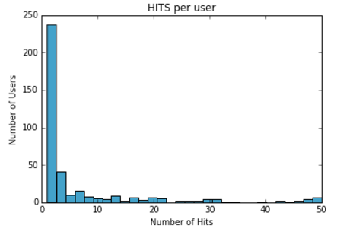
Notes:
but we noticed…

Slide 21
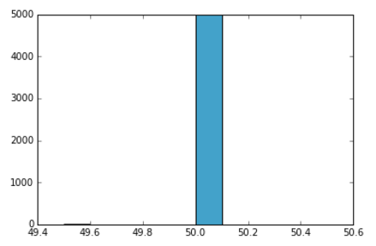
Notes:
phew, only one score from each user per word

Slide 22
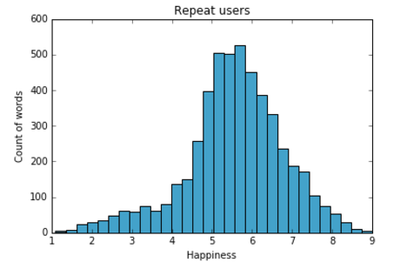
Notes:
h_avg = 5.55

Slide 23
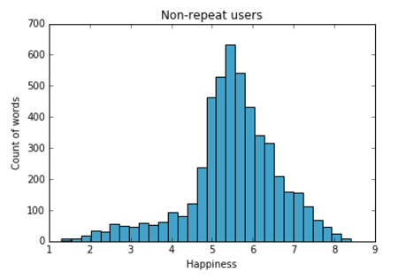
Notes:
h_avg = 5.49

Slide 24
Notes:
h_avg = 5.49,5.55

Slide 25


