Slide 1

Designing Exploratory Visualization Tools

Slide 2
Basic charts for EDA
Table
Bar graph, dot plot
Histogram, frequency polygon, strip plot
Line graph
Scatter plot, bubble (size for third variable)
Box plot
Heatmap matrix
Bar/line or bar/dot combination

Slide 3
What makes for a good visual EDA tool?
Notes:
Stephen Few suggests that the following features are essential for good visual eda tools.
https://www.perceptualedge.com/articles/visual_business_intelligence/evaluating_visual_eda_tools.pdf

Slide 4
Seamless data interaction
Notes:
Get to that next view easily and rapidly.

Slide 5
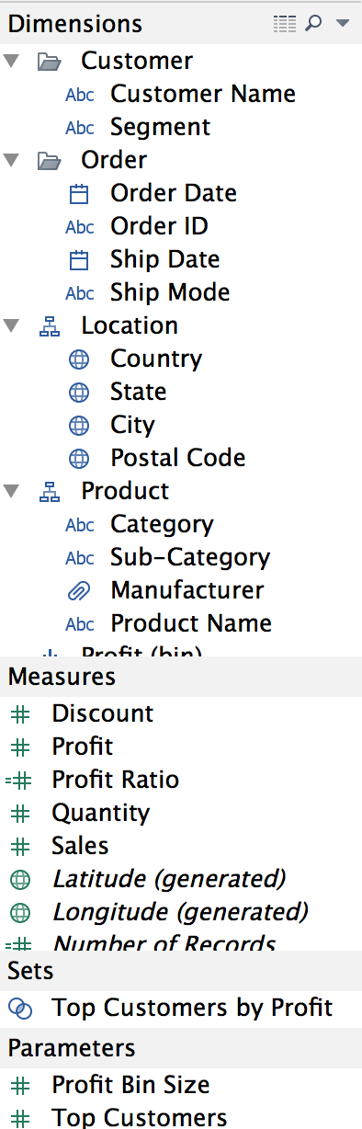
Notes:
tableau provides these features for exploration
visual operations in the column/row panels, sum/bin features on measures, and calculated fileds

Slide 6
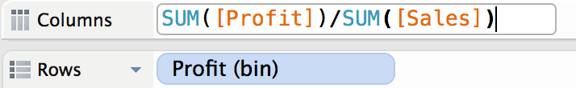
Notes:
visual operations in the column/row panels, sum/bin features on measures

Slide 7
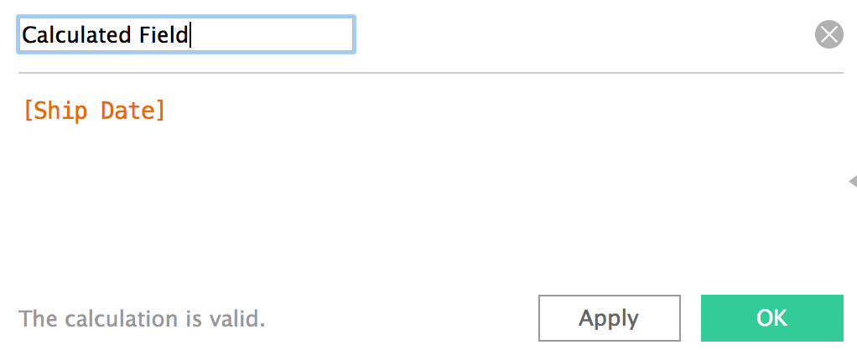
Notes:
tableau provides these features for exploration
visual operations in the column/row panels, sum/bin features on measures, and calculated fileds

Slide 8
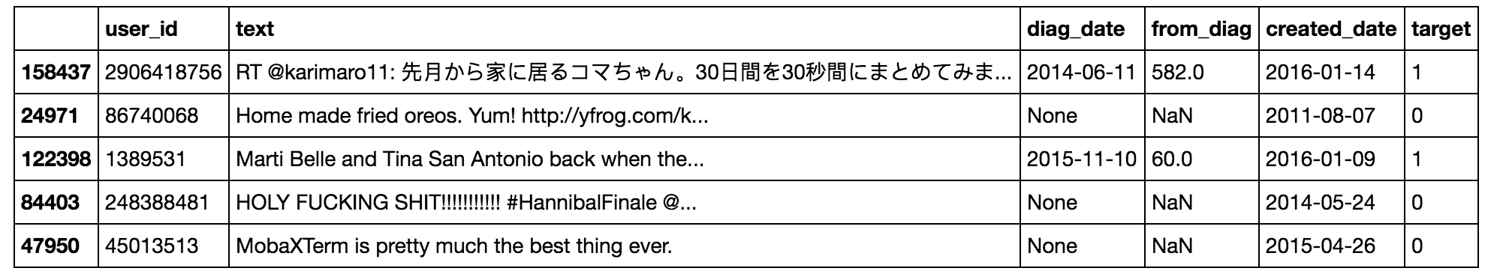
Data transformation operations (e.g., df.groupByKey()).
Notes:
dataframes in pandas, similarly
lots of options
build to work with underlying data architectures like spark

Slide 9
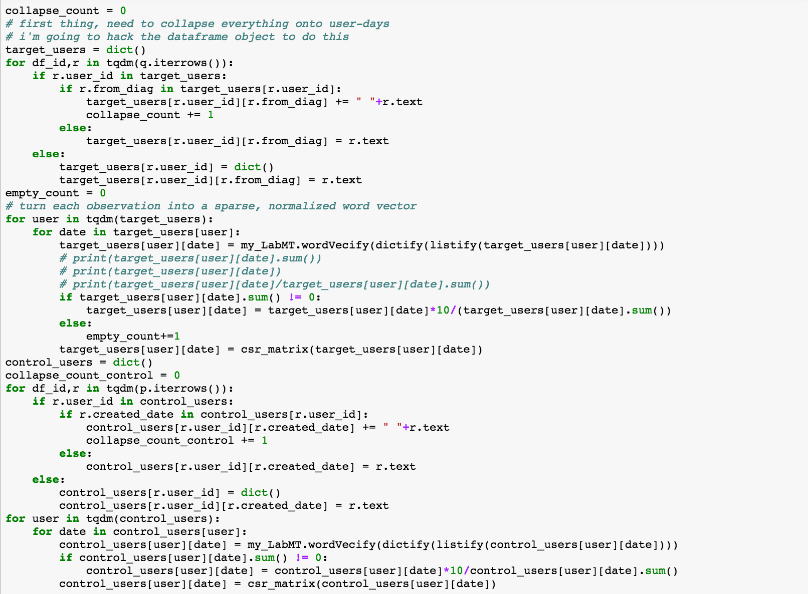
Notes:
you can hammer together the data in any way you want

Slide 10
Rich data comparison

Slide 11
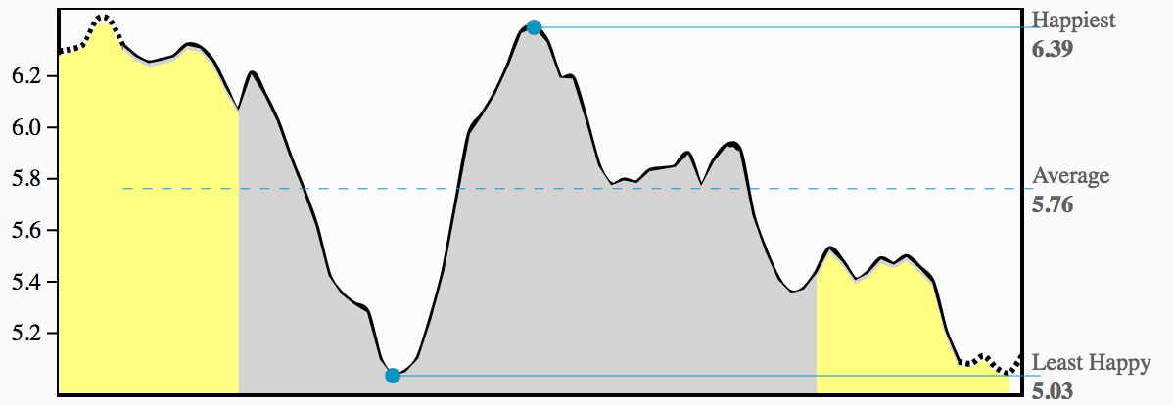

Slide 12
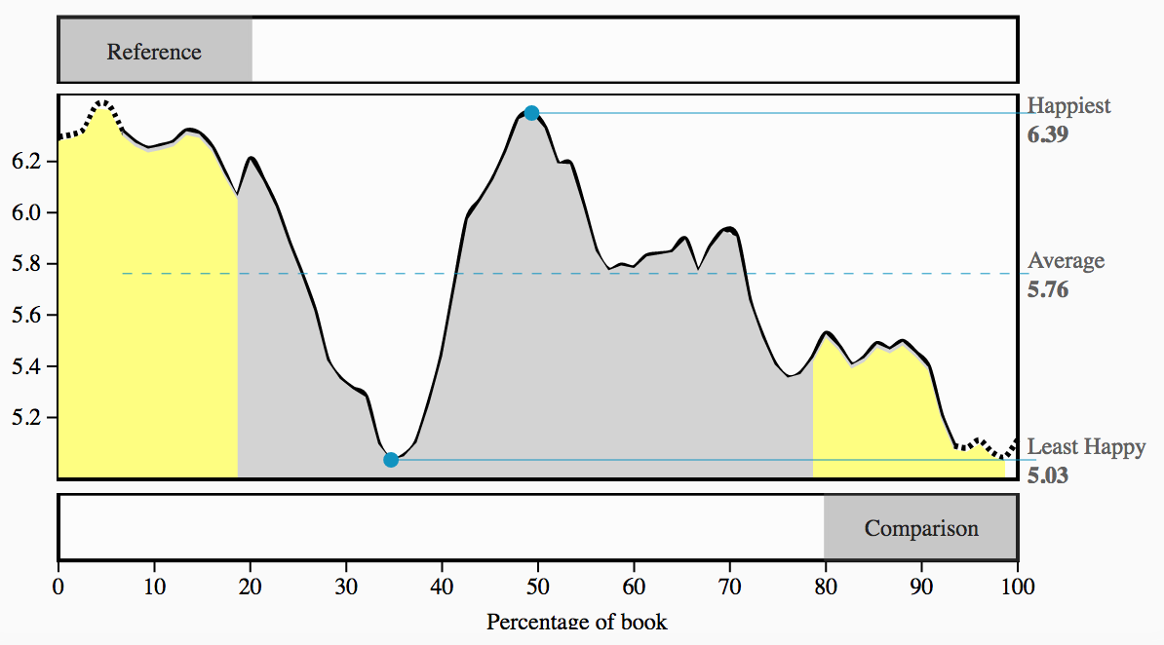

Slide 13
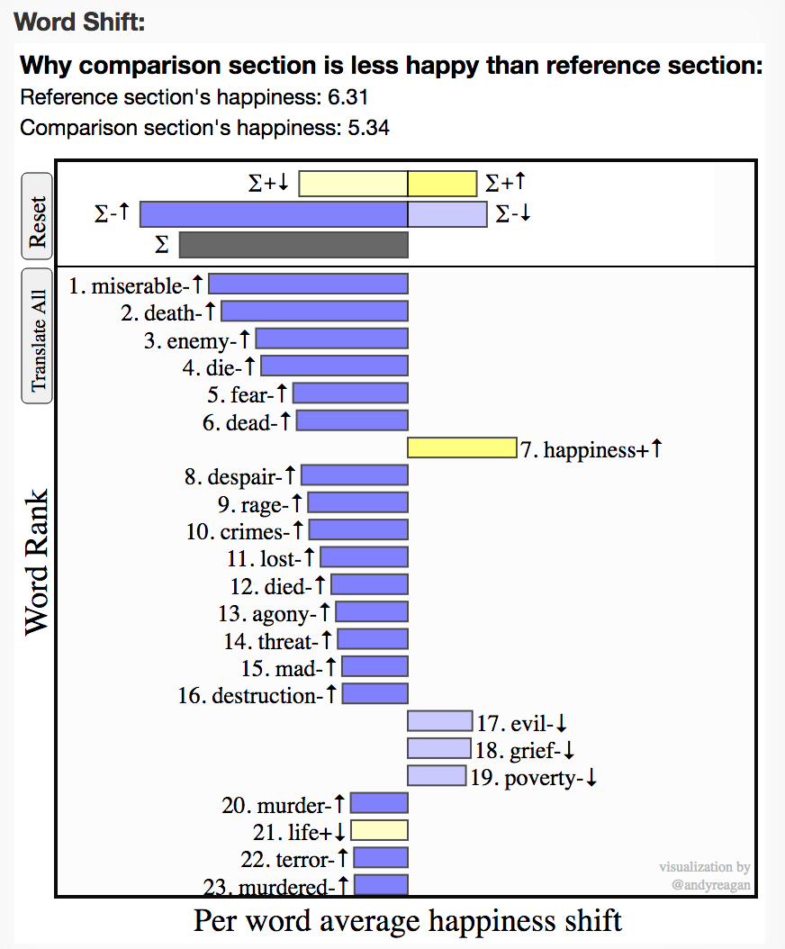

Slide 14
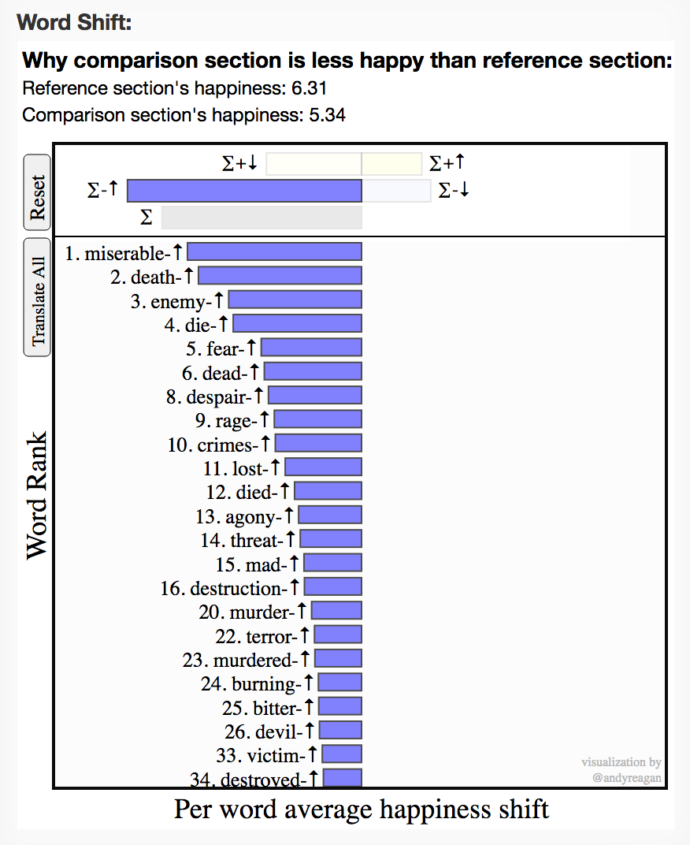

Slide 15
Multifaceted views

Slide 16
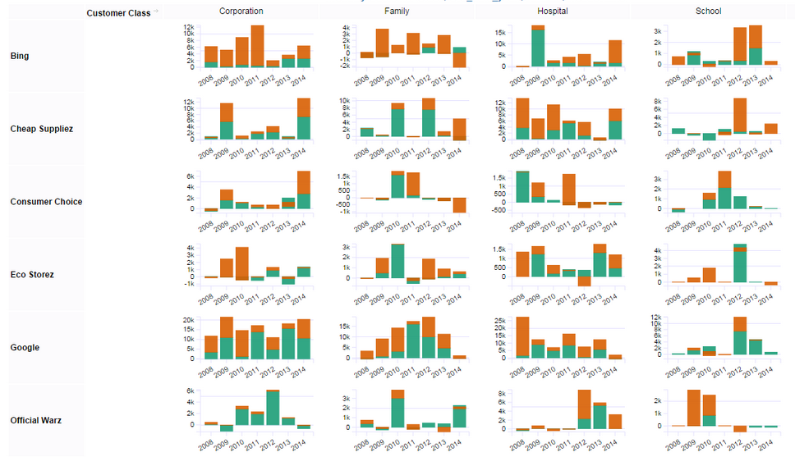

Slide 17
Integrated statistical calculations

Slide 18
Data access and integration
Notes:
open source- make it reproducible

Slide 19


