Slide 1

Design and Validity

Slide 2
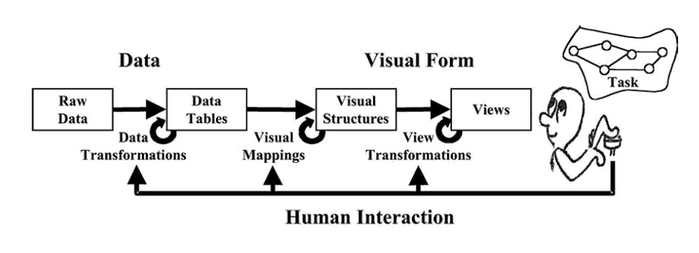
Diagram from Card, Mackinlay, & Shneiderman, 1999.
Readings in Information Visualization: Using Vision to Think
Notes:
Remembe rthis diagram from discussions of the data and visual mappings at the start of the course, you might remember that there is human interaction all along the way. Whether providing the views and view transformations, or developing a visualization tool that allows users to load their own datasets, these interactions are a central part of transmitting information to the users to allow them to perform tasks.

Slide 3
How to choose the right
data transformations, visual mappings, and view transformations for an effective visualization?

Slide 4
The Design Process
Initial user needs assessment & research
Use researched heuristics and perceptual principles as a guide
Select efficient computational and visualization techniques/tools
Design tool/system (prototype to higher fidelity)
Test and collect data
Iterate
Notes:
Techniques and tools appropriate for data and users

Slide 5
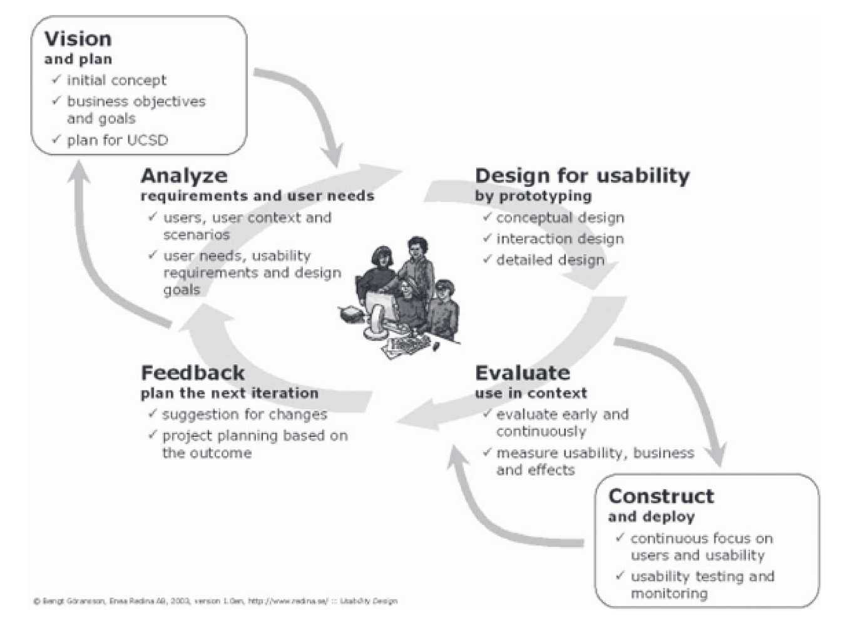
Design Stages
Notes:
REPLACE DIAGRAM

Slide 6
Human-Centered Visualization Design
Places human need, skill, and creativity at the center of the design of visualization systems
Notes:
Perceptual research and heuristics help guide this – but testing testing testing makes it appropriate.

Slide 7
Where Validity Can Break
Wrong domain problem: They don’t do that
Wrong abstraction: Showing them the wrong thing
Wrong encoding/interaction: The way you’re showing doesn’t work
Wrong algorithm: Your code is too slow
(Muzner, 2009)
Notes:
Where can this layer of human interaction so essential to the system break? Tamara Muzner identified several areas …
The breakdown can happen at several levels …

Slide 8
Evaluating Validity
Earlier Stages
Observe and interview target users (needs assessment)
Design data abstraction/operation (data types, transformation, operations)
Justify encoding/interaction design (design heuristics, perception research)
Informal analysis/qualitative analysis of prototypes (task-based)
Algorithm complexity analysis/evaluation
Mid- and Later Stages
Qualitative analysis of system (task-based)
Algorithm performance analysis
Lab or crowdsourced user study (measure time/errors/memory/etc.)
Field study of the deployed system

Slide 9
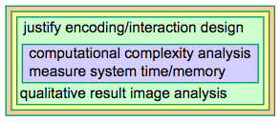
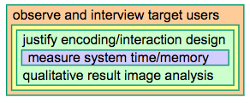
Some Variation in Methods
Visualization Tool 1:
MatrixExplorer
(Henry & Fekete, 2006)
Visualization Tool 2:
Flow map layout
(Phan et al., 2005)
Diagram Source: Munzner, T. (2009). A nested model for visualization design and validation. IEEE Transactions on Visualization and Computer Graphics, 15(6).
Notes:
Varies by company which of these methods are used.

Slide 10


