Slide 1

Bokeh
High-Level, Interactive Plotting in Python

Slide 2
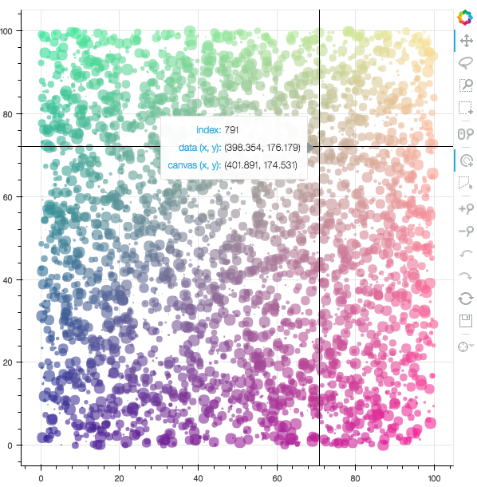
Examples

Slide 3
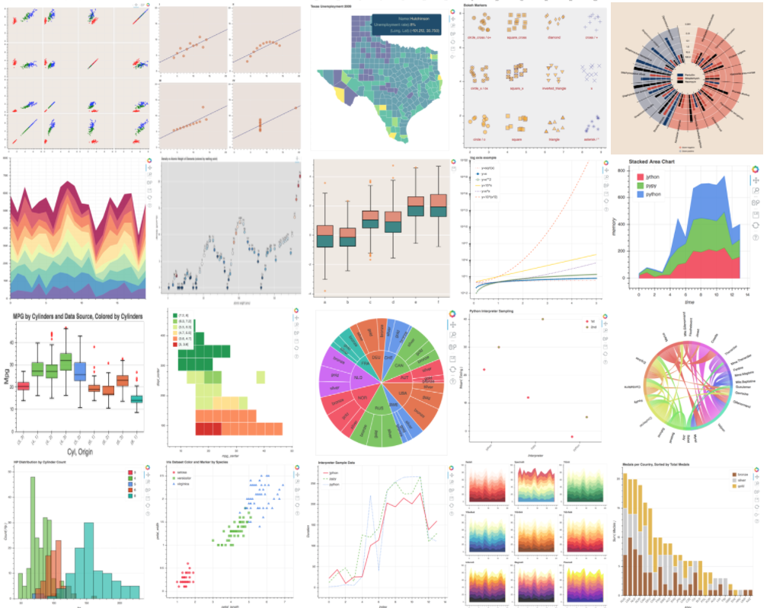
Examples

Slide 4
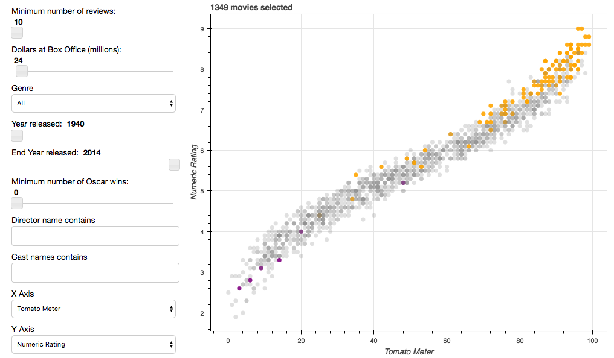
Examples

Slide 5
bokeh.charts
bokeh.plotting
boken.models

Slide 6
Python
bokeh.charts
bokeh.plotting
boken.models

Slide 7
Python
Browser
bokeh.charts
BokehJS
bokeh.plotting
Backbone
boken.models

Slide 8
Python
Browser
bokeh.charts
BokehJS
bokeh.plotting
Backbone
boken.models
JSON
Notes:
plot need to be viewed with a browser

Slide 9
Where to Use It
Running a Bokeh server (akin to Shiny)

Slide 10
Where to Use It
Running a Bokeh server (akin to Shiny)
Inside Jupyter notebook

Slide 11
Where to Use It
Running a Bokeh server (akin to Shiny)
Inside Jupyter notebook
Stand-alone (generate HTML -> PNG)
*Requires user interaction

Slide 12


