Slide 1

Design Applications: Dashboards

Slide 2
"A dashboard is a visual display of the most important information needed to achieve one or more objectives that has been consolidated on a single computer screen so it can be monitored at a glance."
–Stephen Few, Information Dashboard Design
Notes:
Stephen Few – wrote THE book on dashboard design

Slide 3
"A dashboard is a visual display of the most important information needed to achieve one or more objectives that has been consolidated on a single computer screen so it can be monitored at a glance."
Implies understanding of
Audience
Objectives
Notes:
Breaking it down
You need to understand
audience
their objectives
Needs assessment is important!

Slide 4
"A dashboard is a visual display of the most important information needed to achieve one or more objectives that has been consolidated on a single computer screen so it can be monitored at a glance."
How big?
What is the context of use?
Notes:
"single computer screen"
Size matters
mobile, HD TV, web
Context: where?

Slide 5
"A dashboard is a visual display of the most important information needed to achieve one or more objectives that has been consolidated on a single computer screen so it can be monitored at a glance."
Perceptually simple, fast
Avoid distraction
Notes:
"at a glance"
Perceptually simple, fast
Avoid distraction

Slide 6
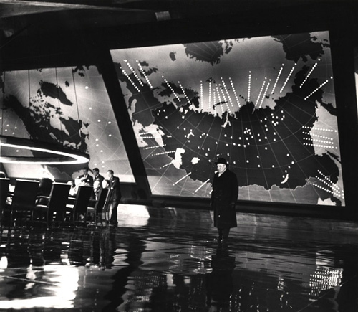
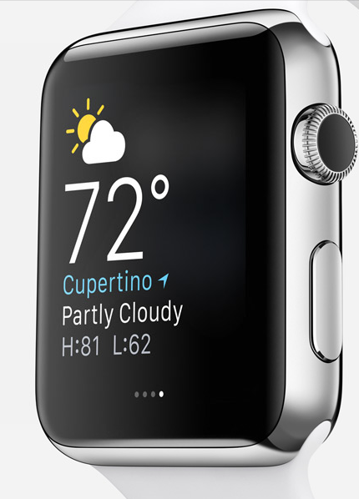
Does this definition cover all dashboards?
Apple, Inc.
Doctor Strangelove, Columbia Pictures, 1964
Notes:
What might be missing?

Slide 7
Needs Assessment
Who is your audience?
What are their goals?
What questions do they want to find answers to?
Notes:
Start with a needs assessment
Be able to answer these questions

Slide 8
Selecting Forms
Dashboards call for
Multiple graphs
Updates over time
Choosing among text, tables, graphs
Notes:
Extra levels of form: chart to chart, update over time, text vs. tables vs. graphs
Don't forget the value of tables.

Slide 9
Selecting Forms
In designing dashboards,
Facilitate quick perception
Facilitate comparison across charts
Use consistent scales and encodings
Use space, and show hierarchy of importance
Include interactivity if possible
Allow drill-down when needed
Notes:
comparisons across graphs
Consistent scales over time
Hierarchy among elements
Space between elements
Interactivity helps with space limitations

Slide 10
Updating Data
Speed requirements dependent on domain and data frame
Streaming or periodic updates
Consider server architecture, use of framework
Notes:
Want to allow fast updates to facilitate perception, this need can depend on domain, stock analyst and IT performance. Embed Bokeh in flask?

Slide 11


