Slide 1

Map Projections & Scales

Slide 2
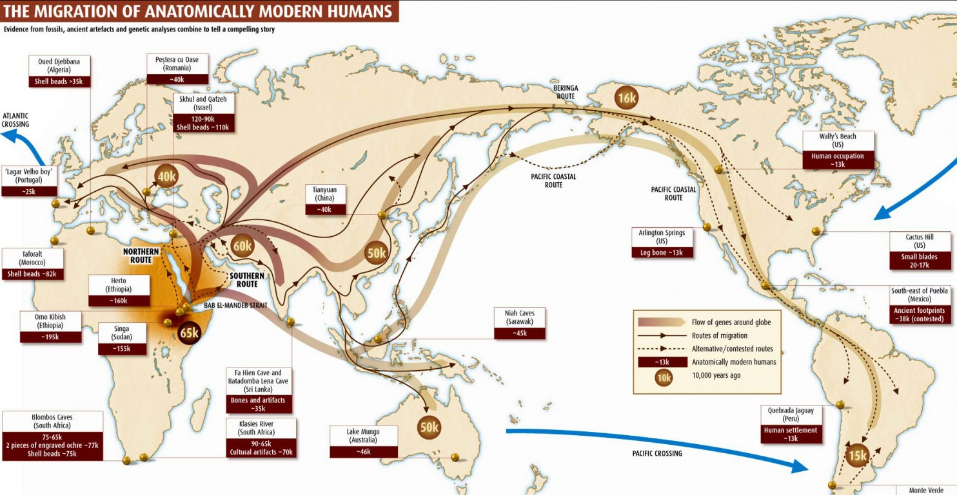
https://www.newscientist.com/article/mg19626271-800-going-global-how-humans-conquered-the-world/
Notes:
Maps help us show places and movement for people, goods, economies, policies, and more
While we see the data shown, often take it for granted the selection of the underlying map
Or https://www.washingtonpost.com/news/worldviews/wp/2014/01/13/40-more-maps-that-explain-the-world/?utm_term=.cbe058bb9514

Slide 3
What is a map? A representation or abstraction of geographic reality.
(Board, 1990)
Notes:
Quote from Kraak’s Cartography p 41
Cartography is the study and practice of map

Slide 4
Which reality?
Notes:
Quote from page 41 of Kraak
Pre computers, in cartography training for projections
spherical coordinates into two dimensions, distortion
Impacts distance, shape, directions

Slide 5
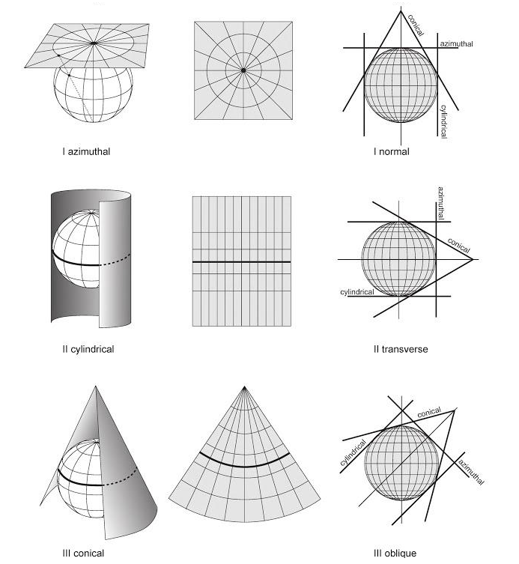
Kraak & Ormeling, 2010. Cartography, third edition, visualization of spatial data.
Notes:
Distortion increases farther from point of line of tangency
Azimuthal (az-ih-muh-thal) – distortion increases from center point, one point no distoration
Cyclindrical and conical have a single line (the standard line) of tangency
Some project place tangency on place mapped

Slide 6
Projection Distortion Characteristics
Conformal: object shape preserved
Equal-area: area sizes preserved
Equidistant: distances between points preserved
Notes:
Conformal – preserving shapes done over small area, can’t be maintained over entire earth
Equal area – though shape NOT preserved
Equidistant – preserve distance from one or two points to all other points, or to lines

Slide 7
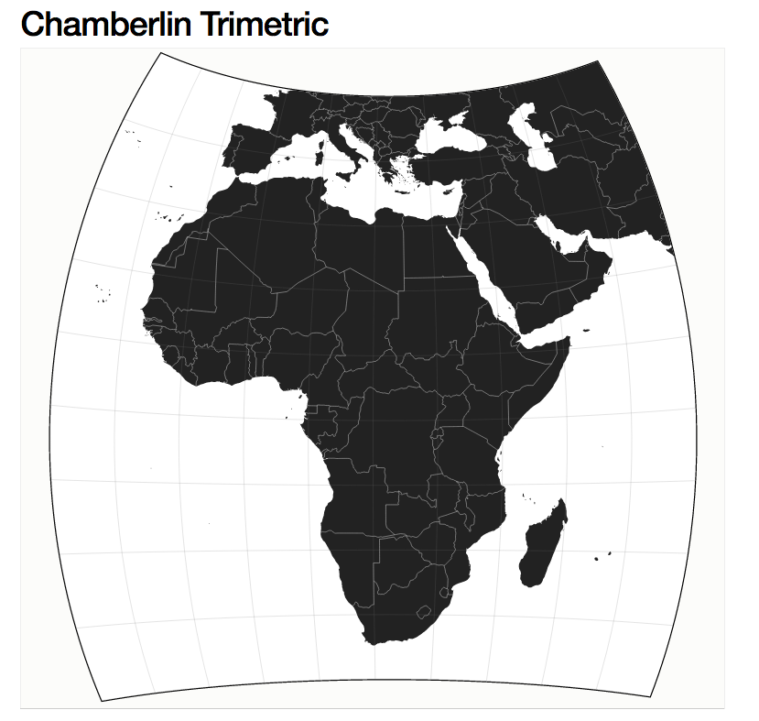
http://bl.ocks.org/mbostock/5625053
Notes:
Others -compromises between distortions of area, direction, and distance,
Wellman Chamberlin chief cartogropher National Geographic society in the 1960s
Often used for continents, not appropriate for entire earth

Slide 8
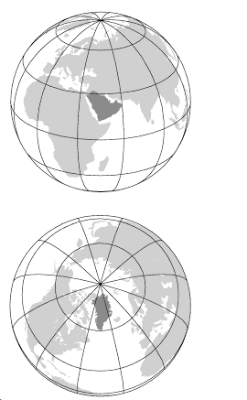
Kraak & Ormeling, 2010. Cartography, third edition, visualization of spatial data.
Notes:
Question becomes not if there’s a distortion pattern, but what type of distortion pattern you select
Greenland and Saudi Arabia, which are about the same size as you can see on the globe

Slide 9
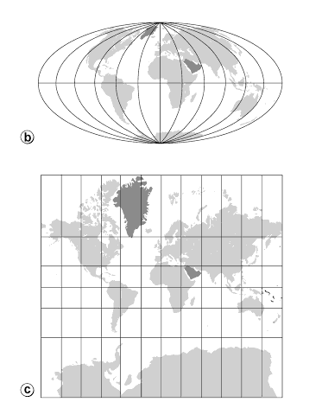
Mollweide Projection
pseudocylindrical, equal-area
Mercator Projection
cylindrical, conformal
Kraak & Ormeling, 2010. Cartography, third edition, visualization of spatial data.
Notes:
Means in practice
equal area projection at top, in this case the Mollweide
Conformal cylindrical projection, good for distance and areas near the equator, still commonly used for world maps

Slide 10
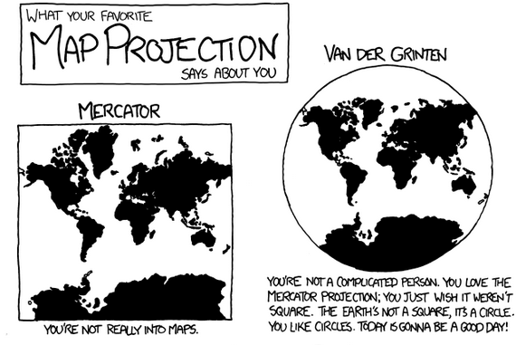
xkcd.com/977
Notes:
lampooned

Slide 11
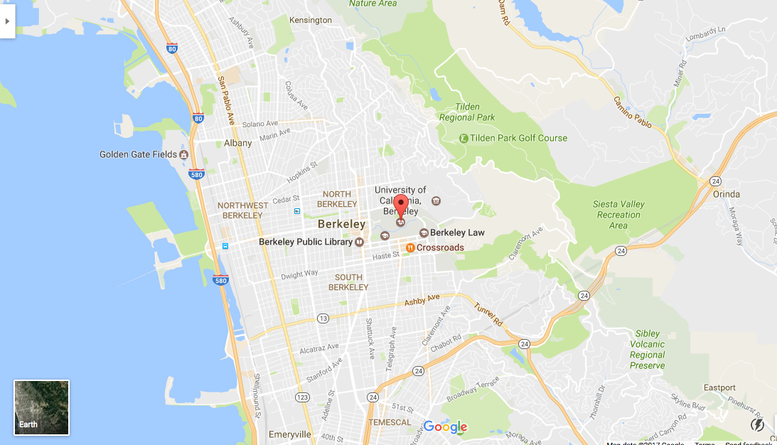
Notes:
Google maps uses Mercator,
Preserves angles, originally did not and high latitude places such as Stockholm streets not at right angles
'zoomed-out view' of the map, it allows close-ups (street level)

Slide 12
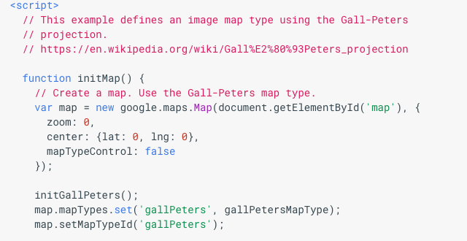
Google Maps API Custom Projection
https://developers.google.com/maps/documentation/javascript/examples/map-projection-simple
Notes:
define and use your own custom projections

Slide 13
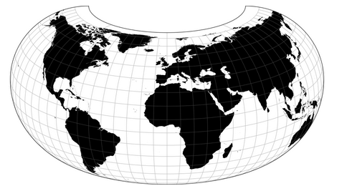
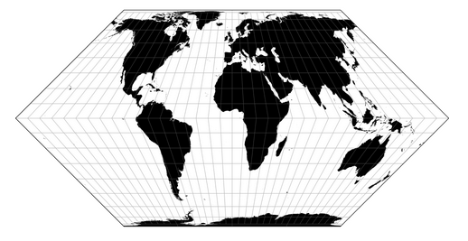
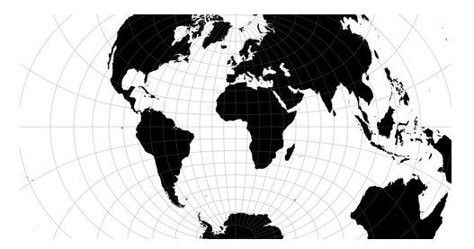
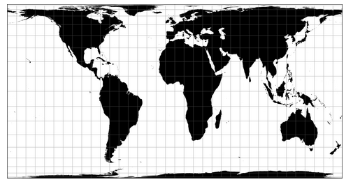
?
https://github.com/d3/d3-geo-projection
Notes:
The choices can be dizzying
First question, what’s it for: compare areas, display directions, measure distance?

Slide 14
Data Examples
flow patterns: conformal
coverage, size of countries, proportional symbol, dot maps: equal-area
navigational maps: equidistant
Notes:
Flow patterns in stratosphere or oceans, retain shape is important
Coverage example vegetation
http://resources.esri.com/help/9.3/arcgisengine/java/gp_toolref/coverage_toolbox/choosing_a_map_projection.htm

Slide 15
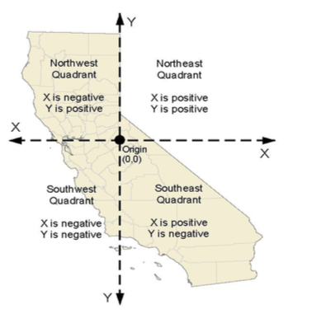
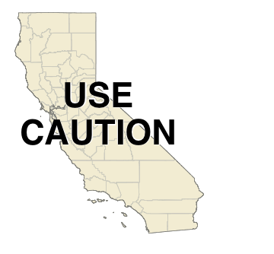
California Albers
(conic, equal-area)
Web Mercator
https://nrm.dfg.ca.gov
Notes:
From the California department of fish and wildlife website
Government organization/contract: check local governing body
Albers: conic e

Slide 16
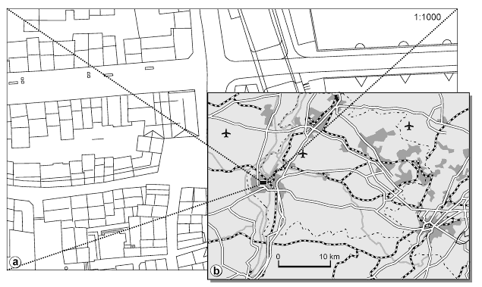
Scales & Generalization
Kraak & Ormeling, 2010. Cartography, third edition, visualization of spatial data.
Notes:
Scale also important – the ratio of distance on the map to the corresponding distance on the surface the map represents 1 cm on the map = 1000 cm or 10 miles of terrain; GIS and cartography small scale means more zoomed out
What shows? at different levels of scale, here at 1: 500,000 scale for the smaller
How is the viewer cued

Slide 17
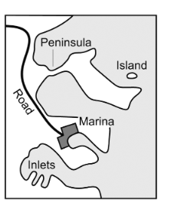

Geometry/Display Modifications
Brewer & Buttenfield, 2007
Notes:
Shapes change dependent on the scale,
Features reduced to twenty percent of original size
First no modification to display or gemoery,
seconnd display only e.g., thinner road and coast lines
Third modify geometry – displace road, enlarge island and peninsula, eliminate small islands, collapse marina into symbol point
http://php.scripts.psu.edu/users/c/a/cab38/ScaleMaster/Brewer_Buttenfield_ScaleMaster_CaGIS_paper_Jan07.pdf

Slide 18
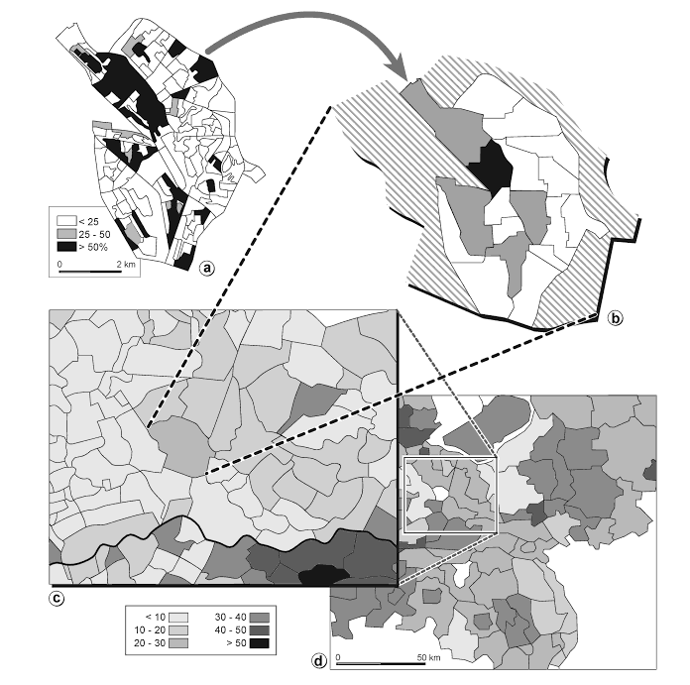
Kraak & Ormeling, 2010. Cartography, third edition, visualization of spatial data.
Notes:
Aggregation by scale matters in how data is perceived! Thematic map, different than a reference map because not just showing natural features but has a theme for the data, whether percipitation or votes. In this case votes
Thematic maps and the influence of scale on socio-economic phenomena: the percentage of Labour votes in part of the Netherlands (a) Utrecht’s voting districts; (b) neighbourhoods; (c) municipalities; (d) regions
P 43

Slide 19


