Slide 1

Connecting to Data

Slide 2
Connecting to data in EDA
Notes:
streaming data? backend framework can matter.
HDFS on backend.
choice of data storage format- nosql versus sql

Slide 3
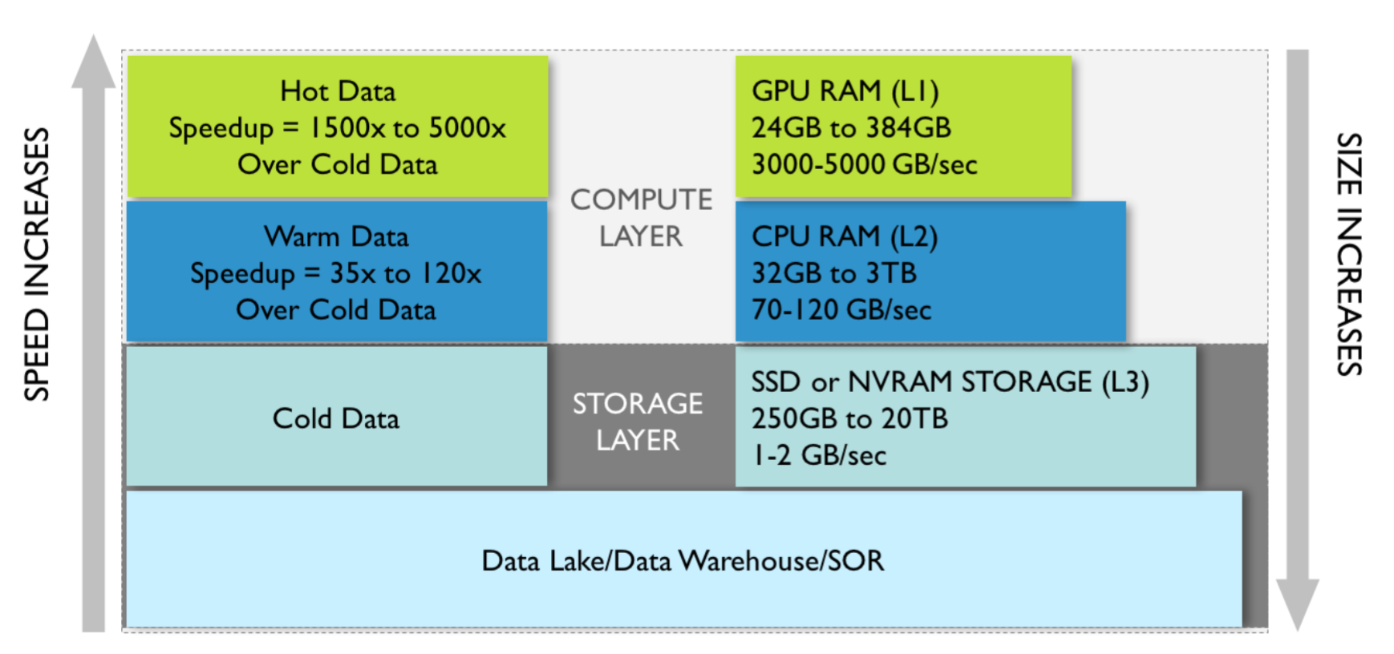
Storage, Processing, Plotting

Slide 4
Scientific visualization tools
Notes:
ParaView, etc, to run across multiple clusters

Slide 5
Tableau, Python
Notes:
One of the most powerful features of Tableau! Connects to databases and extracts based on queries. Practical limit is around 10GB for desktop.
Spark- loads in memory when possible for fast queriers.

Slide 6
Live Data (vs. Extracted)
Pros:
Faster iteration (accessible)
Real-time feedback
Cons:
Added complexity
Memory considerations for big data
Insights out of date

Slide 7
Optimizing for explanatory vis

Slide 8
Browser Loading
Notes:
We ended with this before, and now the JS has to get the data!
Compression across browsers

Slide 9


